Slide 1
Java Map — Overview & Examples

Slide 2
What is java.util.Map?
Map Interface.
Stores key/value pairs.
Maps from the key to the value.
Keys are unique.
a single key only appears once in the Map.
a key can map to only one value·
Values do not have to be unique
Part of java.util since Java 1.2

Slide 3
Core operations
put(key, value) — insert or replace
get(key) — retrieve value
remove(key) — remove mapping(key – value pair)
containsKey(key), containsValue(value)-check if key or value exists
keySet(), values(), entrySet() for traversal

Slide 4
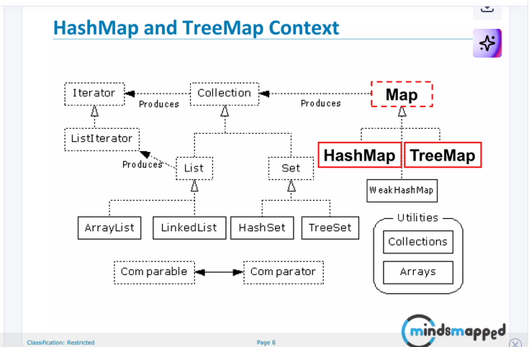

Slide 5
Common implementations
Map Type | Order | Speed | Null | Best Use
HashMap | No order | Very fast (O(1)) | 1 null key, many null values | General purpose, quick lookup
LinkedHashMap | Keeps insertion order | Fast (O(1)) | 1 null key, many null values | When order matters
TreeMap | Sorted by keys | Slower (O(log n)) | No null keys, many null values | When sorted data needed

Slide 6
Example: Using HashMap (Java)
import java.util.*;
Map<String, Integer> scores = new HashMap<>();
scores.put("Alice", 90);
scores.put("Bob", 85);
// replace value
scores.put("Alice", 95);
// iterate
for (Map.Entry<String, Integer> e : scores.entrySet()) {
System.out.println(e.getKey() + " -> " + e.getValue());
}

Slide 7
output
Bob -> 85
Alice -> 95

Slide 8
THANK YOU

