Slide 1


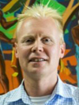
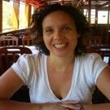
Advancing neglected Plasmodium genomics through cutting-edge sequencing and AI-driven approaches to strengthen malaria control strategies.
MRC LID PhD Project Supervisors: Prof. Taane Clark, Prof. Susana Campino

Slide 2
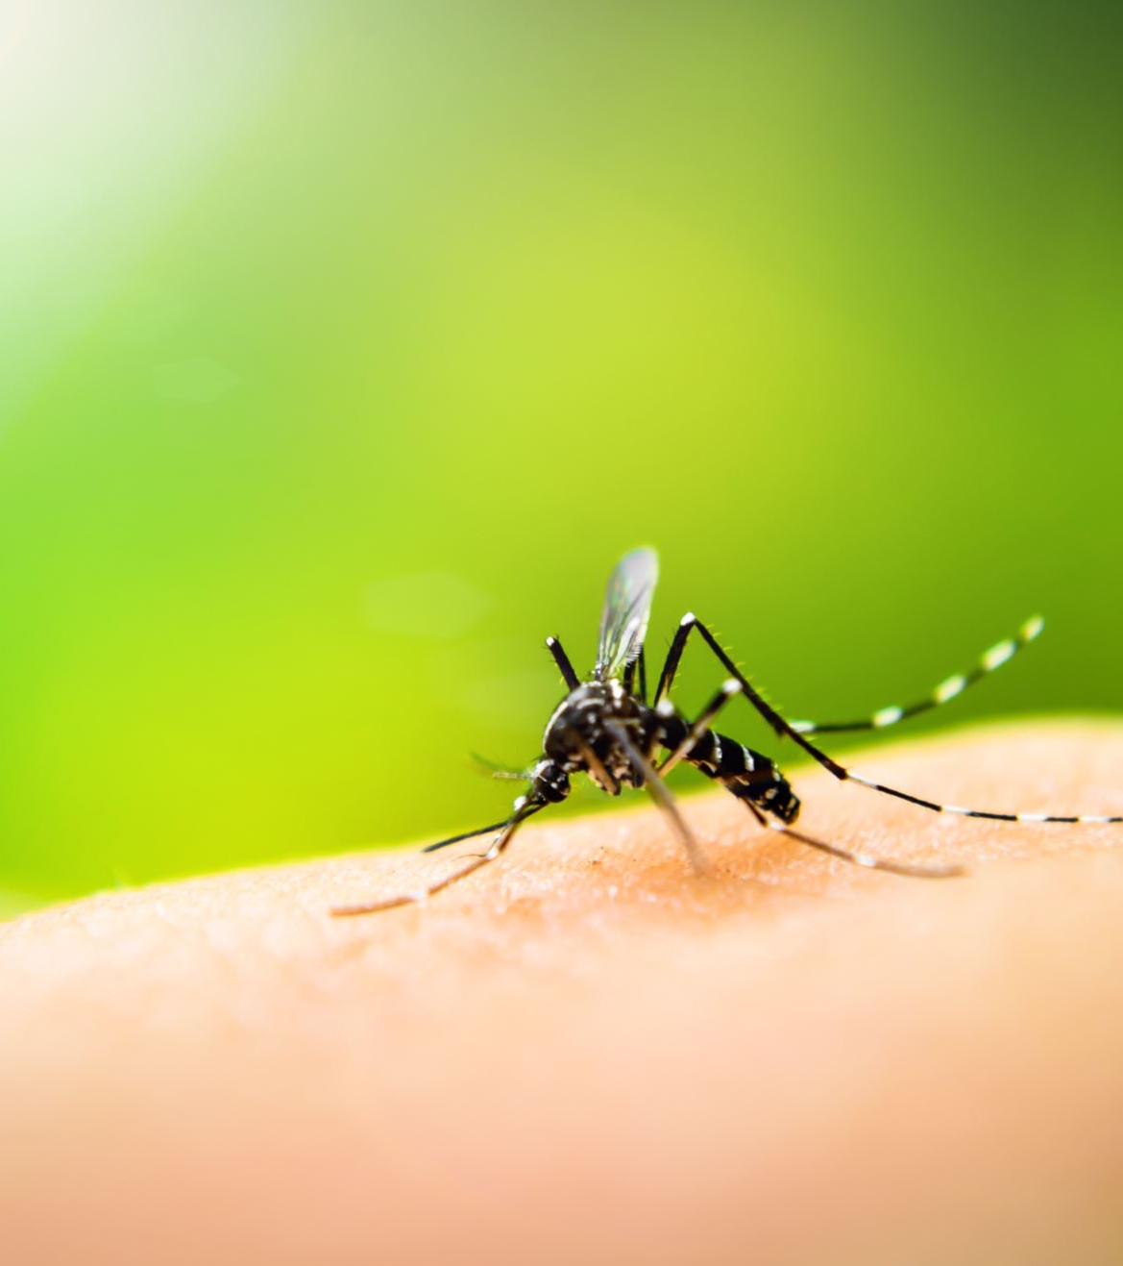
Malaria
249 million cases globally in 2022, with around 6% attributed to five “neglected” Plasmodium species: P. vivax, P. knowlesi, P. malariae, P. ovale curtesi, and P. ovale wallikeri

Slide 3
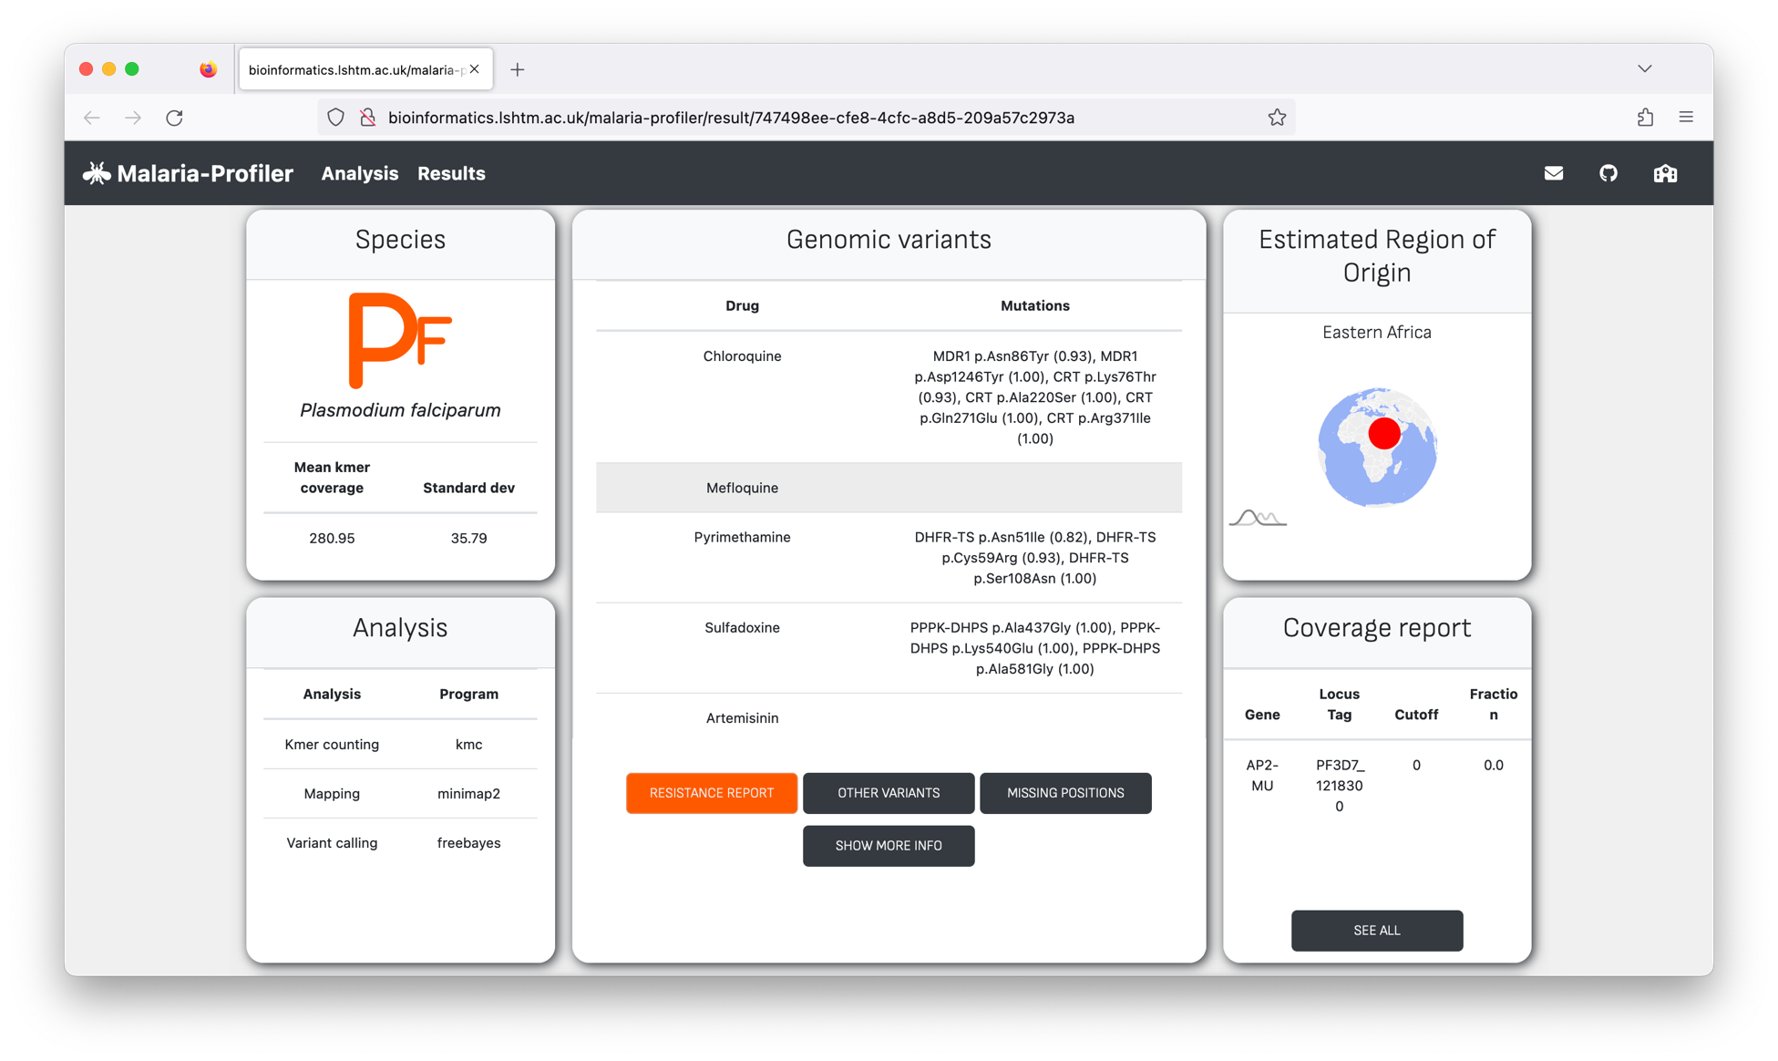
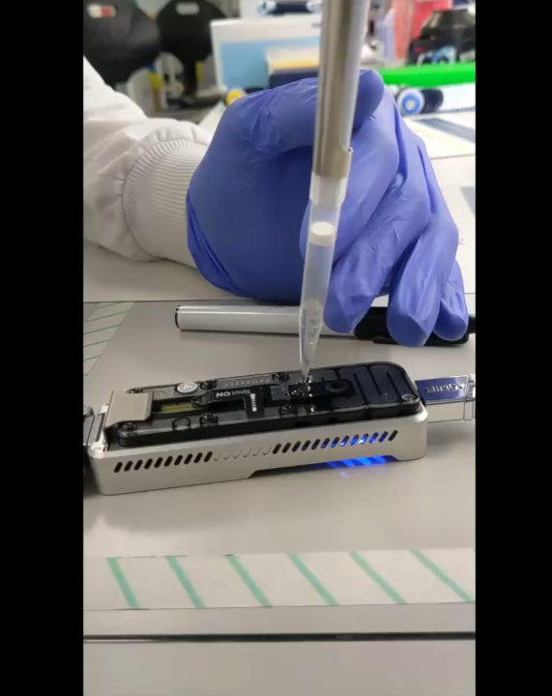
Whole genome sequencing (WGS) and targeted gene amplicon sequencing (Amp-Seq) of Plasmodium DNA can inform infection control
Geographical
source and similarity to other samples, to inform on importation & outbreak events.
Species
Drug resistance mutations to personalise treatments
Oxford Nanopore MinION
Malaria-Profiler - WGS data providing important epidemiological, clinical & surveillance information (bioinformatics.lshtm.ac.uk/malaria-profiler)

Slide 4
The project will integrate sequencing, genomics and AI to understand neglected Plasmodium biology and develop infection control tools
Leveraging established sequencing projects with UKHSA & international collaborators to:
Analyse the population structure of Plasmodium species, applying AI and population genomics to identify molecular markers for infection-tracking assays.
Detect genomic regions associated with drug resistance to provide an early warning system for emerging threats.
Examine genetic diversity in vaccine targets and other critical loci across diverse regions to evaluate the potential effectiveness of new interventions.

Slide 5
The student will…
Join a dynamic team of PhD students & postdoctoral researchers specialising in ‘omics and global health, with expertise spanning clinical/field, wet lab, and computational research.
Contribute to cutting-edge malaria research that offers opportunities for first-author publications and enhances your CV for competitive postdoctoral funding.
Build skills in capacity strengthening within malaria-endemic regions, with a focus on the application of genomics, bioinformatics, population genetics, and AI.
Interested?
Contact Taane (taane.clark@lshtm.ac.uk) or Susana (Susana.campino@lshtm.ac.uk)
Visit us in Keppel Street: https://www.lshtm.ac.uk/aboutus/contact/location
Look at our group website: https://genomics.lshtm.ac.uk

