Slide 1
三类一致性矛盾的改写前后对照
各取一条入选改写。入选条件是总分高于原文，并且惩罚低于原文。
红字标出被删掉的矛盾，以及改写后留下来的那一侧。
01
08
17
左右不对称
风格不一致
同要素矛盾
同一件衣服左右两套语法
手工日装上叠了另一套婚礼
同一条裙子同时写成两套
原文 0.40 / 惩罚 0.65
入选 0.84 / 惩罚 0.00
原文 0.36 / 惩罚 0.60
入选 1.00 / 惩罚 0.00
原文 0.40 / 惩罚 0.65
入选 0.70 / 惩罚 0.00
黑色手工对比
夜花园刺绣
悬垂丝带

Slide 2
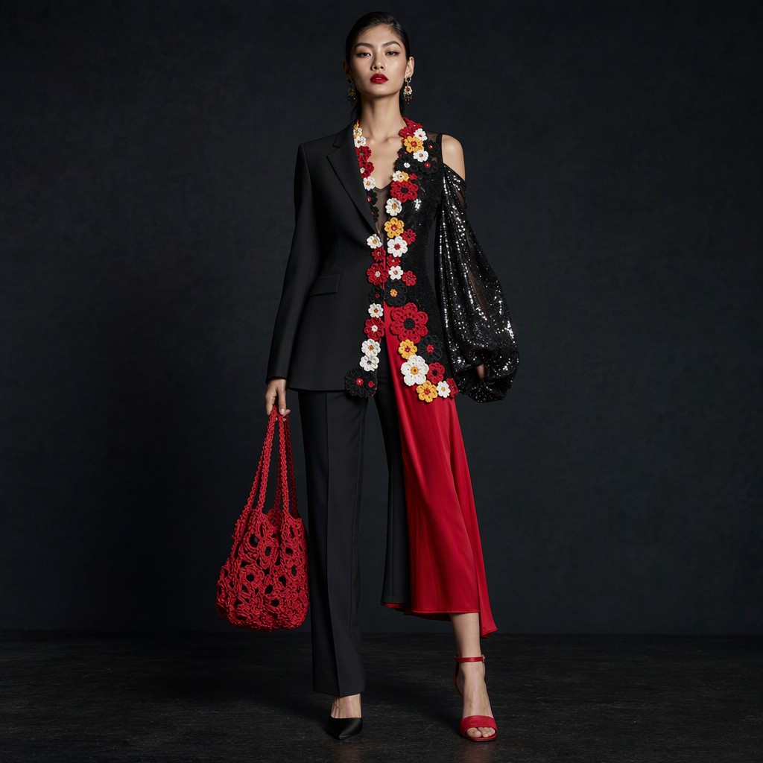
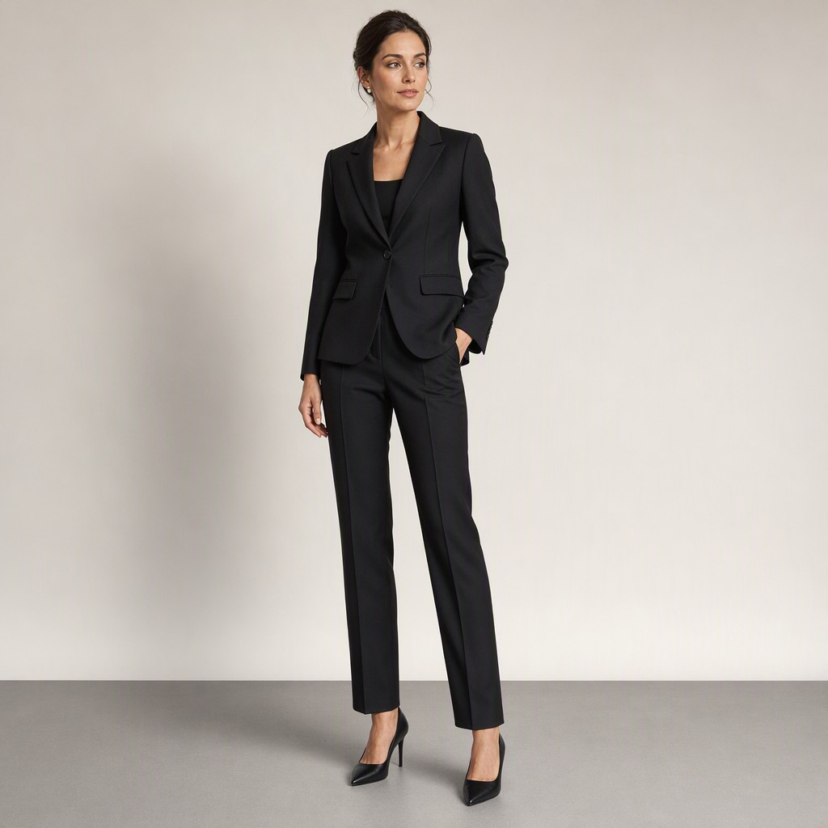
01 左右不对称 黑色手工对比
原文 0.40 / 0.65 → 入选 0.84 / 0.00
改写前
改写后
Theme: black handmade contrast. Concept: a structured black jacket is the dark field, and crochet floral appliqué is the identifying idea. Dense red, white, yellow, and black floral appliqué still runs along the neckline and both front edges, with a red openwork crochet bag. At the same time the left half of this one jacket is matte black wool: notched lapel, set-in tailored sleeve, notched cuff. The right half of the same jacket is high-gloss silk and sequin: no lapel, a cold shoulder, and a bishop sleeve to the knee. The left leg is a black wool trouser with a crease; the right leg is a red silk culotte. The left foot is a closed black satin court pump; the right foot is an open red silk evening sandal.
A matte black wool jacket with a notched lapel, set-in tailored sleeve, and notched cuff, paired with a black wool trouser with a crease, and a closed black satin court pump.
改写点：右半整侧删除，亮片丝绸袖、冷肩主教袖、红丝绸阔腿、露趾凉鞋不再出现。只留左半哑光羊毛翻领夹克、压线西裤、闭口缎面浅口鞋。
钩针贴花和红钩针包没有写进这条入选稿。

Slide 3
01 入选稿的扣分 黑色手工对比
覆盖 1.00 质量 0.80 惩罚 0.00
惩罚没有扣分
五项都是 0：生成内容、一致性、协调性、合理性、公式模板。左右两套已经收成一套，惩罚不再扣。
扣在设计价值
钩针贴花没留下。正文只写了翻领、袖子、西裤和鞋。换掉颜色和面料之后，看不出这是哪一套，所以设计价值三项最高只能到 0.5，合起来是 0.625，质量是 0.80。覆盖是 1.00，总分停在 0.84。
图上的体现
入选图是一套对称的哑光黑西装：翻领、装袖、压线西裤、浅口鞋都在。门襟和胸前没有钩针花，红钩针包也不在。

Slide 4
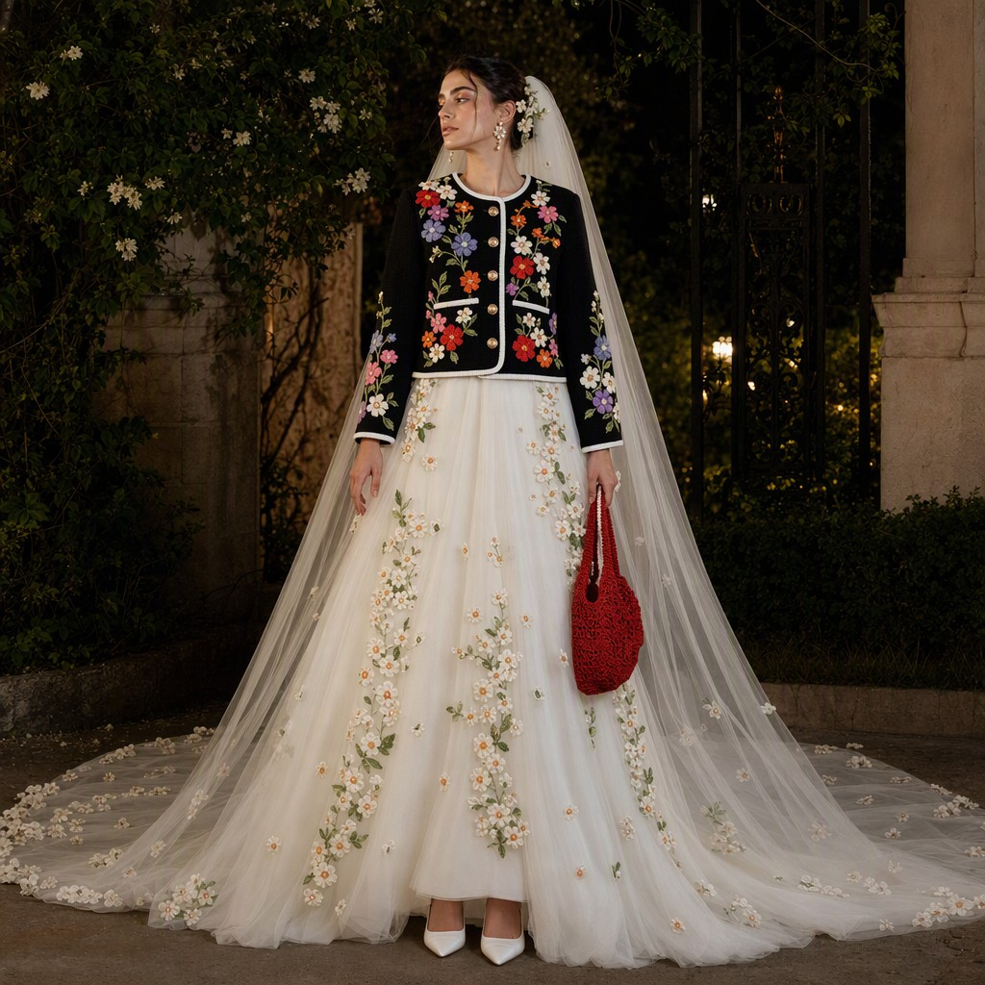
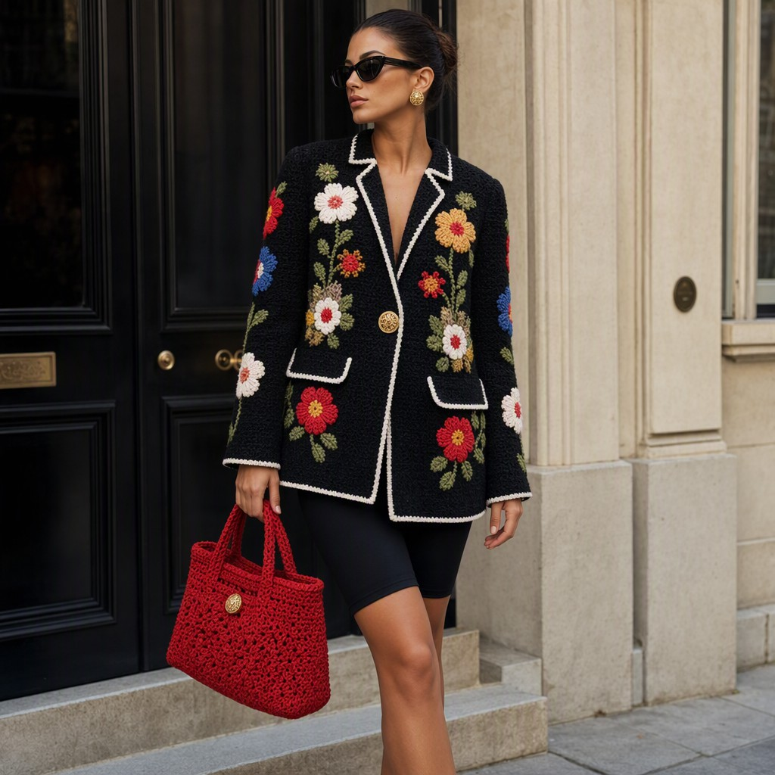
08 风格不一致 夜花园刺绣
原文 0.36 / 0.60 → 入选 1.00 / 0.00
改写前
改写后
Theme: night-garden embroidery. Concept: colored crochet florals on a black ground should stay a dense handmade day look. The boxy black jacket still has that appliqué, gold-tone buttons, white piping, black bike shorts, and a red crochet bag. The lower body and head, however, are a different concept entirely: a white bridal cathedral gown with orange-blossom clusters, a floor-length tulle veil, and white satin court shoes. The handmade day jacket and the bridal ceremony do not belong to one theme.
Boxy black jacket with colored crochet florals on a black ground, featuring appliquéd golden buttons and white piping. The jacket has a boxy silhouette, reaching mid-thigh, with a single-button closure. Black bike shorts sit beneath, providing a sleek, fitted look. Completing the ensemble is a red crochet handbag.
改写点：另一套主题删除。白纱新娘礼服、橙花、及地头纱、白缎浅口鞋不再出现。日装侧留下：黑底彩色钩针、白滚边、黑骑行短裤、红钩针包。

Slide 5
08 入选稿的扣分 夜花园刺绣
覆盖 1.00 质量 1.00 惩罚 0.00
没有剩余扣分
惩罚 0.00，覆盖 1.00，质量 1.00，总分 1.00。五项惩罚都是 0。领口和门襟上的白滚边，换掉颜色和面料之后仍然认得出，所以设计价值没有被压低。
图上对得上留下来的那一侧
黑底彩色钩针、白滚边、金扣、黑骑行短裤、红钩针包都在。头纱、橙花和教堂纱裙不在。

Slide 6
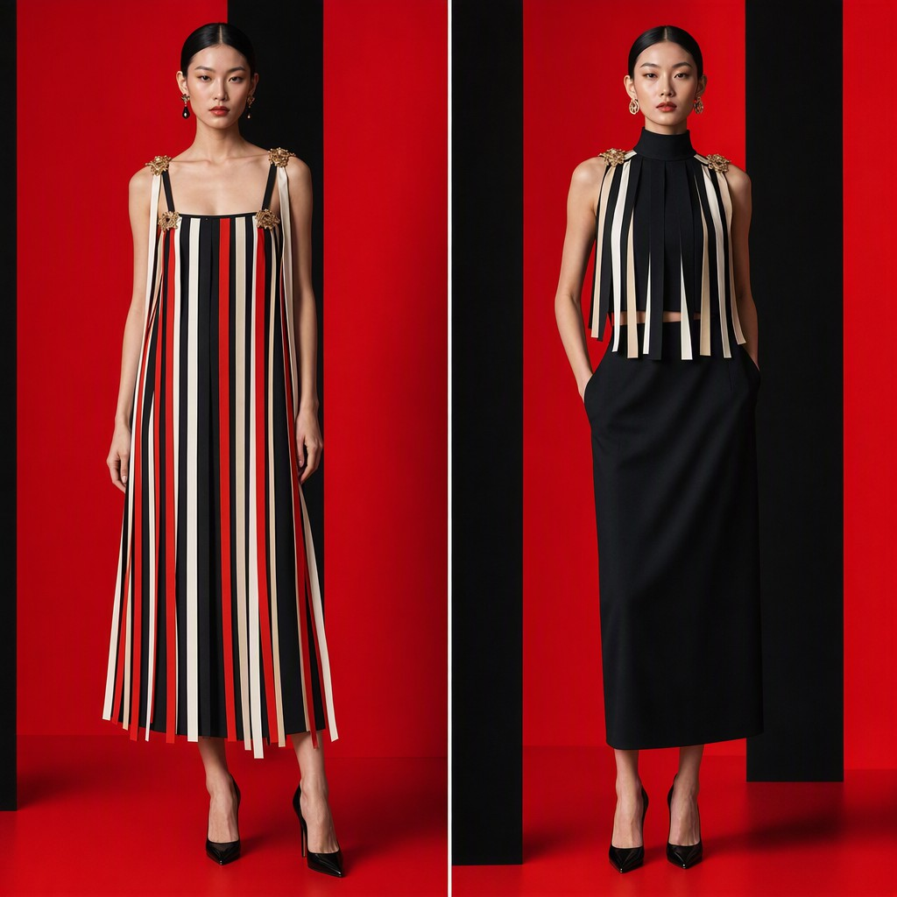
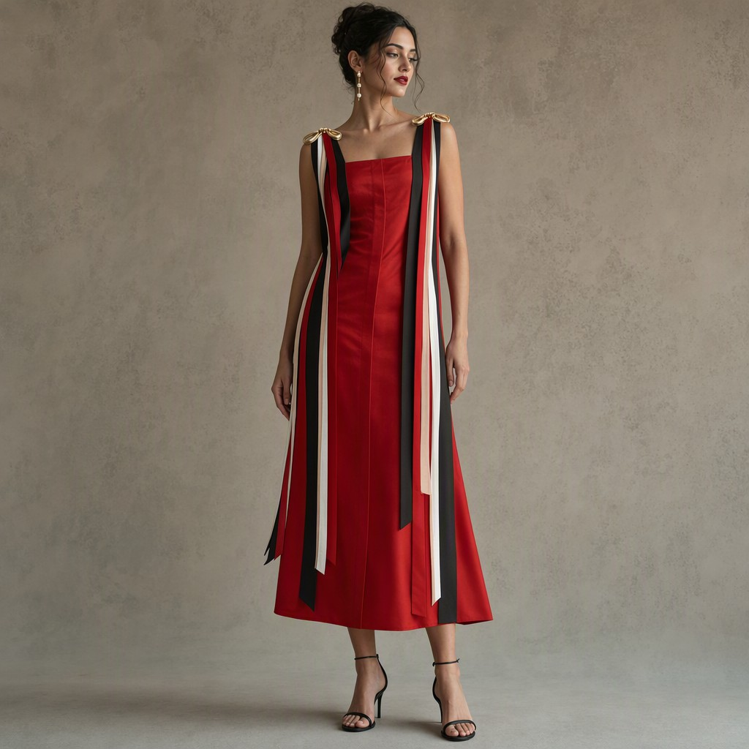
17 同要素矛盾 悬垂丝带
原文 0.40 / 0.65 → 入选 0.70 / 0.00
改写前
改写后
Theme: suspended ribbons. Concept: red, black, white, and pale beige ribbon strips fall from gold-tone shoulder accents and make the linear identity of the dress. The neckline is square to scoop between narrow black straps, and the same neckline is a high stand collar with no straps. The ground is vivid red with black vertical panels, and the same dress is entirely black with no red. The skirt is a loose midi column to mid-calf, and the same hem is a cropped top ending at the waist.
Square-necked, red silk column dress with black vertical panels falling from gold-shoulder ribbons. The hem is a loose midi to mid-calf. The dress closes with a concealed placket and is accented by red, black, white, and pale beige ribbon strips.
改写点：同一条裙子上的第二套绑定删除。立领、全黑、短上衣下摆不再出现。只留方领、红底黑竖条、中长下摆，肩部金饰上的红、黑、白、米白丝带还在。

Slide 7
17 入选稿的扣分 悬垂丝带
覆盖 0.67 质量 0.71 惩罚 0.00
惩罚没有扣分
五项都是 0。立领、全黑、短上衣下摆已经不在，同一条裙子不再写成两套。
扣在覆盖和质量
覆盖 0.67，质量 0.71，总分 0.70，低于 0.80 的分数门。它仍入选，是因为高于原文，并且惩罚更低。规则只认三种一眼能认出来的写法：整片面料上的花纹或肌理、沿着领口门襟下摆走的装饰、外衣敞开后单独也能看懂的内层。肩上的丝带没写成这三种里的任何一种，所以这三项最高只能到 0.5，质量停在 0.71。采样没有留下覆盖轴具体是哪一项没命中。
图上的体现
一条方领红底中长裙，金饰上垂着红、黑、白、米白丝带。文本里的黑竖条没有画成裙身上另一块面板，而是并进了丝带。全文没写鞋，图上的凉鞋是生成时补上的。

