Slide 1
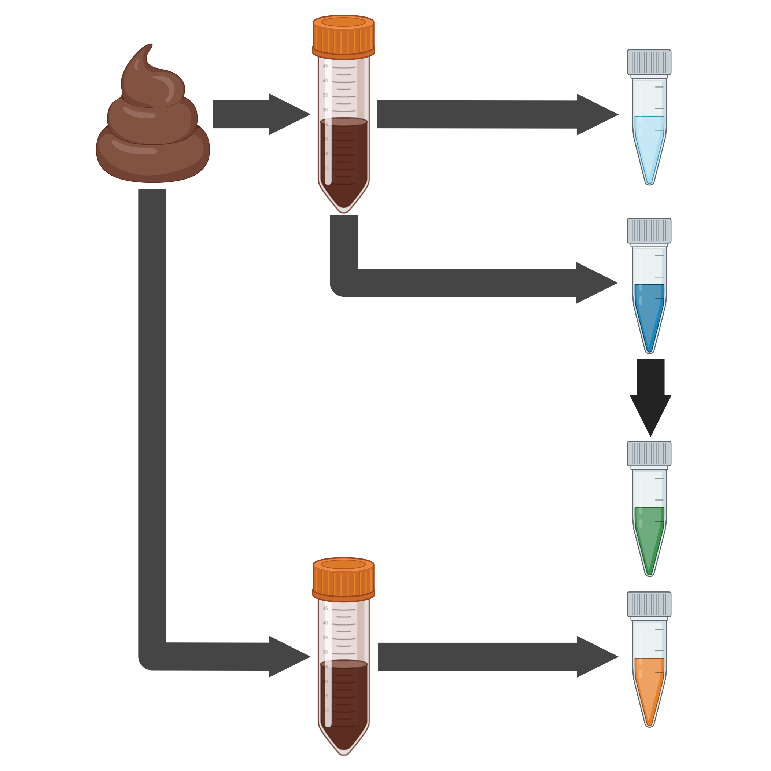
DNA extraction and virome processing methods strongly influence recovered human gut viral community characteristics
Stool
Sample
Virome
prep
Untreated
Virome
DNase Treatment
DNase
Treated
Virome
Multiple Displacement
Amplification
Total DNA
Extraction
MDA
Virome
Meta
genome

