Slide 1
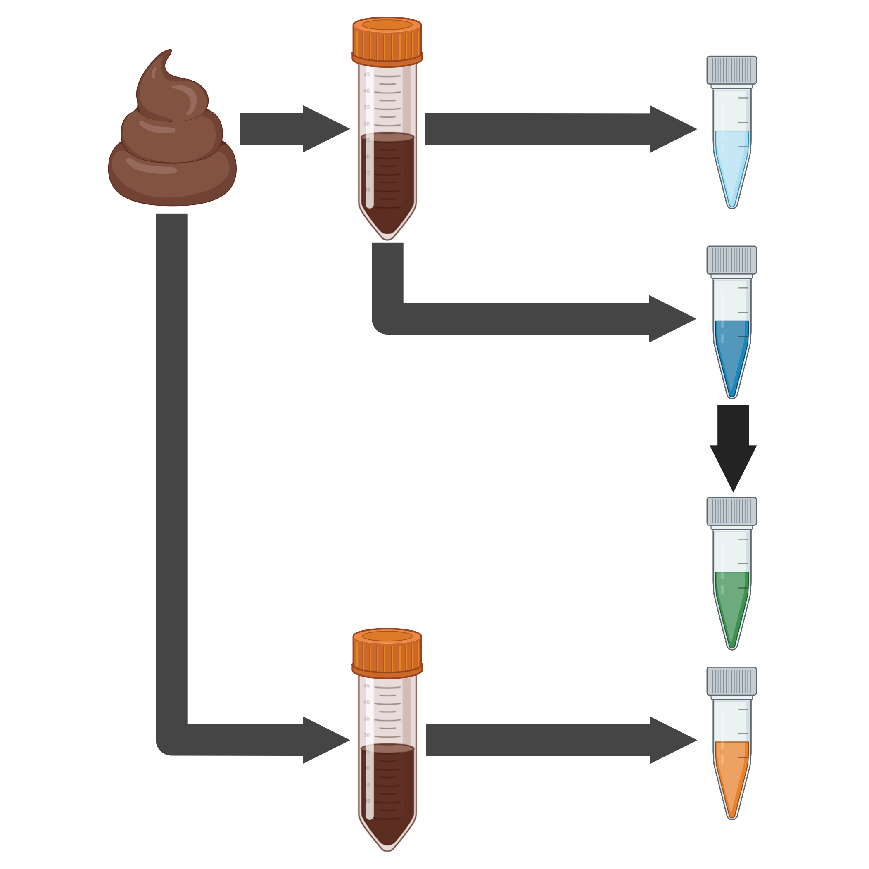
Virome preparation method strongly influences interpretation of human gut viral communities
Stool
Sample
Virome
prep
Untreated
Virome
DNase Treatment
DNase
Treated
Virome
Multiple Displacement
Amplification
Total DNA
Extraction
MDA
Virome
Meta
genome

