Slide 1
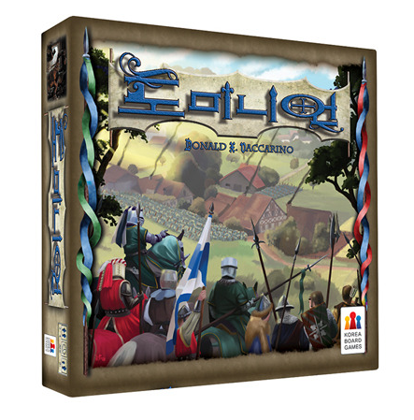
Make Dominion
이상현
서완혁

Slide 2
Part-Division
서완혁 - Main Develop, Server-client, Detail, Card, Shop
이상현 - Interface, Debug, Player, UML, Presentation

Slide 3

Server-Client Model
ROOM1
Client
Client
Sub Server
Client
ROOM2
Client
Main Server
Client
Sub Server
Client

Slide 4
Server-Client Model
Client
I/O
Game Situation
(output)
Simulating….
Player Choice
(input)
Sub Server
Client

Slide 5
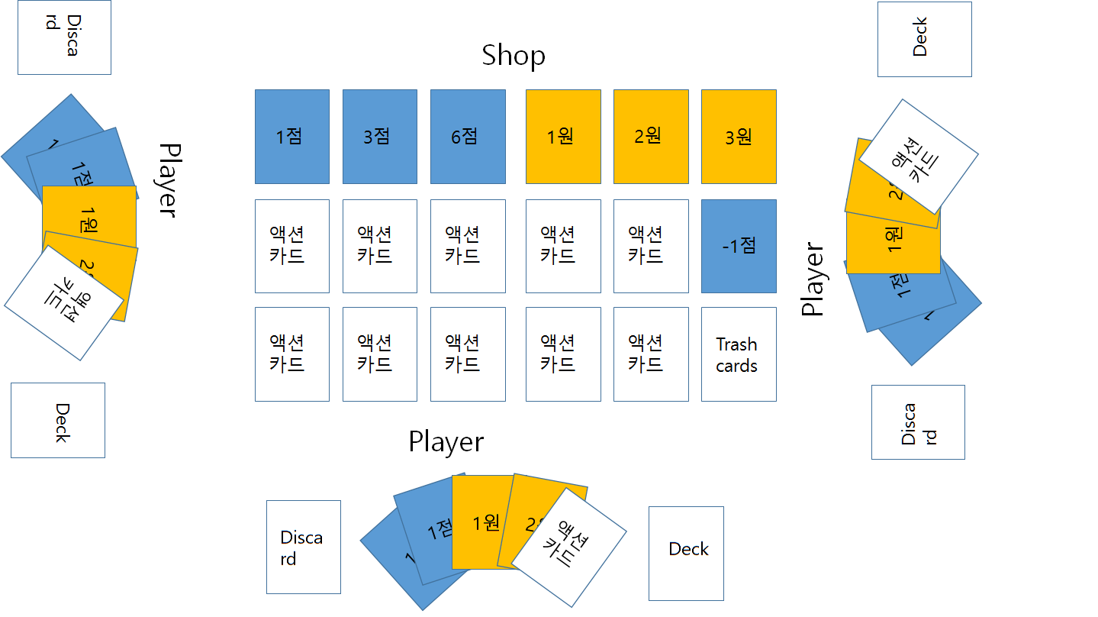
Interface

Slide 6
Interface
Shop
-initial
Shop cards
Num Name Price
1point 2
3point 5
6point 8
1gold 0
2gold 3
3gold 6
Action-1 3
Action-2 4
…
1점
3점
6점
1원
2원
3원
액션카드
액션카드
액션카드
액션카드
액션카드
-1점
액션카드
액션카드
액션카드
액션카드
액션카드
Trash
cards

Slide 7
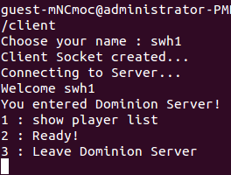
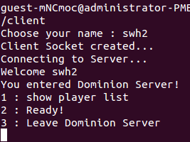

Slide 8
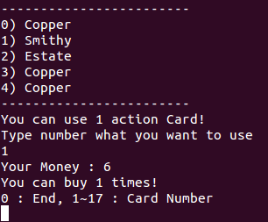
Interface
Player
-Player n turn
Deck cards 10
Discard 8
Hands
Num Name
1point
1point
1gold
2gold
Action1
Status - action
Gold – 3 action – 1 Buy – 1
Choose action?
(1 action, 2 explain card
3 check discard) 1
Action what? 5
1원
2원
Discard
1점
액션카드
1점
Deck

Slide 9
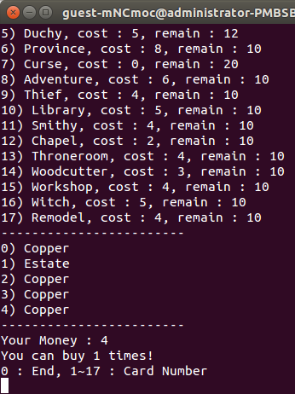
Player
Interface
1점
1원
2원
Discard
1점
Deck
-Player n turn
Deck cards 10
Discard 8
Hands
Num Name
1point
1point
1gold
2gold
Status - buy
Gold – 5 action – 1 Buy – 2
Buy-1?
Buy-2?

Slide 10
Interface
Player
-Player n turn
Deck cards 10
Discard 8
Hands
Num Name
1point
1point
1gold
2gold
Status - buy
Gold – 5 action – 1 Buy – 2
Buy-1? 3
Buy-2? 3
1점
1원
2원
Discard
1점
Deck

Slide 11
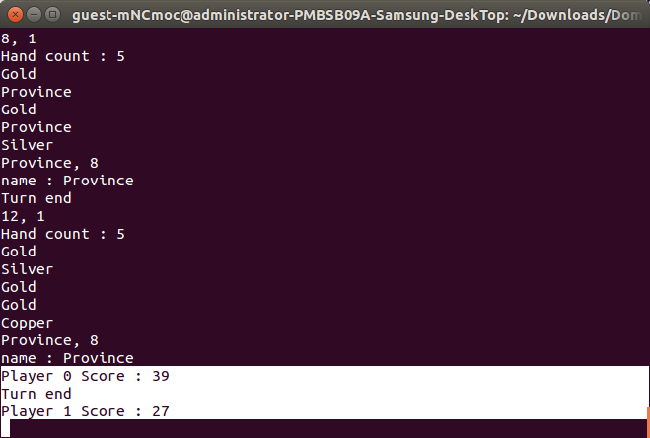
Interface
Buy-2? 3
End condition valid
Calculate score
Player-1 20
Player-2 -5
Player-3 33
Player-3 win…

Slide 12
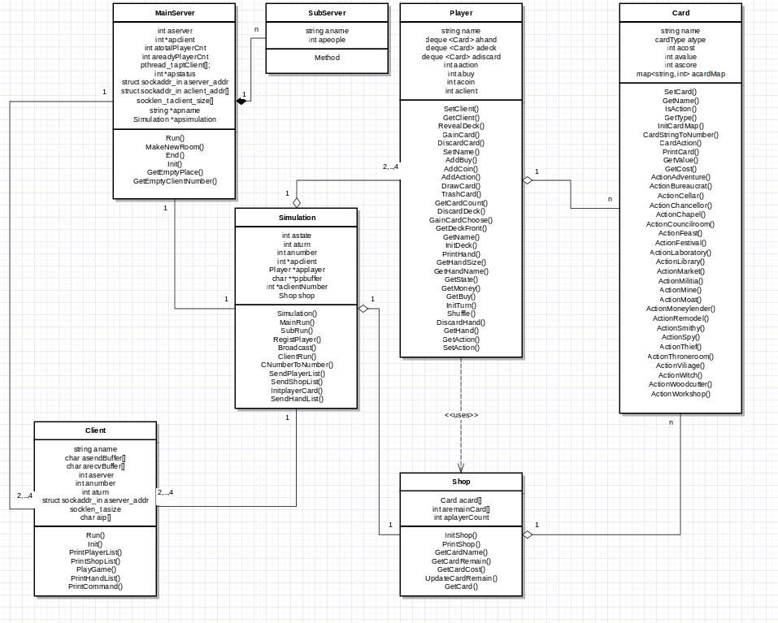
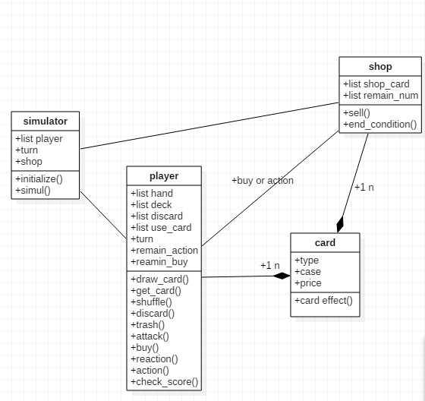
UML

