Slide 1
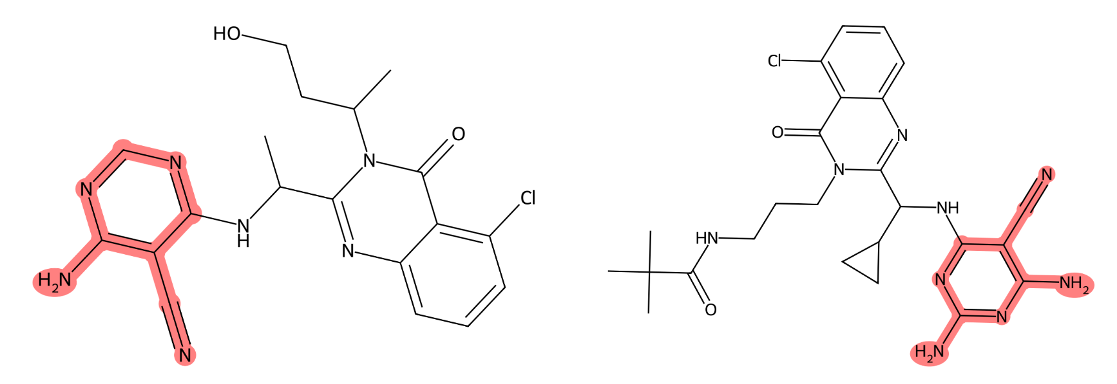
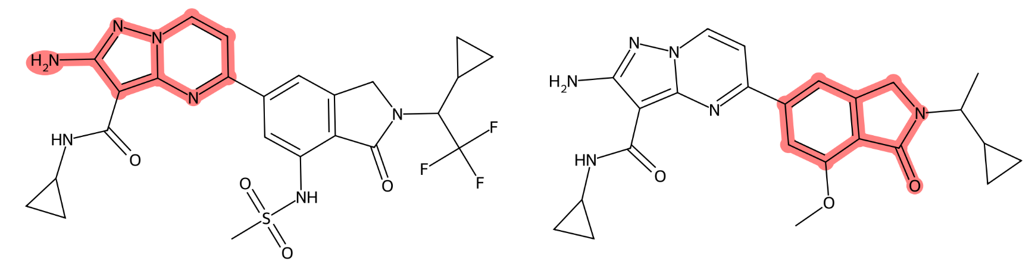
You are running a reproducibility study for compound selectivity prediction. The goal is to train a Balanced Random Forest Classifier to distinguish PI3K-delta (UniProt: O00329) vs PI3K-gamma (UniProt: P48736) selective compounds, evaluate its performance, and identify recurrent molecular anchor fragments that drive the model's correct predictions for each selective class (class 1 & 2) and discuss the chemical insight gained.
Find dataset
Split dataset
Train model
Load dataset
Compute features
Plot classification
results
Identify recurrent anchor rules
Recurrent Molecular Anchor Fragments (Class 1 & 2)
Class PI3K-delta
Class PI3K-gamma
Anchor occurrence: 0.26
Substructure occurrence: 0.26
Anchor occurrence: 0.25
Substructure occurrence: 0.25
Anchor occurrence: 0.36
Substructure occurrence: 0.82
Anchor occurrence: 0.18
Substructure occurrence: 0.36
Occurs in 26.4% of correctly predicted Class 1 compounds. This cyano-substituted pyrimidine motif is a classic kinase hinge-binder.
Occurs in 25.0% of cases. A diamino-cyano pyrimidine derivative, strongly indicating hydrogen-bonding interactions with the hinge region.
Occurs in 36.4% of anchors. A substituted isoquinoline/pyrazolo-pyridine core, highly characteristic of PI3K-gamma selective inhibitors.
Dihydroisoquinolinone derivatives, frequently appearing in gamma-selective chemotypes.
Chemical insights & discussion
Distinct Chemotypes for Selectivity: The recurrent anchors clearly separate the two selective classes. Class 1 (delta) is driven by cyano-pyrimidine hinge binders, while Class 2 (gamma) is driven by isoquinoline/dihydroisoquinolinone scaffolds. This aligns with known structure-activity relationships (SAR) in PI3K inhibitor design.
Hinge Region Mimicry: The high anchor occurrence of cyano-pyrimidines in Class 1 confirms the model has learned the canonical hydrogen-bonding motif required for PI3K catalytic domain binding.
Scaffold-Driven Selectivity: The dominance of bicyclic nitrogenous cores (isoquinolines) in Class 2 suggests that PI3K-gamma selectivity is heavily scaffold-dependent, likely due to subtle differences in the gatekeeper residue or allosteric pocket topology compared to PI3K-delta.
User prompt
Tool calls
Response & output
Discussion

Slide 2
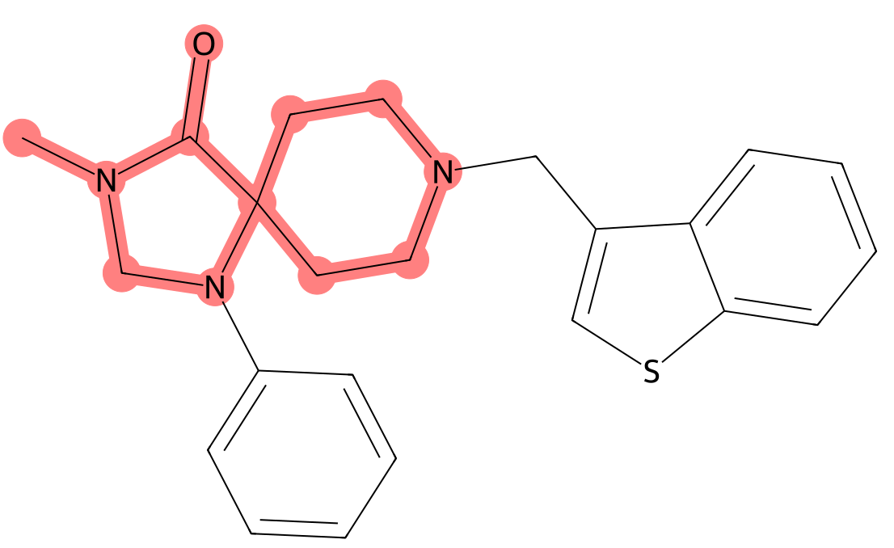
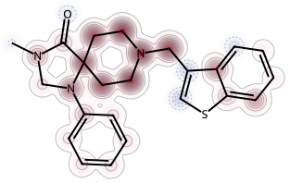
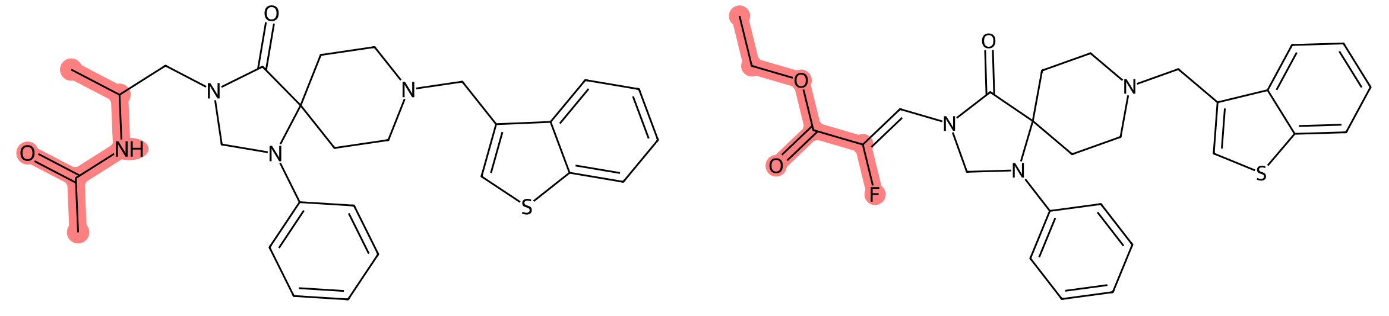
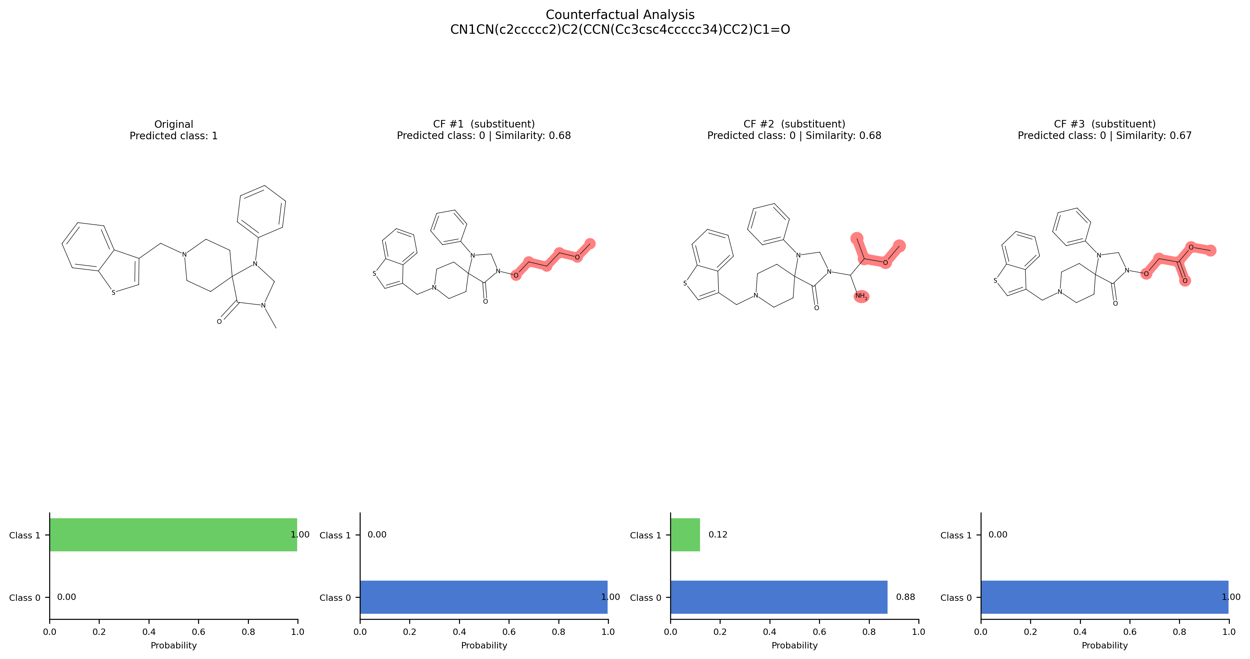
You are running an explainability benchmarking study for compound bioactivity prediction. The goal is to train a Deep Neural Network to distinguish compounds active against the D(2) dopamine receptor (UniProt: P14416) from inactive compounds, evaluate its performance, and then directly compare two pairs of explainability methods on the same on the same correctly predicted active compound: Molanchor vs SHAP and MolCE vs Counterfactuals. Summarize where the methods agree on the structural determinants of the predictions and where they disagree.
Find dataset
Split dataset
Train model
Explain with MolCE
Generate counterfactuals
Load dataset
Compute features
Explain with molanchor
Explain smiles with SHAP
Get top k bit environments
Pair 1: MolAnchor vs SHAP
MolAnchor
SHAP
✅ AGREEMENTS (MolAnchor ↔ SHAP)
Core scaffold importance: Both methods identify the piperazine/benzyl core as critical
N-methyl motif: SHAP's top features (Bits 1280, 1791, 1792) all involve the N-methyl/benzyl-dimethylamine region captured by MolAnchor's anchor
Pharmacophore consensus: Both confirm the morpholinone-piperazine-benzyl framework is essential for D2 binding
❌ DISAGREEMENTS (MolAnchor ↔ SHAP)
Granularity: MolAnchor identifies ONE dominant anchor; SHAP reveals multiple contributing fragments
Peripheral groups: SHAP highlights the benzothiazole (Bit 885, +5.39) as important, while MolAnchor doesn't single it out
Negative contribution: SHAP identifies thiophene substructure (Bit 552, -5.37) as reducing activity—a nuance MolAnchor misses
Pair 2: MolCE vs Counterfactuals
MolCE
Counterfactuals
Rank 1 | Site 1
Contrast: 1.00
Rank 2 | Site 1
Contrast: 1.00
CF #1 (substituent)
Predicted class: 0| Similarity: 0.68
CF #2 (substituent)
Predicted class: 0| Similarity: 0.68
✅ AGREEMENTS (MolCE ↔ Counterfactuals)
Piperazine N as critical site: Both methods identify the piperazine nitrogen substituent as the most impactful site
Substituent sensitivity: Both confirm that modifying the piperazine N-substituent can flip the prediction
Polarity effect: MolCE's contrastive R-groups (polar/charged) align with Counterfactuals showing polar additions eliminate activity
❌ DISAGREEMENTS (MolCE ↔ Counterfactuals)
Scaffold importance: MolCE shows scaffold contrast score = 0.0 (scaffold changes don't matter), while Counterfactuals show substituent changes do matter
Mechanism: MolCE focuses on contrast (why not inactive?), while Counterfactuals show transformation (how to become inactive?)
Key takeaways
Convergent Pharmacophore: All four methods agree that the piperazine-benzyl-morpholinone core is essential for D2 receptor binding.
Critical Switch: The piperazine nitrogen substituent acts as an "on/off switch"—modifying it can eliminate activity even with the core scaffold intact.
Method Complementarity:
MolAnchor: Best for identifying dominant fragments with high precision
SHAP: Best for revealing distributed importance and negative contributions
MolCE: Best for identifying contrastive features (what distinguishes active from inactive)
Counterfactuals: Best for generating actionable structural modifications
Limitation Insight: MolAnchor's single-anchor view may oversimplify; SHAP reveals the benzothiazole's positive contribution that MolAnchor misses. Counterfactuals show that the core scaffold alone is necessary but not sufficient—the N-substituent is the decisive factor.
User prompt
Tool calls
Response & output
Discussion

Slide 3
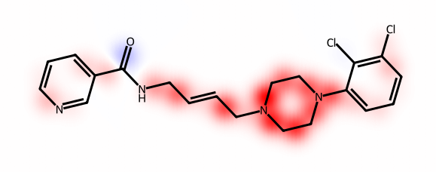
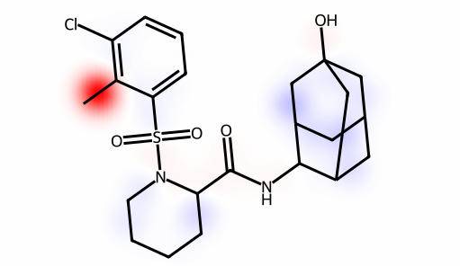
Train a GNN model on a compound activity prediction dataset. Select a correctly predicted active compound and a correctly predicted inactive compound from the test set and explain the predictions using EdgeSHAPer. Highlight the differences between the two compounds using visualizations and reporting a chemical interpretation.
Find dataset
Prepare GNN dataset
Train GNN model
Visualize EdgeSHAPer results
Get bond environments
Load dataset
Split dataset
Select compounds
Explain with EdgeSHAPer
Explanations of active and inactive compounds
Active
Inactive
⬆️ EdgeSHAPer analysis on activity Piperazine Ring Bonds Dominate (φ = 0.116, 0.101, 0.095)
The C-N and C-C bonds within the piperazine ring show the highest positive SHAP values
This suggests the model associates the piperazine scaffold with activity
Piperazine is a common pharmacophore in bioactive molecules
⬇️ EdgeSHAPer analysis on inactivity Methyl-Phenyl Bond Dominates (φ = 0.283)
The C-C bond between methyl and phenyl has an extremely high SHAP value
This suggests the model associates simple alkyl-phenyl systems with inactivity
Lack of complex pharmacophore reduces activity likelihood
Key insights and comparison
Dominant SHAP Contribution:
Active piperazine (φ = 0.116)
Inactive: methyl-phenyl (φ = 0.283)
2. SHAP Values Distribution: more uniform for active (0.045-0.116) and more skewed (0.003-0.283). The active compound relies on multiple features.
3. Key Pharmacophore Features: piperazine + halogenated aryl (active), simple alkyl-aryl (inactive). The active compound has a recognized pharmacophore.
4. Molecular Complexity: moderate for active (12 heavy atoms in core), high for inactive (30 heavy atoms). The active compound has optimal complexity
5. Feature Contribution:
Active: distributed across the scaffold.
Inactive: concentrated in one bond.
Insight: The active molecule uses more balanced features.
User prompt
Tool calls
Response & output
Discussion

Slide 4
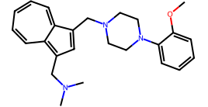
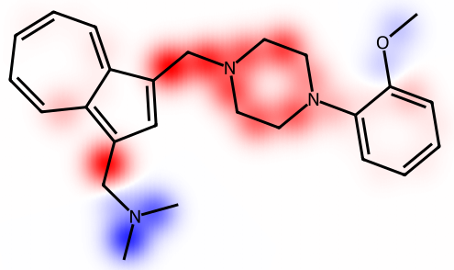
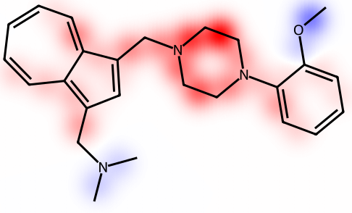
Train two different GNN models on a compound activity prediction dataset and compare their performances. Select a compound from the test set correctly predicted as active by both models. Explain the predictions using EdgeSHAPer and highlight the differences between the learning characteristics of the models showing relevant visualizations.
Find dataset
Prepare GNN dataset
Train GNN model (twice)
Visualize EdgeSHAPer results
Get bond environments
Load dataset
Split dataset
Select compound
Explain with EdgeSHAPer (twice)
Classification performance and compound selection
Metric | GCN | GAT | Winner
Validation Accuracy | 94.54% | 95.06% | 🏆 GAT
Test Accuracy | 93.89% | 95.57% | 🏆 GAT
Compound selected for XAI analysis
SMILES: COc1ccccc1N1CCN(Cc2cc(CN(C)C)c3cccccc2-3)CC1
True Label: Active (Class 1) ✅
Predicted by Both Models: Active (Class 1) ✅
GCN Predicted Probability: 99.96%
GAT Predicted Probability : 99.99%
Key differences in learning characteristics
GCN
GAT
GCN: Fragment-Driven Learning
Top contributors: Aromatic ring bonds (cC) and N-C single bonds
Learning pattern: Focuses on local atomic environments and bond types
Mechanism: Message passing treats all neighbors equally → learns structural motifs
Top bonds: Bonds connecting aromatic rings to alkyl chains
GAT: Context-Aware Learning
Top contributors: Piperazine backbone (NCCN) and aliphatic C-C bonds
Learning pattern: Focuses on molecular backbone and connectivity patterns
Mechanism: Attention weights allow GAT to dynamically weight important neighbors
Top bonds: Bonds within the piperazine ring system
Conclusions
While both models correctly predict this compound as active, GAT demonstrates superior performance and learns more sophisticated molecular representations through its attention mechanism. GAT's focus on the piperazine backbone suggests it captures pharmacophore-relevant features more effectively than GCN's fragment-based approach.
Re-prompting
You highlighted the differences, but it seems that the explanations are similar. Can you describe the similarities?
Key similarities in learning characteristics
Similarity Aspect | GCN Evidence | GAT Evidence | Interpretation
🎯 Top Structural Motif | NCCN (piperazine backbone) appears in top 5 | NCCN is the #1 contributor | Both models identify the piperazine core as the most critical pharmacophore
📈 Contribution Direction | All top 5 bonds have positive phi values | All top 5 bonds have positive phi values | Both models agree these regions drive activity (not inhibit it)
🔗 Bond Type Preference | Prioritizes single bonds (C-C, C-N) | Prioritizes single bonds (C-C, C-N) | Both learn that aliphatic connectivity matters more than aromaticity for this scaffold
🧩 Critical Regions | Piperazine ring + N-alkyl linkers (CCN(C)C, cCN(C)C) | Piperazine ring + N-alkyl linkers (CCN(C)C, cCN(C)C) | Both converge on the central scaffold + substituent attachment points
📊 Explanation Reliability | Trustworthiness : 0.7077 | Trustworthiness: 0.6869 | Nearly identical fidelity/infidelity balance → similar explanation stability
Revised conclusions
Both models independently highlight the piperazine nitrogen-carbon backbone (NCCN) and the N-methylbenzyl linker (CCN(C)C / cCN(C)C). This isn't a coincidence—it reflects a real structure-activity relationship (SAR) in the training data. Both architectures extract the same patterns despite different message-passing mechanisms. This convergence strongly suggests that the piperazine-N-alkyl motif is a genuine, data-supported pharmacophore for this target, rather than an artifact of a specific GNN architecture.
User prompt
Tool calls
Response & output
Discussion

Slide 5
You are running an explainability benchmarking study for compound bioactivity prediction. The goal is to train a Deep Neural Network to distinguish compounds active against the D(2) dopamine receptor (UniProt P14416) from inactive compounds, evaluate its performance, and then directly compare two pairs of explainability methods on the same on the same correctly predicted active compound: Molanchor vs SHAP and MolCE vs Counterfactuals. Summarize where the methods agree on the structural determinants of the predictions and where they disagree.
Find dataset
Split dataset
Train model
Explain with MolCE
Generate counterfactuals
Load dataset
Compute features
Explain with molanchor
Explain smiles with SHAP
Get top k bit environments
Pair 1: MolAnchor vs SHAP
MolAnchor
SHAP
✅ AGREEMENTS (MolAnchor ↔ SHAP)
Core scaffold importance: Both methods identify the piperazine/benzyl core as critical
N-methyl motif: SHAP's top features (Bits 1280, 1791, 1792) all involve the N-methyl/benzyl-dimethylamine region captured by MolAnchor's anchor
Pharmacophore consensus: Both confirm the morpholinone-piperazine-benzyl framework is essential for D2 binding
❌ DISAGREEMENTS (MolAnchor ↔ SHAP)
Granularity: MolAnchor identifies ONE dominant anchor; SHAP reveals multiple contributing fragments
Peripheral groups: SHAP highlights the benzothiazole (Bit 885, +5.39) as important, while MolAnchor doesn't single it out
Negative contribution: SHAP identifies thiophene substructure (Bit 552, -5.37) as reducing activity—a nuance MolAnchor misses
Pair 2: MolCE vs Counterfactuals
MolCE
Counterfactuals
Rank 1 | Site 1
Contrast: 1.00
Rank 2 | Site 1
Contrast: 1.00
CF #1 (substituent)
Predicted class: 0| Similarity: 0.68
CF #2 (substituent)
Predicted class: 0| Similarity: 0.68
✅ AGREEMENTS (MolCE ↔ Counterfactuals)
Piperazine N as critical site: Both methods identify the piperazine nitrogen substituent as the most impactful site
Substituent sensitivity: Both confirm that modifying the piperazine N-substituent can flip the prediction
Polarity effect: MolCE's contrastive R-groups (polar/charged) align with Counterfactuals showing polar additions eliminate activity
❌ DISAGREEMENTS (MolCE ↔ Counterfactuals)
Scaffold importance: MolCE shows scaffold contrast score = 0.0 (scaffold changes don't matter), while Counterfactuals show substituent changes do matter
Mechanism: MolCE focuses on contrast (why not inactive?), while Counterfactuals show transformation (how to become inactive?)
Key takeaways
Convergent Pharmacophore: All four methods agree that the piperazine-benzyl-morpholinone core is the essential pharmacophore for D2 receptor binding.
Critical Switch: The piperazine nitrogen substituent acts as an "on/off switch"—modifying it can eliminate activity even with the intact core scaffold intact.
Method Complementarity:
MolAnchor: Best for identifying dominant fragments with high precision
SHAP: Best for revealing distributed importance and negative contributions
MolCE: Best for identifying contrastive features (what distinguishes active from inactive)
Counterfactuals: Best for generating actionable structural modifications
Limitation Insight: MolAnchor's single-anchor view may oversimplify; SHAP reveals the benzothiazole's positive contribution that MolAnchor misses. Counterfactuals show that the core scaffold alone is necessary but not sufficient—the N-substituent is the decisive factor.
User prompt
Tool calls
Response & output
Discussion

Slide 6
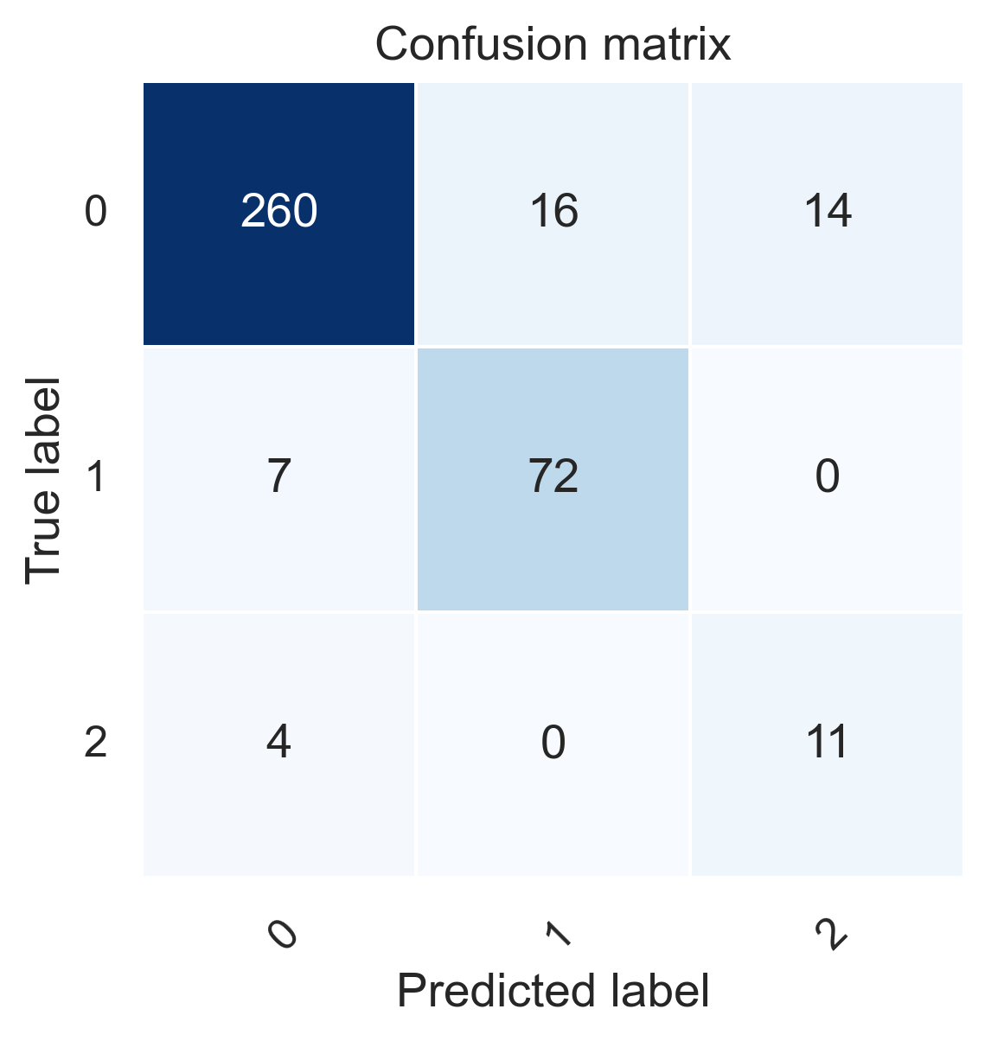
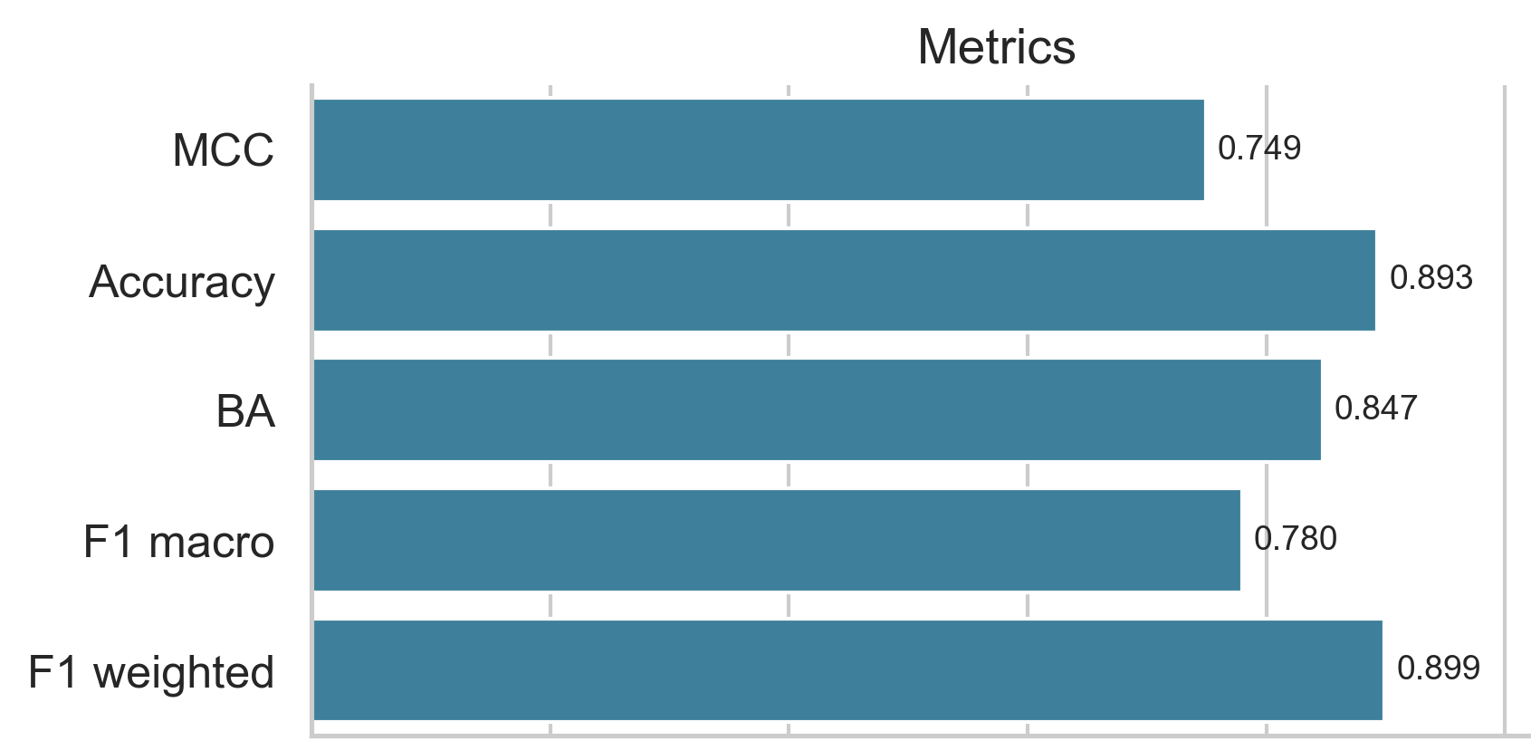
You are running a reproducibility study for compound selectivity prediction. The goal is to train a Balanced Random Forest Classifier to distinguish PI3K-delta (UniProt: O00329) vs PI3K-gamma (UniProt: P48736) selective compounds, evaluate its performance, and identify recurrent molecular anchor fragments that drive the model's correct predictions for each selective class (class 1 & 2) and discuss the chemical insight gained.
Find dataset
Split dataset
Train model
Load dataset
Compute features
Plot classification
results
Identify recurrent anchor rules
Model Performance Evaluation
The Balanced Random Forest model achieved strong performance on the test set:
Accuracy: 89.3%
Balanced Accuracy: 84.7%
MCC: 0.749
F1 Macro: 0.780
Class 1 (PI3K-delta selective) and Class 2 (PI3K-gamma selective) show good separation, though Class 2 has fewer samples (15 in test set), which is typical for highly specific selectivity data.
Recurrent Molecular Anchor Fragments (Class 1 & 2)
Class PI3K-delta
Class PI3K-gamma
Rank 1
Anchor occurrence: 0.26
Substructure occurrence: 0.26
Rank 2
Anchor occurrence: 0.25
Substructure occurrence: 0.25
Rank 1
Anchor occurrence: 0.36
Substructure occurrence: 0.82
Rank 2
Anchor occurrence: 0.18
Substructure occurrence: 0.36
Occurs in 26.4% of correctly predicted Class 1 compounds. This cyano-substituted pyrimidine motif is a classic kinase hinge-binder.
Occurs in 25.0% of cases. A diamino-cyano pyrimidine derivative, strongly indicating hydrogen-bonding interactions with the hinge region.
Occurs in 36.4% of anchors. A substituted isoquinoline/pyrazolo-pyridine core, highly characteristic of PI3K-gamma selective inhibitors.
Dihydroisoquinolinone derivatives, frequently appearing in gamma-selective chemotypes.
Chemical insights & discussion
Distinct Chemotypes for Selectivity: The recurrent anchors clearly separate the two selective classes. Class 1 (delta) is driven by cyano-pyrimidine hinge binders, while Class 2 (gamma) is driven by isoquinoline/dihydroisoquinolinone scaffolds. This aligns with known structure-activity relationships (SAR) in PI3K inhibitor design.
Hinge Region Mimicry: The high anchor occurrence of cyano-pyrimidines in Class 1 confirms the model has learned the canonical hydrogen-bonding motif required for PI3K catalytic domain binding.
Scaffold-Driven Selectivity: The dominance of bicyclic nitrogenous cores (isoquinolines) in Class 2 suggests that PI3K-gamma selectivity is heavily scaffold-dependent, likely due to subtle differences in the gatekeeper residue or allosteric pocket topology compared to PI3K-delta.
User prompt
ChemicHAL response
ChemicHAL discussion

Slide 7



You are running a reproducibility study for compound selectivity prediction. The goal is to train a Balanced Random Forest Classifier to distinguish PI3K-delta (UniProt: O00329) vs PI3K-gamma (UniProt: P48736) selective compounds, evaluate its performance, and identify recurrent molecular anchor fragments that drive the model's correct predictions for each selective class (class 1 & 2) and discuss the chemical insight gained.
Find dataset
Load dataset
Compute features
Split dataset
Train model
Plot classification results
Identify recurrent anchor rules
Model Performance Evaluation
Recurrent Molecular Anchor Fragments (Class 1 & 2)
Class PI3K-delta
Class PI3K-gamma
Rank 1
Anchor occurrence: 0.26
Substructure occurrence: 0.26
Rank 2
Anchor occurrence: 0.25
Substructure occurrence: 0.25
Rank 1
Anchor occurrence: 0.36
Substructure occurrence: 0.82
Rank 2
Anchor occurrence: 0.18
Substructure occurrence: 0.36
[*]c1ncnc(N)c1C#N: Occurs in 26.4% of correctly predicted Class 1 compounds. This cyano-substituted pyrimidine motif is a classic kinase hinge-binder.
[*]c1nc(N)nc(N)c1C#N: Occurs in 25.0% of cases. A diamino-cyano pyrimidine derivative, strongly indicating hydrogen-bonding interactions with the hinge region.
[*]c1ccn2nc(N)c([*])c2n1: Occurs in 36.4% of anchors. A substituted isoquinoline/pyrazolo-pyridine core, highly characteristic of PI3K-gamma selective inhibitors.
[*]N1Cc2cc([*])cc([*])c2C1=O: Dihydroisoquinolinone derivatives, frequently appearing in gamma-selective chemotypes.
The Balanced Random Forest model achieved strong performance on the test set:
Accuracy: 89.3%
Balanced Accuracy: 84.7%
MCC: 0.749
F1 Macro: 0.780
Class 1 (PI3K-delta selective) and Class 2 (PI3K-gamma selective) show good separation, though Class 2 has fewer samples (15 in test set), which is typical for highly specific selectivity data.
User prompt to ChemicHAL
ChemicHAL Response
ChemicHAL tools called

Slide 8
You are running a reproducibility study for compound selectivity prediction. The goal is to train a Balanced Random Forest Classifier to distinguish PI3K-delta (UniProt: O00329) vs PI3K-gamma (UniProt: P48736) selective compounds, evaluate its performance, and identify recurrent molecular anchor fragments that drive the model's correct predictions for each selective class (class 1 & 2) and discuss the chemical insight gained.
Find dataset
Split dataset
Train model
Load dataset
Compute features
Plot classification
results
Identify recurrent anchor rules
Model Performance Evaluation
The Balanced Random Forest model achieved strong performance on the test set:
Accuracy: 89.3%
Balanced Accuracy: 84.7%
MCC: 0.749
F1 Macro: 0.780
Class 1 (PI3K-delta selective) and Class 2 (PI3K-gamma selective) show good separation, though Class 2 has fewer samples (15 in test set), which is typical for highly specific selectivity data.
Recurrent Molecular Anchor Fragments (Class 1 & 2)
Class PI3K-delta
Class PI3K-gamma
Rank 1
Anchor occurrence: 0.26
Substructure occurrence: 0.26
Rank 2
Anchor occurrence: 0.25
Substructure occurrence: 0.25
Rank 1
Anchor occurrence: 0.36
Substructure occurrence: 0.82
Rank 2
Anchor occurrence: 0.18
Substructure occurrence: 0.36
Occurs in 26.4% of correctly predicted Class 1 compounds. This cyano-substituted pyrimidine motif is a classic kinase hinge-binder.
Occurs in 25.0% of cases. A diamino-cyano pyrimidine derivative, strongly indicating hydrogen-bonding interactions with the hinge region.
Occurs in 36.4% of anchors. A substituted isoquinoline/pyrazolo-pyridine core, highly characteristic of PI3K-gamma selective inhibitors.
Dihydroisoquinolinone derivatives, frequently appearing in gamma-selective chemotypes.
Chemical insights & discussion
Distinct Chemotypes for Selectivity: The recurrent anchors clearly separate the two selective classes. Class 1 (delta) is driven by cyano-pyrimidine hinge binders, while Class 2 (gamma) is driven by isoquinoline/dihydroisoquinolinone scaffolds. This aligns with known structure-activity relationships (SAR) in PI3K inhibitor design.
Hinge Region Mimicry: The high anchor occurrence of cyano-pyrimidines in Class 1 confirms the model has learned the canonical hydrogen-bonding motif required for PI3K catalytic domain binding.
Scaffold-Driven Selectivity: The dominance of bicyclic nitrogenous cores (isoquinolines) in Class 2 suggests that PI3K-gamma selectivity is heavily scaffold-dependent, likely due to subtle differences in the gatekeeper residue or allosteric pocket topology compared to PI3K-delta.
User prompt
ChemicHAL response
ChemicHAL discussion

Slide 9
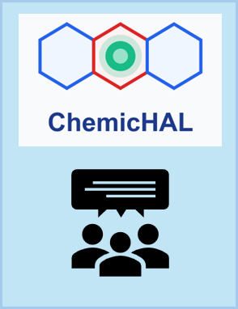
You are running a reproducibility study for compound selectivity prediction. The goal is to train a Balanced Random Forest Classifier to distinguish PI3K-delta (UniProt: O00329) vs PI3K-gamma (UniProt: P48736) selective compounds, evaluate its performance, and identify recurrent molecular anchor fragments that drive the model's correct predictions for each selective class (class 1 & 2) and discuss the chemical insight gained.
Find dataset
Load dataset
Compute features
Split dataset
Train model
Plot classification results

