Slide 1

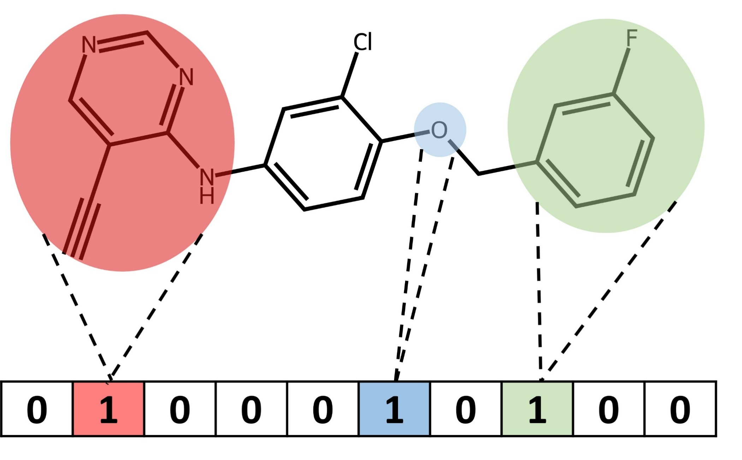
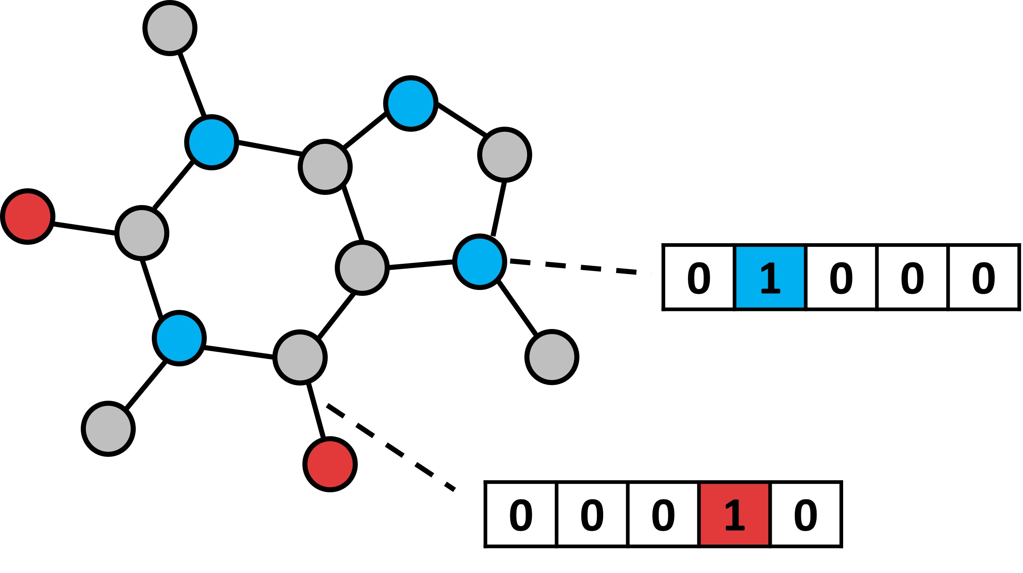
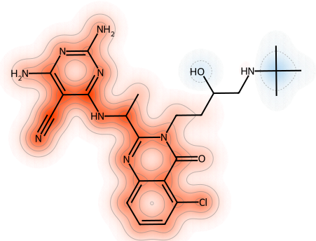
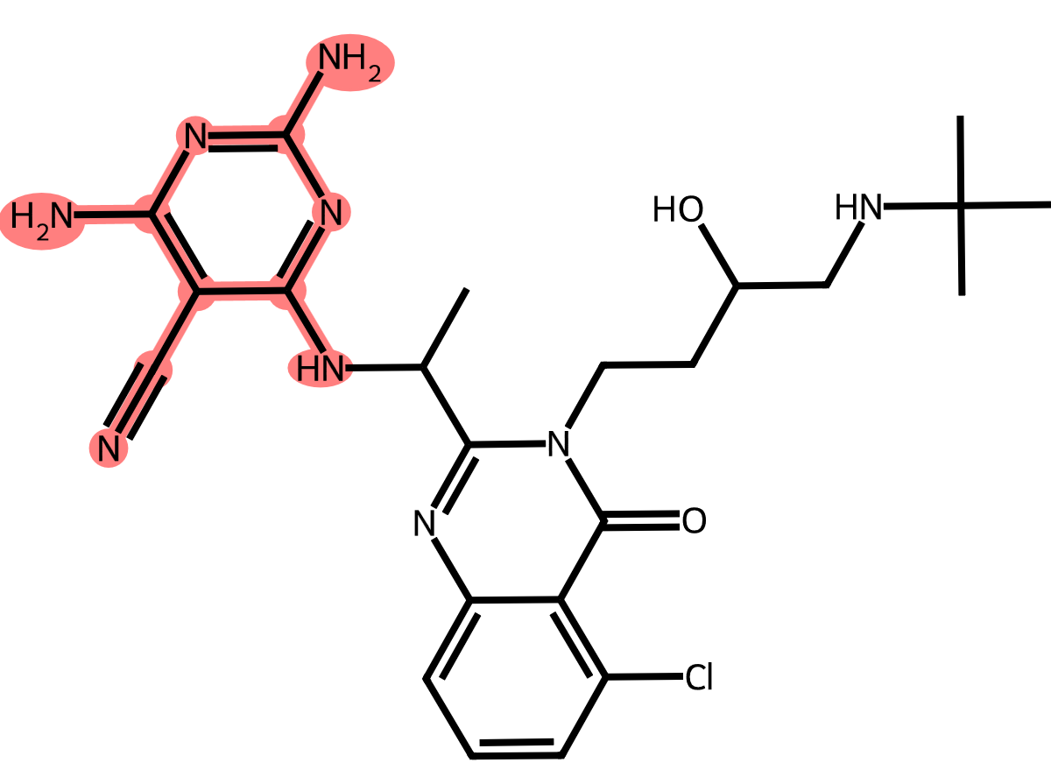

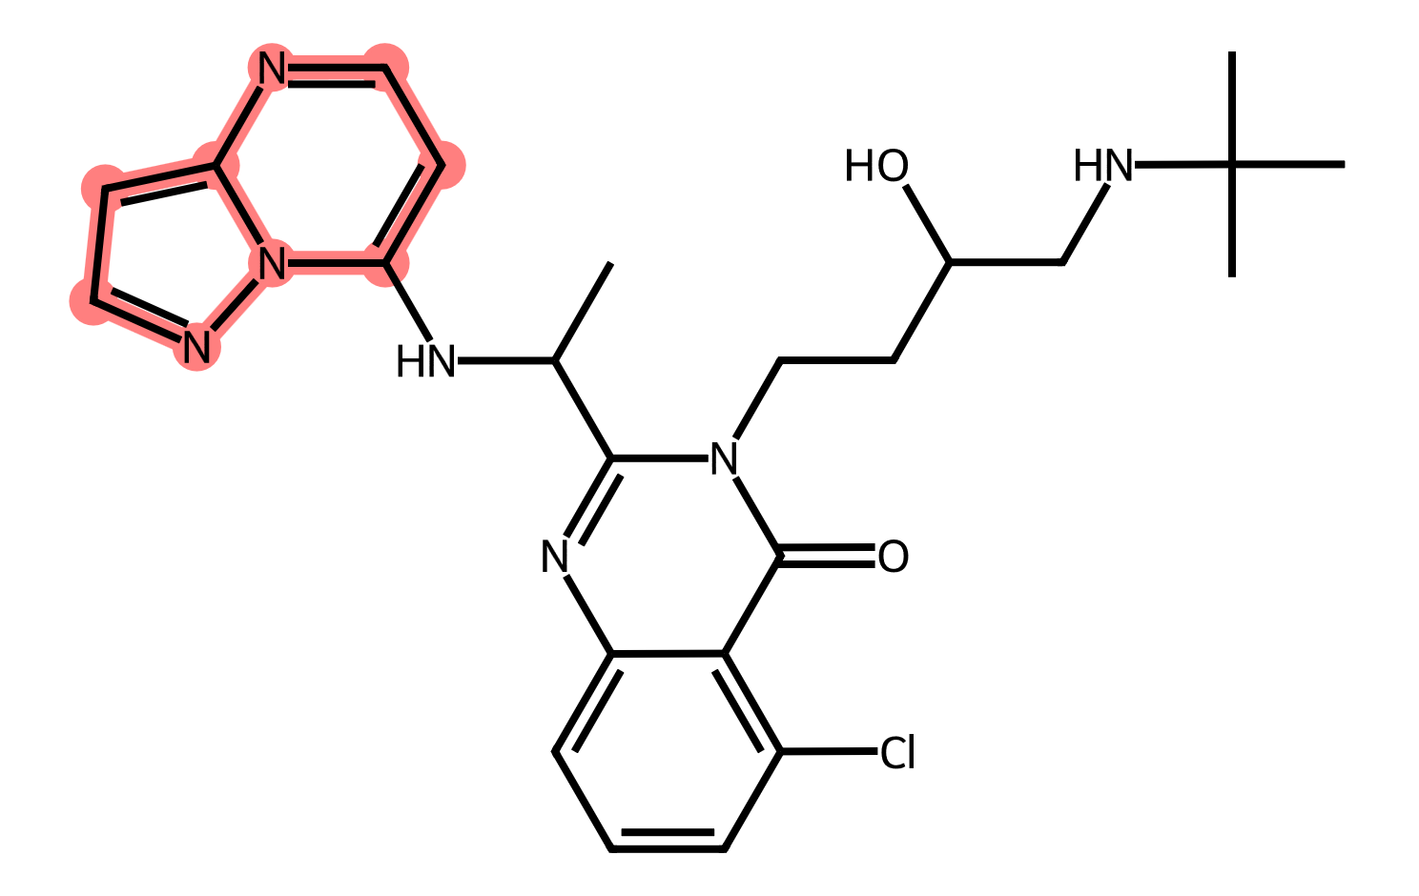
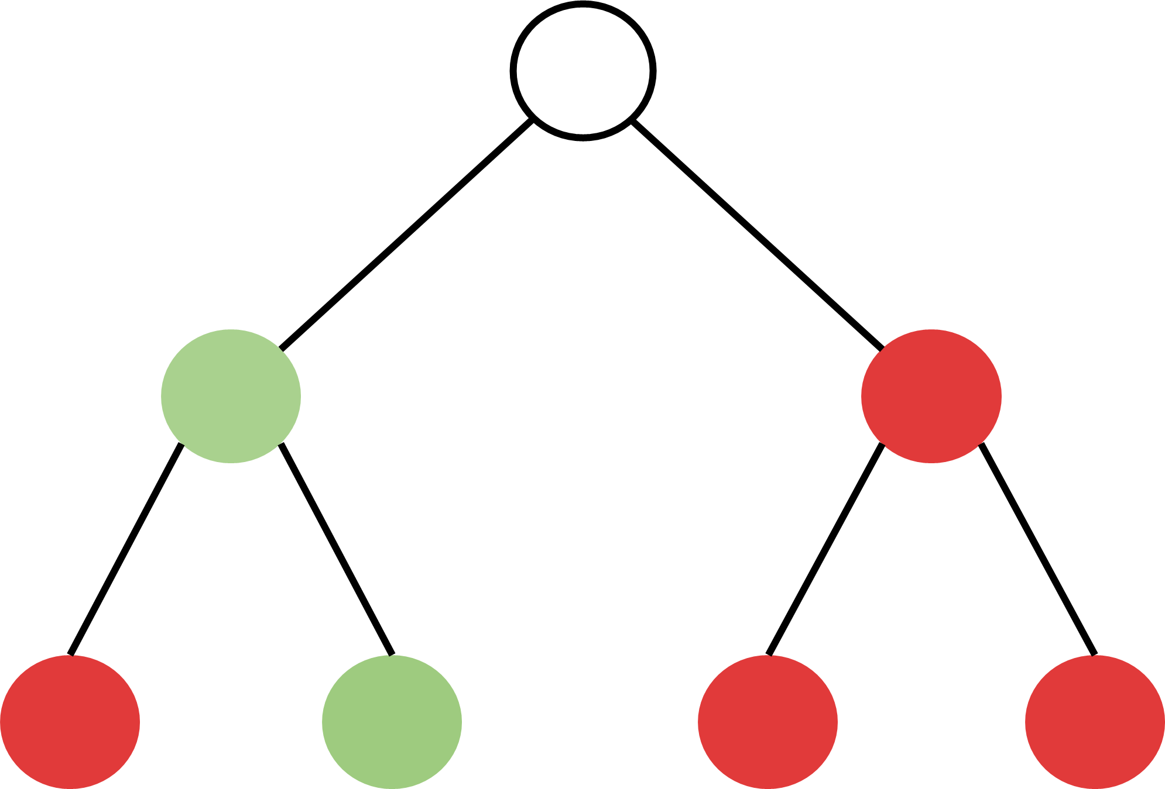
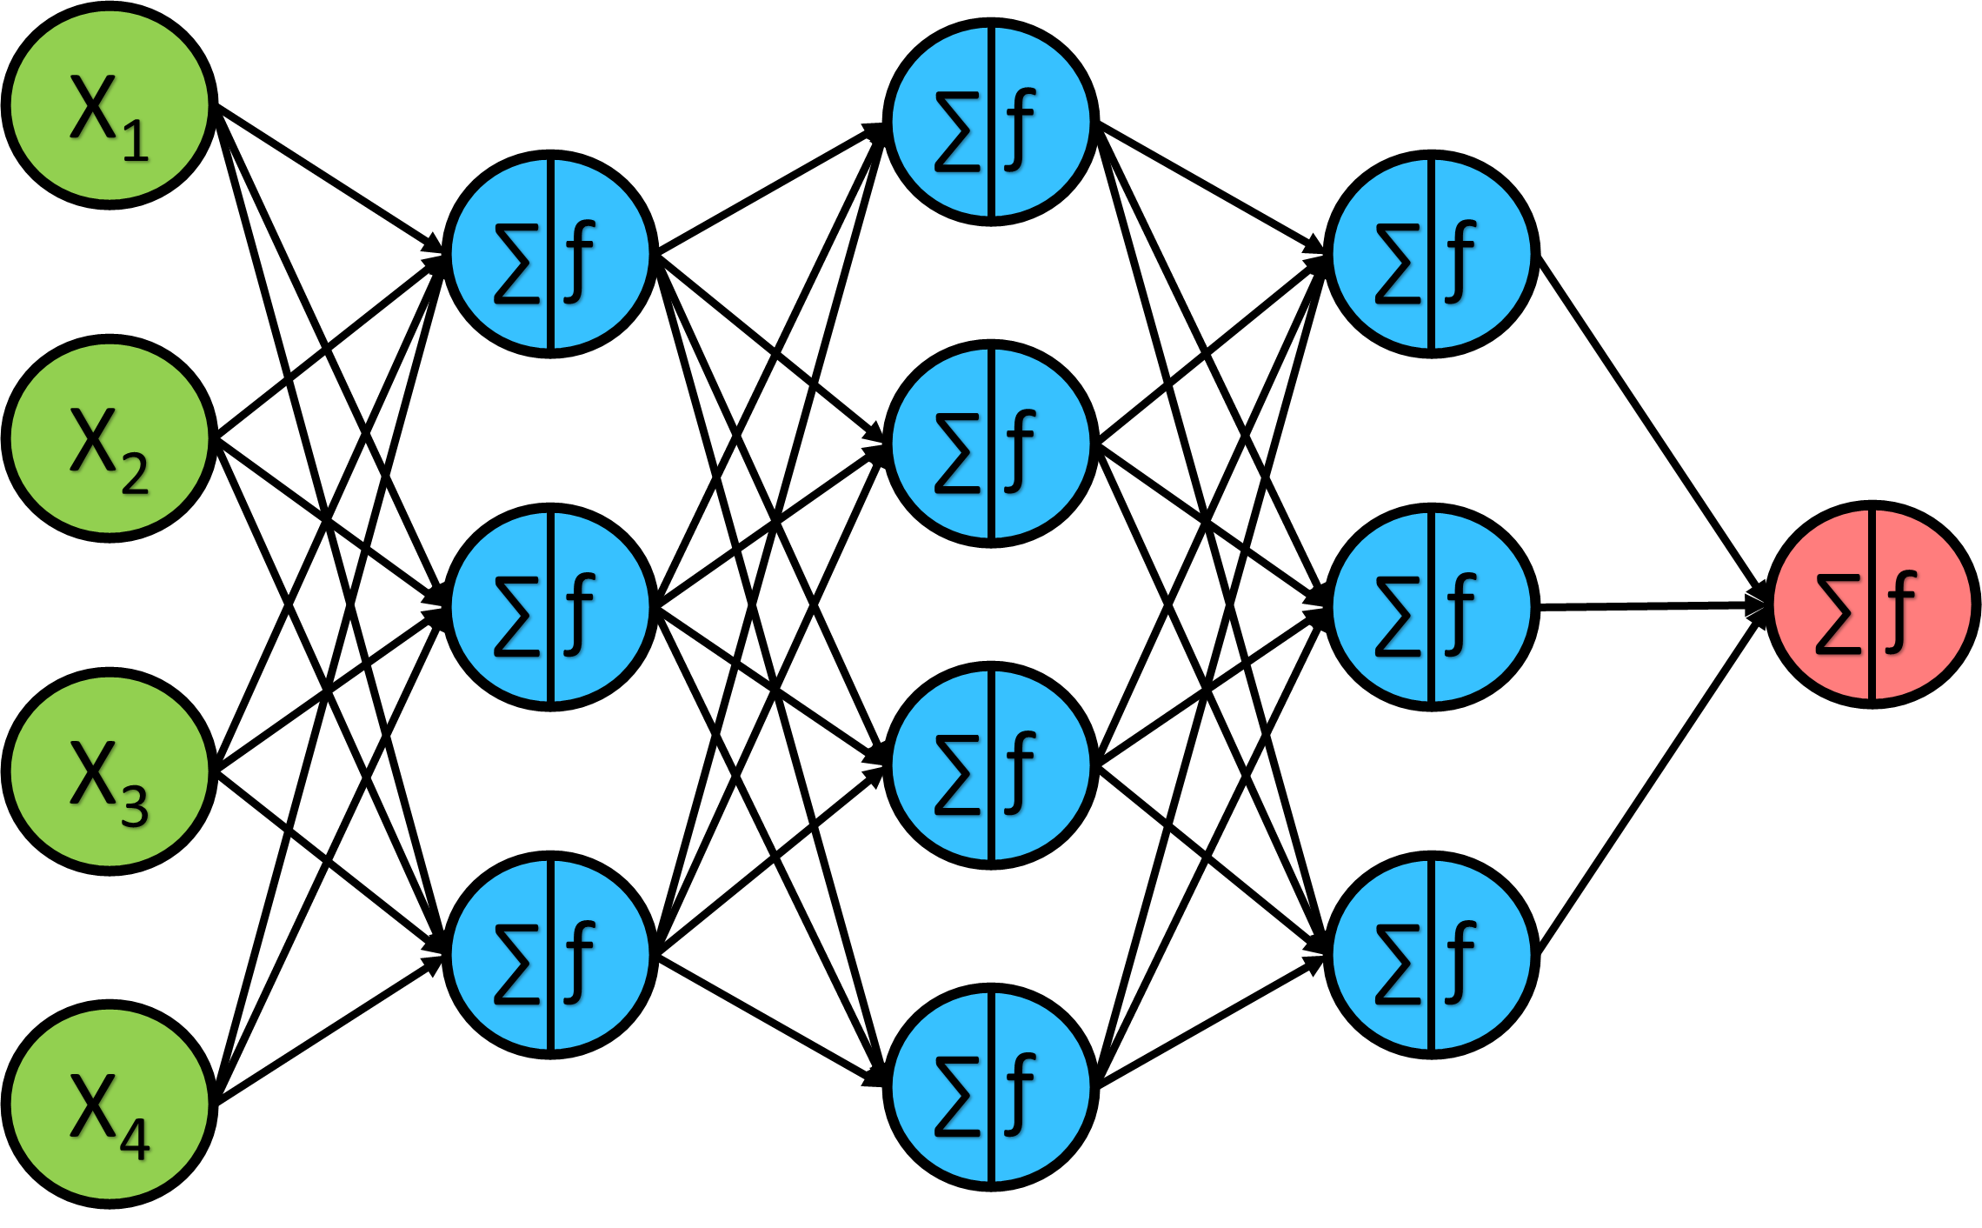
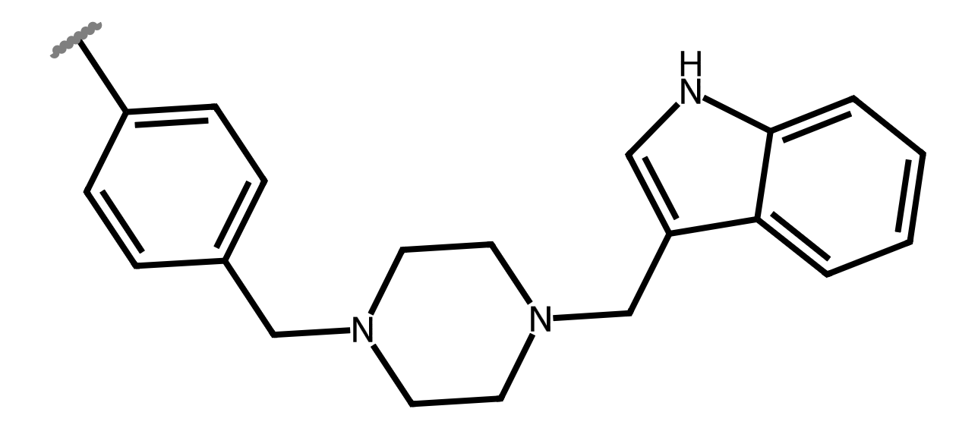

Selectivity datasets
Molecular representations
Explainable artificial intelligence
SHAP
MolAnchor
ChemAgent
ML models
Counterfactuals
MolCE
$${\text{δ}}_{ }^{contr}$$
MCP

Slide 2

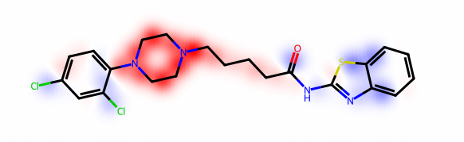

Datasets
Molecular representations
Explainable artificial intelligence
SHAP
MolAnchor
Counterfactuals
MolCE
ML models
$${\text{δ}}_{ }^{contr}$$
EdgeSHAPer
MCP

Slide 3
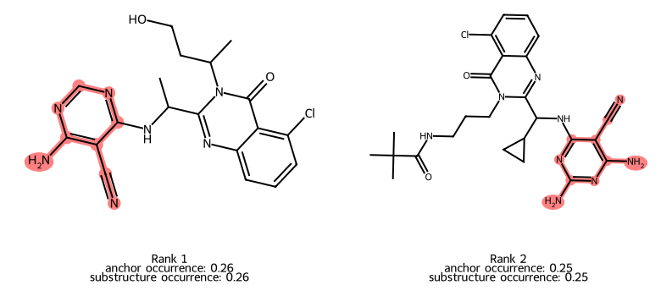
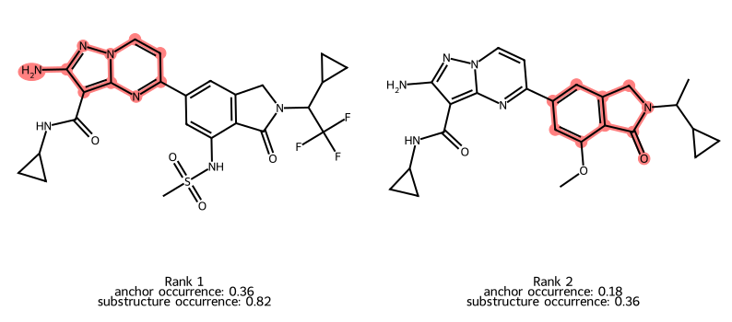
You are running a reproducibility study for compound selectivity prediction. The goal is to train a Balanced Random Forest Classifier to distinguish PI3K-delta (UniProt O00329) vs PI3K-gamma (UniProt P48736) selective compounds, evaluate its performance, and identify recurrent molecular anchor fragments that drive the model's correct predictions for each selective class (class 1 & 2) and discuss the chemical insight gained.
Class 1 (PI3K-delta Selective):
The model identifies cyano-pyrimidine derivatives as key anchors.
Top Fragment: [*]c1ncnc(N)c1C#N (2-amino-4-cyanopyrimidine core)
Class 1 (gamma Selective):
The model identifies purine and tetrahydroisoquinoline-3-one cores as key anchors.
Top Fragments:
[*]c1ccn2nc(N)c([*])c2n1 (Purine-like core)
[*]N1Cc2cc([*])cc([*])c2C1=O (Tetrahydroisoquinoline-3-one derivative)
Insight: This motif is highly characteristic of PI3K-delta selective inhibitors. The presence of the cyano group (-CN) at the 4-position and an amino group (-NH2) at the 2-position of the pyrimidine ring appears to be a critical pharmacophore for delta selectivity. This aligns with known medicinal chemistry strategies where pyrimidine cores are tuned for PI3K-delta by exploiting specific sub-pocket interactions in the ATP-binding site.
Insight: The identification of tetrahydroisoquinoline-3-one scaffolds is particularly interesting. These structures are often found in PI3K-gamma selective inhibitors (e.g., IPI-549 analogues). The purine core also suggests a common heterocyclic motif adapted for gamma selectivity, possibly through extended interactions with the hinge region.

Slide 4
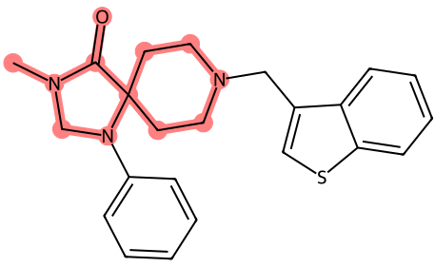
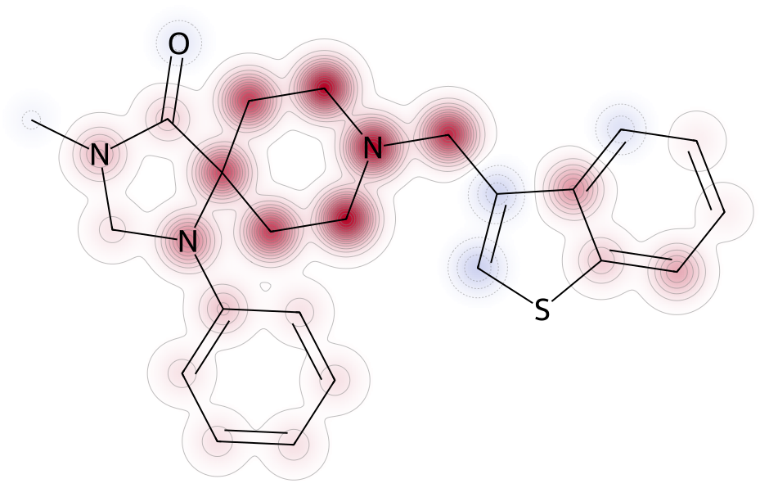
You are running an explainability benchmarking study for compound bioactivity prediction. The goal is to train a Deep Neural Network to distinguish compounds active against the D(2) dopamine receptor (UniProt P14416) from inactive compounds, evaluate its performance, and then directly compare two pairs of explainability methods on the same on the same correctly predicted active compound: Molanchor vs SHAP and MolCE vs Counterfactuals. Summarize where the methods agree on the structural determinants of the predictions and where they disagree.
Agreement: Both methods converge on the morpholine-like ring as the critical pharmacophore. MolAnchor identifies the ring as a cohesive unit, while SHAP confirms that the atoms comprising this ring are indeed the most influential.
Disagreement: MolAnchor focuses strictly on the highest-precision fragment, potentially downplaying the contribution of the aromatic substituents (benzyl/thiophene) that SHAP would assign non-zero values to. MolAnchor is more "binary" (is this fragment present?), while SHAP is more "continuous" (how much does each atom contribute?).

Slide 5
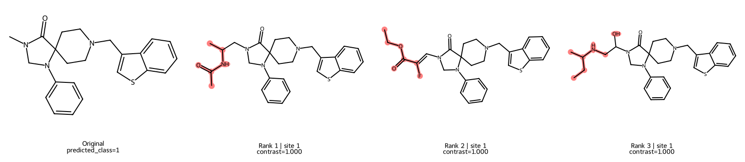
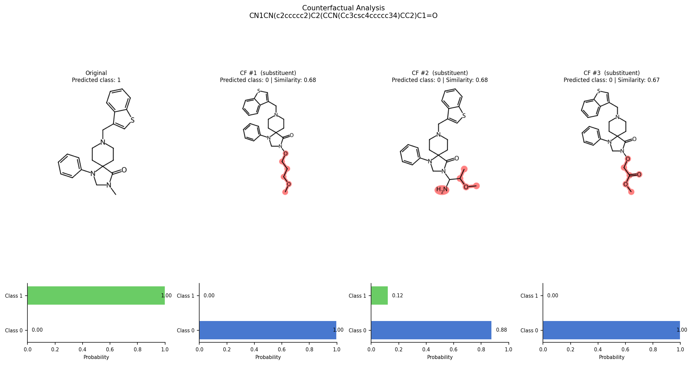
You are running an explainability benchmarking study for compound bioactivity prediction. The goal is to train a Deep Neural Network to distinguish compounds active against the D(2) dopamine receptor (UniProt P14416) from inactive compounds, evaluate its performance, and then directly compare two pairs of explainability methods on the same on the same correctly predicted active compound: Molanchor vs SHAP and MolCE vs Counterfactuals. Summarize where the methods agree on the structural determinants of the predictions and where they disagree.
Rank 1 | Site 1
Contrast=1.000
CF #1 (substituent)
Predicted class: 0 | Similarity: 0.68
CF #2 (substituent)
Predicted class: 0 | Similarity: 0.68
Rank 2 | Site 1
Contrast=1.000
Agreement: Both methods highlight that modifications to the R-groups attached to the morpholine ring are the most sensitive levers for changing bioactivity.
Disagreement: MolCE provides a theoretical contrastive feature (a specific R-group that is "anti-activating"). Counterfactuals provides concrete examples of inactive molecules. MolCE might suggest an R-group not present in the immediate neighborhood of the query, whereas Counterfactuals are constrained by the available library of R-groups for substitution.

Slide 6
Class PI3K-delta
Class PI3K-gamma
The model identifies cyano-pyrimidine derivatives as key anchors.
Top Fragment: [*]c1ncnc(N)c1C#N (2-amino-4-cyanopyrimidine core)
Insight: This motif is highly characteristic of PI3K-delta selective inhibitors. The presence of the cyano group (-CN) at the 4-position and an amino group (-NH2) at the 2-position of the pyrimidine ring appears to be a critical pharmacophore for delta selectivity. This aligns with known medicinal chemistry strategies where pyrimidine cores are tuned for PI3K-delta by exploiting specific sub-pocket interactions in the ATP-binding site.
The model identifies purine and tetrahydroisoquinoline-3-one cores as key anchors.
Top Fragments:
[*]c1ccn2nc(N)c([*])c2n1 (Purine-like core)
[*]N1Cc2cc([*])cc([*])c2C1=O (Tetrahydroisoquinoline-3-one derivative)
Insight: The identification of tetrahydroisoquinoline-3-one scaffolds is particularly interesting. These structures are often found in PI3K-gamma selective inhibitors (e.g., IPI-549 analogues). The purine core also suggests a common heterocyclic motif adapted for gamma selectivity, possibly through extended interactions with the hinge region.

Slide 7
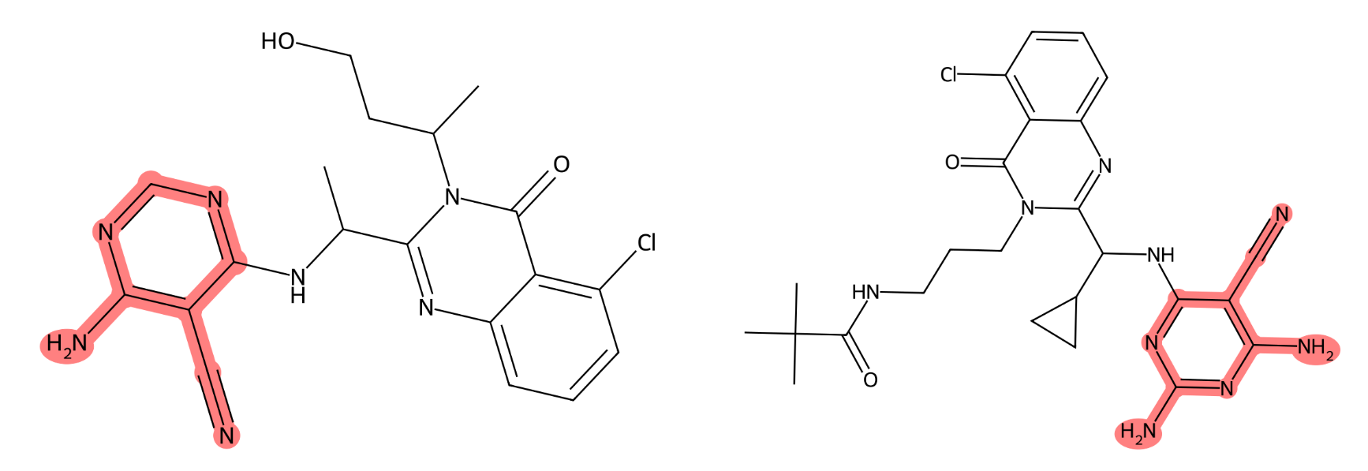
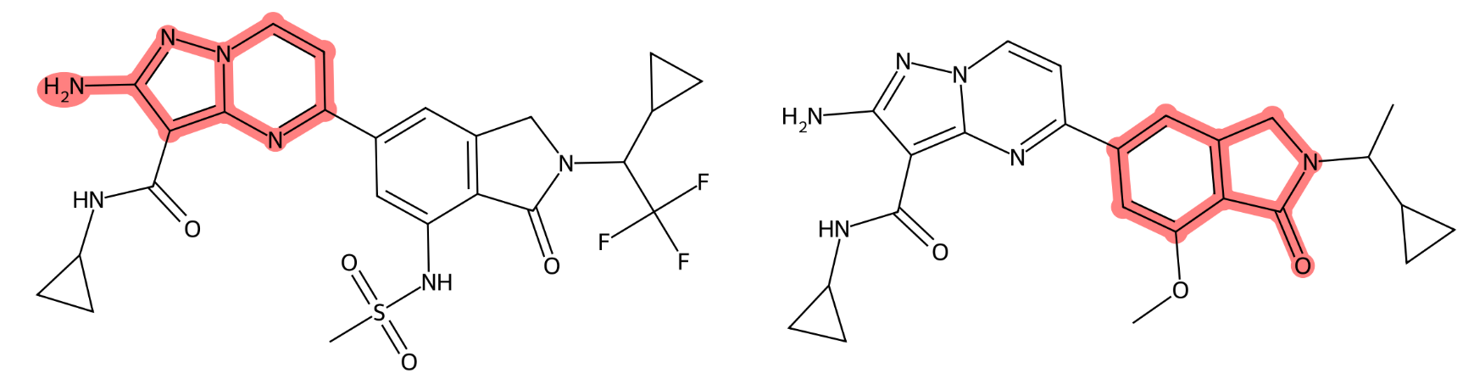
Class PI3K-delta
Class PI3K-gamma
Rank 1
Anchor occurrence: 0.26
Substructure occurrence: 0.26
Rank 2
Anchor occurrence: 0.25
Substructure occurrence: 0.25
Rank 1
Anchor occurrence: 0.36
Substructure occurrence: 0.82
Rank 2
Anchor occurrence: 0.18
Substructure occurrence: 0.36
[*]c1ncnc(N)c1C#N: Occurs in 26.4% of correctly predicted Class 1 compounds. This cyano-substituted pyrimidine motif is a classic kinase hinge-binder.
[*]c1nc(N)nc(N)c1C#N: Occurs in 25.0% of cases. A diamino-cyano pyrimidine derivative, strongly indicating hydrogen-bonding interactions with the hinge region.
[*]c1ccn2nc(N)c([*])c2n1: Occurs in 36.4% of anchors. A substituted isoquinoline/pyrazolo-pyridine core, highly characteristic of PI3K-gamma selective inhibitors.
[*]N1Cc2cc([*])cc([*])c2C1=O: Dihydroisoquinolinone derivatives, frequently appearing in gamma-selective chemotypes.

Slide 8
Rank 1
Anchor occurrence: 0.26
Substructure occurrence: 0.26
Rank 2
Anchor occurrence: 0.25
Substructure occurrence: 0.25
Rank 1
Anchor occurrence: 0.36
Substructure occurrence: 0.82
Rank 2
Anchor occurrence: 0.18
Substructure occurrence: 0.36
Chemical Insights & Discussion
Distinct Chemotypes for Selectivity: The recurrent anchors clearly separate the two selective classes. Class 1 (delta) is driven by cyano-pyrimidine hinge binders, while Class 2 (gamma) is driven by isoquinoline/dihydroisoquinolinone scaffolds. This aligns with known structure-activity relationships (SAR) in PI3K inhibitor design.
Hinge Region Mimicry: The high anchor occurrence of cyano-pyrimidines in Class 1 confirms the model has learned the canonical hydrogen-bonding motif required for PI3K catalytic domain binding.
Scaffold-Driven Selectivity: The dominance of bicyclic nitrogenous cores (isoquinolines) in Class 2 suggests that PI3K-gamma selectivity is heavily scaffold-dependent, likely due to subtle differences in the gatekeeper residue or allosteric pocket topology compared to PI3K-delta.

Slide 9
MolAnchor
SHAP
Comparing XAI methods
Agreement: Both methods converge on the morpholine-like ring as the critical pharmacophore. MolAnchor identifies the ring as a cohesive unit, while SHAP confirms that the atoms comprising this ring are indeed the most influential.
Disagreement: MolAnchor focuses strictly on the highest-precision fragment, potentially downplaying the contribution of the aromatic substituents (benzyl/thiophene) that SHAP would assign non-zero values to. MolAnchor is more "binary" (is this fragment present?), while SHAP is more "continuous" (how much does each atom contribute?).
Morpholine-like ring as the critical pharmacophore
MolAnchor - focus on the highest-precision fragment
SHAP – focus on atom contribution

Slide 10
Counterfactuals
MolCE
Comparing XAI methods
Agreement: Both methods highlight that modifications to the R-groups attached to the morpholine ring are the most sensitive levers for changing bioactivity.
Disagreement: MolCE provides a theoretical contrastive feature (a specific R-group that is "anti-activating"). Counterfactuals provides concrete examples of inactive molecules. MolCE might suggest an R-group not present in the immediate neighborhood of the query, whereas Counterfactuals are constrained by the available library of R-groups for substitution.
R-groups attached to the morpholine ring
MolCE - R-group that is “anti-activating”
Counterfactuals - concrete examples of inactive molecules

