Slide 1
AI Agent for Chemical Explainability
Department of Life Science Informatics, B-IT
Lamarr Institute for Machine Learning and Artificial Intelligence
LIMES Institute Program Unit Medicinal Chemistry
Rheinische Friedrich-Wilhelms-Universität Bonn

Slide 2
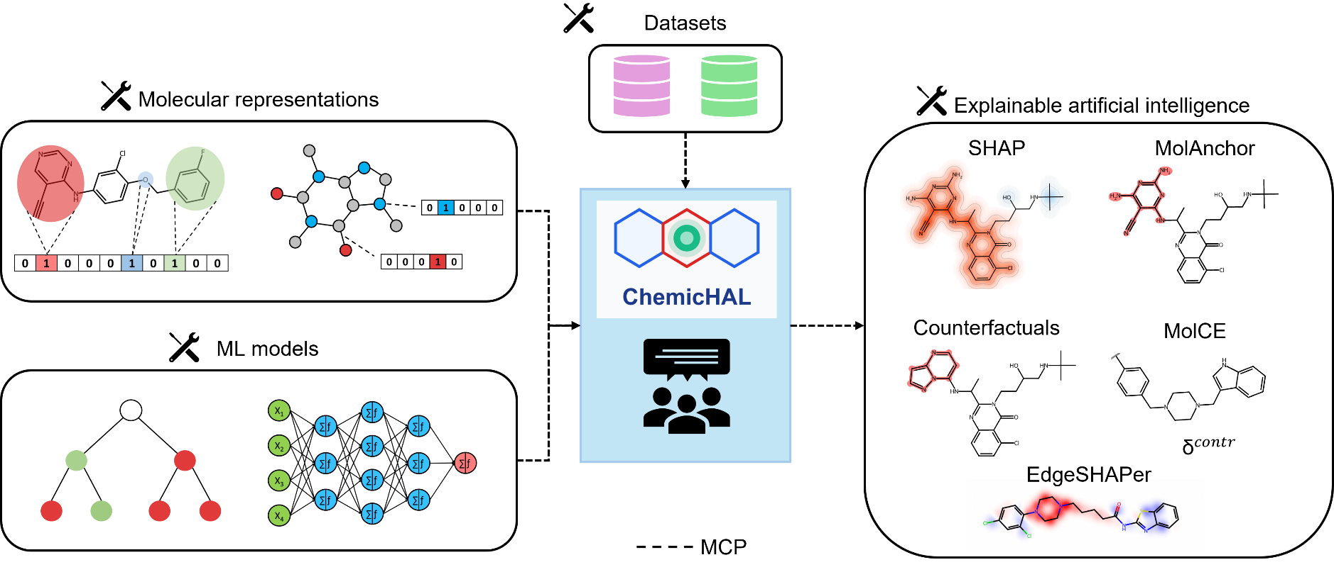
Project description
Aim: Design an agentic AI framework for interpretable AI applied to QSAR tasks

Slide 3
Project goals
Goal: Showcase the utility of Agentic AI combined with XAI
Provide access to interpretable AI for non-coding chemists
Highlight where using agentic AI can be an advantage over running analysis manually

Slide 4
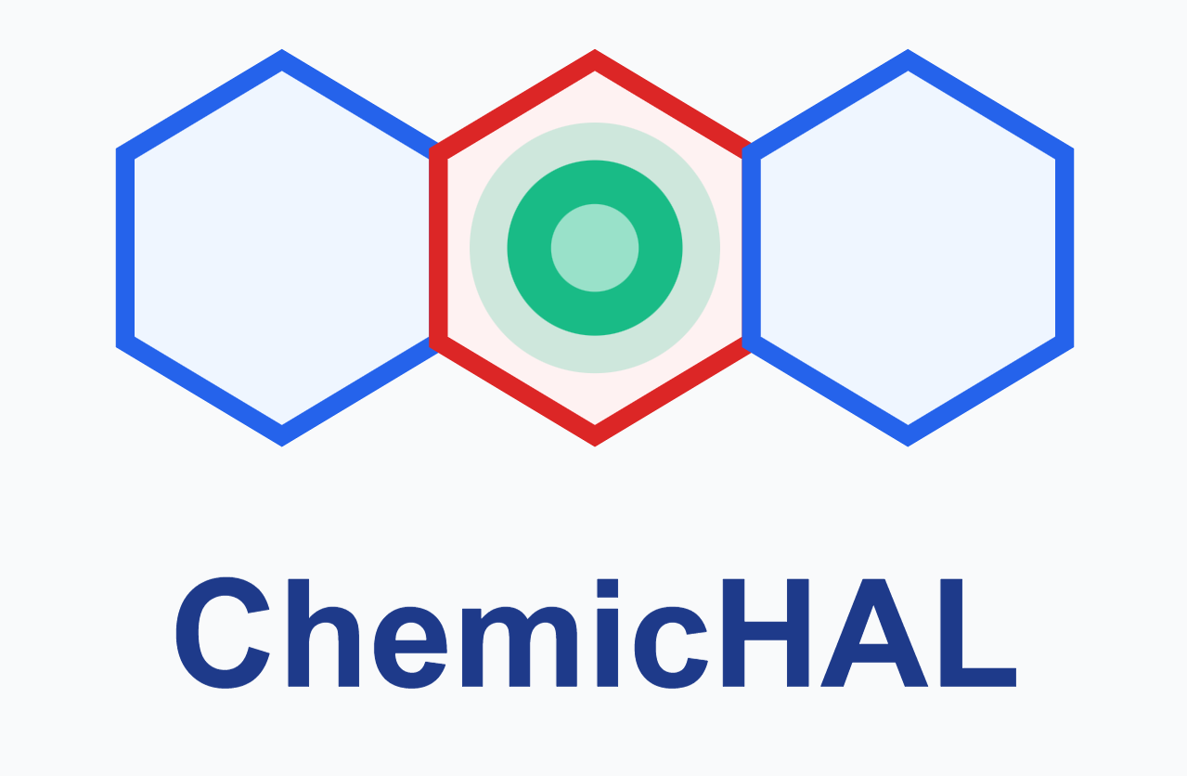

Project setup
Framework
LM Studio + Open Source LLM (Qwen 3.6)
ML models
Traditional ML – RF, BRF, SVM
Deep learning – DNN, GNN (GCN, GAT etc.)
Datasets
Binary bioactivity classification
Multiclass selectivity prediction
Splitting strategies
Random
Scaffold
Explainability methods
SHAP (EdgeSHAPer)
MolAnchor
Contrastive (Counterfactuals, MolCE)

Slide 5
Prompt 1
Goal: Showcase that the AI agent is able to use tools correctly to reproduce known results
Can the agent derive verifiable, correct chemical insight from model explanations?
You are running a reproducibility study for compound selectivity prediction. The goal is to train a Balanced Random Forest Classifier to distinguish PI3K-delta (UniProt O00329) vs PI3K-gamma (UniProt P48736) selective compounds, evaluate its performance, and identify recurrent molecular anchor fragments that drive the model's correct predictions for each selective class (class 1 & 2) and discuss the chemical insight gained.

Slide 6
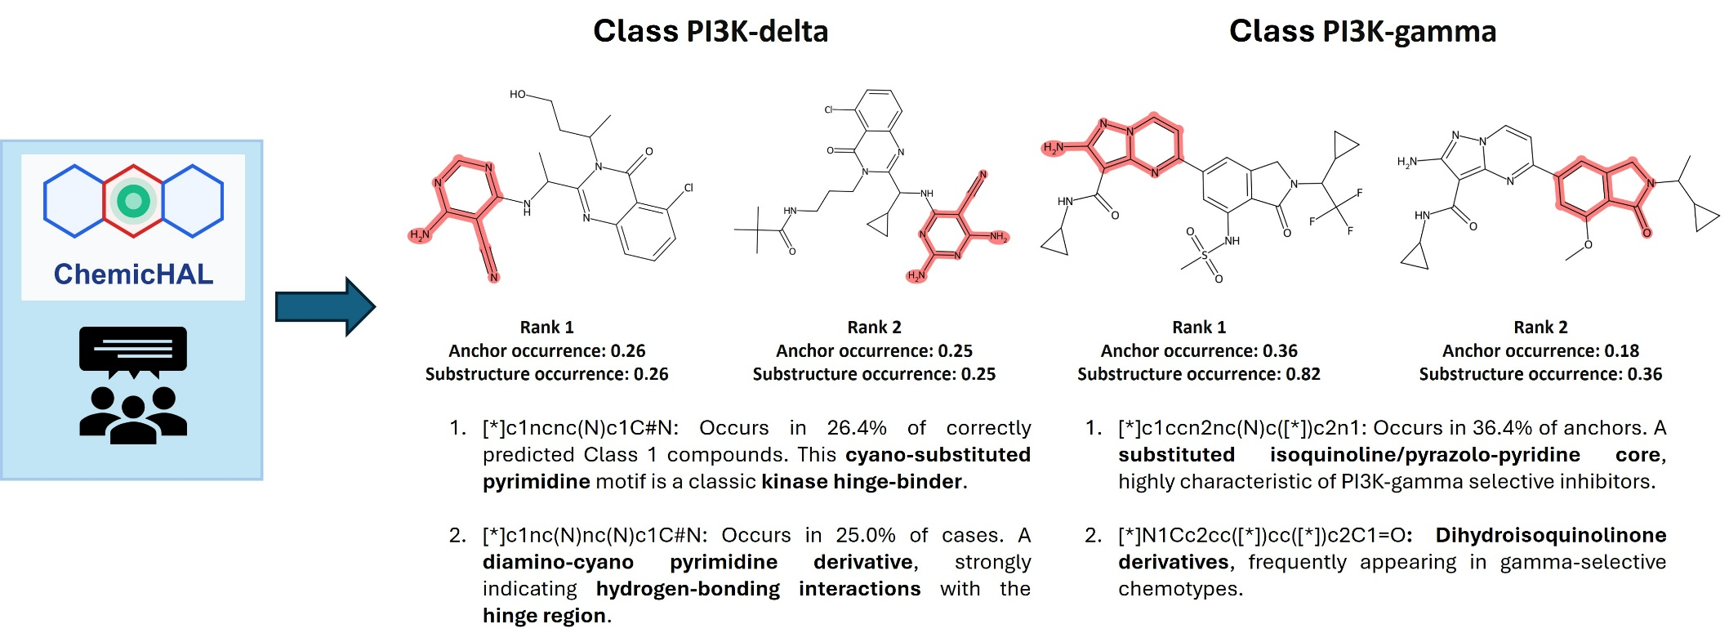
Prompt 1
Anchors of the original paper were reproduced
Chemical nomenclature is correct

Slide 7
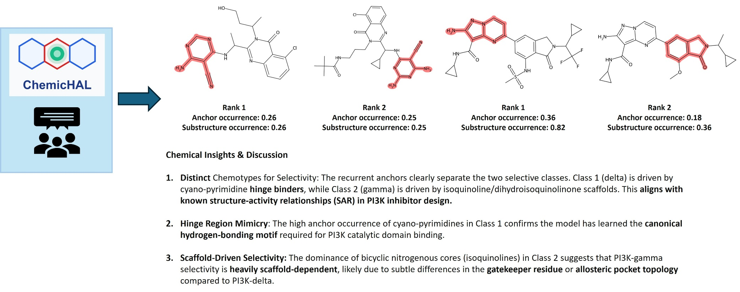
Prompt 1
Hinge-region binding, hydrogen-bond networks and allosteric pockets are rightfully mentioned

Slide 8
Prompt 2
Goal: Demonstrate the ability of the agent to provide chemically intuitive explanations for model predictions
Can the agent correctly interpret and compare explanations derived from different XAI methods?
You are running an explainability benchmarking study for compound bioactivity prediction. The goal is to train a Deep Neural Network to distinguish compounds active against the D(2) dopamine receptor (UniProt P14416) from inactive compounds, evaluate its performance, and then directly compare two pairs of explainability methods on the same on the same correctly predicted active compound: Molanchor vs SHAP and MolCE vs Counterfactuals. Summarize where the methods agree on the structural determinants of the predictions and where they disagree.

Slide 9
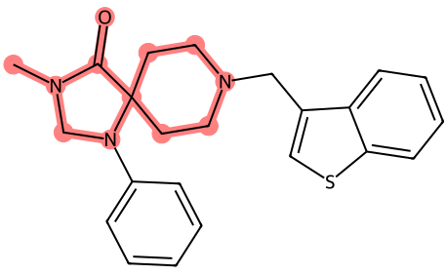
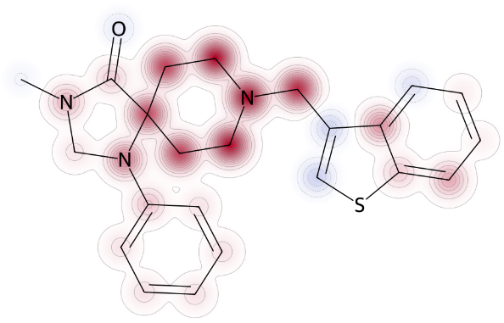
Prompt 2
MolAnchor
SHAP
Comparing XAI methods
Agreement: Both methods converge on the morpholine-like ring as the critical pharmacophore. MolAnchor identifies the ring as a cohesive unit, while SHAP confirms that the atoms comprising this ring are indeed the most influential.
Disagreement: MolAnchor focuses strictly on the highest-precision fragment, potentially downplaying the contribution of the aromatic substituents (benzyl/thiophene) that SHAP would assign non-zero values to. MolAnchor is more "binary" (is this fragment present?), while SHAP is more "continuous" (how much does each atom contribute?).
Morpholine-like ring as the critical pharmacophore
MolAnchor - focus on the highest-precision fragment
SHAP – focus on atom contribution

Slide 10
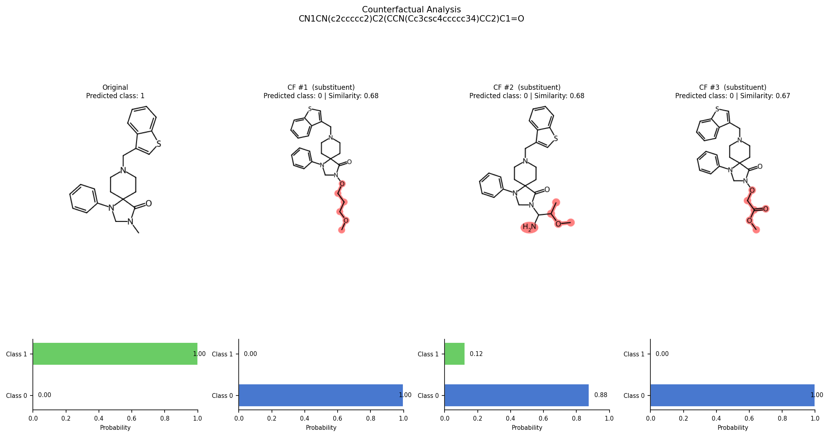
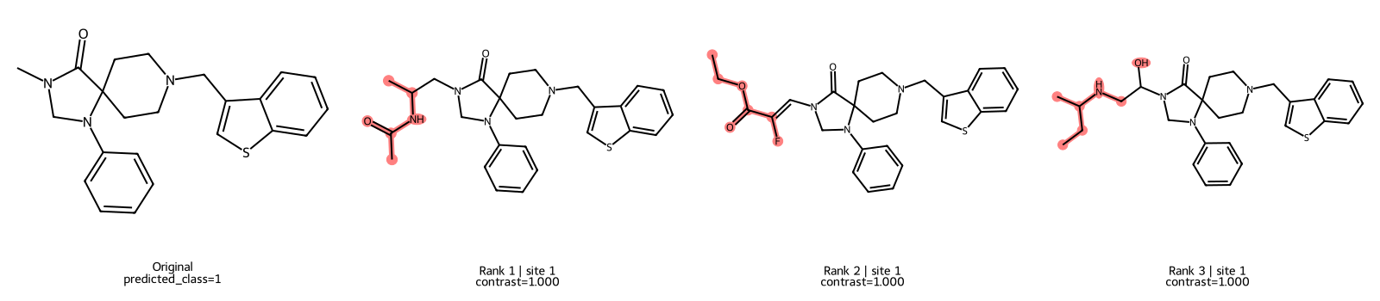
Prompt 2
Counterfactuals
MolCE
Comparing XAI methods
Agreement: Both methods highlight that modifications to the R-groups attached to the morpholine ring are the most sensitive levers for changing bioactivity.
Disagreement: MolCE provides a theoretical contrastive feature (a specific R-group that is "anti-activating"). Counterfactuals provides concrete examples of inactive molecules. MolCE might suggest an R-group not present in the immediate neighborhood of the query, whereas Counterfactuals are constrained by the available library of R-groups for substitution.
R-groups attached to the morpholine ring
MolCE - R-group that is “anti-activating”
Counterfactuals - concrete examples of inactive molecules

Slide 11
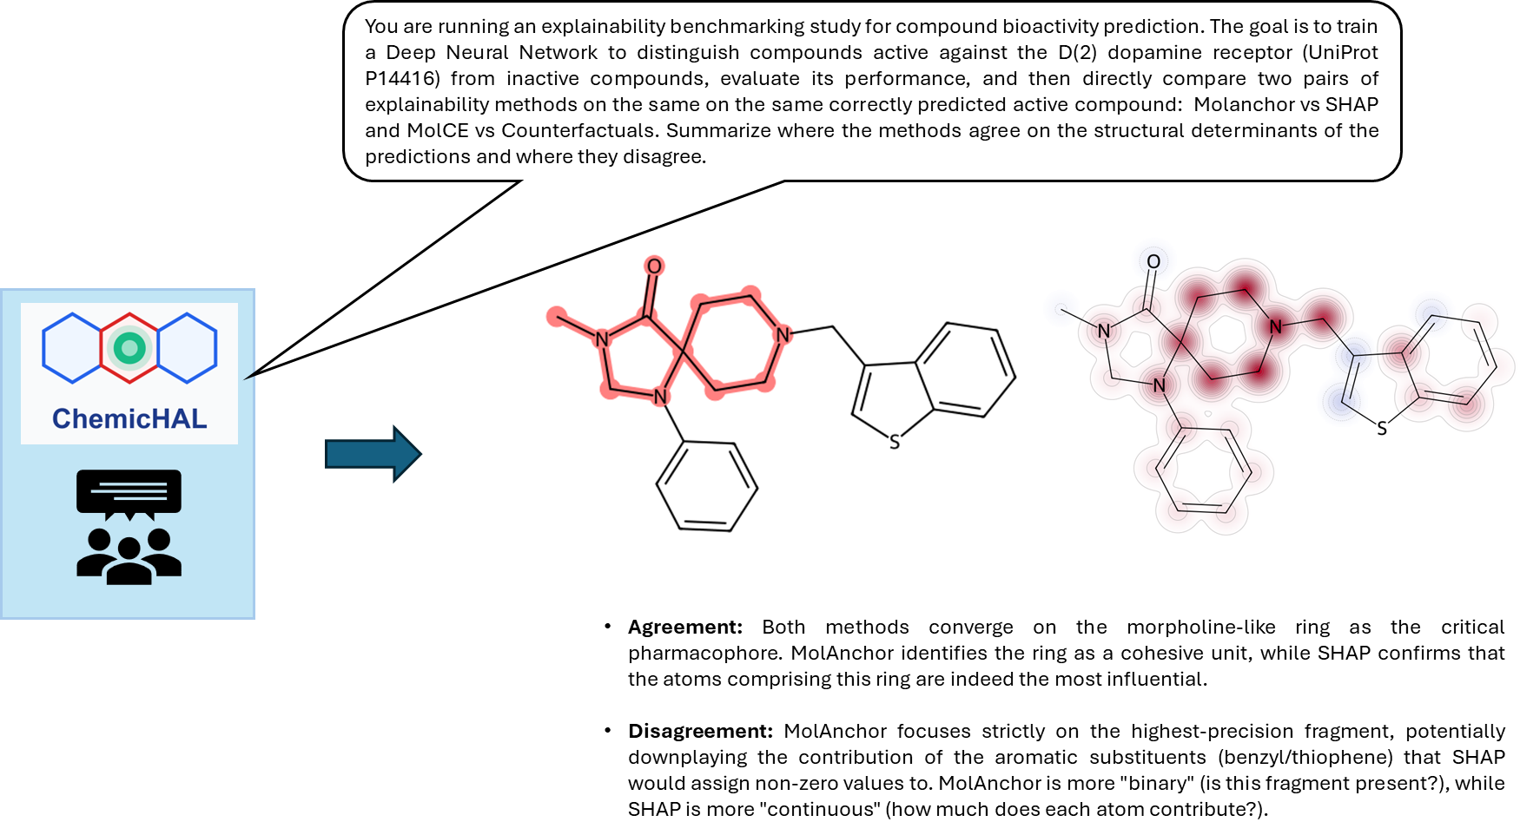
Prompt 2

Slide 12
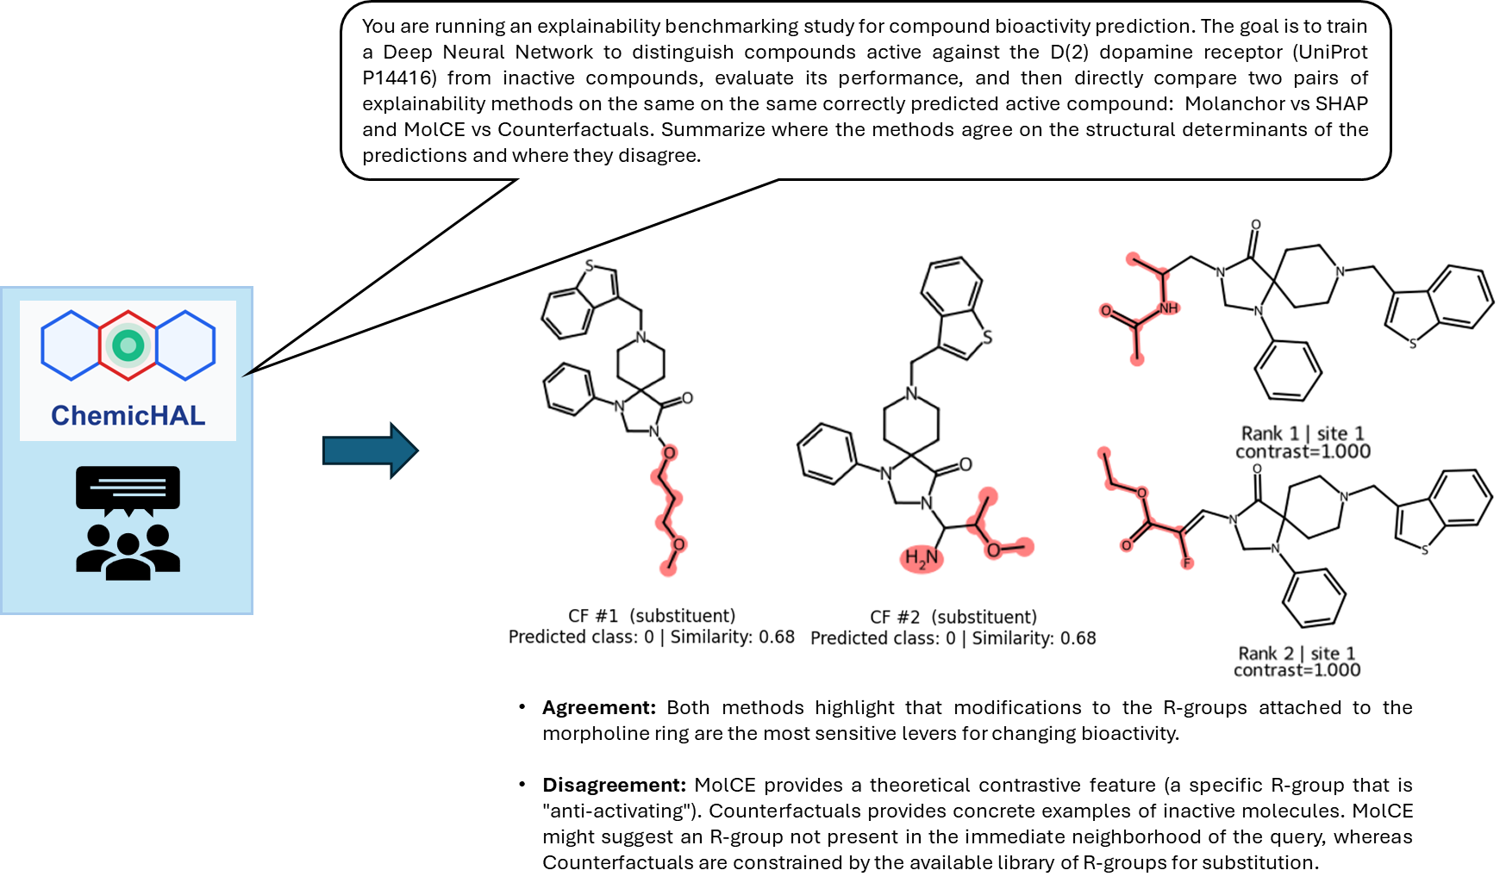
Prompt 2

Slide 13
Prompt 3
# Provided by the best junior research group leader I know

Slide 14
Conclusion
Aim: Design an agentic AI framework for interpretable AI applied to QSAR tasks
The framework allows for the building of interpretable AI without coding experience
ChemicHAL was able to correctly choose tools and reproduce known results
The agent provided chemical interpretation for explanations
Concluded by our Japanese emissary

Slide 15
Future perspective
Make an “organization repository” available for the whole lab to ease the integration of new components
Create a guide for lab members for the implementation of AI agents

Slide 16
Lessons learned
Setup inference on a work-station (hopefully cluster in future)
The quality and choice of LLM matters a lot
Proper design of docstrings and documentation is essential

