Slide 1
AI Agent for ChemicHAL Explainability
Department of Life Science Informatics, B-IT
Lamarr Institute for Machine Learning and Artificial Intelligence
LIMES Institute Program Unit Medicinal Chemistry
Rheinische Friedrich-Wilhelms-Universität Bonn

Slide 2
AI Agents in Chemistry
Large language models (LLMs) offer an attractive solution through conversational interfaces
Accessibility: No coding or cheminformatics expertise required
Integration: Connect literature, databases, and lab tools in one system
Reasoning: Interpret results and adapt in real time
Prompt
LLM
Chemistry tools
Response

Slide 3
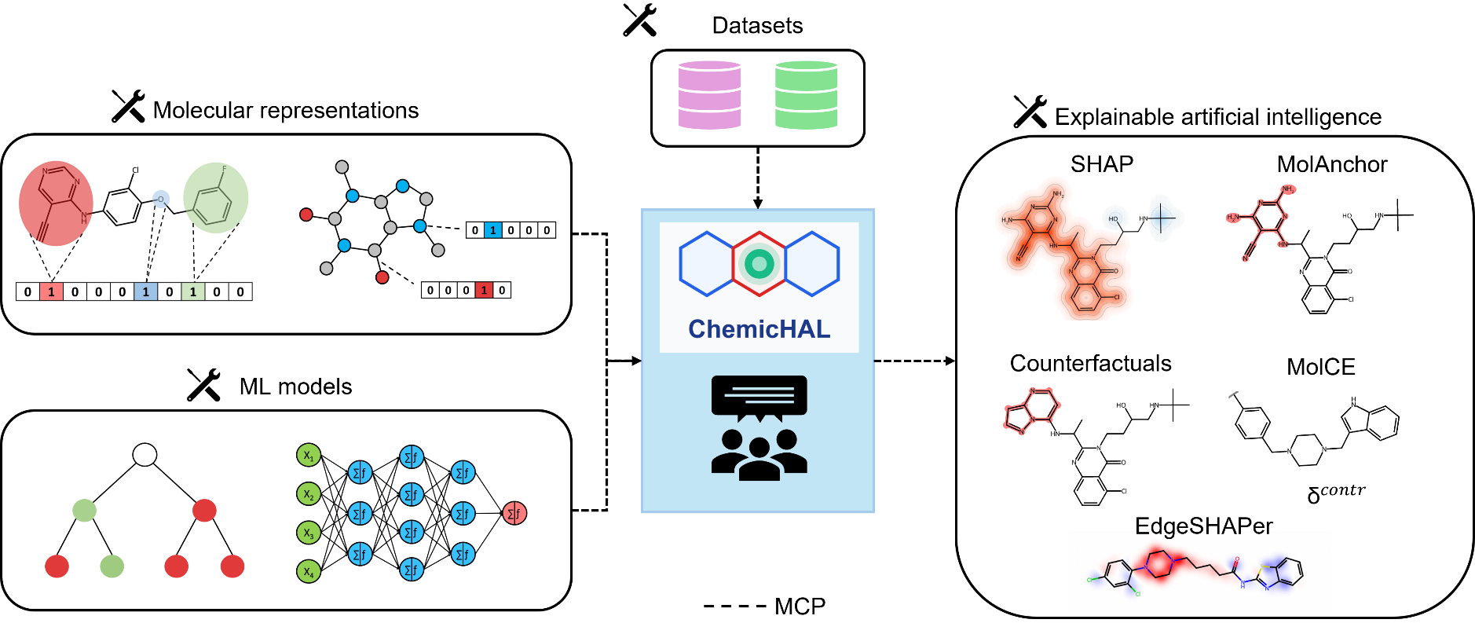
Project description
Aim: Design an agentic AI framework for interpretable AI applied to QSAR tasks

Slide 4
Project goals
Goal: Showcase the utility of Agentic AI combined with XAI
Provide access to interpretable AI for non-coding chemists
Highlight where using agentic AI can be an advantage over running analysis manually

Slide 5
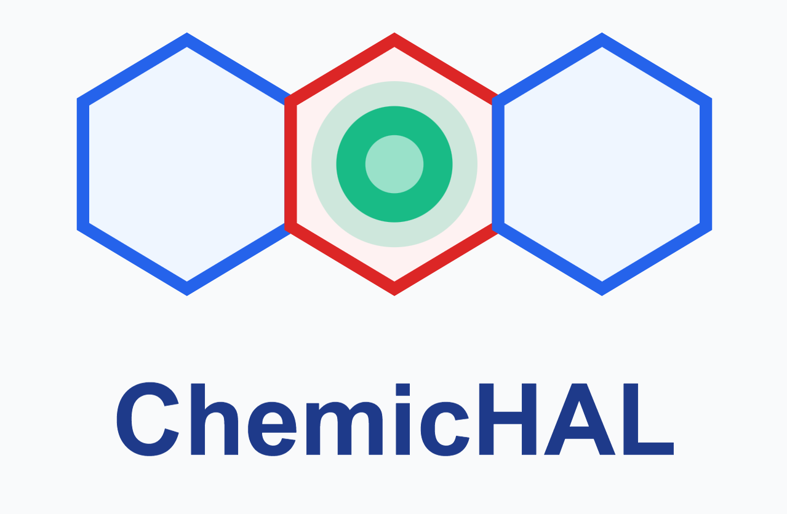

Project setup
Framework
LM Studio + Open Source LLM (Qwen 3.6)
ML models
Traditional ML – RF, BRF, SVM
Deep learning – DNN, GNN (GCN, GAT etc.)
Datasets
Binary bioactivity classification
Multiclass selectivity prediction
Splitting strategies
Random
Scaffold
Explainability methods
SHAP (EdgeSHAPer)
MolAnchor
Contrastive (Counterfactuals, MolCE)

Slide 6
Study objectives
Prompt 1: Showcase that the AI agent is able to use tools to reproduce known results and correctly put them into the chemical context
Prompt 2: Demonstrate the ability of the agent to provide and compare explanations derived from different XAI methods
Prompt 3: Display the capacity of the agent to compare and interpret explanations for different predictions
Prompt 4: Determine whether agent is capable of analyzing and comparing the learning characteristics of distinct ML-models

Slide 7
Prompt 1
Goal: Showcase that the AI agent is able to use tools to reproduce known results and correctly put them into the chemical context
Can the reproduce the Anchor PI3K-study and provide correct chemical insight from model explanations?
You are running a reproducibility study for compound selectivity prediction. The goal is to train a Balanced Random Forest Classifier to distinguish PI3K-delta (UniProt O00329) vs PI3K-gamma (UniProt P48736) selective compounds, evaluate its performance, and identify recurrent molecular anchor fragments that drive the model's correct predictions for each selective class (class 1 & 2) and discuss the chemical insight gained.

Slide 8

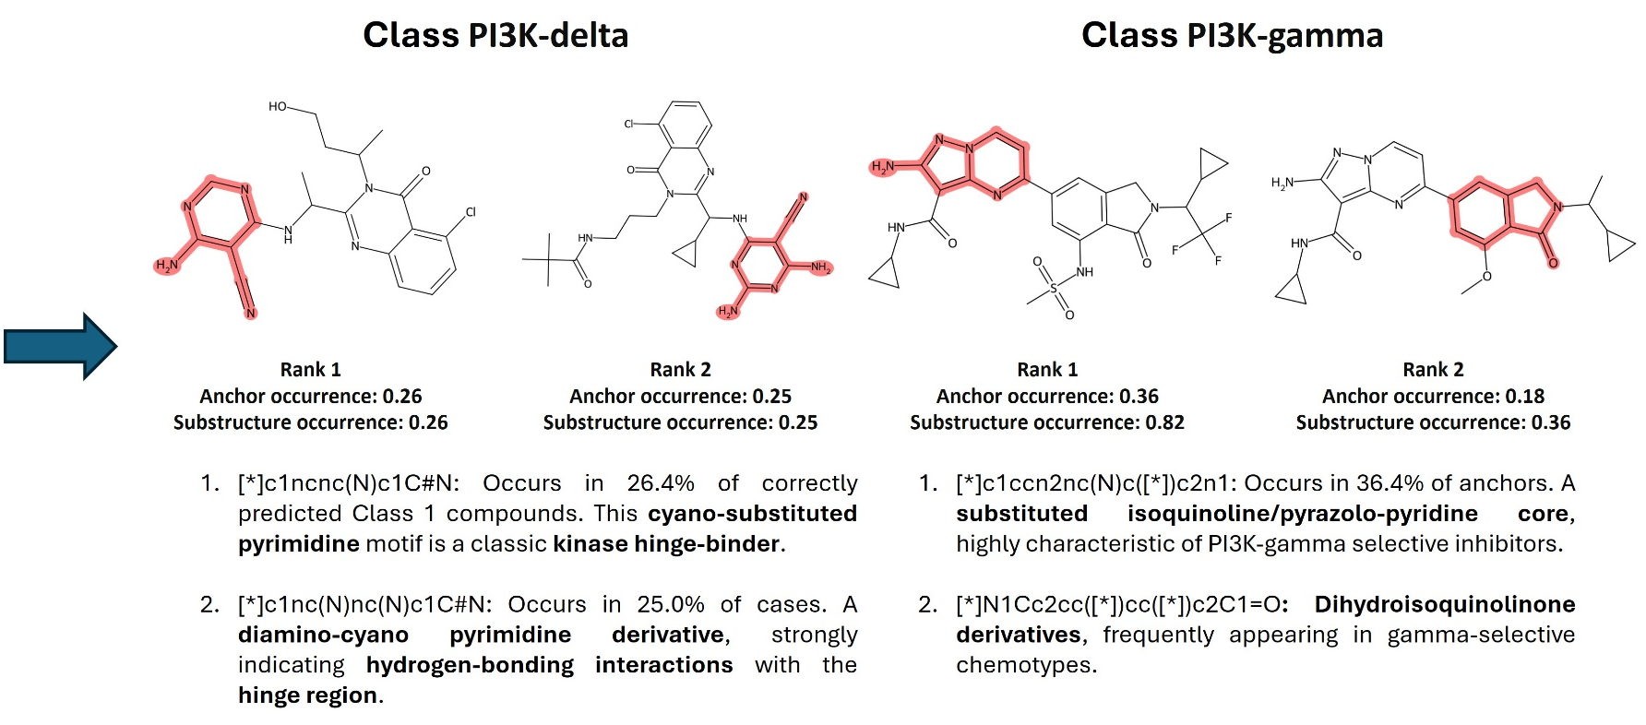
Prompt 1
Anchors of the original paper were reproduced
Chemical nomenclature is (mostly) correct

Slide 9
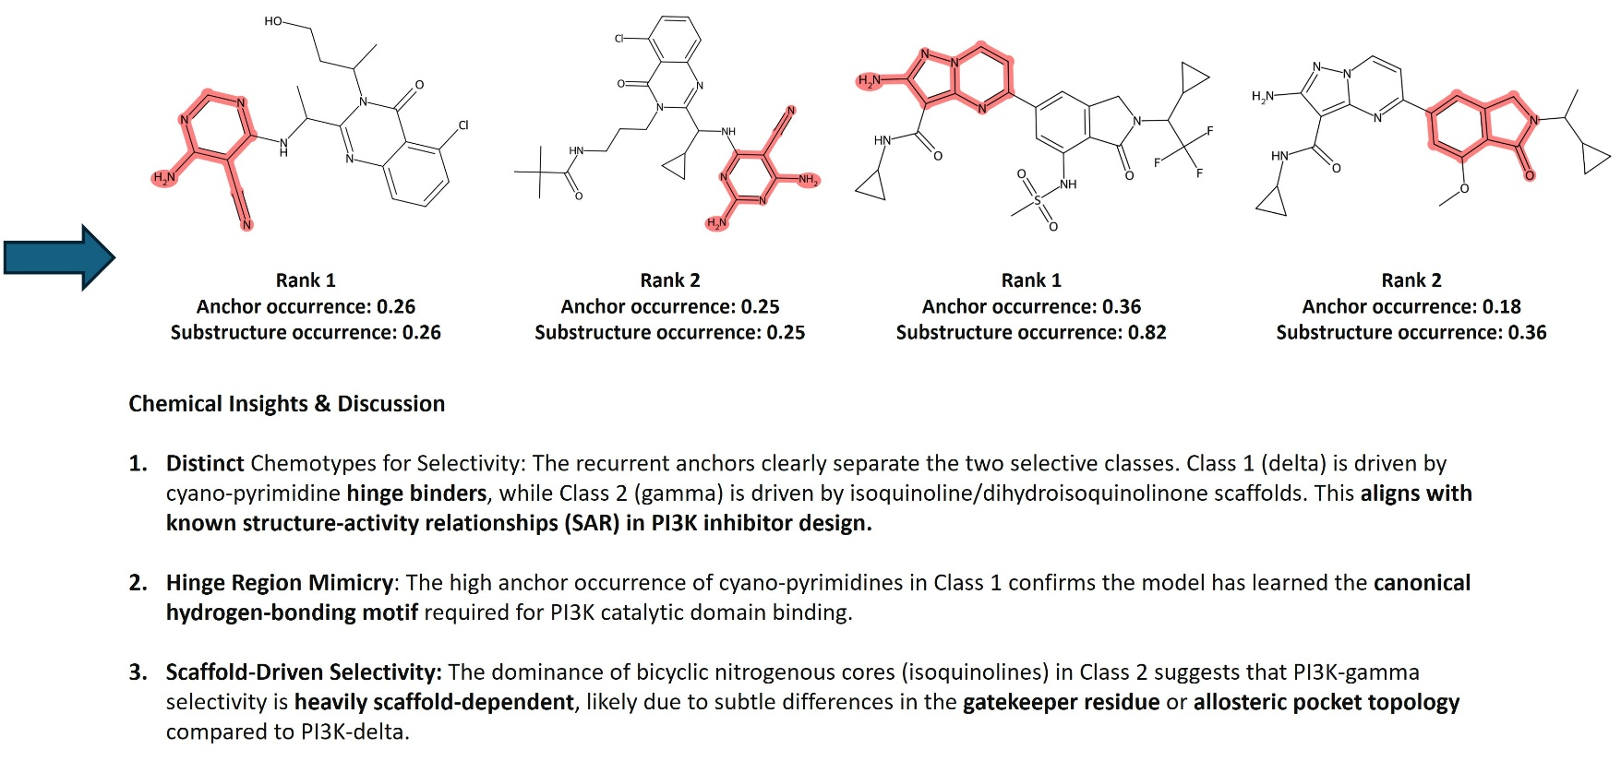
Prompt 1
Hinge-region binding, hydrogen-bond networks and allosteric pockets are rightfully mentioned

Slide 10
Prompt 2
Goal: Demonstrate the ability of the agent to provide and compare explanations derived from different XAI methods
Can the agent correctly interpret and compare explanations:
MolAnchor vs SHAP
MolCE vs Counterfactuals
You are running an explainability benchmarking study for compound bioactivity prediction. The goal is to train a Deep Neural Network to distinguish compounds active against the D(2) dopamine receptor (UniProt P14416) from inactive compounds, evaluate its performance, and then directly compare two pairs of explainability methods on the same on the same correctly predicted active compound: Molanchor vs SHAP and MolCE vs Counterfactuals. Summarize where the methods agree on the structural determinants of the predictions and where they disagree.

Slide 11

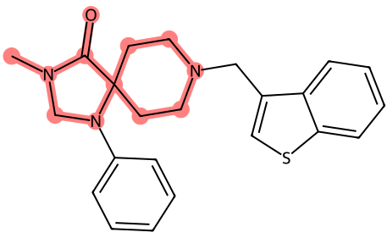
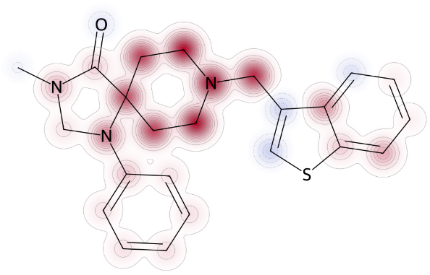
Prompt 2
Identifies morpholine-like ring structure as pharmacophore
Correctly describes utility of MolAnchor vs SHAP
MolAnchor
SHAP
Comparing XAI methods
Agreement: Both methods converge on the morpholine-like ring as the critical pharmacophore. MolAnchor identifies the ring as a cohesive unit, while SHAP confirms that the atoms comprising this ring are indeed the most influential.
Disagreement: MolAnchor focuses strictly on the highest-precision fragment, potentially downplaying the contribution of the aromatic substituents (benzyl/thiophene) that SHAP would assign non-zero values to. MolAnchor is more "binary" (is this fragment present?), while SHAP is more "continuous" (how much does each atom contribute?).

Slide 12
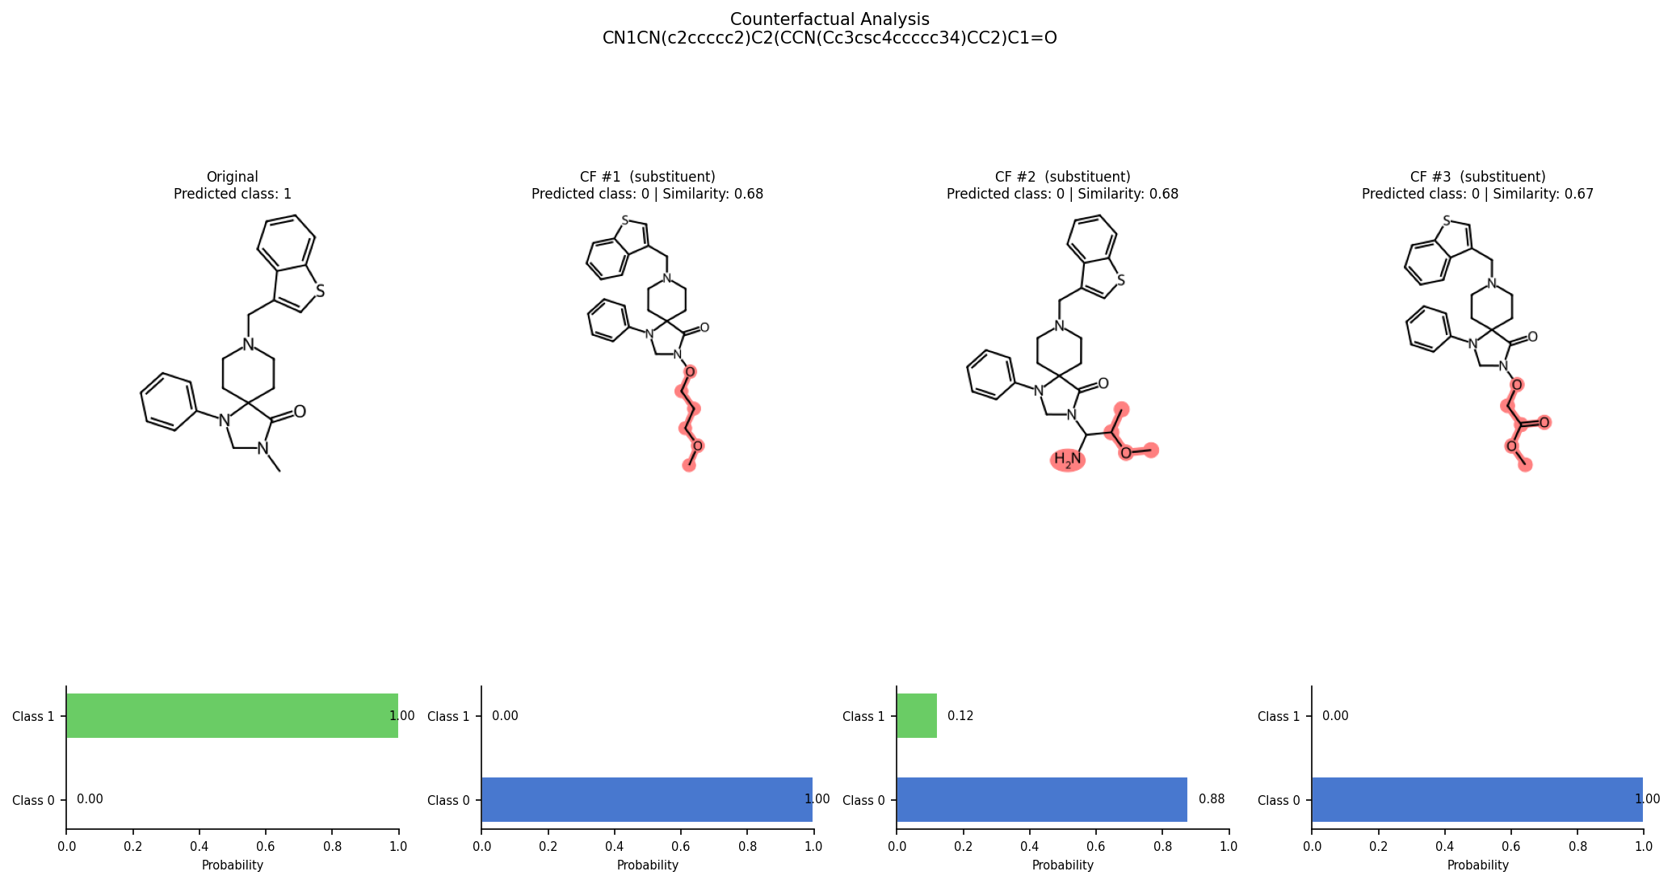
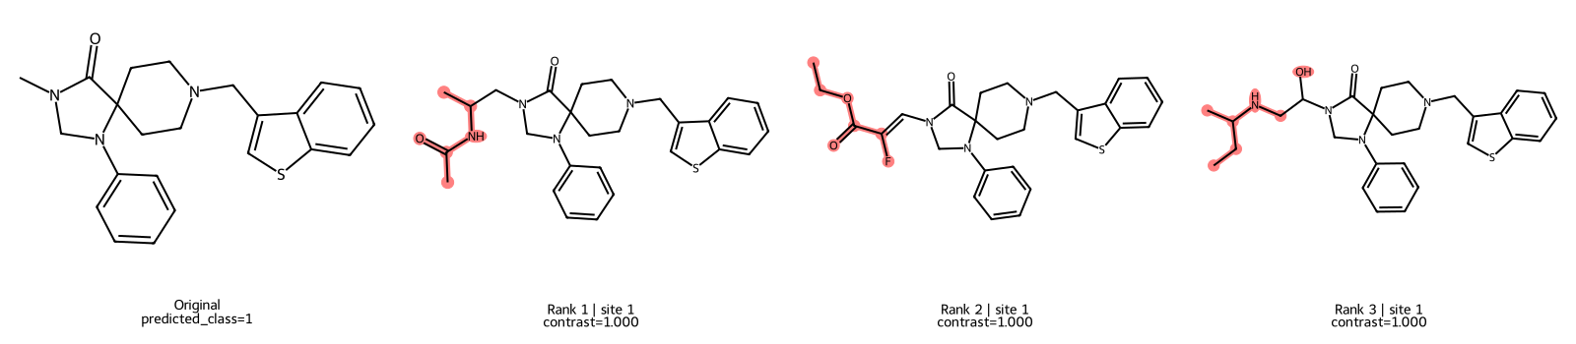
Prompt 2
Morpholine ring are the most sensitive levers for bioactivity
Correctly describes utility of MolCE vs Counterfactuals
Counterfactuals
MolCE
Rank 1 | Site 1
Contrast=1.000
Rank 2 | Site 1
Contrast=1.000
CF #1 (substituent)
Predicted class: 0 | Similarity: 0.68
CF #2 (substituent)
Predicted class: 0 | Similarity: 0.68
Agreement: Both methods highlight that modifications to the R-groups attached to the morpholine ring are the most sensitive levers for changing bioactivity.
Disagreement: MolCE provides a theoretical contrastive feature (a specific R-group that is "anti-activating"). Counterfactuals provides concrete examples of inactive molecules. MolCE might suggest an R-group not present in the immediate neighborhood of the query, whereas Counterfactuals are constrained by the available library of R-groups for substitution.

Slide 13
Prompt 3
Goal: Display the capacity of the agent to compare and interpret explanations for different predictions
Can the agent correctly compare and interpret different explanations of a GNN model for active and inactive compounds?
Train a GNN model on a compound activity prediction dataset. Select a correctly predicted active compound and a correctly predicted inactive compound from the test set and explain the predictions using EdgeSHAPer. Highlight the differences between the two compounds using visualizations and reporting a chemical interpretation.

Slide 14
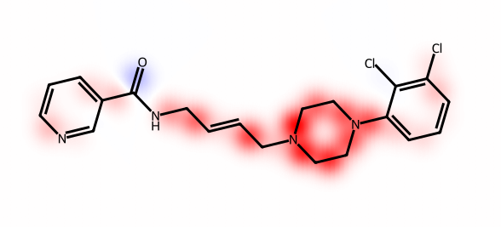
Prompt 3
Identifies piperazine ring as the main prediction contributor
Associates dichlorophenyl substitution with improved binding affinity (very generic)
Amide-Alkene linker contributes positively, allowing for optimal positioning of pharmacophores
Active compound
EdgeSHAPer insights – Active
Piperazine Ring Bonds Dominate (φ = 0.116, 0.101, 0.095)
The C-N and C-C bonds within the piperazine ring show the highest positive SHAP values
This suggests the model associates the piperazine scaffold with activity
Piperazine is a common pharmacophore in bioactive molecules
Dichlorophenyl Substitution Pattern
The presence of two chlorine atoms on the phenyl ring contributes positively
Halogenated aromatic systems are often associated with improved binding affinity
Amide-Alkene Linker
The C-C bonds in the alkene linker (φ = 0.089, 0.070) contribute positively
This flexible linker allows optimal positioning of pharmacophores

Slide 15

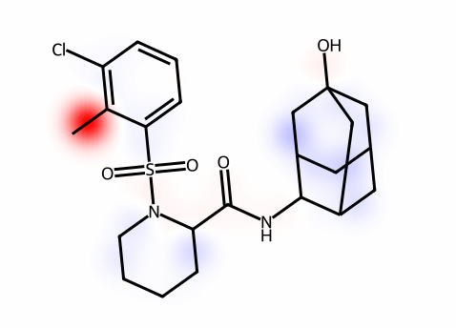
Prompt 3
Identifies the Methyl-Phenyl bond as the main positive contributor
Sulfonamide group with a low positive contribution towards the active class
Refers to Adamantanol as a terpenoid structure, which is not correct
Inactive compound
EdgeSHAPer insights – Inactive
Methyl-Phenyl Bond Dominates (φ = 0.283)
The C-C bond between methyl and phenyl has an extremely high SHAP value
This suggests the model associates simple alkyl-phenyl systems with inactivity
Lack of complex pharmacophore reduces activity likelihood
Sulfonamide Group
The S-N bond (φ = 0.013) and S=O bonds (φ = 0.003) have low positive contributions
Sulfonamides in this context may not contribute to the target activity
Terpenoid Structure
The bicyclic terpenoid structure with hydroxyl group shows minimal SHAP contribution
Complex 3D structure may not align with target binding site

Slide 16
Prompt 3
Active compound
Inactive compound
Comparative analysis
Aspect | Active Compound | Inactive Compound | Interpretation
Dominant SHAP | 0.116 (piperazine) | 0.283 (methyl-phenyl) | Inactive has more extreme values
SHAP Distribution | More uniform (0.045-0.116) | More skewed (0.003-0.283) | Active compound relies on multiple features
Key Pharmacophore | Piperazine + halogenated aryl | Simple alkyl-aryl | Active has recognized pharmacophore
Molecular Complexity | Moderate (12 heavy atoms in core) | High (30 heavy atoms) | Active has optimal complexity
Feature Contribution | Distributed across scaffold | Concentrated in one bond | Active uses more balanced features

Slide 17
Prompt 4
Goal: Determine whether agent is capable of analyzing and comparing the learning characteristics of distinct ML-models
Can the agent correctly compare and interpret explanations of different GNN models on the same compound?
Train two different GNN models on a compound activity prediction dataset and compare their performances. Select a compound from the test set correctly predicted as active by both models. Explain the predictions using EdgeSHAPer and highlight the differences between the learning characteristics of the models showing relevant visualizations.

Slide 18
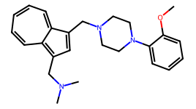
Prompt 4
GCN vs GAT
Metric | GCN | GAT | Winner
Best Validation Accuracy | 94.54% | 95.06% | 🏆 GAT
Test Accuracy | 93.89% | 95.57% | 🏆 GAT
Compound selected for XAI
SMILES: COc1ccccc1N1CCN(Cc2cc(CN(C)C)c3cccccc2-3)CC1
True Label: Active (Class 1) ✅
Predicted by Both Models: Active (Class 1) ✅
GCN Confidence: 99.96% (Probability)
GAT Confidence: 99.99%
GCN

Slide 19
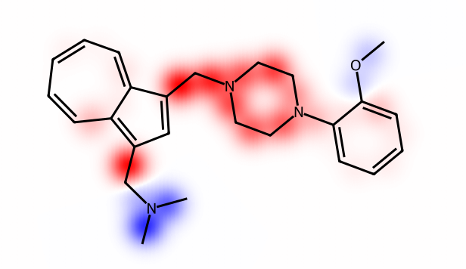
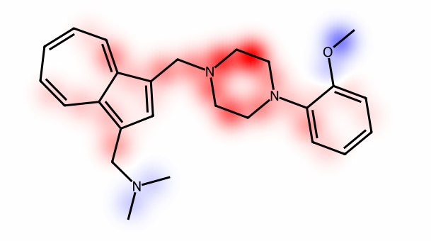
Prompt 4
Identifies different learning characteristics between the different GNN models
GCN
GAT
Key Differences in Learning Characteristics
GCN: Fragment-Driven Learning
Top contributors: Aromatic ring bonds (cC) and N-C single bonds
Learning pattern: Focuses on local atomic environments and bond types
Mechanism: Message passing treats all neighbors equally → learns structural motifs
Top bonds: Bonds connecting aromatic rings to alkyl chains
GAT: Context-Aware Learning
Top contributors: Piperazine backbone (NCCN) and aliphatic C-C bonds
Learning pattern: Focuses on molecular backbone and connectivity patterns
Mechanism: Attention weights allow GAT to dynamically weight important neighbors
Top bonds: Bonds within the piperazine ring system

Slide 20

Prompt 4
GCN
GAT
Conclusion
While both models correctly predict this compound as active, GAT demonstrates superior performance and learns more sophisticated molecular representations through its attention mechanism. GAT's focus on the piperazine backbone suggests it captures pharmacophore-relevant features more effectively than GCN's fragment-based approach.
Note: the agent focused on the differences, overinterpreting the results. It is clear that the models learned similar patterns (with different top bonds and magnitudes), but the agent did not mention any similarity between them.
Notes:
Control -> without difference

Slide 21
Conclusion
Aim: Design an agentic AI framework for interpretable AI applied to QSAR tasks
No-code framework enables the building of interpretable AI pipelines
ChemicHAL correctly selected tools and reproduced known results
Enables multi-model comparison and learning behavior characterization
Chemical interpretation of explanations with actionable optimization insights
Note: results interpretation should be considered with caution!

Slide 22
Future perspective
Make an “organization repository” available for the whole lab to ease the integration of new components
Create a guide for lab members for the implementation of AI agents

Slide 23
Lessons learned
Setup inference on a work-station (hopefully cluster in future)
The quality and choice of LLM matters a lot
Use the system prompt to nudge the LLM to desirable responses
Proper design of docstrings and documentation is essential
Using code assistants (eg. Claude code, Github CoPilot) makes the large repositories manageable

Slide 24
Prompt 3
Key findings
The GNN Model Learned Meaningful Chemical Patterns
The model correctly identifies piperazine-based scaffolds as activity-promoting
Simple alkyl-aryl systems are associated with inactivity
Active Compound Relies on Multiple Features
SHAP values are distributed across the piperazine ring, linker, and aromatic systems
This suggests the model learned a complex, multi-factor decision boundary
Inactive Compound Has Dominant Single Feature
One bond (methyl-phenyl) contributes 50%+ of the total SHAP
This suggests simpler, more localized decision logic
Model Trustworthiness
Active compound: Trustworthiness = 0.903
Inactive compound: Trustworthiness = 0.960
Both explanations are highly reliable
Actionable Insights
Piperazine-based scaffolds with halogenated aromatic rings are favorable
Multiple balanced features contribute to activity (not just one dominant feature)
Simple alkyl-aryl systems are less likely to be active

Slide 25
Prompt 3
Active compound
Inactive compound
EdgeSHAPer insights
Piperazine Ring Bonds Dominate (φ = 0.116, 0.101, 0.095)
The C-N and C-C bonds within the piperazine ring show the highest positive SHAP values
This suggests the model associates the piperazine scaffold with activity
Amide-Alkene Linker
The C-C bonds in the alkene linker (φ = 0.089, 0.070) contribute positively
This flexible linker allows optimal positioning of pharmacophores
EdgeSHAPer insights
Methyl-Phenyl Bond Dominates (φ = 0.283)
The C-C bond between methyl and phenyl has an extremely high SHAP value
This suggests the model associates simple alkyl-phenyl systems with inactivity
Lack of complex pharmacophore reduces activity likelihood
Terpenoid Structure
The bicyclic terpenoid structure with hydroxyl group shows minimal SHAP contribution
Complex 3D structure may not align with target binding site

Slide 26
Prompt 4
Identifies different learning characteristics between the different GNN models
GCN
GAT
Interpretation of learning patterns
GCN identifies aromatic-alkyl connections as most important. This suggests GCN has learned that:
The link between aromatic rings and aliphatic chains is critical for activity
Bond polarity and hybridization changes drive predictions
GCN learns local structural features more effectively
GAT identifies the piperazine backbone as most important. This suggests GAT has learned that:
The central scaffold connectivity is key to activity prediction
Molecular topology and ring systems are weighted more heavily
GAT learns global structural patterns through attention

Slide 27
Prompt 3
Key findings
The GNN Model Learned Meaningful Chemical Patterns
The model correctly identifies piperazine-based scaffolds as activity-promoting
Simple alkyl-aryl systems are associated with inactivity
This aligns with medicinal chemistry principles
Active Compound Relies on Multiple Features
SHAP values are distributed across the piperazine ring, linker, and aromatic systems
This suggests the model learned a complex, multi-factor decision boundary
Inactive Compound Has Dominant Single Feature
One bond (methyl-phenyl) contributes 50%+ of the total SHAP
This suggests simpler, more localized decision logic
Model Trustworthiness
Active compound: Trustworthiness = 0.903
Inactive compound: Trustworthiness = 0.960
Both explanations are highly reliable
Final assessment
GNN Model Performance: Excellent (95.21% test accuracy)
EdgeSHAPer Explanations: Highly reliable (trustworthiness > 0.90)
Chemical Interpretability: The model learned meaningful structure-activity relationships
Actionable Insights:
Piperazine-based scaffolds with halogenated aromatic rings are favorable
Multiple balanced features contribute to activity (not just one dominant feature)
Simple alkyl-aryl systems are less likely to be active

Slide 28
Prompt 3
Active compound
Inactive compound
EdgeSHAPer insights – Active
Piperazine Ring Bonds Dominate (φ = 0.116, 0.101, 0.095)
The C-N and C-C bonds within the piperazine ring show the highest positive SHAP values
This suggests the model associates the piperazine scaffold with activity
Piperazine is a common pharmacophore in bioactive molecules
Dichlorophenyl Substitution Pattern
The presence of two chlorine atoms on the phenyl ring contributes positively
Halogenated aromatic systems are often associated with improved binding affinity
Amide-Alkene Linker
The C-C bonds in the alkene linker (φ = 0.089, 0.070) contribute positively
This flexible linker allows optimal positioning of pharmacophores
EdgeSHAPer insights – Inactive
Methyl-Phenyl Bond Dominates (φ = 0.283)
The C-C bond between methyl and phenyl has an extremely high SHAP value
This suggests the model associates simple alkyl-phenyl systems with inactivity
Lack of complex pharmacophore reduces activity likelihood
Sulfonamide Group
The S-N bond (φ = 0.013) and S=O bonds (φ = 0.003) have low positive contributions
Sulfonamides in this context may not contribute to the target activity
Terpenoid Structure
The bicyclic terpenoid structure with hydroxyl group shows minimal SHAP contribution
Complex 3D structure may not align with target binding site

Slide 29
LIVE DEMO

Slide 30
Conclusion
Aim: Design an agentic AI framework for interpretable AI applied to QSAR tasks
The framework allows for the building of interpretable AI without coding experience
ChemicHAL was able to correctly choose tools and reproduce known results
The system was effective in comparing different models and analyzing their learning characteristics
The agent provided chemical interpretation for explanations and proposed “actionable insights”
Note: results interpretation should be considered with caution!

Slide 31
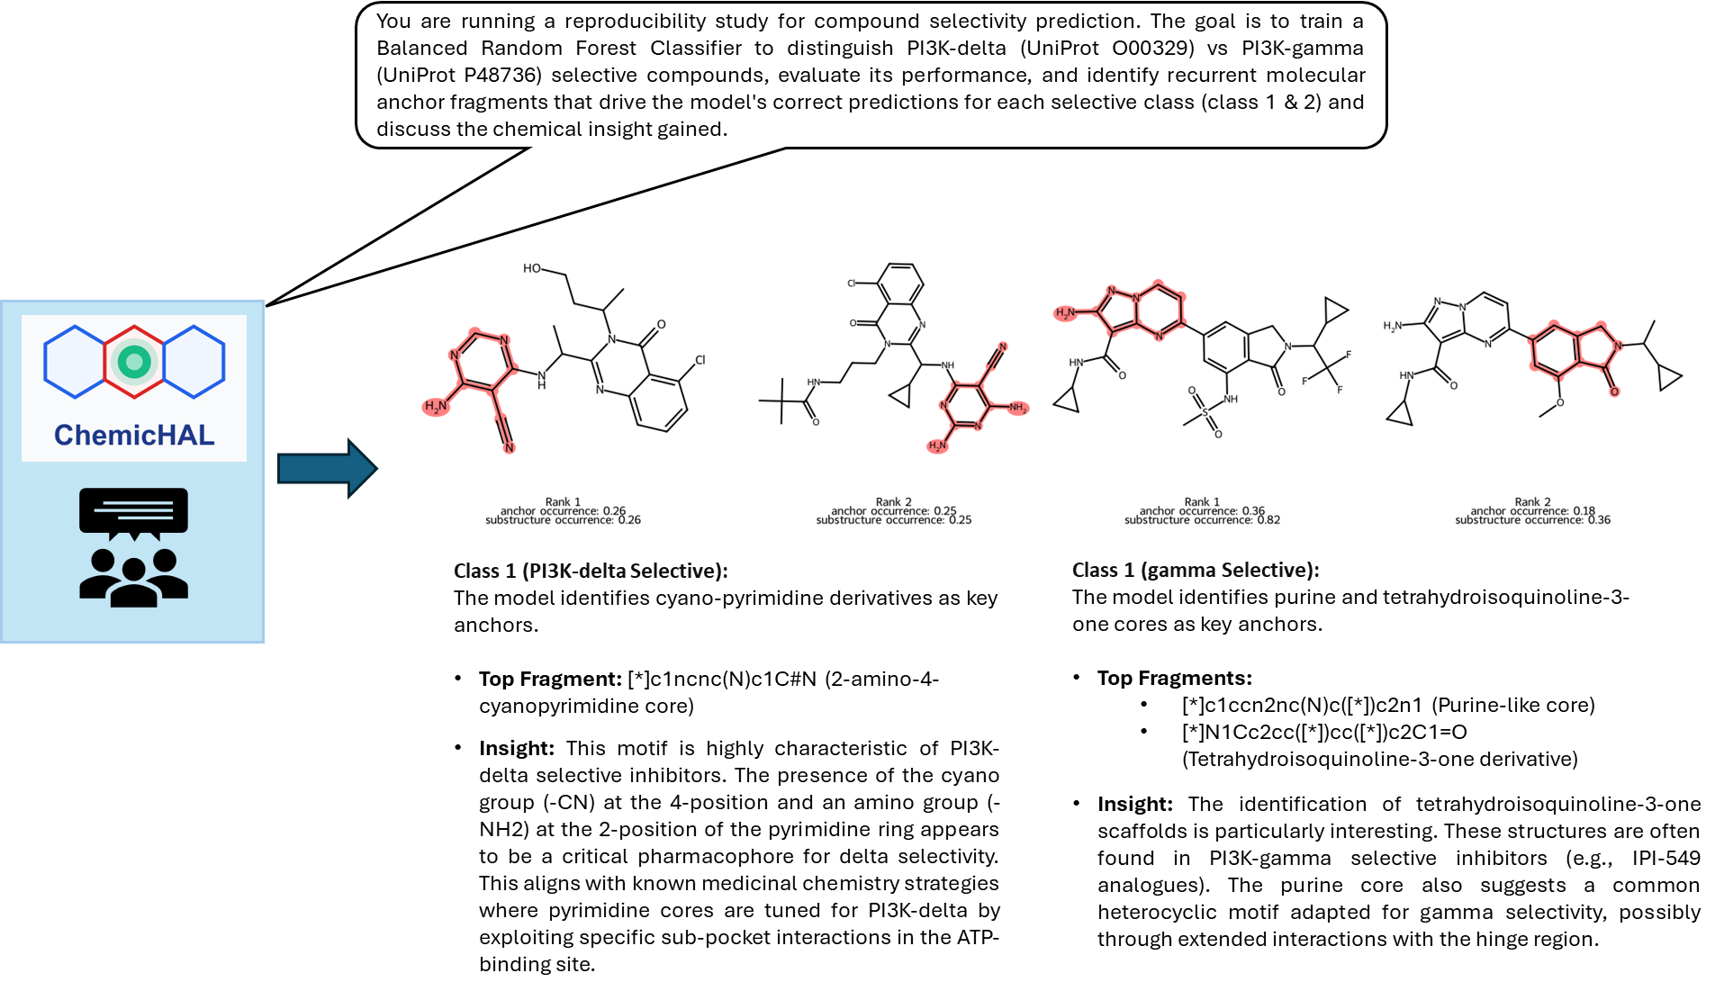
Prompt 1

Slide 32
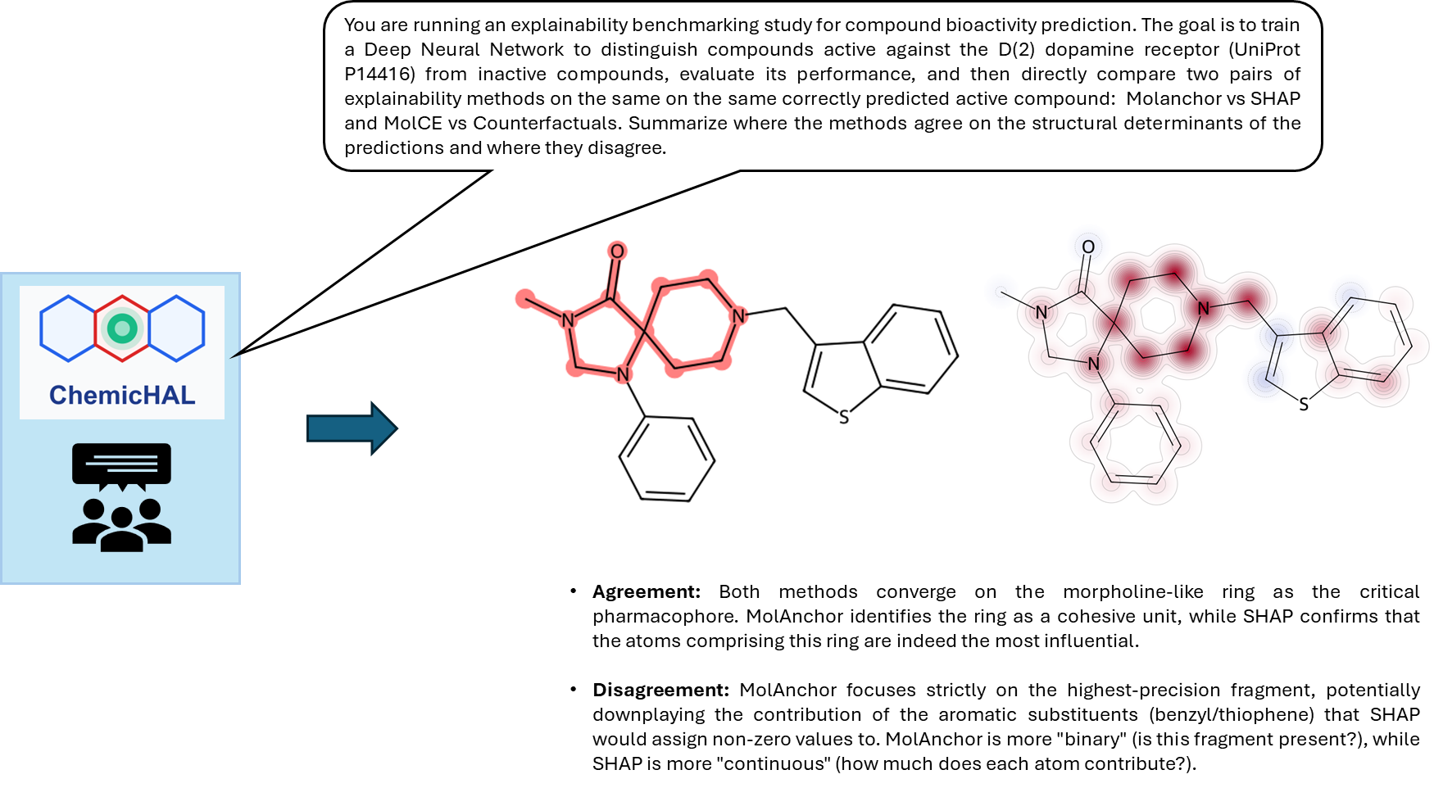
Prompt 2

Slide 33
Prompt 3
GNN model
Architecture | GCN (4 layers, 64 hidden channels)
Training Samples | 5,342
Validation Samples | 668
Test Samples | 835
Best Validation Accuracy | 95.96%
Test Accuracy | 95.21%
Training Loss Metric | Binary Cross-Entropy
Active compound
Inactive compound
Property | Value
SMILES | O=C(NCC=CCN1CCN(c2cccc(Cl)c2Cl)CC1)c1cccnc1
True Label | 1 (Active)
Predicted Label | 1 (Active)
Confidence | 99.99%
Molecular Weight | ~441.34 g/mol
Key Features | Dichlorophenyl ring, piperazine, pyridine, amide linker
Property | Value
SMILES | Cc1c(Cl)cccc1S(=O)(=O)N1CCCCC1C(=O)NC1C2CC3CC1CC(O)(C3)C2
True Label | 0 (Inactive)
Predicted Label | 0 (Inactive)
Confidence | 99.38%
Molecular Weight | ~415.53 g/mol
Key Features | Chlorotoluene, sulfonamide, bicyclic terpenoid
GCN

