Slide 1


SmartD: Smart Meter Data Analytics Dashboard
Presented by: Aylin Jarrah Nezhad
Supervised by: Prof. Karl Aberer,
Tri Kurniawan Wijaya, Matteo Vasirani, LSIR Lab

Slide 2
Project Overview

Slide 3
Current Challenges Associated With Energy Consumption:
Nonrenewable energy sources such as fossil fuel …
Renewable energy sources such as sunlight, wind …
Demand growth
Understanding the customer’s consumption behavior
Our Objectives:
Visualization of big energy consumption data
Analysis of the customer energy consumption behavior
Final Output: Web-based application that:
Provides comparison of energy consumption for individuals and groups of the customers
Estimates the energy consumption behavior of a new customer

Slide 4
Dataset
Timestamped energy consumption values:
782 customers (over 20 million records)
Measured every 30 minutes
From 2009 to 2010
Questionnaire containing 143 questions

Slide 5
Comparison of energy consumption

Slide 6
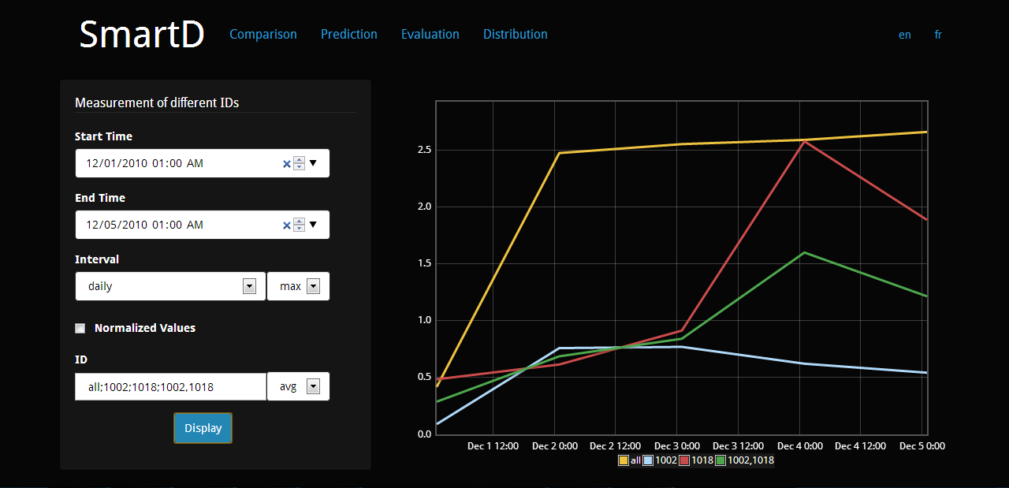
All;1002;1018;1002,1018
12/05/2010 01:00 AM
12/01/2010 01:00 AM
Daily

Slide 7
Distribution of energy consumption values

Slide 8
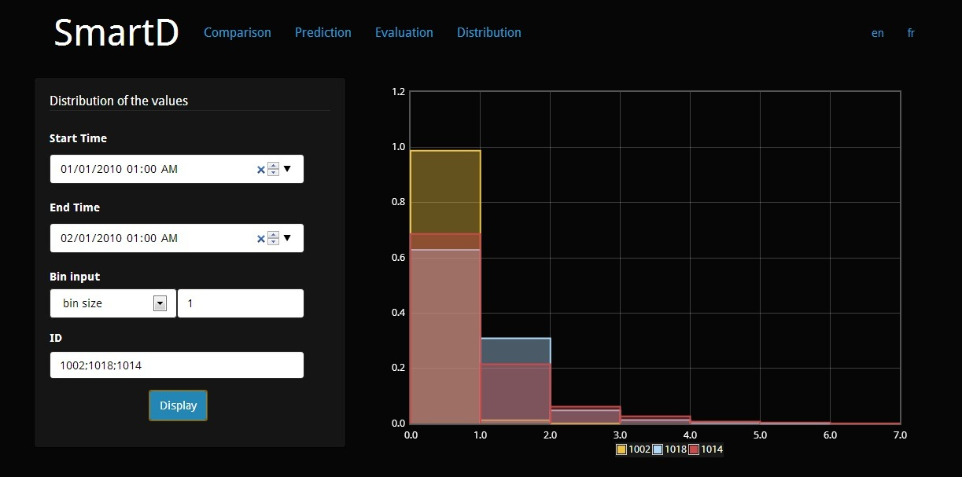
01/01/2010 01:00 AM
02/01/2010 01:00 AM
1002;1018;1014
Bin Size

Slide 9
Prediction of new customers’ consumption behavior

Slide 10








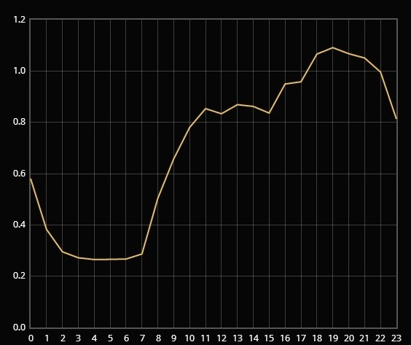

Find similar customers
In question space
Predicted daily energy consumption
Similar customers

Slide 11
How to provide a better estimation of new customer’s consumption behavior?

Slide 12
Finding & Ranking of relevant Questions
Find relevant questions for energy consumption at 12h00 AM based on context
…
Find relevant questions for energy consumption at 11h00 PM based on context
Rank the questions
Find similar customers
Plot the predicted energy consumption behavior

Slide 13
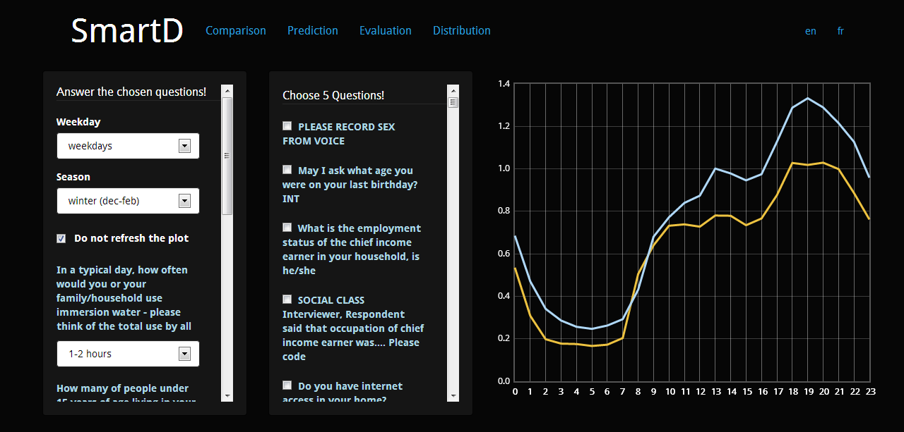

Slide 14
What is the best n?

Slide 15



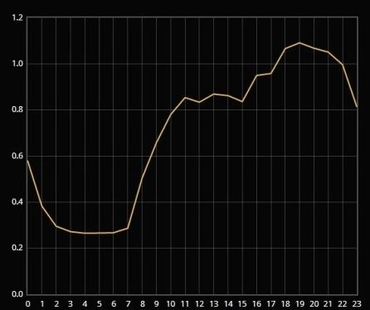
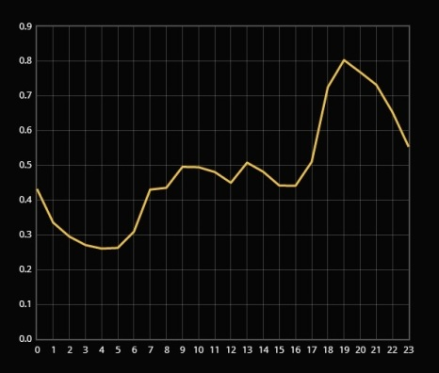
Find n similar customers
In question space
For fixed k
…
Find the distance
In consumption space

Slide 16
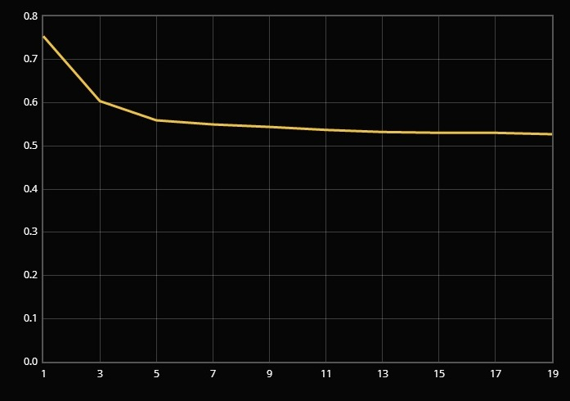
Evaluation: similar customers’ number

Slide 17
What is the best k?

Slide 18
Find n (fixed) similar customers
In question space
For k questions
…
Find the distance
In consumption space

Slide 19
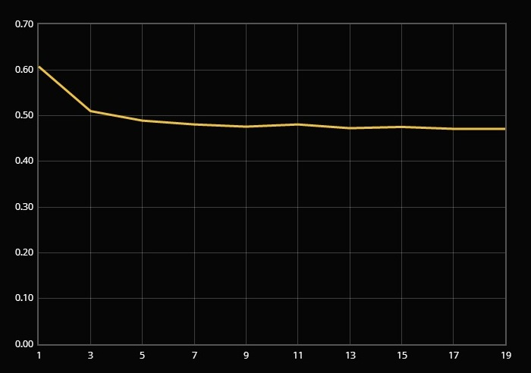
Evaluation: Questions’ number

Slide 20
Conclusion
Final Output: Web-based application that:
Provides comparison of energy consumption for individuals and groups of the customers
Estimates the energy consumption behavior of a new customer
Future work:
Comparison between the energy consumption of similar households.

Slide 21


