Slide 1
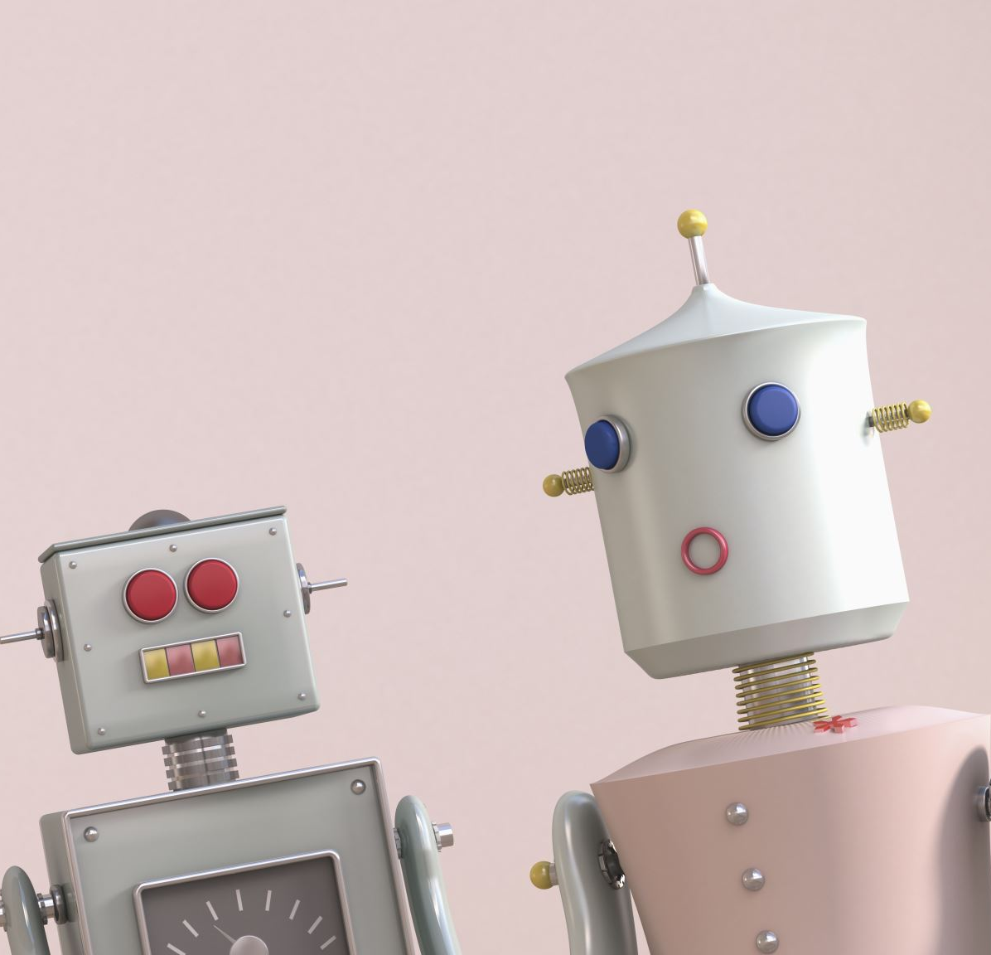
CHATBOT– HEALTHCARE DOMAIN

Slide 2
OVERVIEW
WHAT IS A CHATBOT
HISTORY OF CHATBOT
CHATBOT AND HEALTHCARE
CHATBOT ARCHITECTURE
PROJECT EXECUTION
FUTURE SCOPE
CONCLUSION

Slide 3
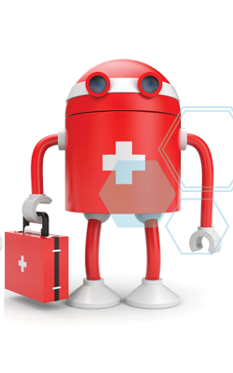
WHAT IS CHATBOT
A computer program designed to simulate conversion with human users, especially over the internet.
The main factor that motivates the people to use chatbots are:-
Productivity
Entertainment
Social and relational factor
Curiosity

Slide 4
HISTORY OF CHATBOT
1950’s-1980’s
Neural
Methods pt2
transformers
Statistical
Methods
2010’s
Symbolic
Rule-based
systems
Neural
Methods
Embeddings, RNN’s
1990’s-2000’s
2017+

Slide 5
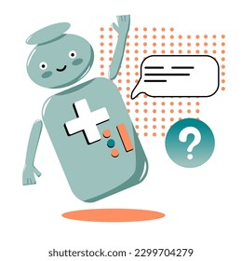
CHATBOT IN HEALTHCARE AND MEDICAL SCIENCE
Chatbots in the healthcare field are providing patient assistance and care.
AI-powered medical assistant can book appointments, monitor a patient’s health status and perform other time-intensive responsibilities such as inventory, billing, and claims management.
There are these key limitations:-
Explaining ability
Data requirement
Transferability

Slide 6
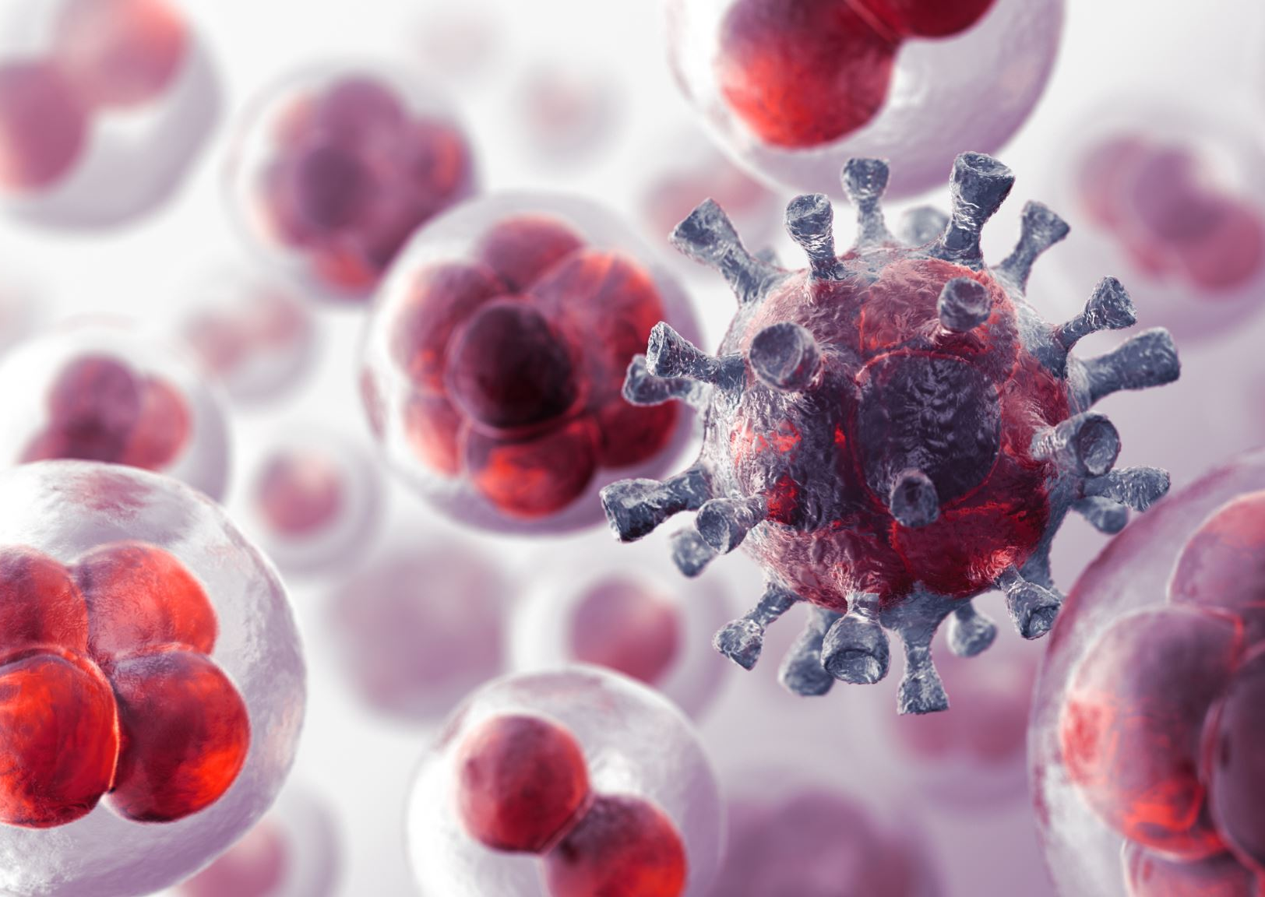
Impact of Chatbot in Healthcare
Impact of chatbots has increased against the COVID-19 pandemic. Chatbots have effectively designed and helped in up-to-date Health information quickly, and lessening the psychological damage caused by fear and isolation. Immediate collaborations between healthcare workers, companies, academics, and governments are merited and maid easy in supplying the correct medicine at the time.

Slide 7
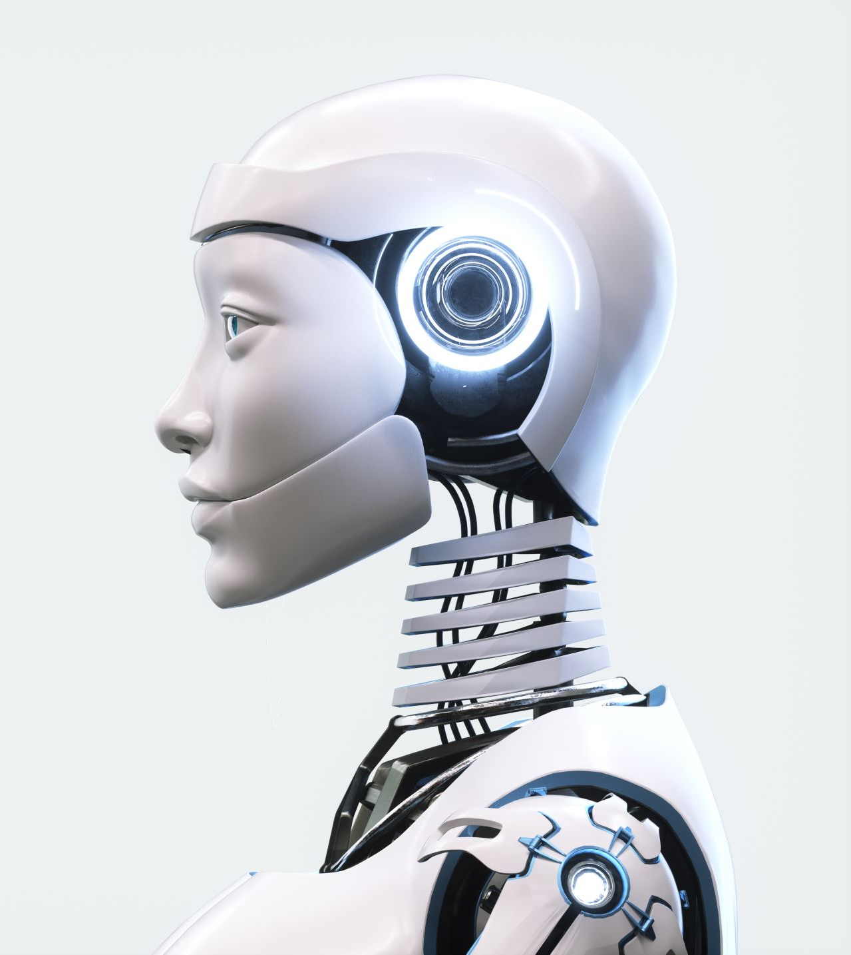
Difference ways to build a chatbot
RASA
Wit.ai
Dialog flow
IBM Watson
Pandora bots
Bot press

Slide 8

Reasons to take RASA over other Frameworks
its core component is open-source and free
it allows the incorporation of many external state-of-the-art NLP models
it is highly customizable and flexible
it uses Python which is our language of choice
It has an easy-to-use command-line interface for common tasks such as training, testing, or running models
it has great documentation, written and video tutorials.

Slide 9
ARCHITECTURE OF CHATBOT
Actions
Web Page
Chatbot Server
Human Input – Chat
NLP
Knowledge
IM/ Chat
Application
Mobile App
Machine Learning
Machine Response NLG
Smart Application
Logic and Rules
Parser
Data Sources
…Others

Slide 10
PROJECT EXECUTION
Data collection and EDA
Train the Chatbot using Rasa
Implementation of chatbot
Creating Web Application using Flask

Slide 11
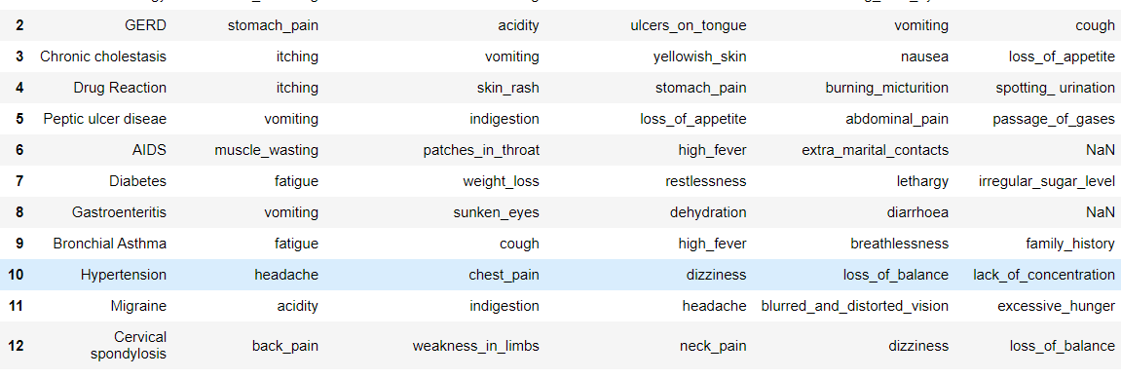
Data collection EDA File Handling

Slide 12
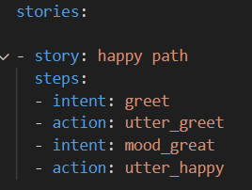
Training the Chatbot using Rasa
Components of Rasa:
NLU: NLU (Natural Language Understanding) is part of Rasa that performs intent classification, entity extraction, and response retrieval.
Domain: It specifies the intents, entities, slots, responses, forms, and actions your bot should know about. It also defines a configuration for conversation sessions.
Stories: Stories train a model to identify conversation patterns and generalize to unseen conversation paths.

Slide 13
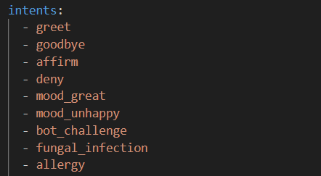
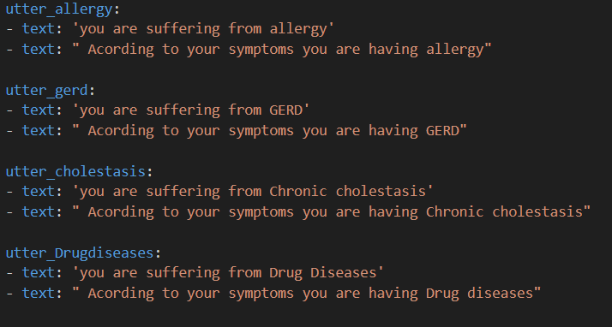
Intents: Intent refers to the goal the customer has in mind when typing in a question or comment
Utterances: The sample utterances are a set of likely spoken phrases mapped to the intents.

Slide 14
Web Application Development
Flask has been used for the deployment of the chatbot in web applications.
It is a lightweight Python web framework that provides useful tools and features that make creating web applications in Python easier.
It gives developers flexibility and is a more accessible framework for new developers since you can build a web application quickly using only a single Python file.

Slide 15
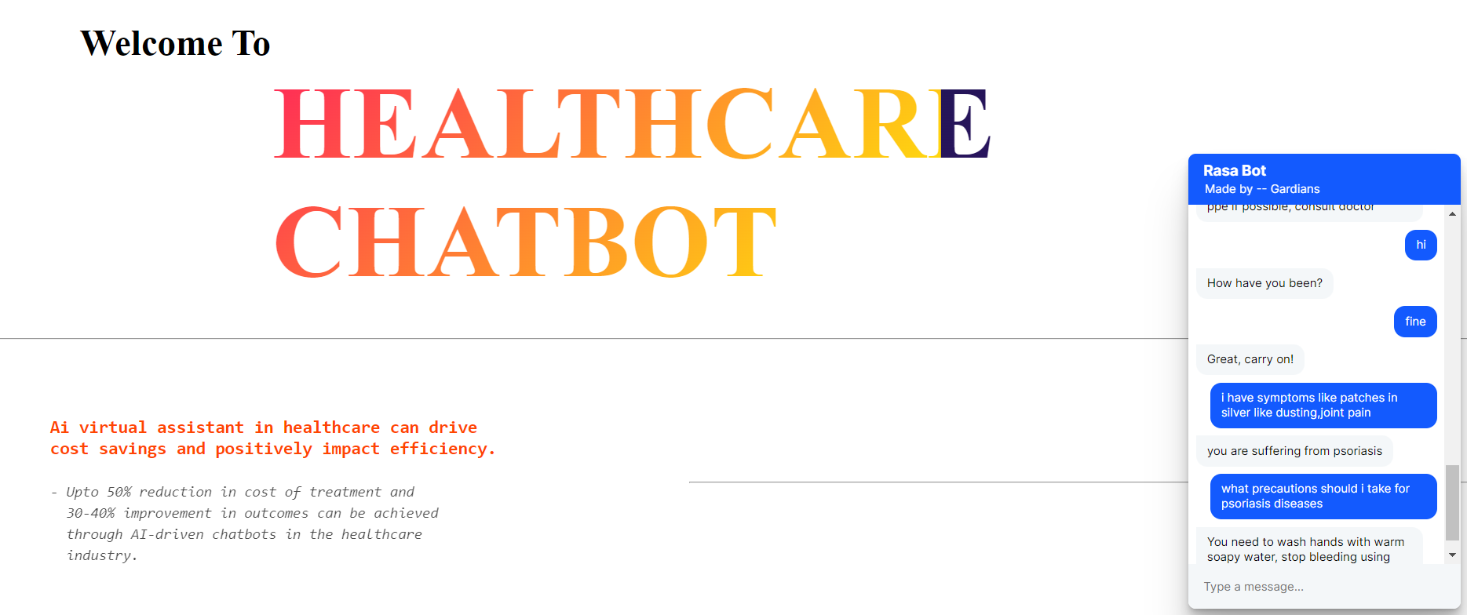
Final output :

Slide 16
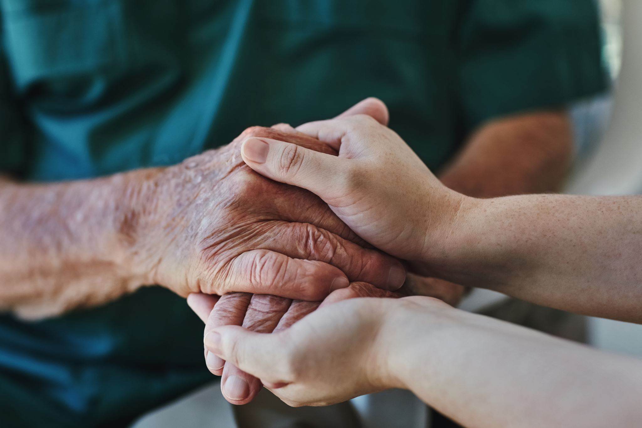
Challenges and limitation
Giving human intelligence is almost impossible
Time constraints
Enough knowledge representation
Should be a very specific keyword
Technological limitation of AI
Medical Limitation
Ethical challenges
Better regulations
Misconceptions and overhyping
Human rejection

Slide 17

Future scope of ai in health care
More efficient and voice chatting chatbot
Chatbots are Everywhere, and sectors where they will probably make the maximum impact on the near future in Healthcare.
No need to pay an unnecessary visit to a doctor. Chatbots are here to help you , AI and ML solutions have already shown the ability to perform tasks, in many cases, better than humans .
Leaders like Amazon are calling a “golden age” and as setting a new standard for competitive differentiation.
AI is expected to enhance healthcare for both patients and doctor. Clubbed with data analytics, AI could yield faster and accurate diagnosis.

Slide 18
Conclusion
The key is to insurance that most of the population can access and therefore benefit from this technological disruption. If India is successful in doing so, there is an opportunity to benefit from the positive changes that Technology will bring to Health Care.
Artificial intelligence has a range of applications across the healthcare sector by performing descriptive, predictive, and prescriptive functions, AI in healthcare in India is currently Augmenting human capacity rather than replacing human labor altogether.

