Slide 1

Amazon Food Review

Slide 2
AGENDA
Machine Learning
Objective of the Project
NLP (Natural Language Processing)
Project Summary:
EDA
Model Building
Model Evaluation
Conclusion
Q&A
Challenges

Slide 3
Machine Learning
Machine learning is a branch of artificial intelligence (AI) and computer science which focuses on the use of data and algorithms to imitate the way that humans learn, gradually improving its accuracy.
Why Machine Learning ?
Machine learning is important because it gives enterprises a view of trends in customer behavior and business operational patterns, as well as supports the development of new products.

Slide 4
Project life cycle of Machine Learning:
Business Objective
Data Gathering
Data Preparation
Exploratory Data Analysis
Model Building
Model Evaluation

Slide 5
Machine Learning Methods
Supervised Machine Learning :
when labeled datasets are used to train algorithms to classify data or predict outcomes accurately.
Classifying spam mails from your inbox.
Reducing customer churn
Fraud detection
Methods used in supervised learning include neural networks, naïve bayes, linear regression, logistic regression, random forest, and support vector machine (SVM).
Unsupervised Machine Learning : uses machine learning algorithms to analyze and cluster unlabeled datasets.

Slide 6
Objective of Project:
Sentiment classification aims to determine the overall intention of a written text which can be of admiration or criticism type. This can be achieved by using machine learning algorithms So, the problem that is going to be investigated in the project is as follow: Which machine learning approach performs better in terms of accuracy on the Amazon reviews.
Python Language is used for the analysis.
NLP , supervised learning is used for Model Building.
Text Data : Text_Data.zip
IDE: Google Collab

Slide 7
NLP : Natural Language Processing
It is a subset of Artificial Intelligence where the computer is taught to understand text and spoken words.
Applications of NLP:
NLP
Sentimental analysis
Email Filtering
Smart Assistant
Online Searches
Chatbots
Language Translation

Slide 8











Libraries Used:

Slide 9
Project Contents:
Storing Text Data into Data Frame
Preliminary Data cleaning
File Handling
EDA
Data Processing
Model Building
Model Evaluation
Conclusion

Slide 10
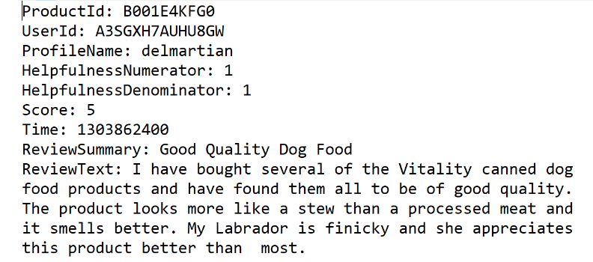
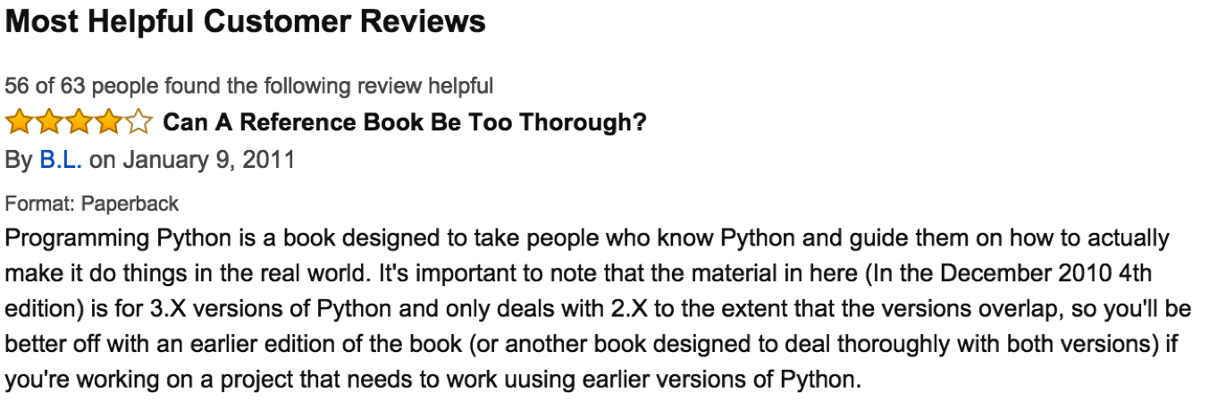
Sample of Raw Text Data

Slide 11
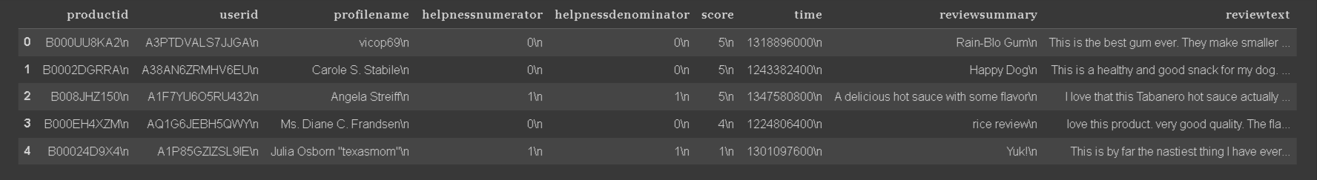
Raw Data Frame of the Text Data

Slide 12
Data Cleaning
Removed Special Characters (\n)
Data type conversions
Evaluated Helplessness and dropped the numerator and denominator columns.
Assumed score less than 3 as negative sentiment and hence valued it -1 .
Score more than or equal to 3 is assumed as positive sentiment and valued it 1.

Slide 13
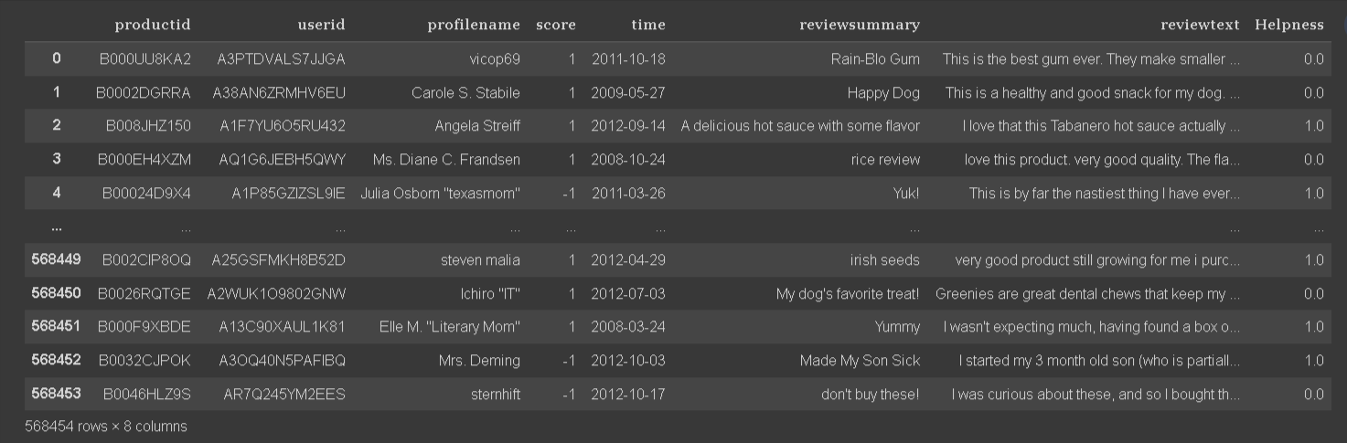
Cleaned Data Frame

Slide 14
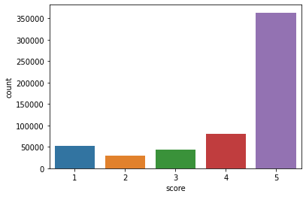
EDA
Shape = 568454 Rows and 8 Variables
Number of products : 74258
Number of Users : 256059
Duration: 08 oct 1999 to 26 oct 2012
260 users with more than 50 reviews
Score Distribution : Most of the Reviewers gave 5 score.

Slide 15
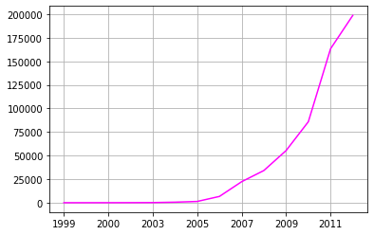
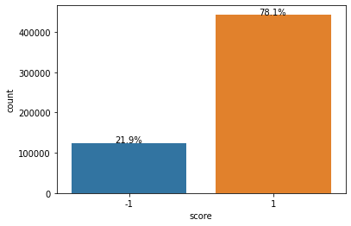
Continue…
Product purchased every year
Positive sentiments (score = 1) : 443777
Negative Sentiment s (score = -1): 124677

Slide 16
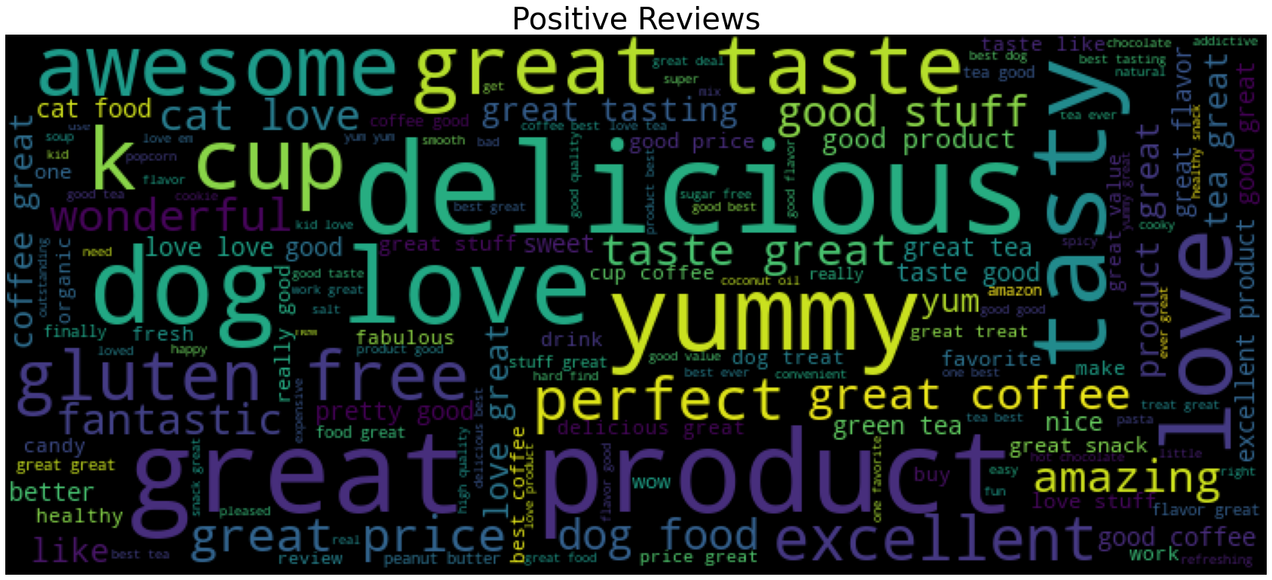
Word Cloud : Positive Reviews

Slide 17
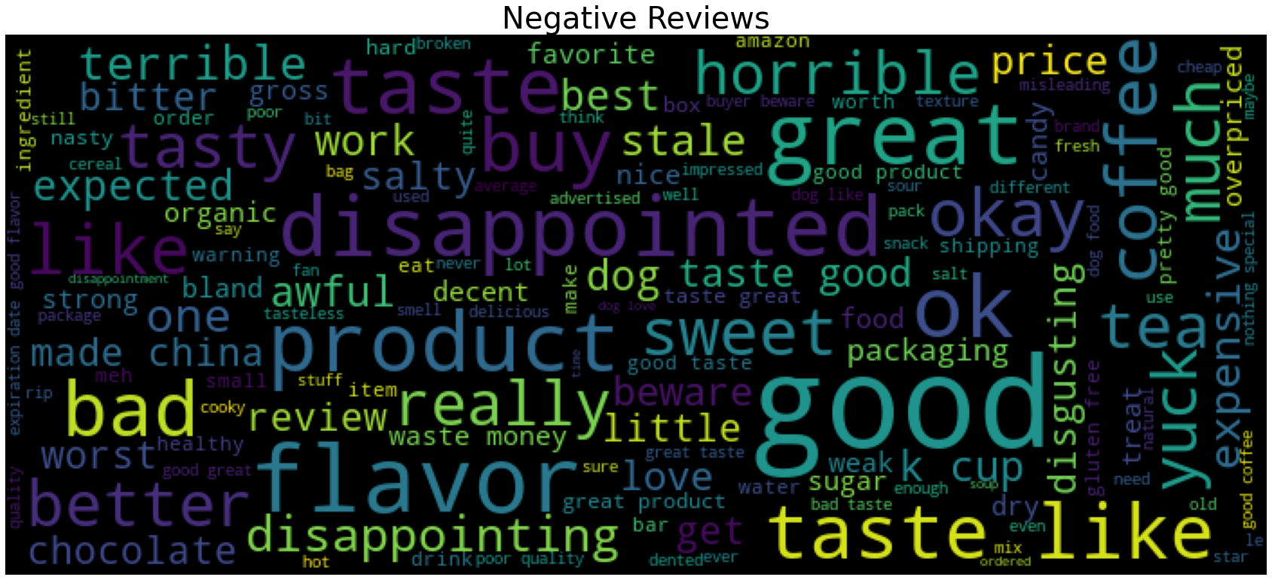
Word Cloud : Negative Reviews

Slide 18
Data Processing
Step 1 : Select Independent (X) and dependent Variables (Y)
Step 2 : Split the data into Train/Test
Step 3 : Data Cleaning
Step 4 : Data Transformation

Slide 19

Segregation and Splitting
Input Variable (X)
X_train
X_test
Output Variable(Y)
Y_train
Y_test

Slide 20
Data Cleaning:
X_Train
Removing special characters
Convert into lower case
Removing stop words
Stemming and lemmatization
X_Test
Data Transformation:
X_Train-cleaned
X_Train_Transformed
Count vectorizer
X_Test-cleaned
X_Test_Transformed

Slide 21
Model Building
As Score is provided in the data (labeled ) and score is a discreate value , which can be classified ,
We used supervised learning technique, The classification algorithms.
The algorithms tested :
Logistic Regression
Decision Tree
Random Forest
Naïve Bayes
K – Nearest Neighbour
Ada Booster
Gradient Boosting

Slide 22
Model Evaluation
As Classification Model is used , Accuracy is used for Evaluation.
Other evaluation methods :
Confusion Matrix
Precision vs Recall
ROC Curve (Receiver Operating Characteristics )
F1 Score
Log-Loss

Slide 23
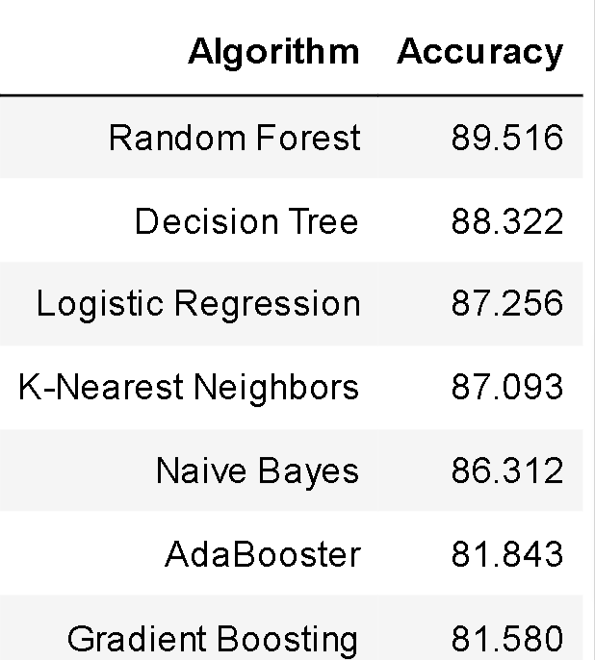
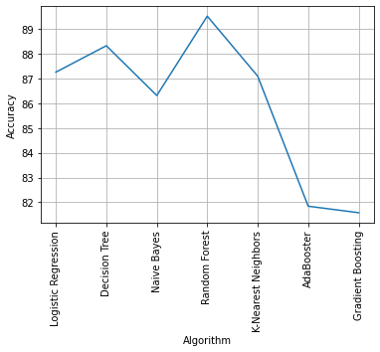
Model with Random Forest Algorithm predicted with an accuracy of 89.52%.

Slide 24
Conclusion
From the given data of Reviews , 78% had given Positive Score (1).
Reviewers expressed positive sentiment through words
‘delicious ’, ’yummy’, ’perfect’, ’tasty’, ’great ‘ and many other adjectives.
Reviewers expressed negative sentiment through words
‘disappointment’, ‘terrible’ , ‘bland’ , ‘yuck’, ‘ expensive‘ , ‘china’.
Random Forest Classifier Algorithm proves to be the best for the Prediction ML Model .

Slide 25
Challenges faced
Due to the vast data and long length text in Review , we used Review summary as an Input Variable.

Slide 26



