Slide 1

DATA ANALYSIS
OF
MBA COLLEGES BASED IN INDIA

Slide 2
ABOUT ME
Name : Landa Shasi Kumar
Innomatics Batch : 185
Qualification: B.tech Civil Engg.
Work Experience: Fresher

Slide 3
Agenda
Objective of the Project
Web Scraping – Details (Websites, IDE )
Summary of the Data
Exploratory & Data Analysis:
Data Cleaning
Univariate Analysis
Bivariate Analysis
Multi variate Analysis
Conclusion
My Experience/Challenges working on Web Scraping – Data Analysis Project.

Slide 4
Python Language is used for data analysis. Website: Siksha Interface: Jupyter Notebook
Objective of Project:
To find the best colleges for MBA in India based on different criteria.

Slide 5
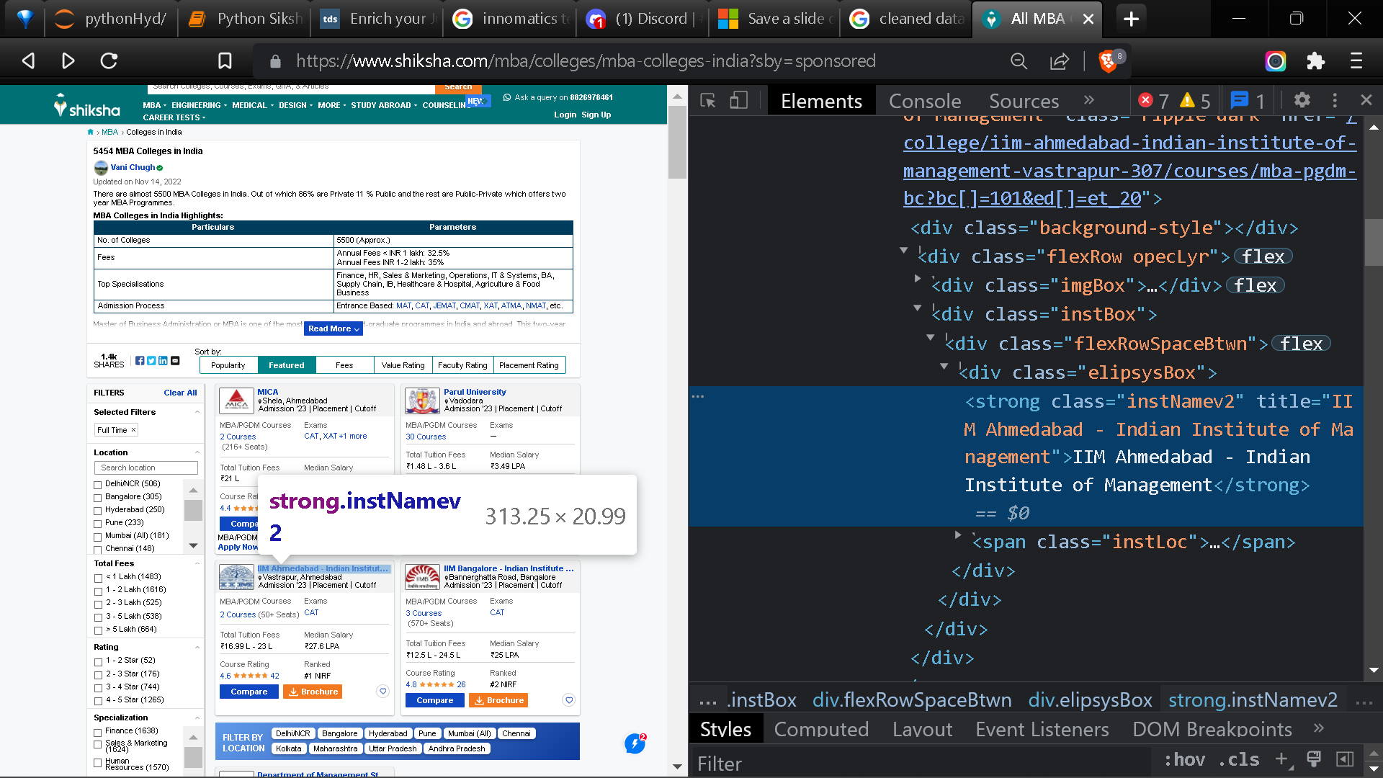

Slide 6
Libraries Used
Pandas
Numpy
Matplotlib
Seaborn
Urlib
Bs4 : Beautifulsoup
Requests
re
Ipywidgets : Interact , interact_manual

Slide 7
Describing Libraries
Pandas: open source data analysis and manipulation tool
Numpy: NumPy is a python library mainly used for working with arrays and to perform a wide variety of mathematical operations on arrays. Matplotlib.pyplot and Seaborn : to create numerous and diverse plot types. Urlib.request and Requests: To fetch URLs Bs4,Beautifulsoup: pulling data out of HTML re: allows you to quickly check whether a given string matches a given pattern
Ipywidgets : Interact , interact_manual :They enhance the interactive feature of Jupyter notebook application

Slide 8
Web scrapping / Data Collection
Web scraping is an automatic method to obtain large amounts of data from websites. Most of this data is unstructured data in an HTML format which is then converted into structured data in a spreadsheet or a database so that it can be used in various applications.
Variables extracted:
Names of the College
Location of the college
Fee of the college
Number of Seats
Entrance exam accepted
Ratings on Shiksha website

Slide 9
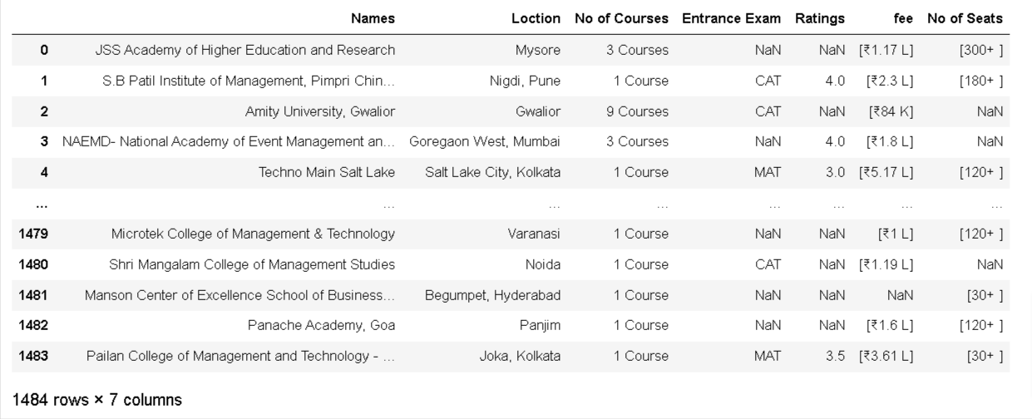
Grouping extracted data into Data Frame

Slide 10
Cleaning the Data
Removed null values.
Indexed City from Location.
Indexed numerical value from courses.
Removed special characters ([,₹)from fee and then converting k (1000) & L(100000) into numerical values.
Removed special characters ([,+) to get numerical value of No of Seats.
Assigned modified columns to existing Data Frame after changing data types accordingly.
Sorted index

Slide 11
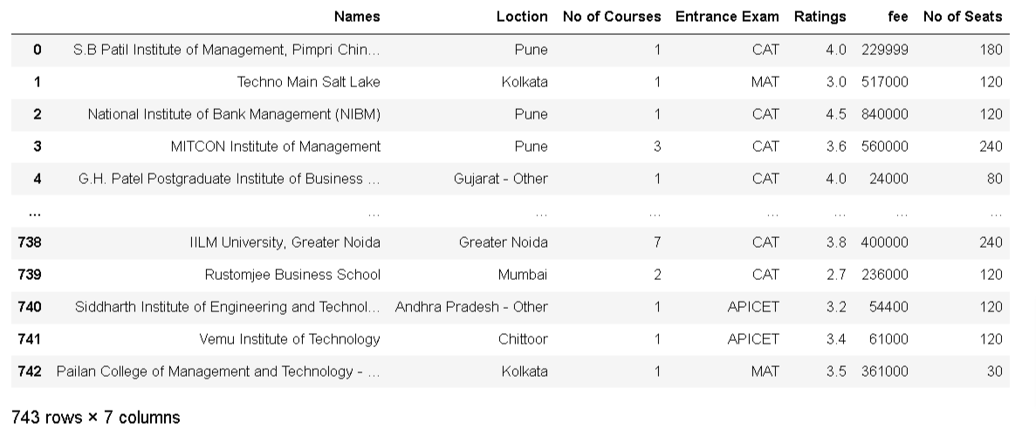
CLEANED DATA

Slide 12
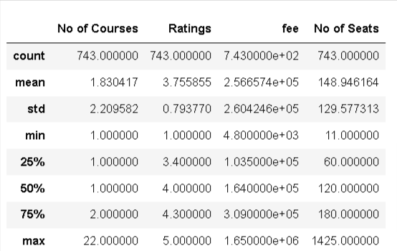
Describing Numerical Variables

Slide 13
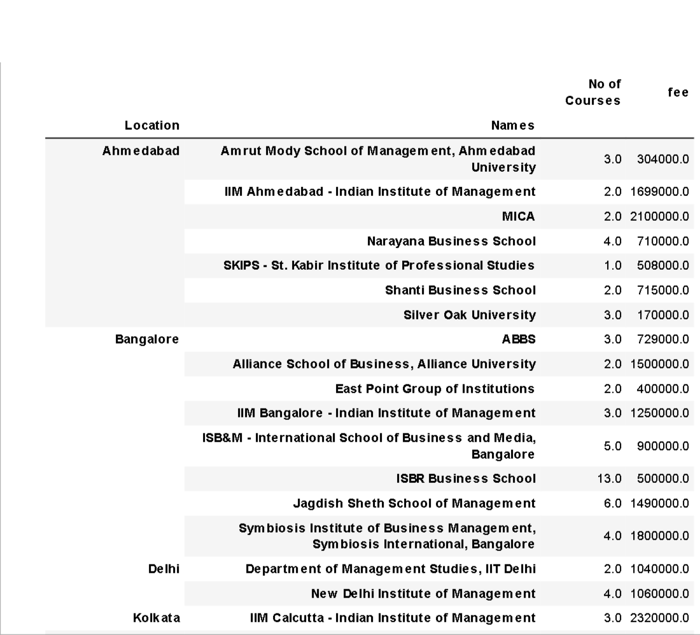
Location Based Colleges along with Fee and Number of Courses Offered

Slide 14
Uni Variate Analysis
Uni means one and this means that the data has only one kind of variable. The major reason for univariate analysis is to use the data to describe. The analysis will take data, summaries it, and then find some pattern in the data.
Following plot will be used for Univariate analysis:
Bar plot
Pie chart
Violin plot
Distribution Plot

Slide 15
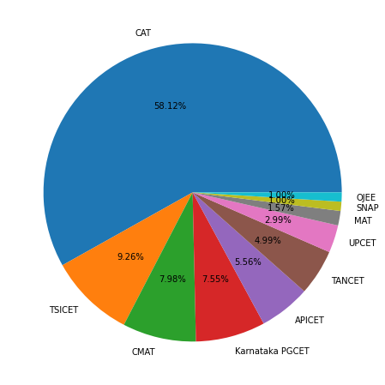
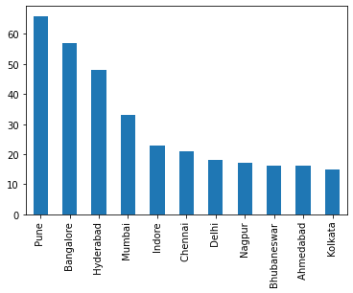
Locations with most number of colleges
Entrance Exam widely Accepted by Colleges
Metropolitan cities have most number of colleges.
CAT is the most preferred exam of the colleges followed by State conducted examinations like TSICET , Karnataka PGCET, APICET etc.

Slide 16
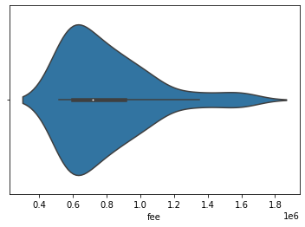
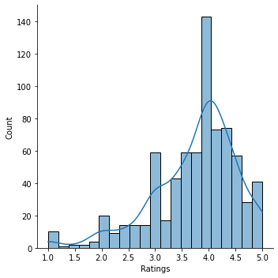
Most of the college’s rating fall in between 3 to 4.5
How colleges are rated in India ?
Fee of colleges in India
The avg Fee ranges from 6-10lakhs.

Slide 17
Bi Variate Analysis
when two variables are to be observed against each other , Bivariate analysis is used.
To find how a variable is dependent on another variable.
The relation can be between two numerical values , two categorical values or one numerical and one categorical value.

Slide 18
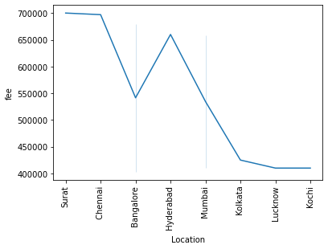
Fee vs Location
Surat , Chennai and some other big cities cost you more compared to cities like Lucknow , Kochi, etc.

Slide 19
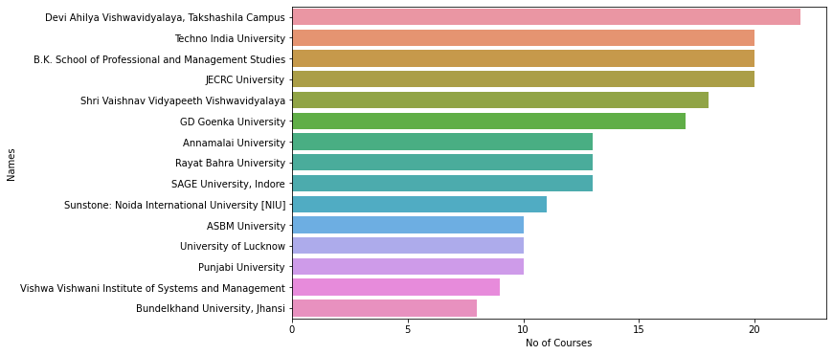
Colleges offering more than one type of courses
Courses and Colleges

Slide 20
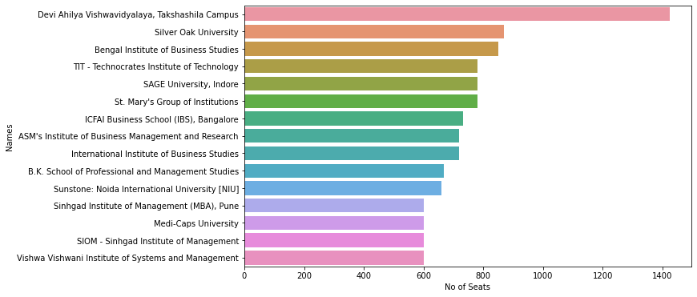
College vs No of Seats
Just incase you worry about competition , these colleges can better your chances of selection.

Slide 21
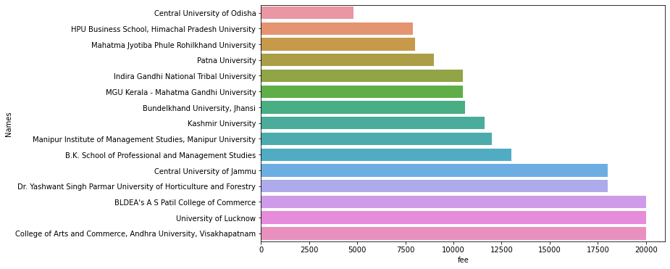
Colleges vs Fees
If you are not willing to spend much on MBA , these are some of the colleges with low fees.

Slide 22
Multi - Variate Analysis
Multivariate analysis is a more complex form of a statistical analysis technique and is used when there are more than two variables in the data set. Here, we will try to see relations between continuous variables and the 'Approved' column. To do that, we will plot a pair plot, with Hue as Approved.

Slide 23
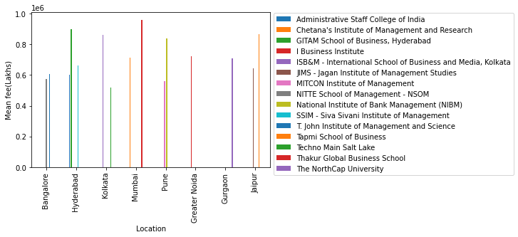
Location vs Colleges vs fee
Colleges in major Cities and their corresponding fee.

Slide 24
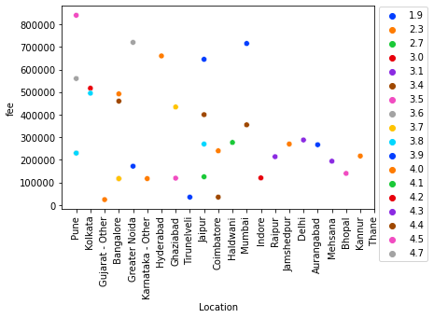
Location , Fee vs Ratings
Based on Location and Fee , we compare the Ratings of colleges.

Slide 25
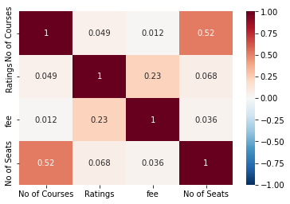
Co-Relation Between Numerical Variables
All the variables are positively co-related.
No of Courses and No of Seats highly co related among other features.

Slide 26
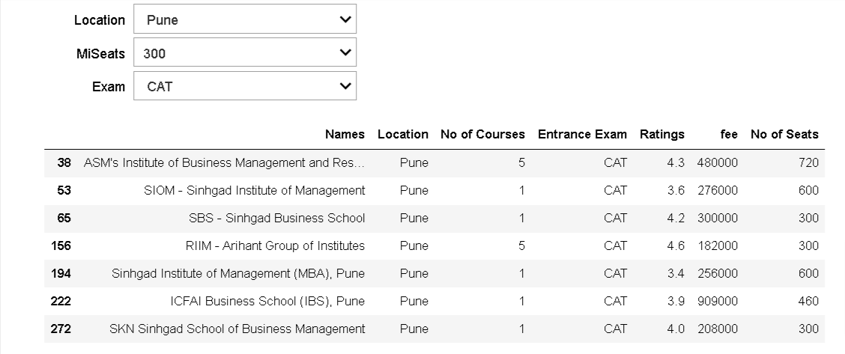
User selected Location , Minimum Seats and Entrance Exam Output:

Slide 27
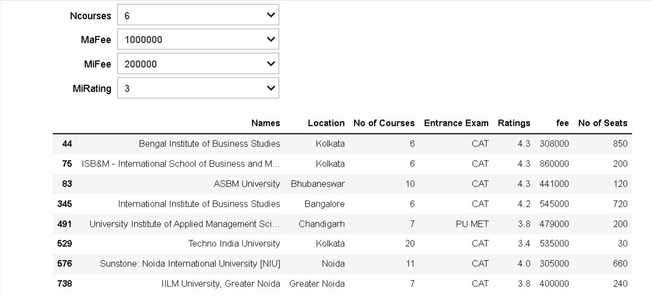
User selected max and min fees along with min no of courses and min rating . Output:

Slide 28
Conclusion
The best MBA colleges are concentrated in Big Cities like Pune, Hyderabad, Mumbai , Kolkata , Bangalore and Delhi.
The minimum budget should be around 7L for colleges in these Cities.
CAT is compulsory Exam before applying for MBA colleges , followed by State Conducted examinations.

Slide 29
Experience and Problems placed
Had some difficulties due to featured colleges (like ads) which change every time the website refreshes.
For most of the colleges , the median salary is not mentioned. Which could have enhanced my analysis.

Slide 30



