Slide 1
Photometric Calibration of DES
James Lasker
LSST SN Cosmology Workshop @ Pitt
November 17, 2016

Slide 2
What is Photometric Calibration?
DES measures fluxes of stars, galaxies, supernovae, etc as counts of photoelectrons on CCDs
Converting those counts to physical fluxes and magnitudes is the purpose of calibration
Major effort from the calibration working group in DES.

Slide 3
Photometric Calibration is the largest systematic error in Supernova Cosmology
Pan-STARRS Supernova Survey Systematic Error Budget
Systematic Error Source | Contribution to dw
Photometric Calibration | 0.045
SN Color Model | 0.023
Host Galaxy Dependence | 0.015
MW Extinction | 0.013
Selection Bias | 0.012
Coherent Flow | 0.007
Scolnic D, Rest A, Riess A, Huber ME, Foley RJ, Brout D, Chornock R, Narayan G, Tonry JL, Berger E, et al. (2014) Systematic uncertainties associated with the Cosmological Analysis of the First Pan-STARRS1 Type Ia Supernova Sample. APJ 795:45

Slide 4
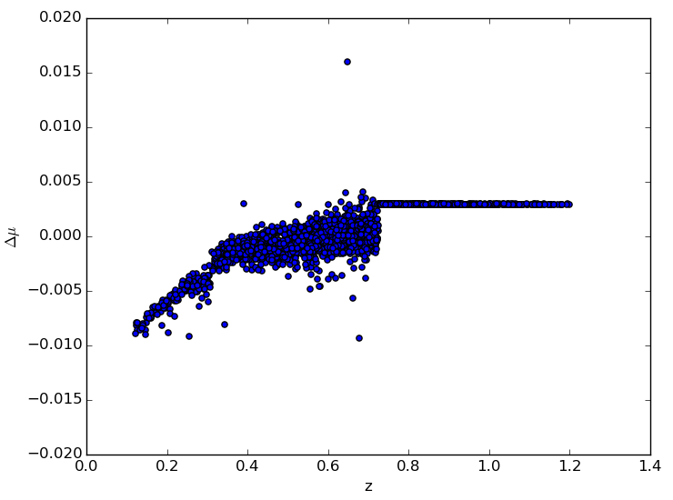
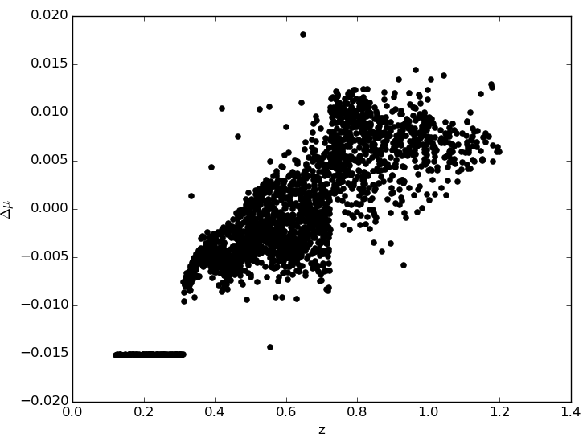
A 1% calibration uncertainty causes light curve fitter to add systematic bias in Distance Modulus with redshift as well as introducing scatter
g
z
Δμ
Δμ
z
z
Notes:
Effects of 1% systematic uncertainty in g band on left side and z band on right side
This bias results from the bias in light curve fit due to the additional systematic error in photometry. The flat line represents regions of redshift space where the light curve fitter does not use that band.

Slide 5
DES has several paths attacking the photometric calibration
Observations of standard stars (CalSpec and Other independently calibrated stars)
Cross-checking the Calibration with previous well-calibrated surveys like Pan-STARRS

Slide 6
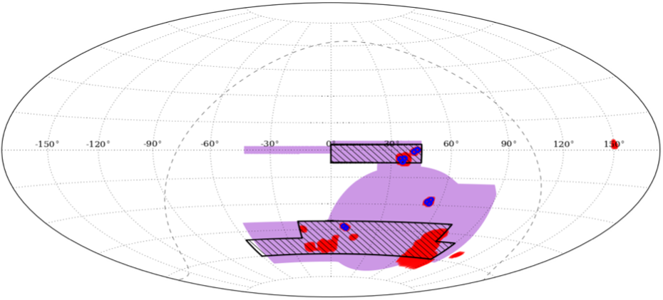
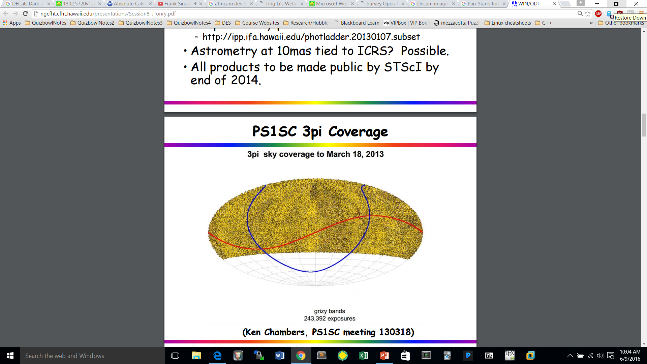
FGCM Calibration is cross-checked by prior surveys
Largest and best-calibrated survey, Pan-STARRS (PS1) overlaps with 8 DES Supernova Fields
PS1 is calibrated to 5 mmag across 3π of the sky
Yellow and black = PS1
Purple = DES wide field
Blue = DES supernova fields
Scolnic, D., S. Casertano, A. Riess, A. Rest, E. Schlafly, R. J. Foley, D. Finkbeiner, et al. 2015. “Supercal: Cross-Calibration of Multiple Photometric Systems to Improve Cosmological Measurements with Type Ia Supernovae.” The Astrophysical Journal 815 (2) (December 16): 117. doi:10.1088/0004-637x/815/2/117.

Slide 7
The cross-calibration of DES and PS1
Using the measured filter transmission functions of DES + PS1, we calculate synthetic magnitudes for a library of standard stars
Then compute the expected magnitude difference between the two surveys as a function of color.
Compare the expected difference with the observed difference

Slide 8
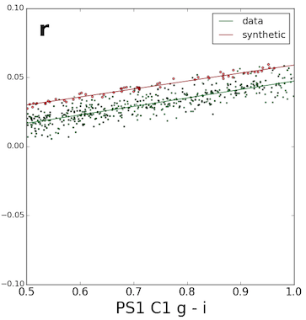
The cross calibration of DES and PS1
This plot is using the stars in DES field C1
Ideally, slopes are identical and the offset is zero.
Slopes here are very close to identical, but the offset is 13 mmag.
For individual fields this offset can vary by a few mmag from zero, but this is too much.
However, there are still unapplied corrections.
0.013 mag
PS1 mag – DES mag
PS1 g – i mag

Slide 9
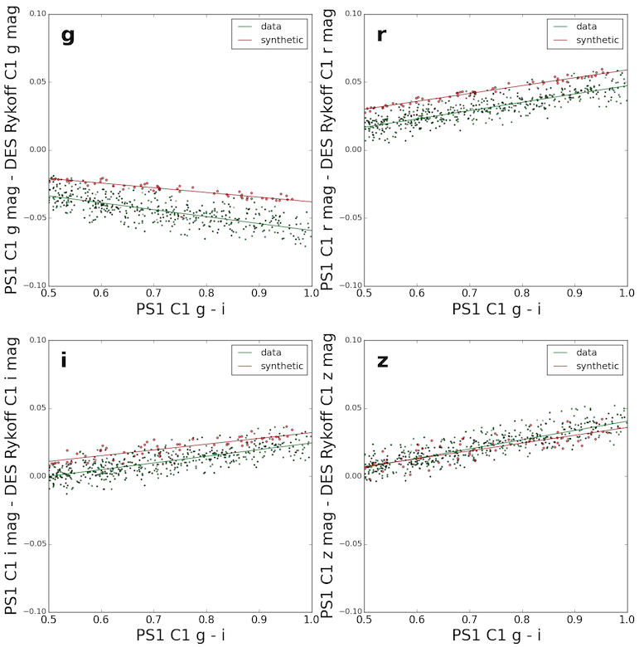
The cross calibration of DES and PS1
PS1 mag – DES mag
0.013 mag
0.016 mag
PS1 mag – DES mag
0.009 mag
-0.001 mag
PS1 g – i mag
PS1 g – i mag

Slide 10
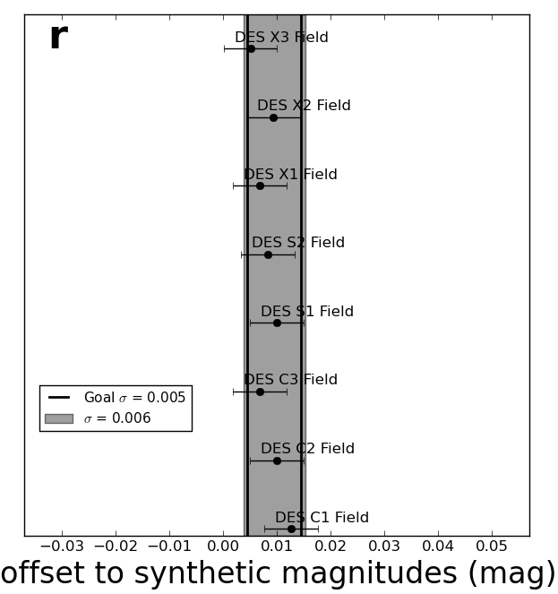
Field to Field Relative Calibration of DES and PS1
Calibration uncertainty goal is 0.5 % (5 mmag)
Shaded area indicates current uncertainty.
The arrows on the previous slide

Slide 11
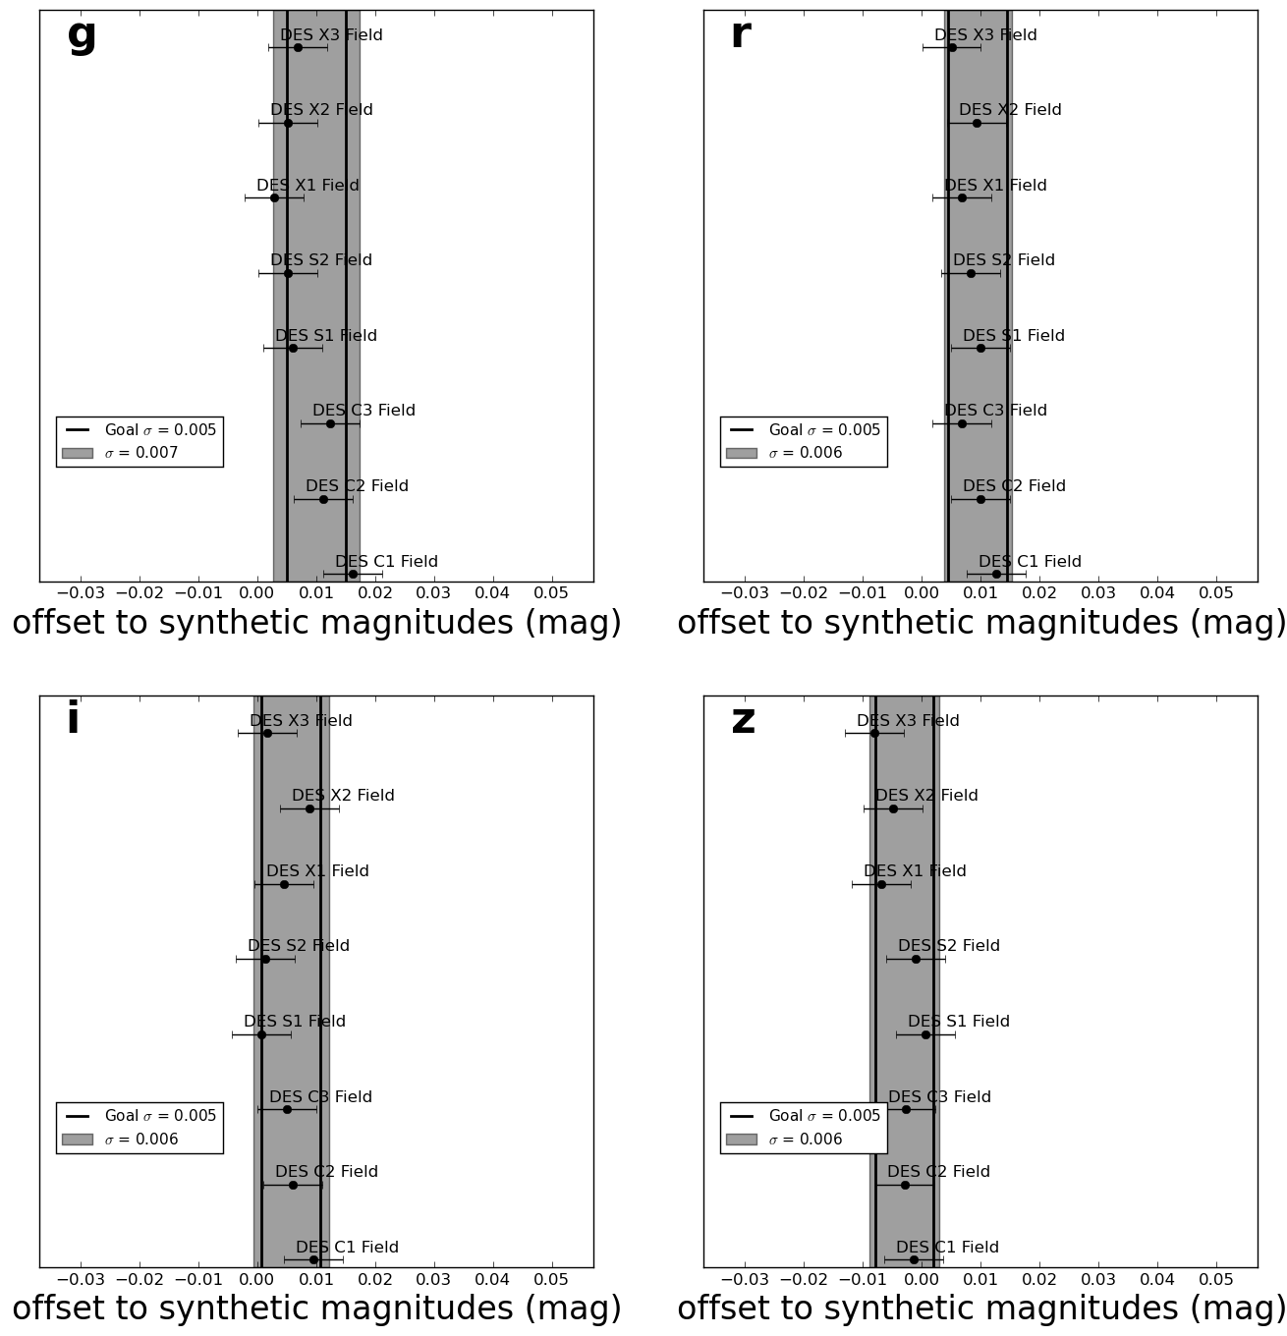
Field to Field Relative Calibration of DES and PS1

Slide 12
Conclusions
Difference Imaging only requires ~2% calibration
Current Calibration is ~1% (includes errors from standard stars not shown here)
In order to reduce Calibration systematic to be subdominant to statistics, need 0.5%
Still working to improve both mean and scatter using chromatic corrections from SN SEDs, atmospheric models, and CCD-by-CCD transmission functions.
Li, T. S., DePoy, D. L., Marshall, J. L., Tucker, D. L., Bernstein, G. M., et al., "Assessment of Systematic Chromatic Errors that Impact Sub-1% Photometric Precision in Large-Area Sky Surveys”, 2016, AJ, 151,157

