Slide 1
ELAsTiCC Tutorial
Rob Knop
DESC Sprint Week
2024-10-28

Slide 2
What is ELAsTiCC?
• Catalog-level simulation of 4 million transients and variables
‣ SNANA simulations (R. Kessler)
‣ 37 SNANA models*
‣ 62 million “sources” (photometry points), 43 million with S/N≥5
‣ 990 million “forced sources” (forced photometry points)
• Campaign to test LSST/DESC alert cycle (LSST Alerts → Brokers → DESC)
‣ Trial run: ELAsTiCC1, 2022 Sep–2023 Jan
‣ ELAsTICC2, 2023 Nov–Dec
‣ Includes broker classification data in addition to SNANA simulations from 4–5 brokers.
Notes:
Some of the models are different models for the same type of object, e.g. 6 different models for SNII.

Slide 3










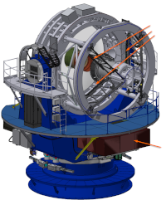

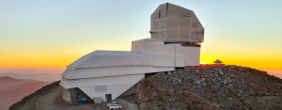


DESC
TOM
FAST
TiDES / 4MOST
Alert
Production
PPDB
DRP

Slide 4


“ppdb”, truth tables
ELAsTiCC
simulations
training sample
alert
ZADS Alert Server
classification
alert

Slide 5
Data Formats Available
• SNANA FITS files (+CSV for object truth)
• Parquet files
• Tarballs of AVRO alerts
• Web API / PostGreSQL Database on the DESC TOM

Slide 6
SNANA FITS Files
• Use if you already know or want to learn the SNANA format.
• Use with the lib_elasticc2 python library.
On NERSC: /global/cfs/cdirs/desc-td/ELASTICC2
• One subdirectory for each model
• 40 _HEAD.FITS and _PHOT.FITS (gzipped) files in each subdirectory
• CSV file in subdirectory with object truth: ELASTICC2_FINAL_{model}.DUMP

Slide 7
Parquet Files
On NERSC: /global/cfs/cdirs/desc-td/ELASTICC2_parquet
Parquet schema includes many (but not all) of the fields from the HEAD file and object truth file as scalars, and several fields from the PHOT files as lists. (See demo.)
Files are divided by SNANA model. SNID is the “key” field that identifies a given object.

Slide 8
DESC Tom Web API / SQL Database
https://desc-tom.lbl.gov
• You need a username/password on the TOM. (Ask Rob; give him the username you want and the email address associated with the TOM account.)
• There are some web API calls to get information (demo shortly). If there are others that you think would be useful, talk to Rob.
• There is an interface that lets you query the PostgreSQL database directly:
https://github.com/LSSTDESC/tom_desc/blob/main/sql_query_tom_db.ipynb

Slide 9
Structure of ELAsTiCC2 database
Note: all tables have elasticc2_ prepended
diaobject
diasource
brokermessage
4.1×10⁶
62×10⁶
377×10⁶
diaforcedsource
411×10⁶
brokerclassifier
diaobjecttruth
20
gentypeofclassid
• Brokers provided classifications as classID, using the ELAsTiCC2 taxonomy.
• Truth tables have SNANA gentype.
• The *of* tables provide the mapping.
classidofgentype
Table definitions:
https://github.com/LSSTDESC/elasticc/blob/lib_elasticc2/jupyter/sprint_week_2024oct/elasticc2_schema.txt

Slide 10
ELAsTiCC2 Taxonomy
Alert
└── 2000 Variable
│ ├── 2230 Fast
│ │ ├── 2231 Fast/Other
│ │ ├── 2232 KN
│ │ ├── 2233 M-dwarf Flare
│ │ ├── 2234 Dwarf Novae
│ │ └── 2235 uLens
│ └── 2240 Long
│ ├── 2241 Long/Other
│ ├── 2242 SLSN
│ ├── 2243 TDE
│ ├── 2244 ILOT
│ ├── 2245 CART
│ └── 2246 PISN
└── 2300 Recurring
├── 2310 Recurring/Other
├── 2320 Periodic
│ ├── 2321 Periodic/Other
│ ├── 2322 Cepheid
│ ├── 2323 RR Lyrae
│ ├── 2324 Delta Scuti
│ ├── 2325 EB
│ └── 2326 LPV/Mira
└── 2330 Non-Periodic
├── 2331 Non-Periodic/Other
└── 2332 AGN
https://github.com/LSSTDESC/elasticc/blob/main/taxonomy/taxonomy.ipynb
Alert
├── 0 Meta
│ ├── 100 Meta/Other
│ ├── 200 Residual
│ └── 300 NotClassified
├── 1000 Static
│ └── 1100 Static/Other
└── 2000 Variable
├── 2100 Variable/Other
├── 2200 Non-Recurring
│ ├── 2210 Non-Recurring/Other
│ ├── 2220 SN-like
│ │ ├── 2221 SN-like/Other
│ │ ├── 2222 Ia
│ │ ├── 2223 Ib/c
│ │ ├── 2224 II
│ │ ├── 2225 Iax
│ │ └── 2226 91bg

Slide 11
Tarballs of AVRO Alerts
• This is a terrible format for reading the data: redundant, inefficient.
• Only use these if you are specifically dealing with realtime processing of actual alerts.
• No, really, don’t use this format.
Alerts tarred up by MJD (all object types mixed):
/global/cfs/cdirs/desc-td/ELASTICC2_ALERTS
You will need the ELAsTiCC2 alert schema:
https://github.com/LSSTDESC/elasticc/tree/elasticc2/alert_schema
elasticc.v0_9_1.alert.avsc is the schema of an alert; it refers to other files in that directory.

Slide 12
Getting set up for the tutorials at NERSC
Setting yourself up to run the DESC Jupyter kernels:
source /global/common/software/lsst/common/miniconda/kernels/setup.sh
source /global/common/software/lsst/common/miniconda/kernels/setup.sh
→ This will set up the standard DESC kernels for use in jupyter. You may want to rerun this every so often to get updates!
(It creates directories and files underneath ~/.local/share/jupyter/kernel)
Verify that you have them with:
jupyter kernelspec list
→ You should see a number of desc-* kernels, including the most basic desc-python and desc-td-env-dev
https://confluence.slac.stanford.edu/display/LSSTDESC/Using+Jupyter+at+NERSC#UsingJupyteratNERSC-setup

Slide 13
Running the desc-td environment at NERSC
Jupyter is great for tutorials and demos and mucking about, but is not where you want to be doing serious development.
Get yourself into the desc-td environment on your shell at NERSC by running:
or (for the Time Domain environment):
source /global/common/software/lsst/common/miniconda/setup_current_python.sh
source /global/cfs/cdirs/lsst/groups/TD/setup_td.sh
source /global/cfs/cdirs/lsst/groups/TD/setup_td_dev.sh
or

Slide 14
Getting set up for the tutorials at NERSC
The tutorials use the Polars python package, which as of this writing is not in the standard DESC environments. Hopefully soon, this specific setup will become unnecessary! You will be able to just use the desc-python or desc-td kernels (or, outside of jupyter, environments).
https://github.com/LSSTDESC/desc-python/wiki/Add-Packages-to-the-desc-python-environment

Slide 15
Getting set up for the tutorials at NERSC
Run the following from a NERSC shell
cd $SCRATCH
mkdir desc_env_temp
export DESCPYTHONUSERBASE=$PWD/desc_env_temp
python /global/common/software/lsst/common/miniconda/start-kernel-cli.py desc-python
pip install --user --no-build-isolation polars
cd ~/.local/share/jupyter/kernels
cp -a desc-python desc-python-elasticc-tutorial
cd desc-python-elasticc-tutorial
{
"argv": [
"/global/common/software/lsst/common/miniconda/kernels/python-prod.sh",
"-f",
"{connection_file}"
],
"display_name": "desc-python-elasticc-tutorial",
"language": "python",
"env": { "DESCPYTHONUSERBASE": "$SCRATCH/desc_env_temp" }
}
Edit the file kernel.json to have the following contents (the last three lines are what’s changed; the last one added, the previous two modified).

Slide 16
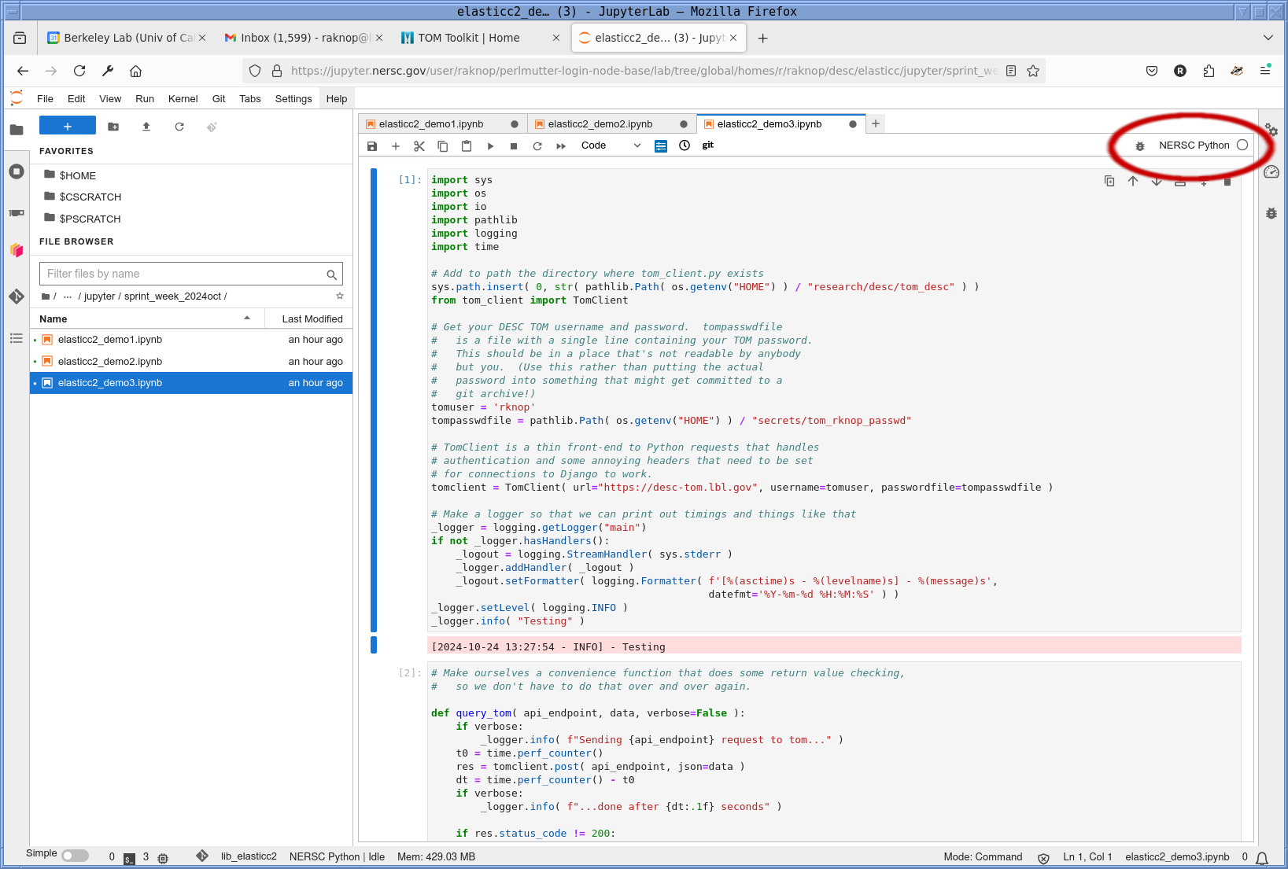
Change your kernel to desc-td-env-dev

Slide 17
Finding information about ELAsTiCC:
• ELAsTiCC public web page, ideally with full documentation:
https://portal.nersc.gov/cfs/lsst/DESC_TD_PUBLIC/ELASTICC/
• Slack: #elasticc-comms (ping me, Rick, Alex M., etc.)
• The DESC TOM:
• https://desc-tom.lbl.gov (ping me for an acocunt)
• https://github.com/LSSTDESC/tom_desc
• ELAsTiCC Metrics:
• https://desc-tom.lbl.gov/elasticc2/
• API:
https://github.com/LSSTDESC/elasticc_metrics/blob/main/elasticc2_rest_metric_demo.ipynb
• SQL:
https://github.com/LSSTDESC/tom_desc?tab=readme-ov-file#accessing-the-tom
https://github.com/LSSTDESC/tom_desc/blob/main/sql_query_tom_db.ipynb

