Slide 1
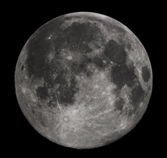
Notes:
This was originally my first slide. I kind of liked it there.
Background was brightened with power-point to get it to show up on a projector.

