Slide 1
A brief Introduction to Causal Inference
Zhelong Huang
https://kirigaya.cn

Slide 2
Overview
Introduction
Formulation
Graphs and models
Causal effect estimate

Slide 3
Motivating example: Simpson’s paradox
Introduction | Formulation | Graphs and models | Causal effect estimate

Slide 4
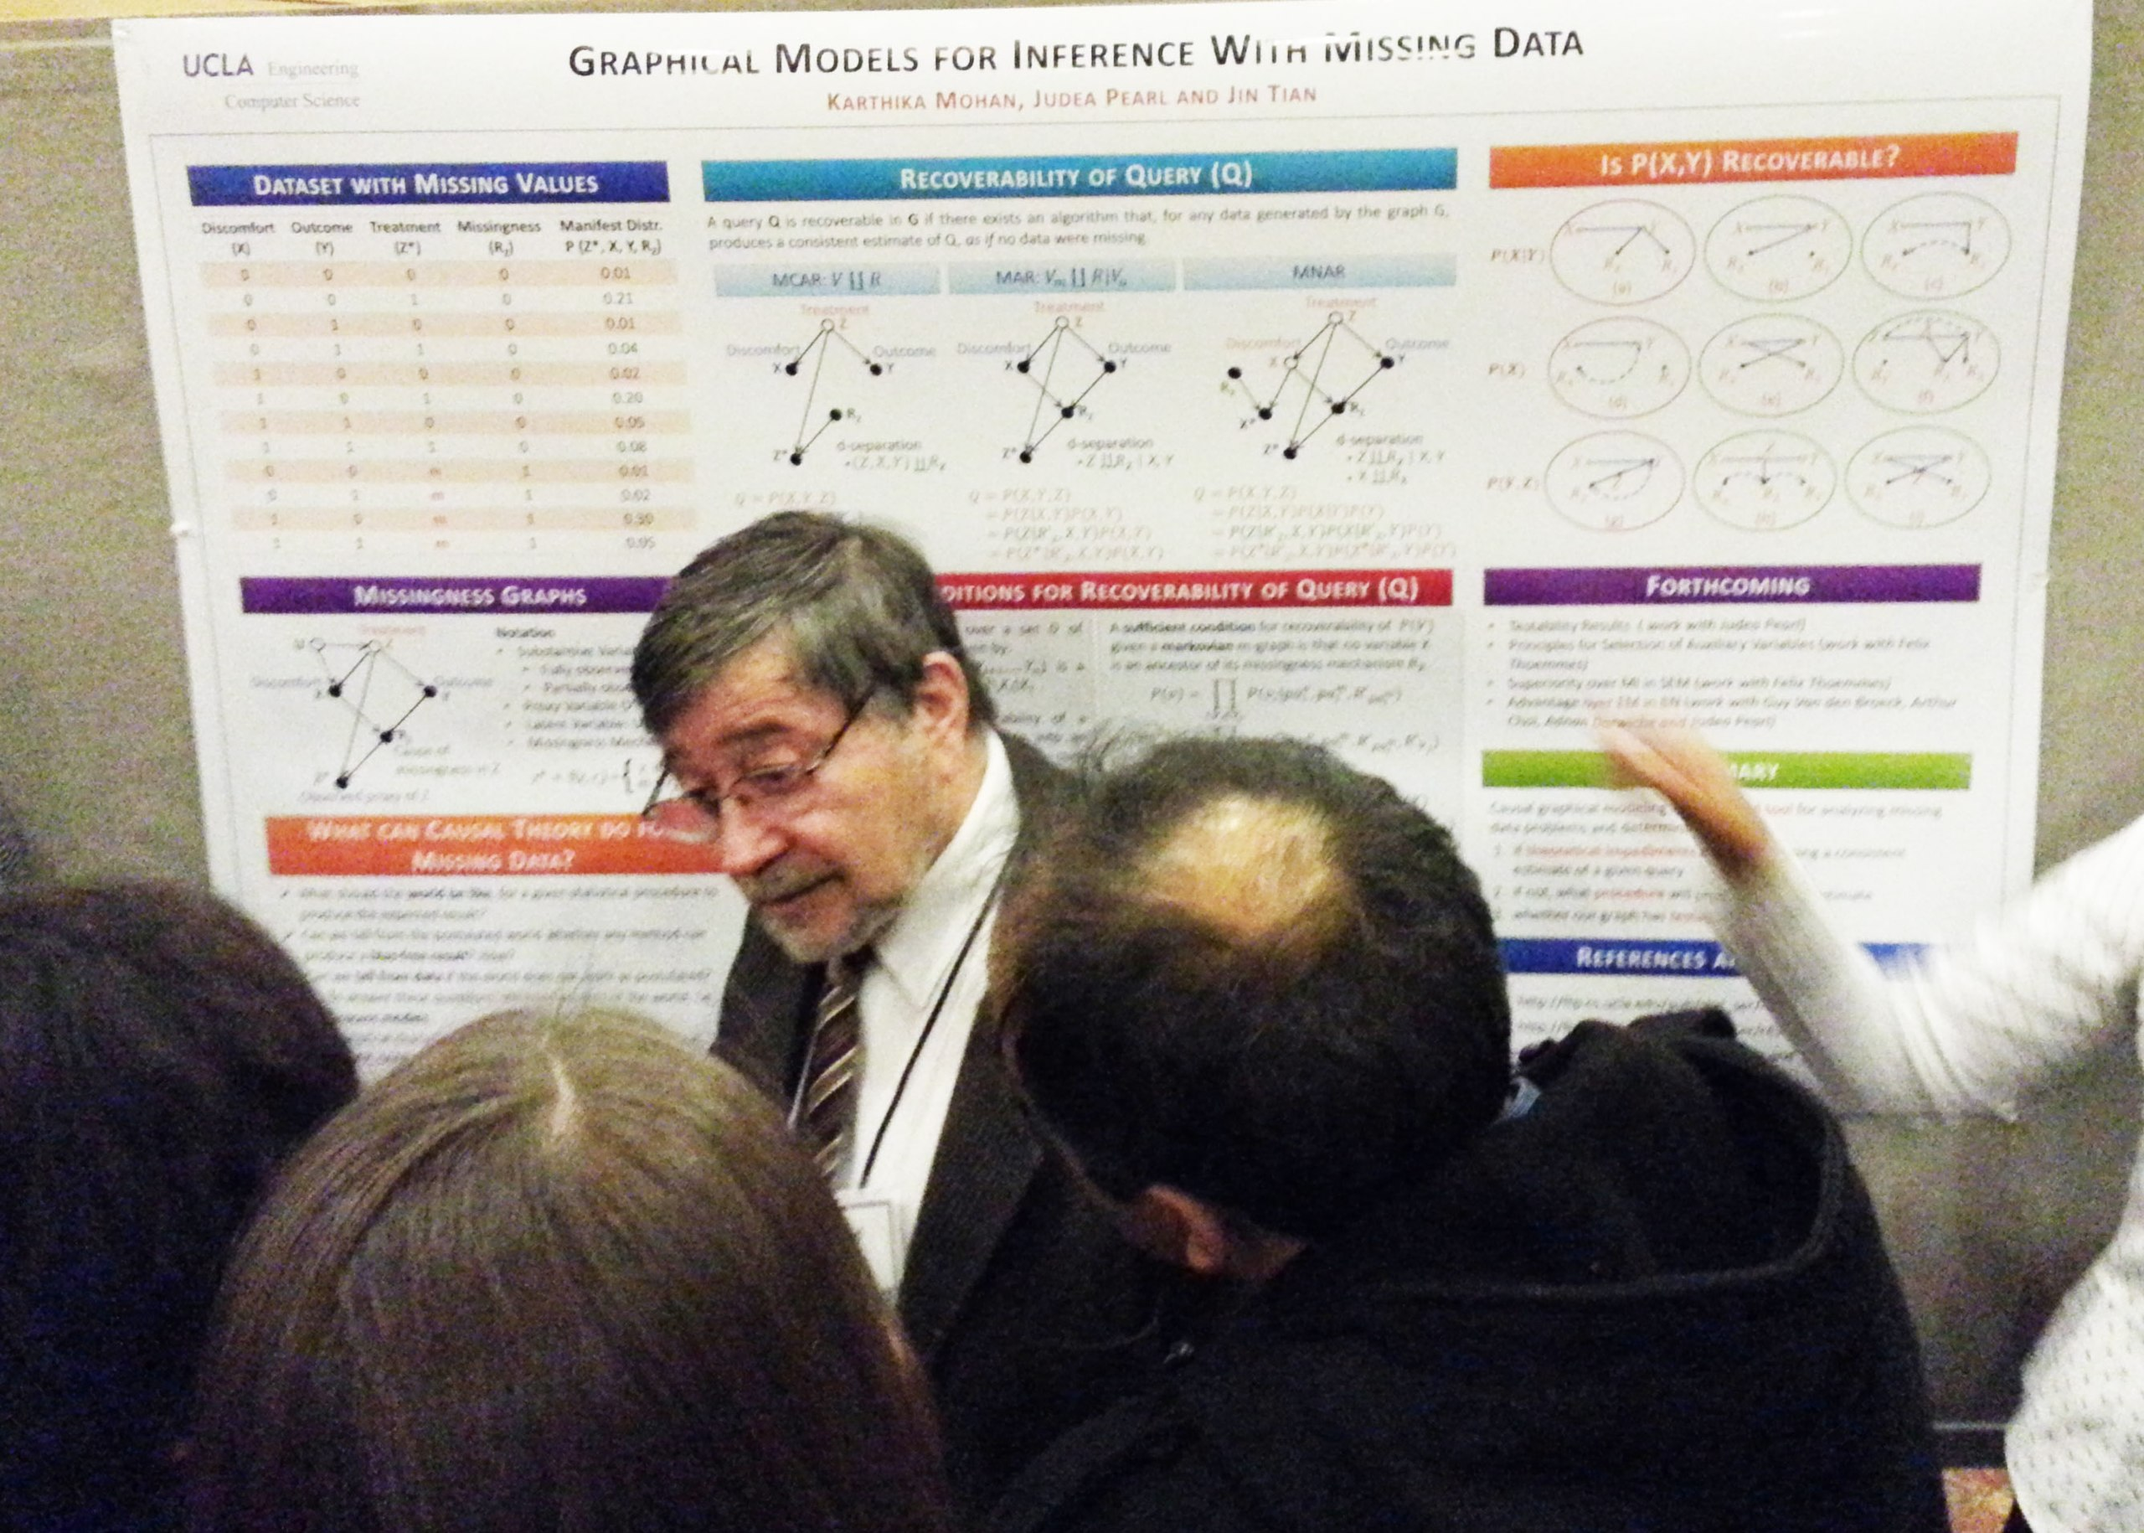
Judea Pearl at the 2013 Conference on Neural Information Processing Systems.
2011 Turing award

Slide 5
Overview
Introduction
Formulation
Graphs and models
Causal effect estimate

Slide 6
Overview
Introduction
Formulation
Graphs and models
Causal effect estimate

Slide 7
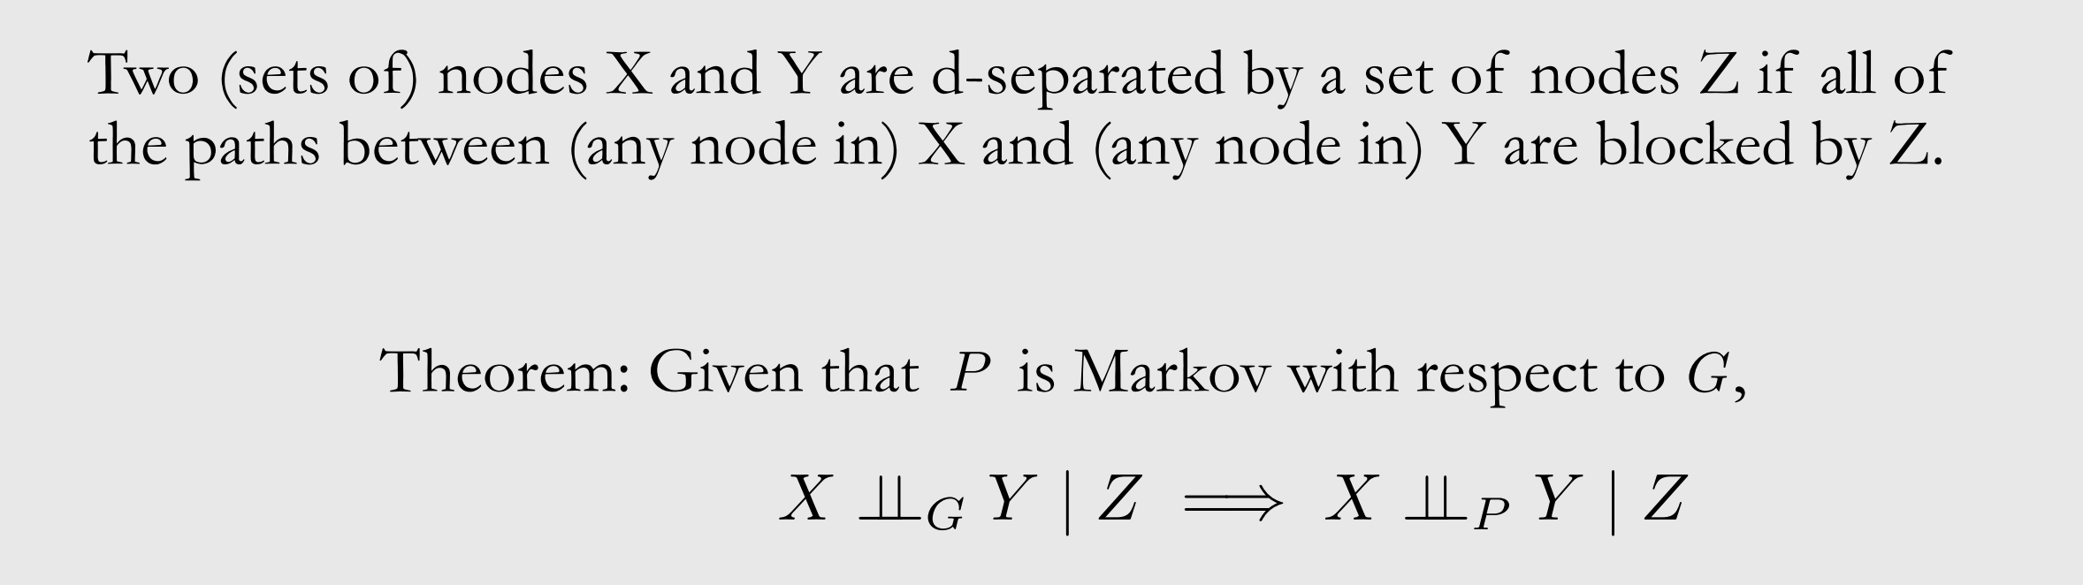
d-separation
$G$: Graph d-separation $P$: probability dependent
Introduction | Formulation | Graphs and models | Causal effect estimate

Slide 8
Overview
Introduction
Formulation
Graphs and models
Causal effect estimate

Slide 9
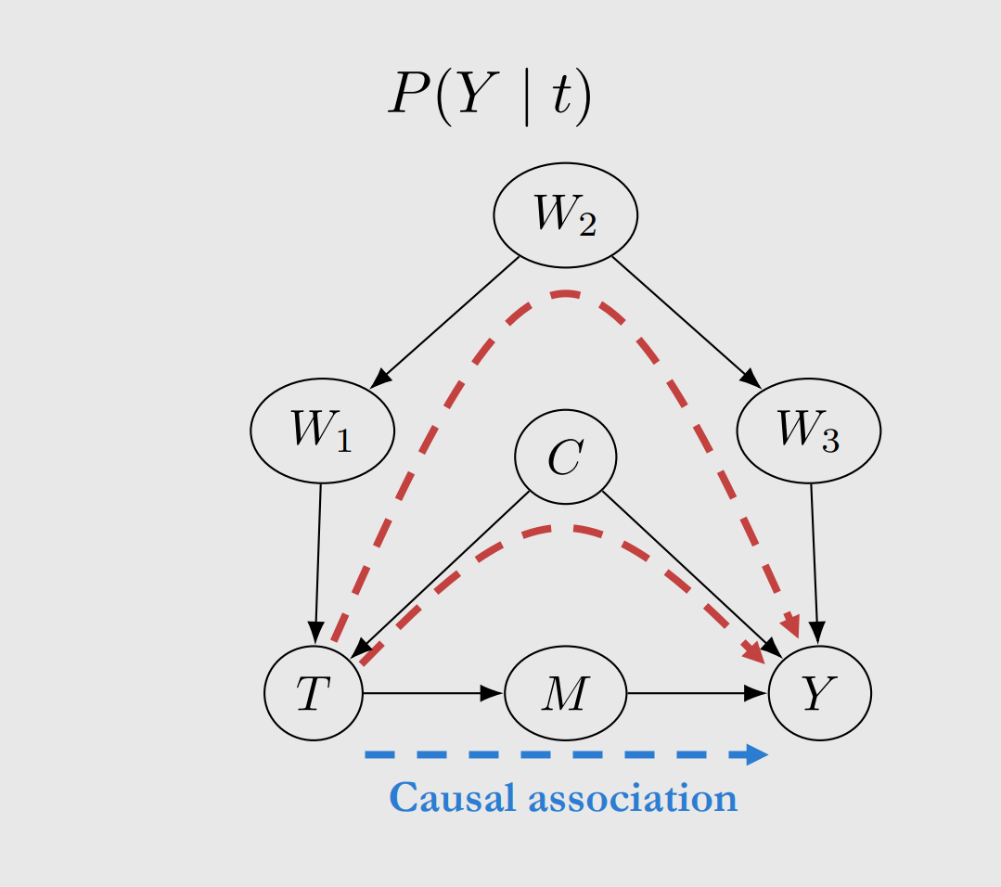
Blocking backdoor paths
Introduction | Formulation | Graphs and models | Causal effect estimate

Slide 10
Summary
Formulation
DAG
Fork, chain, immorality
Local Markov assumption, Minimality assumption, Causal edge assumption
Blocked path, d-separation, flow of association and causation

Slide 11
Inference and material
https://github.com/dougbrion/pytorch-classification-uncertainty
Sensoy M, Kaplan L, Kandemir M. Evidential deep learning to quantify classification uncertainty[J]. Advances in neural information processing systems, 2018, 31.
Zhelong Huang
https://kirigaya.cn

