Slide 1
Towards Accurate Camouflaged Object Detection With Mixture Convolution And Interactive Fusion
Unlimited progress
College
name

Slide 2
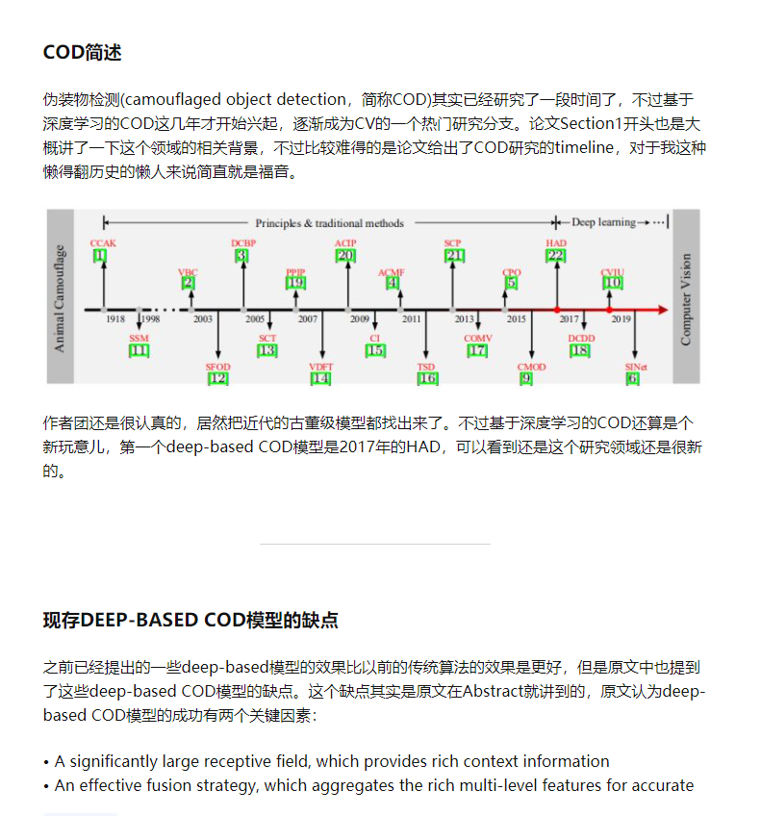
About paper/My note
published date: 2021.01.23
paper's url: https://arxiv.org/abs/2101.05687
major contribution: MCIF-Net
my note url: https://zhuanlan.zhihu.com/p/346044158

Slide 3
outline
Basic introduction of COD and its development timeline
Point out two major limitations of the existing deep-based COD methods: 1. ignore the significance of large reception fields 2. the feature fusion mechanism is too simple
The DMC (dual-branch mixture convolution) module is proposed for limitation1, and an attention-based fusion mechanism: the MIF (multi-level interactive fusion) module is proposed for limitation2.
Using ResNet50 as the backbone, the paper proposes MCIF-Net by combining the two modules mentioned above.
Results of quantitative evaluation shows that MCIF-Net outperforms SOTA models in terms of all four evaluation metrics.
Ablation studies on two benchmark datasets show the effectiveness of DMC and IMF.
Application on other COD-like tasks.

Slide 4
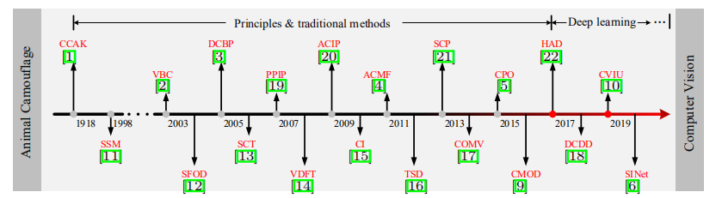
Timeline of COD
HAD proposed in 2017 is the first deep-based COD model

Slide 5
two major limitations
ignore the significance of large reception fields
DMC
the feature fusion mechanism is too simple
IMF

Slide 6
That's all
Unlimited progress

