Slide 1



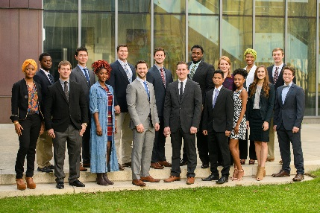

Pandas Dataframes: The Kevin Bacon of the data structures in data analytics James B. Davis, PhD Director, Master of Science in Analytics Louisiana State University

Slide 2


Kevin Bacon Game
Movie buffs challenge each other to find the shortest path between an arbitrary actor and prolific actor Kevin Bacon.
Similarly, data scientists are challenged with taking data from arbitrary resources and wrangling it into a structure for analysis.

Slide 3

Pandas Data Frames
Python library for data analysis
High-performance containers for data analysis
Data structures with a lot of functionality
Meaningful labels
Time series functionality
Handling missing data
Relational operations

Slide 4
Pandas Data Frames
Data import & export in various formats
csv, xlsx, json, and many others
“Wrangle” data
missing data
wrong format
Exploratory Data Analysis using pandas
Statistical & graphical methods

Slide 5
Pandas Data Frames
Let’s Practice!
https://github.com/LSU-Analytics/sql_saturday_2018

Slide 6
Why Consider the MSA?
The No. 1 job in America pays over $100,000 a year
As companies try to understand consumer behavior, data scientists are in high demand. Boasting a median base salary of $110,000 and a job-satisfaction score of 4.4 out of 5, data scientist was ranked No. 1 on Glassdoor’s “Best Jobs in America” list in 2016, 2017 and 2018.
https://www.msn.com/en-us/money/careersandeducation/the-no-1-job-in-america-pays-over-dollar100000-a-year/ar-AAsirZd

Slide 7
MS in Analytics
1-Year Program (6th Year)
Summer (3) Fall (5), Spring (5) Semesters
36 Credit Hours (R, Python, SAS workshops)
Full-Time, Part-Time, & Online
Work on Projects with Company Sponsors
Student groups submit proposals and are selected on a competitive basis
Certifications

Slide 8

Contact
James Davis, Director: jamesdavis@lsu.edu
225-892-0230 (c)
Gabrielle LeBoeuf: gleboe2@lsu.edu
Do not wait. APPLY NOW!

