Slide 1

Introduction to Python
A readable, dynamic, pleasant,
flexible, fast and powerful language
Dr. James Davis
Stephenson Department of Entrepreneurship
and Information Systems
jamesdavis@lsu.edu

Slide 2
Overview
Background
Syntax
Types / Operators / Control Flow
Functions
Classes
Tools

Slide 3

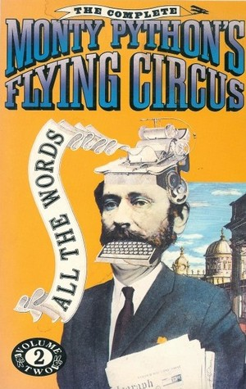
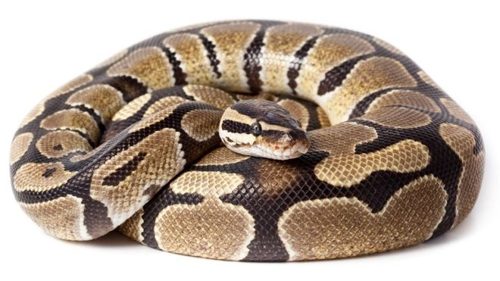
What about the name

Slide 4
What is Python
Multi-purpose (Web, GUI, Scripting, etc.)
Object Oriented
Interpreted
Focus on readability and productivity

Slide 5
Features
Batteries Included
Everything is an Object
Interactive Shell
Strong Introspection
Cross Platform
CPython, Jython, IronPython, PyPy

Slide 6
Who Uses Python
Google
NASA
Library of Congress
DOW Chemical
...the list goes on...

Slide 7
Releases
Created in 1989 by Guido Van Rossum
Python 1.0 released in 1994
Python 2.0 released in 2000
Python 3.0 released in 2008
Python 2.7 is a popular version
3.* adoption will took a few years
Python 3.6 is the recommended version

Slide 8
Syntax

Slide 9
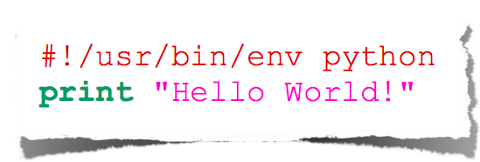
Hello World
hello_world.py

Slide 10
Indentation
Most languages don’t care about indentation
Most humans do
We tend to group similar things together

Slide 11
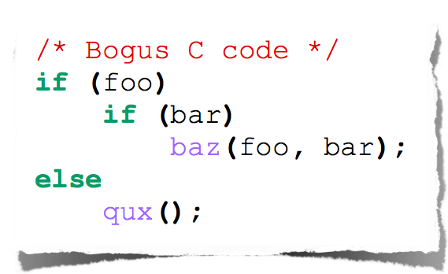
Indentation
The else here actually belongs to the 2nd if statement

Slide 12
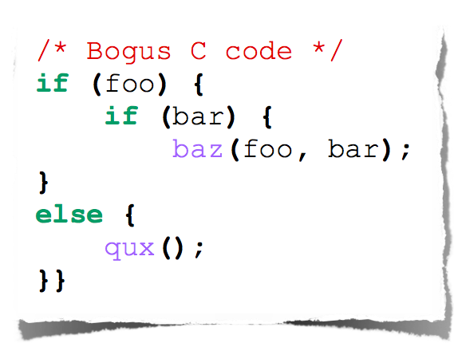
Indentation
The else here actually belongs to the 2nd if statement

Slide 13
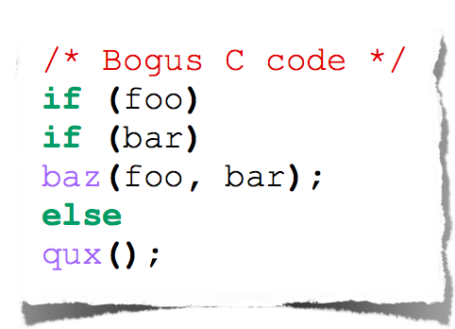
Indentation
Very bad habit

Slide 14
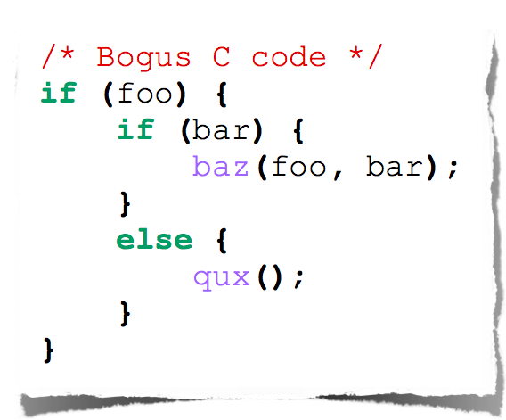
Indentation
You should always be explicit

Slide 15
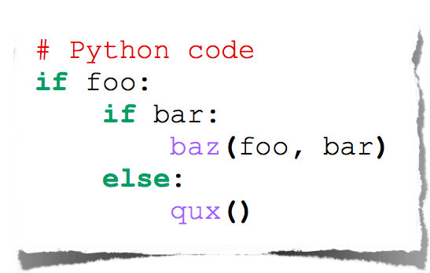
Indentation
Text
Python embraces indentation

Slide 16
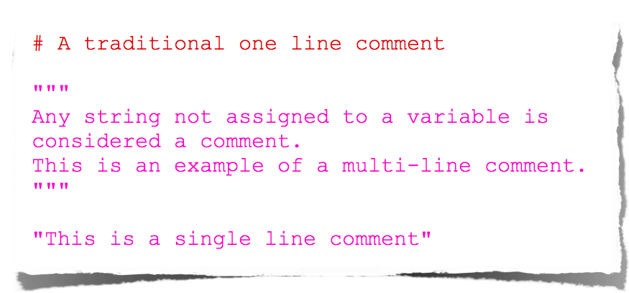
Comments

Slide 17
Types

Slide 18
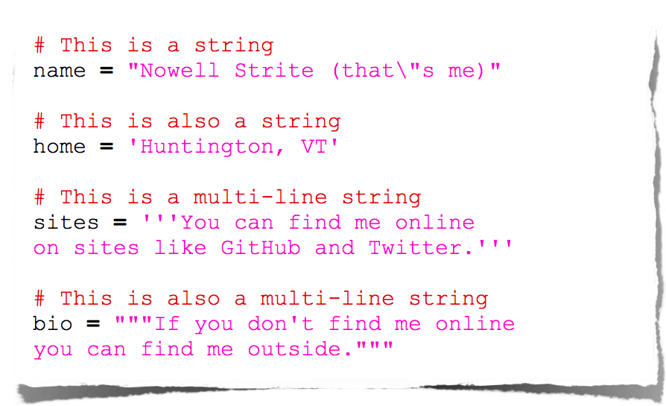
Strings

Slide 19
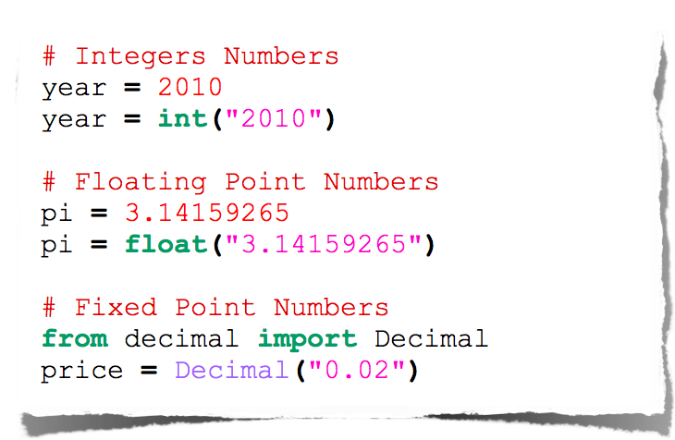
Numbers

Slide 20

Null

Slide 21
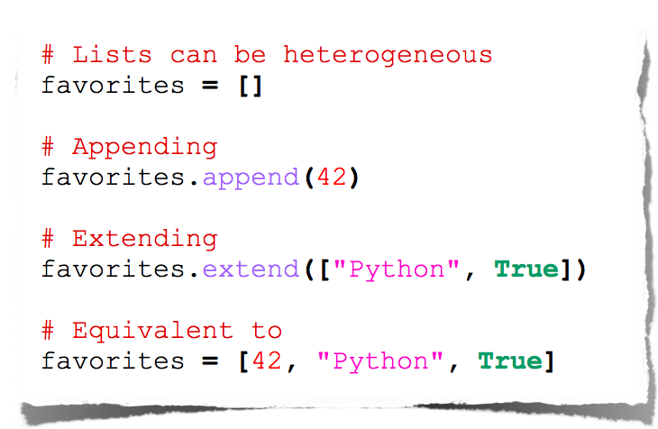
Lists

Slide 22
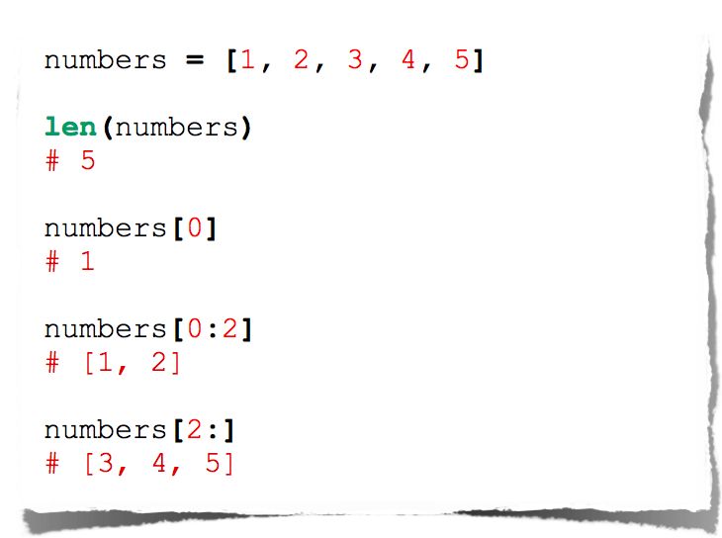
Lists

Slide 23
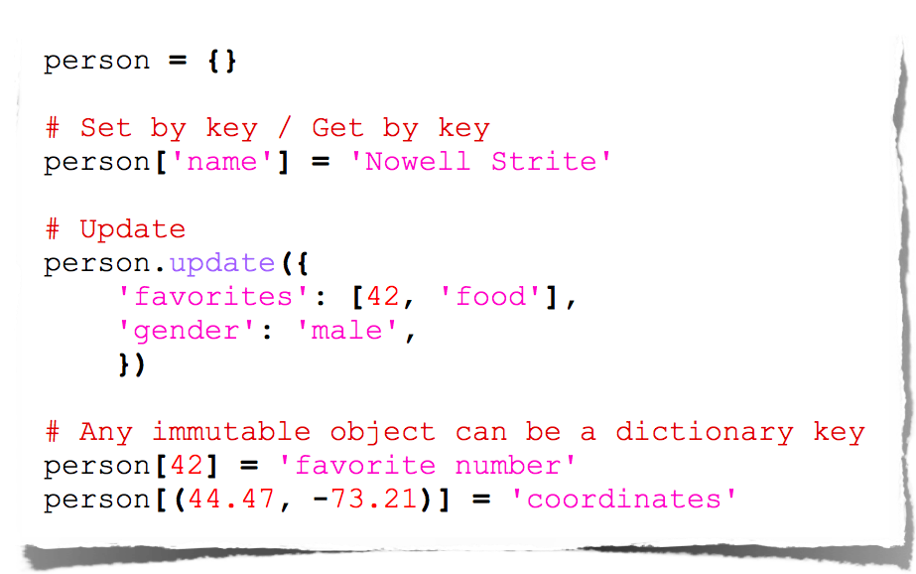
Dictionaries

Slide 24
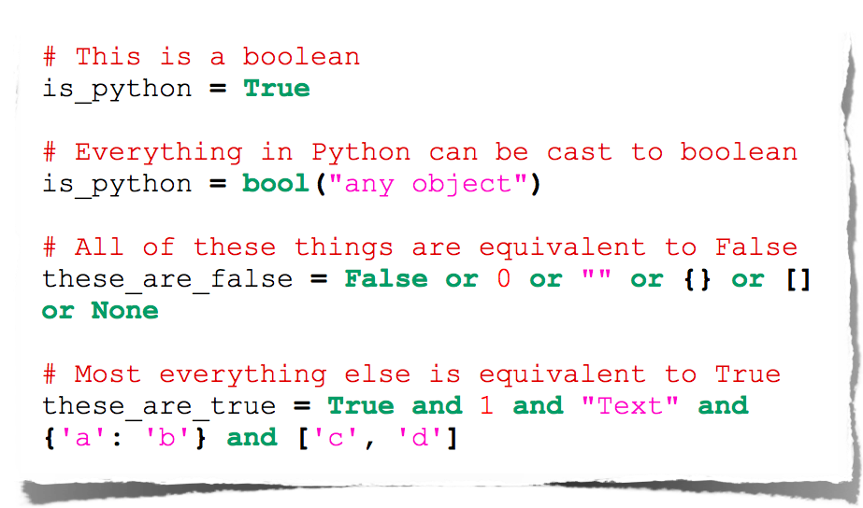
Booleans

Slide 25
Operators

Slide 26
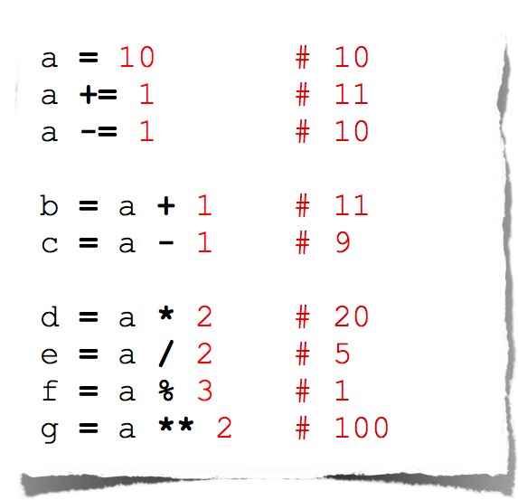
Arithmetic

Slide 27
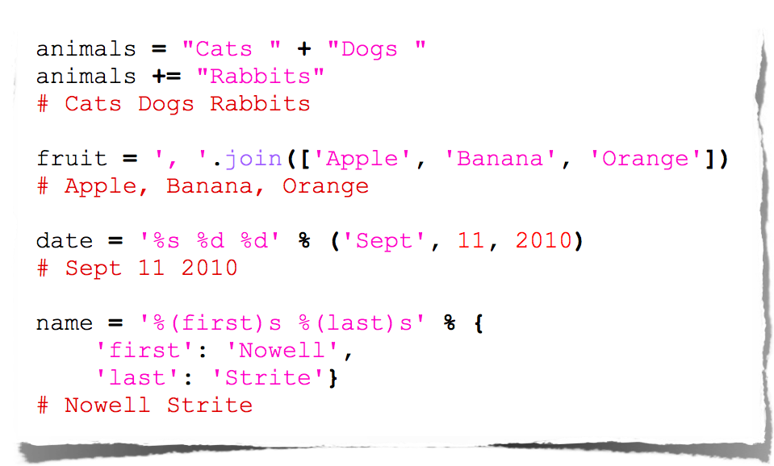
String Manipulation

Slide 28
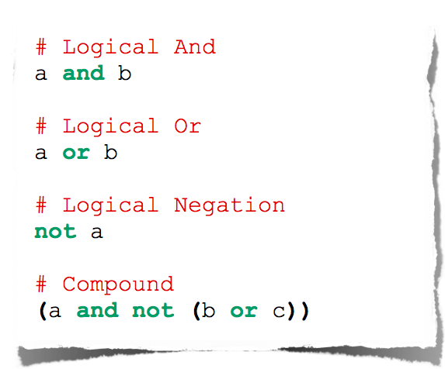
Logical Comparison

Slide 29
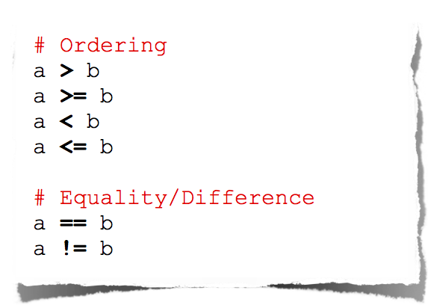
Arithmetic Comparison

Slide 30
Control Flow

Slide 31
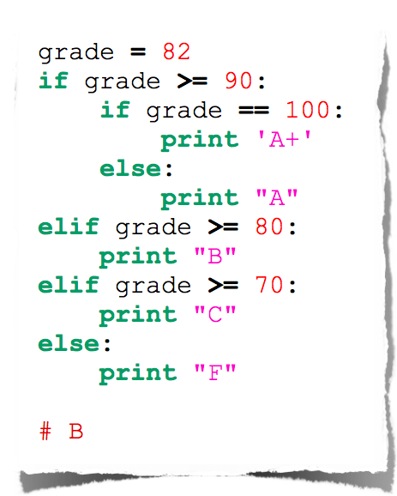
Conditionals

Slide 32
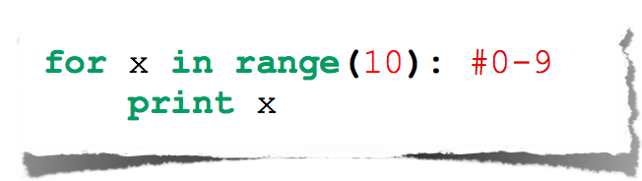
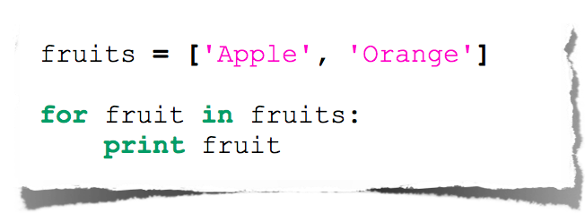
For Loop

Slide 33
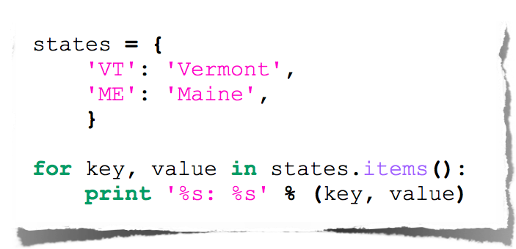
Expanded For Loop

Slide 34
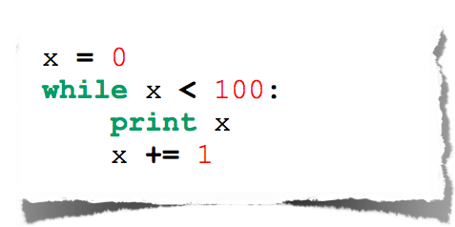
While Loop

Slide 35
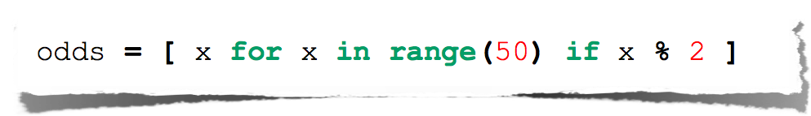
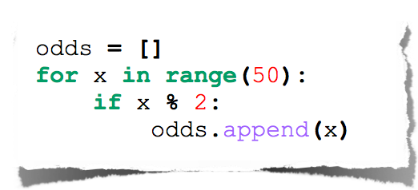
List Comprehensions
Useful for replacing simple for-loops.

Slide 36
Functions

Slide 37
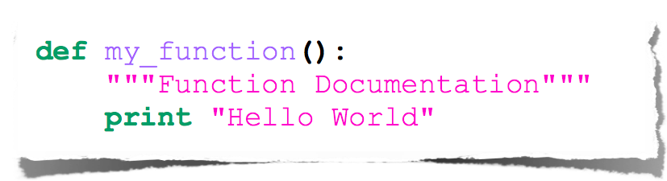
Basic Function

Slide 38
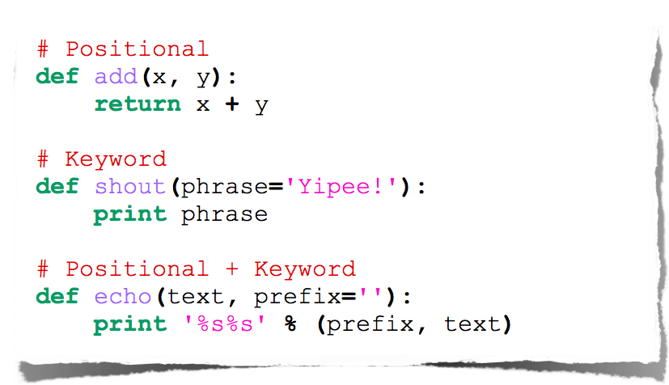
Function Arguments

Slide 39
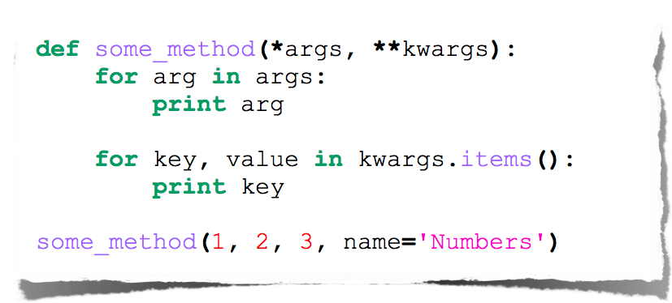
Arbitrary Arguments

Slide 40
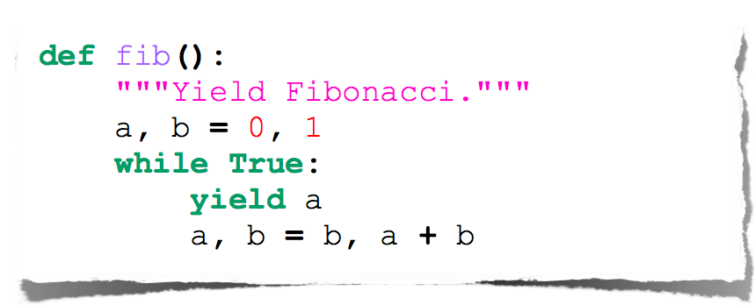
Fibonacci Generator

Slide 41
Imports
Allows code isolation and re-use
Adds references to variables/classes/functions/etc. into current namespace

Slide 42
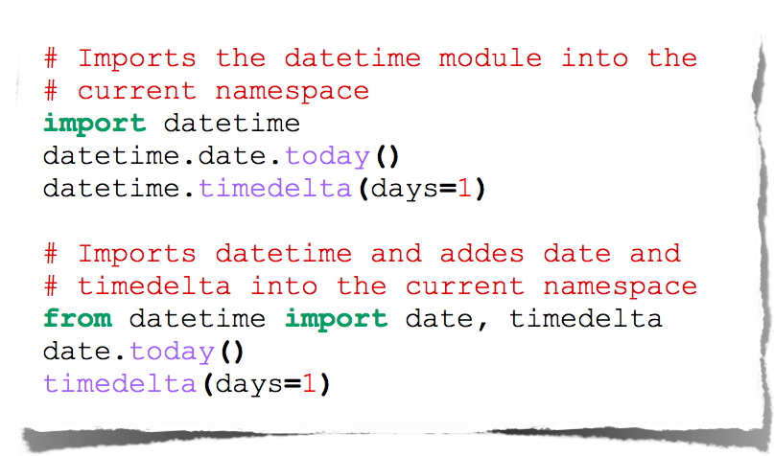
Imports

Slide 43
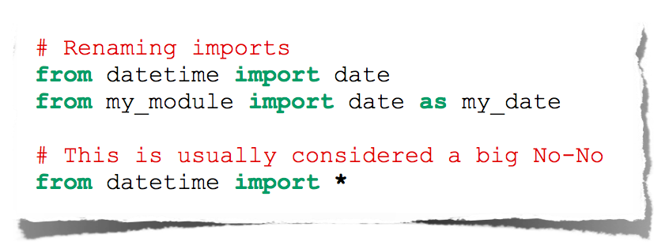
More Imports

Slide 44
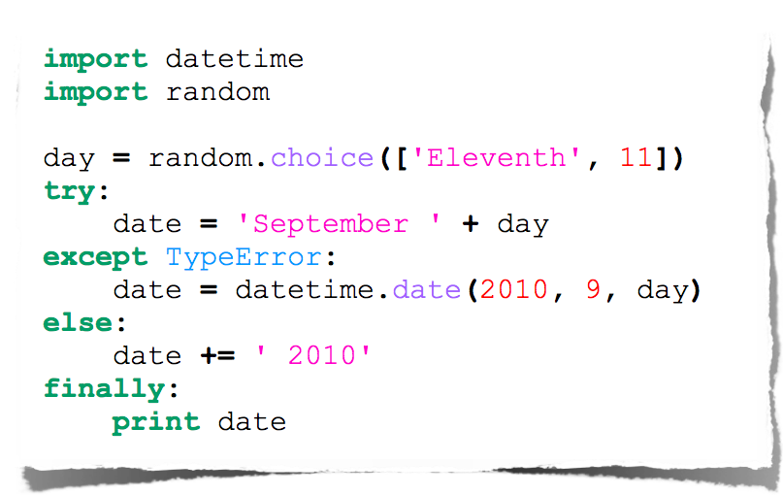
Error Handling

Slide 45
Documentation

Slide 46
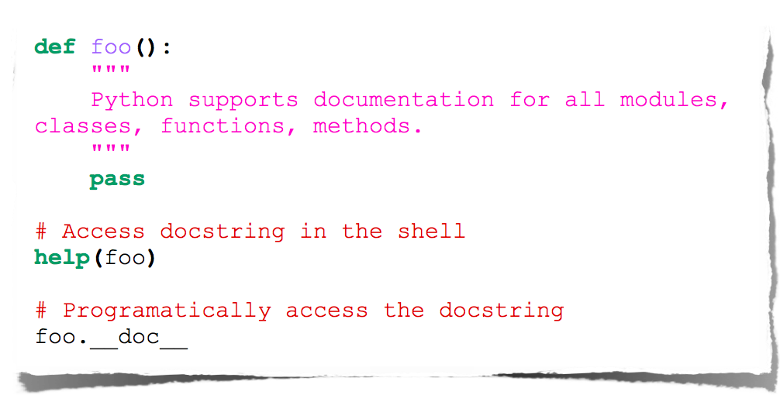
Docstrings

Slide 47
Tools

Slide 48
Web Frameworks
Django
Flask
Pylons
TurboGears
Zope
Grok

Slide 49
IDEs
Anaconda (Data Science)
Emacs
Vim
Komodo
PyCharm
Eclipse (PyDev)

Slide 50
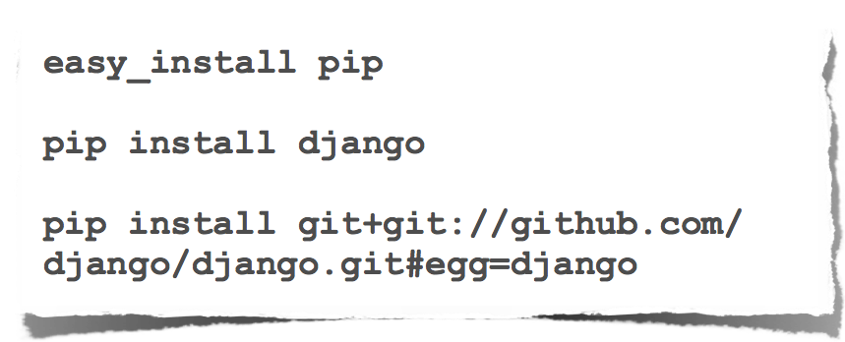
Package Management

Slide 51
Questions?

