Slide 1
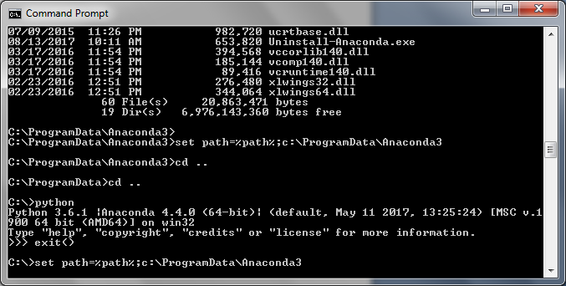
C:\> set path=%path%;c:\ProgramData\Anaconda3
C:\> set path=%path%;c:\ProgramData\Anaconda3\scripts

