Slide 1
Next Generation Engineering:
Seeing What’s Visible
Joseph Bordogna
National Science Foundation
http:// www.nsf.gov/bordogna
IEEE Computer Society
International Conference on Microelectronics Systems Education
July 21, 1997

Slide 2
“I never predict. I just look out the window and see what’s visible -- but not yet seen.”
Peter Drucker
Forbes Magazine
March 10, 1997

Slide 3
Innovation vis-a-vis Productivity
`
The source of wealth is something specifically human: KNOWLEDGE
Knowledge applied to tasks we already know how to do is PRODUCTIVITY
Knowledge applied to tasks that are new and different is INNOVATION
Managing for the Future: The 1990s and Beyond
Peter F. Drucker, 1992

Slide 4
Innovation System
Concurrent Integration
Analysis
Reduction
Synthesis
Integration
Science
Engineering
Innovation
Wealth Creation
Sustainable Development
Discovery of
New Knowledge
& Basic Laws
Design
Manufacture
Maintenance
Policy Context
Economic Context
Societal Needs
The Public Good
Natural Capital
T
Capital Formation
& Investment
e
c
h
Devices
Processes
Systems
n
o
Ideas
Information
l
o
g
y

Slide 5
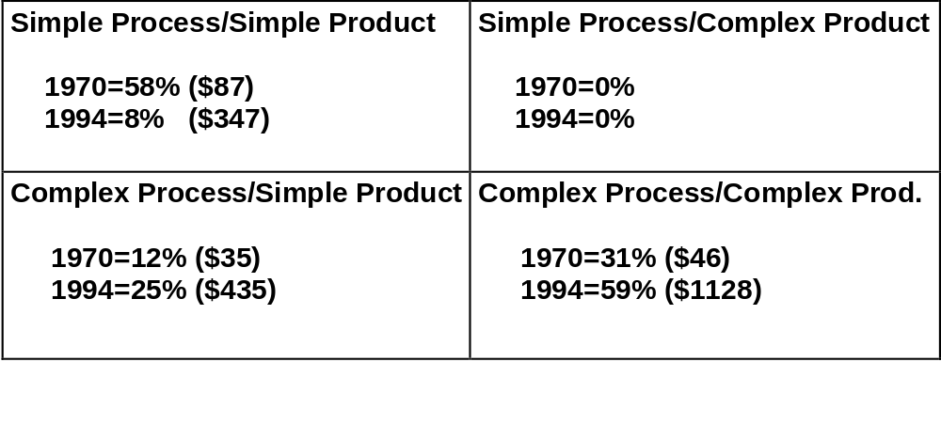
Added Value:
Thirty most Valuable Exports in 1970 & 1994
“Economic well being in the future will likely go to those who are
successful in innovating complex technologies.”
Source: Kash & Rycroft: “Technology Policy in the 21st Century…”

Slide 6
Innovation & Complexity
“Diversity is integral to complexity. The innovation of complex technologies is normally accomplished by accessing or creating new knowledge, decoupling from existing knowledge, and/or reconfiguring knowledge.”
“Innovation occurs in two ways, with the creation of new trajectories and through innovation along those trajectories. In most cases, commercial success comes with innovation along trajectories.”
Technology Policy in the 21st Century:
How Will We Adapt to Complexity? Don Kash, Robert Rycroft

Slide 7
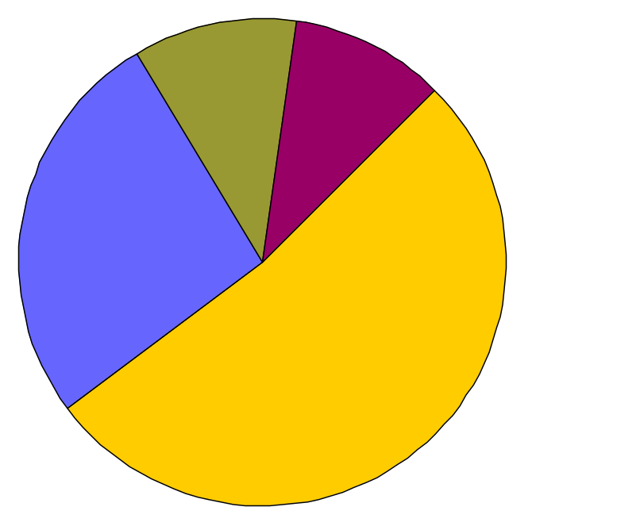
Science/Technology Linkage
New York Times
May 13, 1997
“Study Finds Publicly Financed Science is a Pillar of Industry”
73% of recent U.S. patents cite research from public & non-profit organizations.
Non-profit
11%
Govt. Labs
10.2%
Industry
26.7%
Academe
52.1%
Sources of papers cited
on U.S. Patents
Source: CHI Research (Narin, featured in New York Times on 5/13/97)

Slide 8
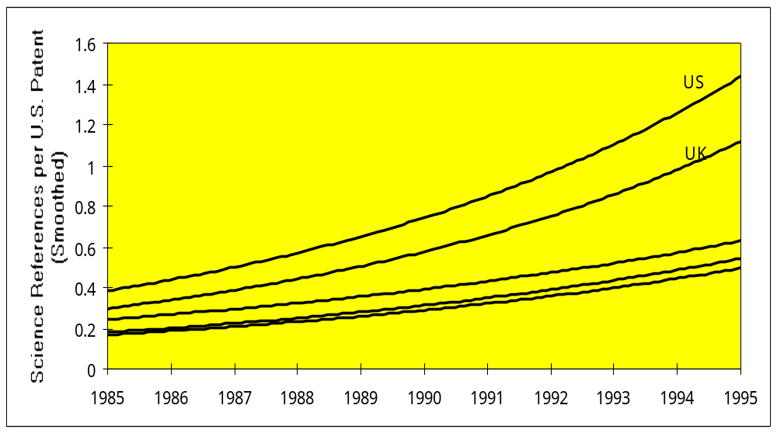
Science Linkage: Citations from Patents to Papers
France
Germany
Japan
Source: Narin (1997)

Slide 9
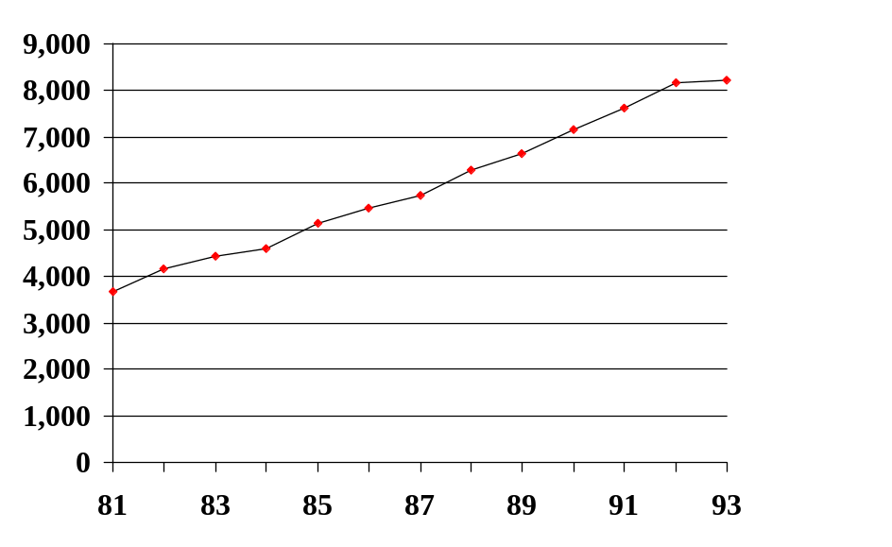
Industry-University Cooperation
Industry Articles with co-authors
from academe & government
Cross-sectoral co-authorship has grown steadily since ‘81
For industry papers:
  38% now include co-authors from academe
  up from 22% in ‘81
#
p
a
p
e
r
s
Source: S/E Indicators, Chapter 5

Slide 10
Next Generation Engineering Career Paths
Sustainable development: avoiding environmental harm; energy & materials efficiency
Life cycle engineering; infrastructure creation and renewal
Micro / nanotechnology / microelectromechanical systems
Mega systems
Smart systems
Multimedia and computer-communications systems
Living systems engineering
Product and process development, quality and control
System integration; system reconfiguration
Creative enterprise transformation
. . . ??

Slide 11
Next Generation Engineering Skill Set
Systems integration; synthesis
Engineering science; analysis
Problem formulation as well as problem solving
Engineering design
Ability to realize products
Facility with intelligent technology to enhance creative opportunity
Ability to manage complexity and uncertainty
Teamwork; sensitivity in interpersonal relationships
Language and multi-cultural understanding
Ability to advocate and influence
Entrepreneurship; management skills; decision making
Knowledge integration, education and mentoring

Slide 12
Components of a Holistic Baccalaureate Education
Vertical (In-depth) Thinking
Abstract Learning
Reductionism - Fractionization
Develop Order
Understand Certainty
Analysis
Research
Solve Problems
Develop Ideas
Independence
Technological - Scientific Base
Engineering Science
Lateral (Functional) Thinking
Experiential Learning
Integration - Connecting the Parts
Correlate Chaos
Handle Ambiguity
Synthesis
Design / Process / Manufacture
Formulate Problems
Implement Ideas
Teamwork
Societal Context / Ethics
Functional Core of Engineering

Slide 13
Functional Core of Engineering
Design to meet safety, reliability, environmental, cost, operational and maintenance objectives
Manufacturing and construction / Ability to realize products
Creation and operation of complex systems
Understanding of physical constructs and economic, industrial, social, political, and international context in which engineering is practiced
Understanding and participating in the process of research
Intellectual skills needed for career-long learning

Slide 14
Engineering Education
Practice-Oriented
Master’s-Level
Curriculum
Holistic
Undergraduate
Curriculum
Integrative
Discovery-Focused
Doctoral
Curriculum
Enable
Next Generation
Engineer
Cognitive
Systems
Infrastructure
Career-Long
Learning
Infrastructure

Slide 15
NSF: FY98 Holistic Themes
Knowledge & Distributed Intelligence
Life and Earth’s Environment
Educating for the Future

Slide 16
Knowledge and Distributed Intelligence
Knowledge is available to anyone, located anywhere, at anytime.
Power, information, and responsibility are moving away from centralized control to the individual.
Notes:
Major focus for NSF is KDI, Knowledge and Distributed Intelligence.
Refers to phenomenon resulting from convercence of computing and communications technologies.
Knowledge is available to anyone, located anywhere, at anytime.
Power, information, and responsibility are moving away from centralized control to the individual
KDI by contrast is perhaps the most encompassing venture NSF has ever pursued. It cuts across all fields of research and reaches education at all levels.

Slide 17
Knowledge & Distributed Intelligence in the Age of Information
Next Generation Internet
Multidisciplinary Approaches
  Knowledge Networking
  Learning and Intelligent Systems
  New Computational Challenges

Slide 18
Life and Earth’s Environment
Life in Extreme Environments
Urban Communities

Slide 19
Educating for the Future
Integration of Research and Education
Research Experiences for
Undergraduates (REU)
Faculty Early Career Development (CAREER)
Grant Opportunities for Academic Liaison with Industry (GOALI)
Systemic Reform
Integrative Graduate Education and Research Training (IGERT)

Slide 20
Challenges for 21st Century Academe
Educate students to:
See the world whole; sense the coupling among seemingly disparate fields of endeavor
Perform synthesis in balance with analysis
Build connections between the world of learning and the world beyond
Innovate

