Slide 1
Next Generation Engineering
Joseph Bordogna
National Science Foundation
http:// www.nsf.gov/bordogna
Strategic Directions in Biomedical Engineering
Whitaker Foundation
October 7, 1997

Slide 2
Innovation vis-a-vis Productivity
`
The source of wealth is something specifically human: KNOWLEDGE
Knowledge applied to tasks we already know how to do is PRODUCTIVITY
Knowledge applied to tasks that are new and different is INNOVATION
Managing for the Future: The 1990s and Beyond
Peter F. Drucker, 1992

Slide 3
Innovation System
Concurrent Integration
Analysis
Reduction
Synthesis
Integration
Science
Engineering
Innovation
Wealth Creation
Sustainable Development
Discovery of
New Knowledge
& Basic Laws
Design
Manufacture
Maintenance
Policy Context
Economic Context
Societal Needs
The Public Good
Natural Capital
T
Capital Formation
& Investment
e
c
h
Devices
Processes
Systems
n
o
Ideas
Information
l
o
g
y

Slide 4
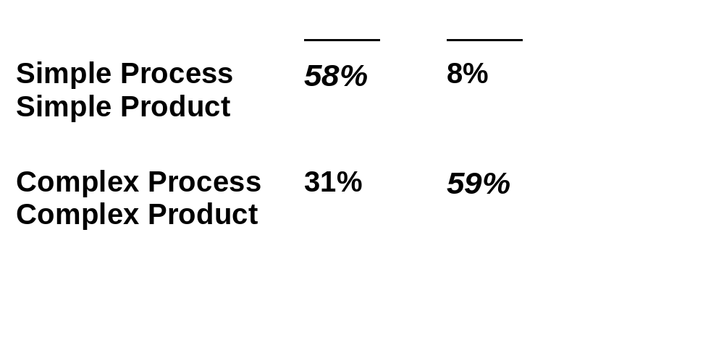
Complex Technologies & Global Markets
Comparison of Top 30 Exports, 1970 & 1994
“Economic well being in the future will likely go to those who are
successful in innovating complex technologies.”
Source: Kash & Rycroft, “Technology Policy in the 21st Century”.

Slide 5
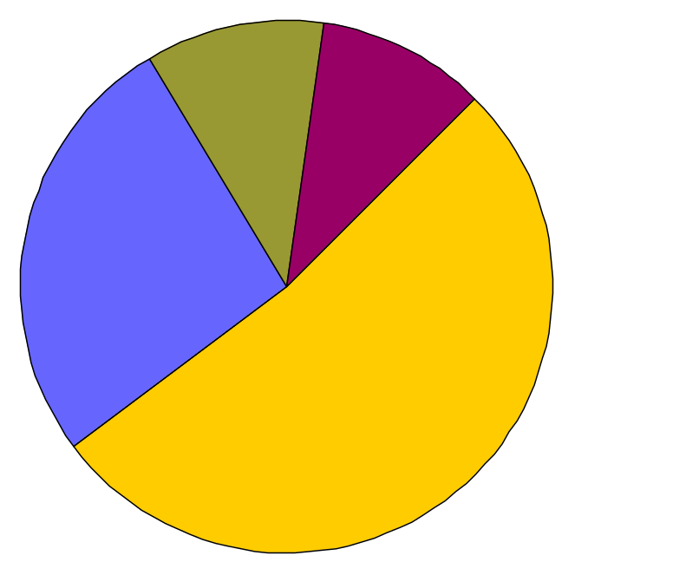
Science/Technology Linkage
New York Times
May 13, 1997
“Study Finds Publicly Financed Science is a Pillar of Industry”
73% of recent U.S. patents cite research from public & non-profit organizations.
Non-profit
11%
Govt. Labs
10.2%
Industry
26.7%
Academe
52.1%
Sources of papers cited
on U.S. Patents
Source: CHI Research (Narin, featured in New York Times on 5/13/97)

Slide 6
Next Generation Engineering Career Paths
Sustainable development: avoiding environmental harm; energy & materials efficiency
Life cycle engineering; infrastructure creation and renewal
Micro / nanotechnology / microelectromechanical systems
Mega systems
Smart systems
Multimedia and computer-communications systems
Living systems engineering
Product and process development, quality and control
System integration; system reconfiguration
Creative enterprise transformation
. . . ??

Slide 7
Next Generation Engineering Skill Set
Systems integration; synthesis
Engineering science; analysis
Problem formulation as well as problem solving
Engineering design
Ability to realize products
Facility with intelligent technology to enhance creative opportunity
Ability to manage complexity and uncertainty
Teamwork; sensitivity in interpersonal relationships
Language and multi-cultural understanding
Ability to advocate and influence
Entrepreneurship; management skills; decision making
Knowledge integration, education and mentoring

Slide 8
Components of a Holistic Baccalaureate Education
Vertical (In-depth) Thinking
Abstract Learning
Reductionism - Fractionization
Develop Order
Understand Certainty
Analysis
Research
Solve Problems
Develop Ideas
Independence
Technological - Scientific Base
Engineering Science
Lateral (Functional) Thinking
Experiential Learning
Integration - Connecting the Parts
Correlate Chaos
Handle Ambiguity
Synthesis
Design / Process / Manufacture
Formulate Problems
Implement Ideas
Teamwork
Societal Context / Ethics
Functional Core of Engineering

Slide 9
Functional Core of Engineering
Design to meet safety, reliability, environmental, cost, operational and maintenance objectives
Manufacturing and construction / Ability to realize products
Creation and operation of complex systems
Understanding of physical constructs and economic, industrial, social, political, and international context in which engineering is practiced
Understanding and participating in the process of research
Intellectual skills needed for career-long learning

Slide 10
Engineering Education
Practice-Oriented
Master’s-Level
Curriculum
Holistic
Undergraduate
Curriculum
Integrative
Discovery-Focused
Doctoral
Curriculum
Enable
Next Generation
Engineer
Cognitive
Systems
Infrastructure
Career-Long
Learning
Infrastructure

Slide 11
NSF Outcome Goals
Discoveries at and across the frontier of science and engineering.
Connections between discoveries and their use in service to society.
A diverse, globally-oriented workforce of scientists and engineers.
Improved achievement in mathematics and science skills needed by all Americans.
Meaningful information on the national and international science and engineering enterprise.

Slide 12
NSF Core Strategies
Develop Intellectual Capital
Strengthen the Physical Infrastructure
Integrate Research and Education
Promote Partnerships

Slide 13
NSF Themes
Knowledge & Distributed Intelligence
Life and Earth’s Environment
Educating for the Future

Slide 14
NSF Core Investments
Science and Technology Centers
Engineering Research Centers
Engineering Education Coalitions
Integrative Graduate Education and Research Training (IGERT)
Faculty Early Career Development (CAREER)
Grant Opportunities for Academic Liaison with Industry (GOALI)

Slide 15
Hardening of the Categories
“There is no graver threat to the process of discovery than that dread disease, ‘hardening of the categories’.”
Bob Miller
Science Artist
San Francisco

Slide 16
“I never predict. I just look out the window and see what’s visible -- but not yet seen.”
Peter Drucker
Forbes Magazine
March 10, 1997

Slide 17
Seeing What’s Visible:
21st Century Academe
Traditional
Department-based
Campus-centric
Few Links to Industry
Building-Block Courses
Research vs. Education
Emerging
Topic-based
Global Reach
Robust Industry Partnership
Holistic Curriculum
Integration of Research & Education

Slide 18
Challenges for 21st Century Academe
Educate students to:
See the world whole; sense the coupling among seemingly disparate fields of endeavor
Perform synthesis in balance with analysis
Build connections between the world of learning and the world beyond
Innovate

