Slide 1


Working capital that releases only when the cargo's own evidence says it should.
Evidence-gated trade finance, settled in Paxos USDG on Robinhood Chain.
Production build live on Robinhood Chain Testnet.
Mainnet release next.
Arbitrum Open House Singapore · Online Buildathon · October 2026
cargoflow.adoranto737.workers.dev · github.com/LSUDOKO/CargoFlow
Notes:
CargoFlow is working capital for physical trade that releases only when the cargo's own evidence says it should. A financier escrows Paxos USDG for one shipment, and signed sensor evidence decides, milestone by milestone, how much the exporter can draw. The production build is live on Robinhood Chain Testnet today, and the mainnet release is next.

Slide 2
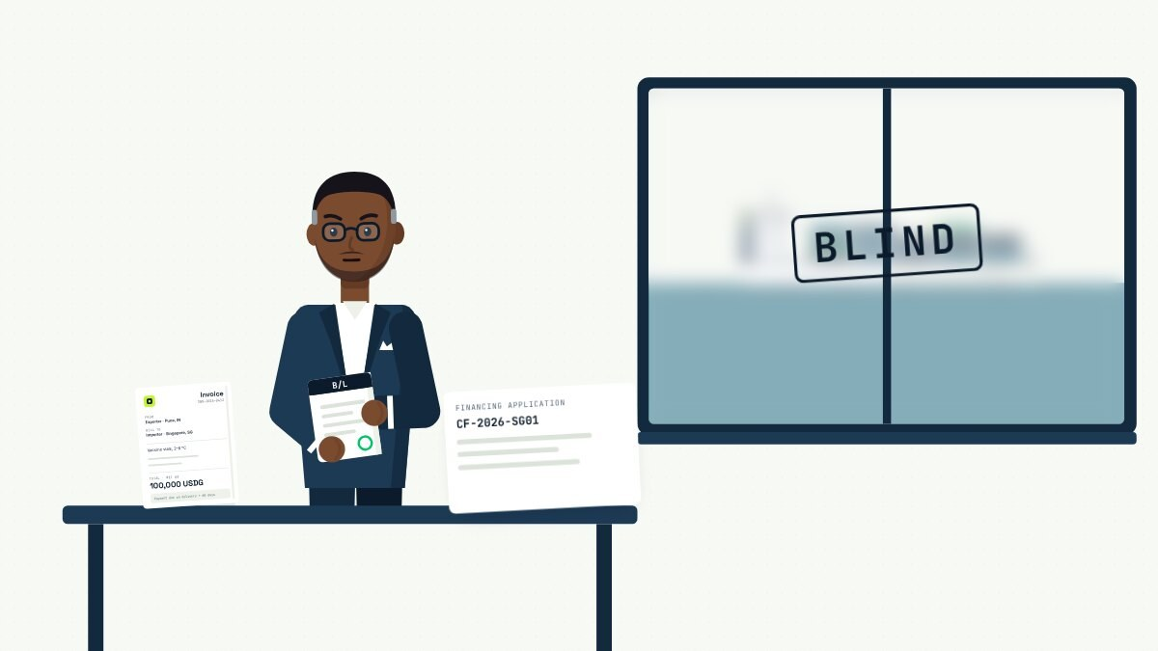
02 · THE PROBLEM
TRADE FINANCE TODAY
A lender sees paperwork, not the container.
So it lends blind, or does not lend at all. The exporter waits about two months for cash it has already earned, while the cargo is at risk in transit.
Daniel, the financier, holds the documents. The reefer stays out of sight.
Atradius Payment Practices Barometer India 2025: average B2B payment terms of 52 days
Notes:
Here is the problem. A lender advancing money against a reefer container sees invoices and a bill of lading, never the container itself, so it either lends blind or does not lend at all. Meanwhile the exporter waits about two months for cash it has already earned, and the cargo is at risk the whole way.

Slide 3
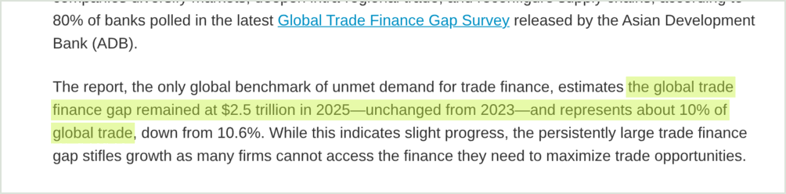
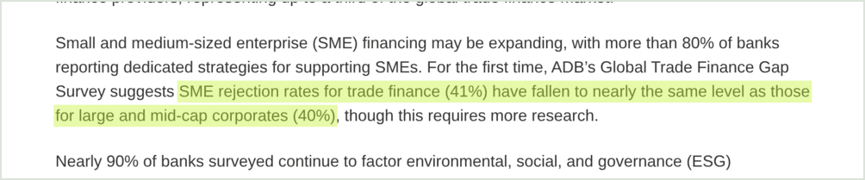
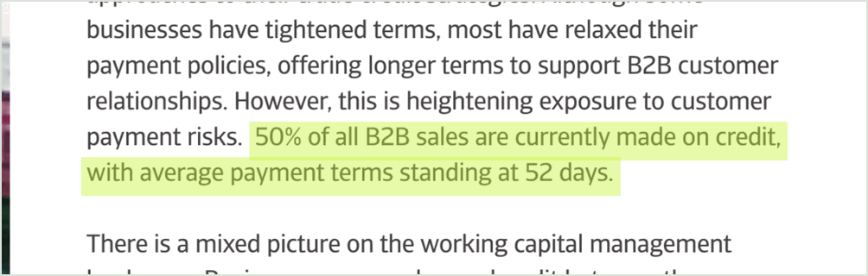
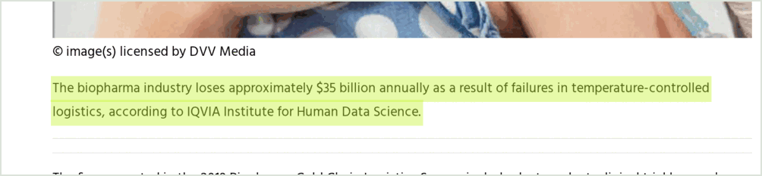
03 · THE PROBLEM, IN NUMBERS
SOURCED, HIGHLIGHTED ON THE ORIGINAL PAGES
The gap is large, and it is documented.
$2.5T
41%
global trade finance gap in 2025 (ADB)
of SME trade finance applications rejected (ADB)
52 days
~$35B
average B2B payment terms in India (Atradius)
lost by biopharma each year to cold-chain failures (IQVIA)
ADB, 15 Jan 2026 citing the ADB Global Trade Finance Gap Survey · Atradius India 2025, p. 3 · Air Cargo News, 26 Jul 2019, citing IQVIA
Notes:
The numbers are sourced and highlighted on the original pages. The Asian Development Bank puts the global trade finance gap at 2.5 trillion dollars in 2025, with 41 percent of SME applications rejected. In India, average B2B payment terms are 52 days, and biopharma alone loses about 35 billion dollars a year to cold-chain failures, according to IQVIA.

Slide 4
04 · WHY NOW
WHY NOW
Money became programmable. Now it can answer to evidence.
$
RH
P-256
Rs
Paxos USDG
Robinhood Chain
Passkeys on chain
Arbitrum Stylus
A US-dollar stablecoin from Paxos Digital Singapore. The only money CargoFlow moves.
An Arbitrum chain built for tokenised real-world assets, with USDG deployed.
The RIP-7212 precompile lets a buyer pay with Face ID, no seed phrase.
Evidence fusion in Rust, measured 19x cheaper than the Solidity reference.
USDG 0x7E95…802F on chain 46630 · 10 contracts source-verified · Stylus: 31,511 vs 611,945 gas at 128 readings (stylus/README.md)
Notes:
Why now: money has become programmable, and the rails CargoFlow needs now exist on one chain. Paxos USDG is the only asset CargoFlow moves, Robinhood Chain is an Arbitrum chain built for real-world assets with USDG already deployed, and its P-256 precompile lets a buyer pay with a passkey. Stylus runs the evidence maths in Rust, measured 19 times cheaper than the Solidity reference.

Slide 5
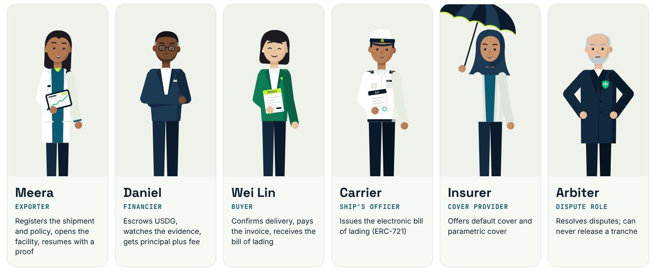
05 · THE SOLUTION
THE SOLUTION
Capital that answers to the cargo's evidence.
1
A financier escrows USDG for one shipment.
2
Tranches release only when signed sensor evidence passes an on-chain policy.
3
The buyer's one payment repays the financier, pays the exporter and hands over the bill of lading.
Illustrative characters. Everything they do is a real contract call.
PHYSICAL REALITY · CRYPTOGRAPHIC EVIDENCE · EVIDENCE CONFIDENCE · FINANCIAL RISK · AVAILABLE CAPITAL · USDG SETTLEMENT
Notes:
CargoFlow in three lines. A financier escrows USDG for one shipment; tranches reach the exporter only when the cargo's signed sensor evidence satisfies an on-chain policy; and the buyer's single payment repays the financier, pays the exporter and hands over the electronic bill of lading in the same transaction. Meet the cast: Meera exports, Daniel finances, Wei Lin buys.

Slide 6
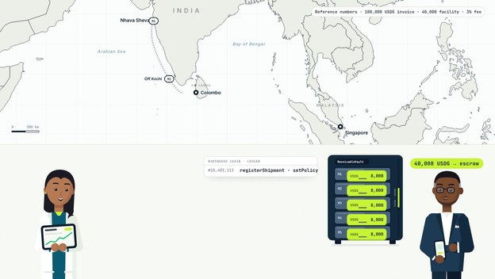
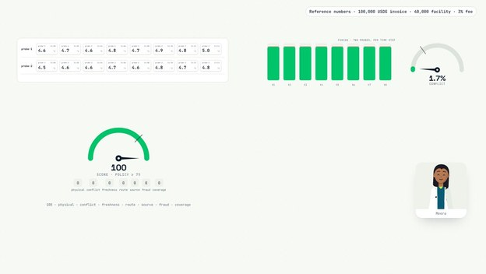
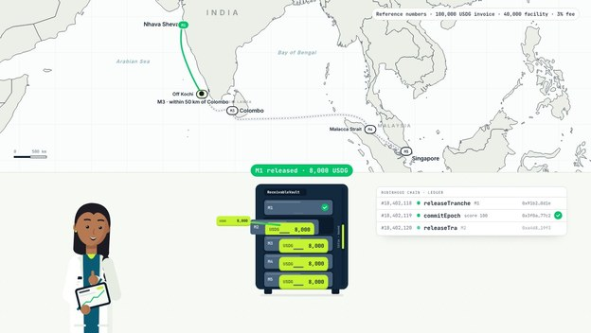
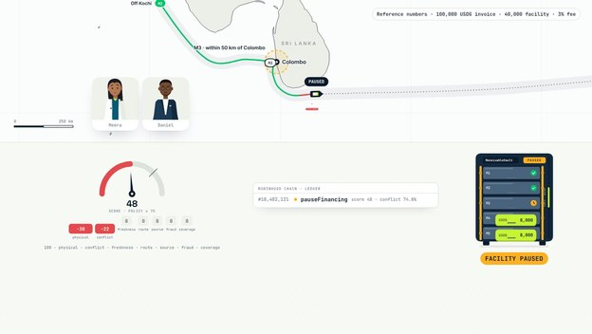
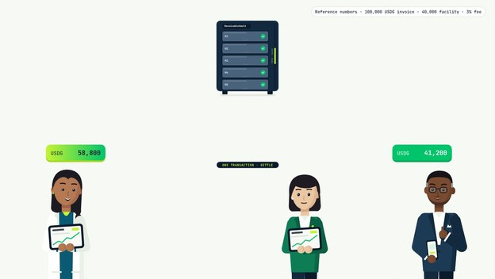
06 · HOW IT WORKS
HOW IT WORKS
Five steps, every one on chain.
1
Escrow
2
Evidence
3
Release
4
Pause, prove
5
Settle
Daniel deposits the 40,000 USDG facility into the vault.
Signed readings fuse into a score from 0 to 100.
Evidence passes the policy: 8,000 USDG to Meera.
Score 48 pauses it; a Groth16 proof resumes it.
One 100,000 USDG payment splits and moves the title.
Reference numbers: 100,000 USDG invoice, 40,000 USDG facility, 3% fee.
createFacility · depositCapital · commitEpoch · evaluateAndReleaseMilestone · pauseFinancing · resumeWithProof · settle (contracts v3, 3 Oct 2026)
Notes:
Five steps, every one on chain. Daniel escrows the whole facility; the logger signs each reading and the backend fuses the probes into a score; when evidence passes the policy in the right place, a tranche goes to Meera. If a probe overheats the score drops to 48 and releases stop, until a Groth16 proof of the other probe's readings resumes the facility, and Wei Lin's single payment settles everything.

Slide 7
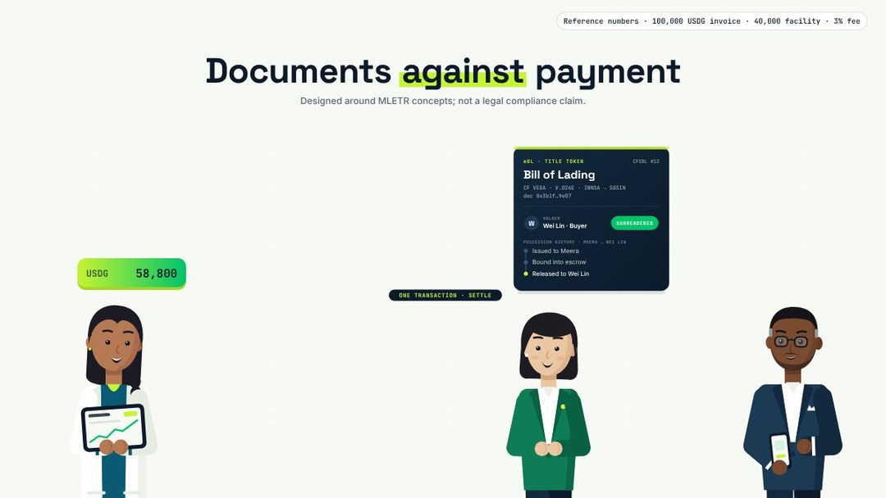
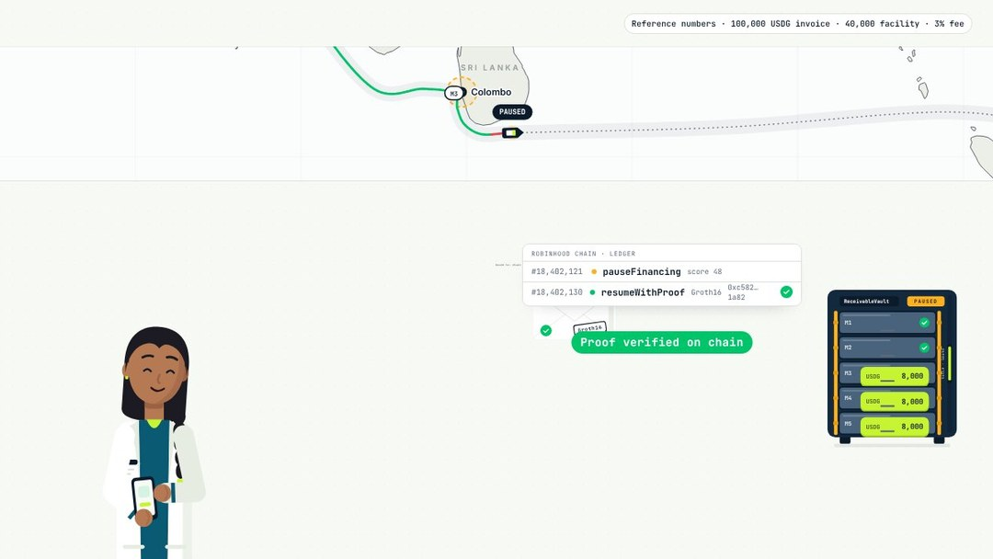
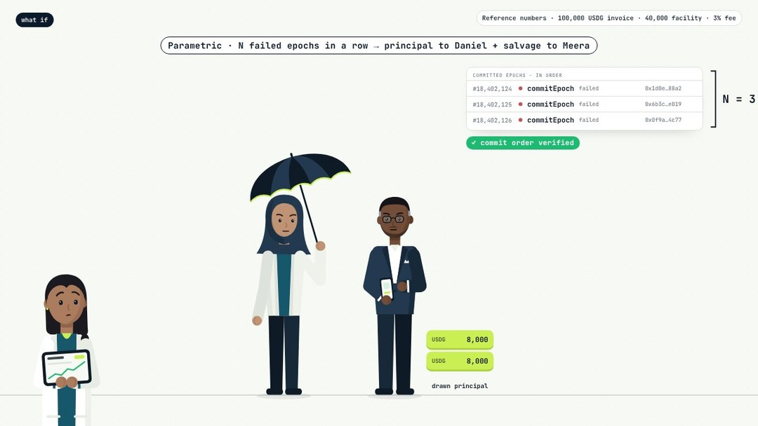
07 · SAFETY NETS
BUILT INTO THE CONTRACTS
Safety nets are part of the protocol.
Title moves with money
Automatic recovery
Parametric cover
The carrier's ERC-721 bill of lading leaves escrow inside the buyer's payment.
A proof is prepared once a probe has eight fresh in-band readings. The exporter signs once.
Pays out after N failed epochs in a row, proven from the commit order.
Disputes go to an arbiter role that can never release money · README "Under the hood" · docs/architecture.md
Notes:
Three safety nets are part of the protocol, not bolted on. The bill of lading leaves escrow inside the buyer's payment, so title and money move together. Recovery is automatic once a probe has eight fresh in-band readings, and parametric cover pays after N failed epochs in a row, proven from the registry's own commit order.

Slide 8
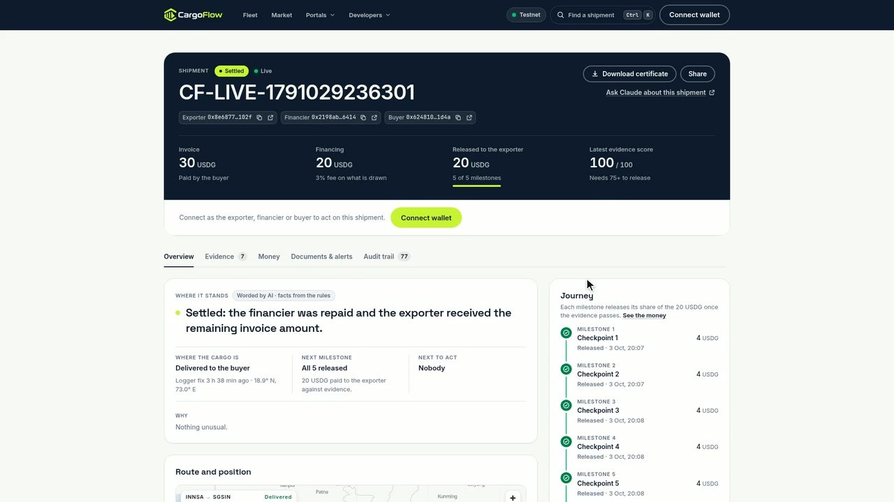
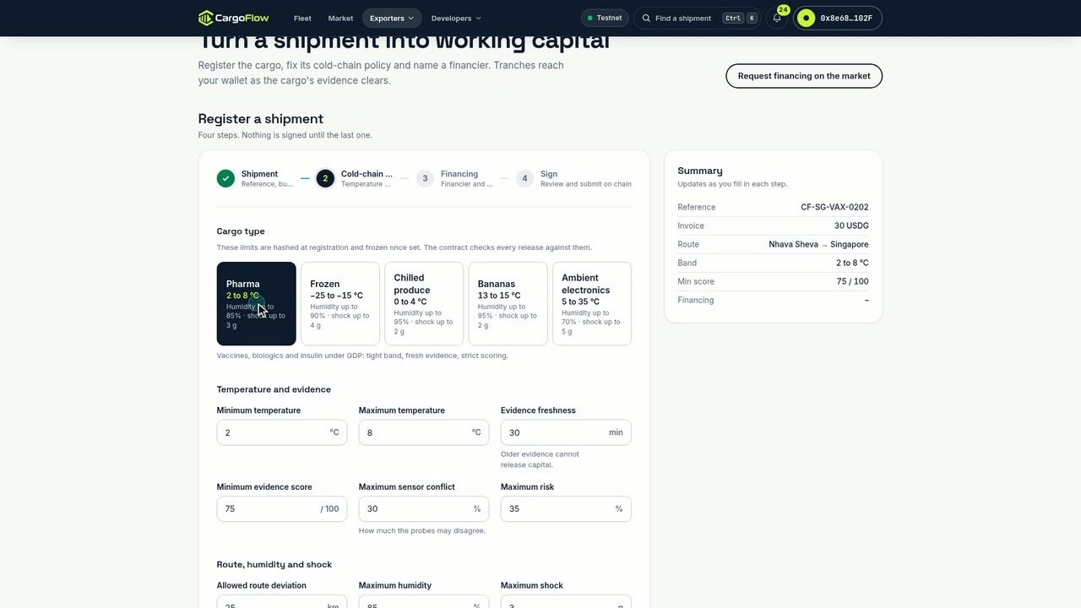
08 · THE PRODUCT
LIVE AT CARGOFLOW.ADORANTO737.WORKERS.DEV
A product each party can use today.
Shipment dashboard: settled, five of five milestones released.
Exporter wizard: the Pharma 2 to 8 °C template fills the policy.
Pages: /track, /exporter, /financier, /buyer, /market, /ebl, /arbiter, /shipments, /developers, /docs, /deployments · open the live app
Notes:
This is the product, recorded on the live site. Each shipment has a dashboard showing invoice, financing, milestones and the latest evidence score; this one is settled with five of five milestones released. The exporter wizard turns a shipment into working capital, with a pharma template that fills the 2 to 8 degree policy in one click.

Slide 9
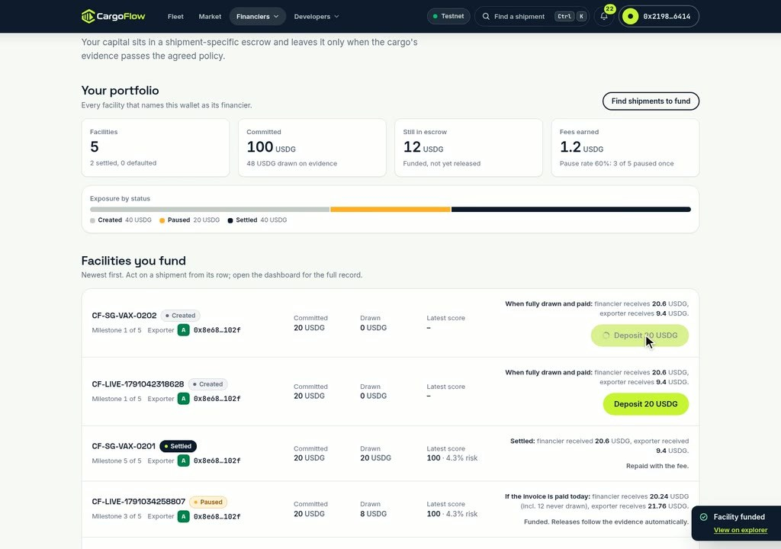
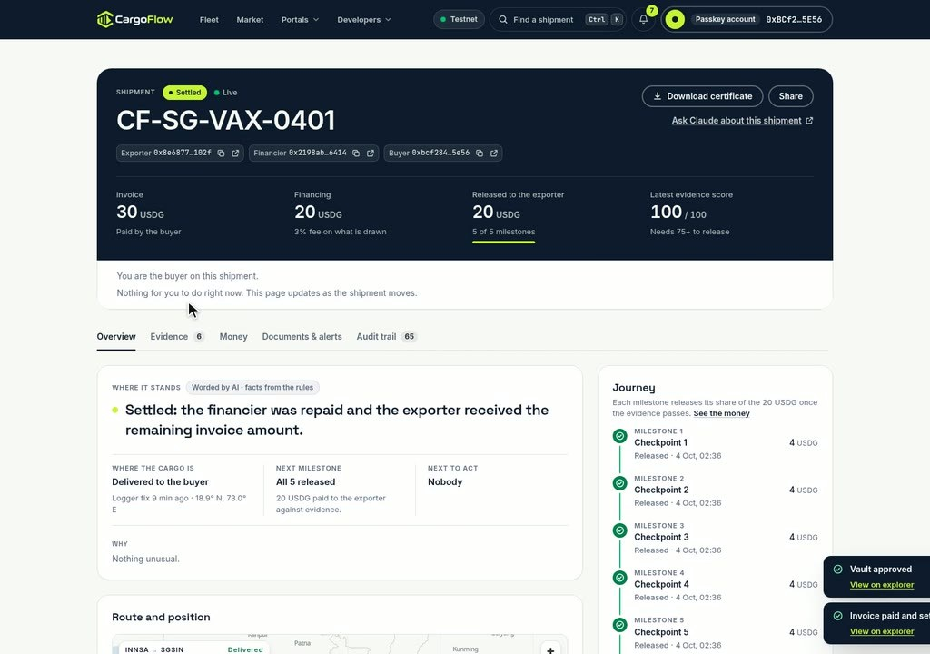
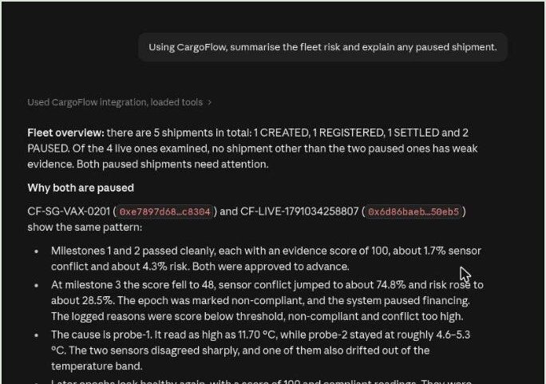
09 · THE PRODUCT
EVERY PARTY, ITS OWN SESSION
Fund it, pay it, ask Claude about it.
Financier: portfolio, exposure and one-click deposits.
Buyer: confirms delivery and pays with a passkey.
claude.ai: 25 tools through remote MCP. Claude never holds a key.
Remote MCP server: cargoflow-mcp.adoranto737.workers.dev/mcp · every write is signed by the party in its own wallet or passkey
Notes:
Financiers fund requests on a market that suggests a fee band and explains it. The buyer confirms delivery and pays with a passkey through a ZeroDev smart account, no wallet extension. And anyone can ask Claude about a shipment through the remote MCP server: Claude reads 25 tools and prepares unsigned transactions, but every write is signed by the party itself.

Slide 10
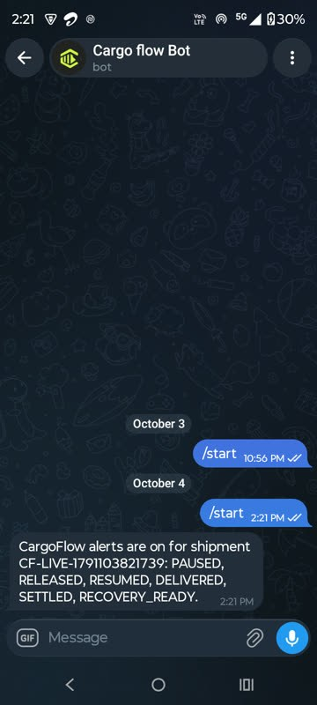
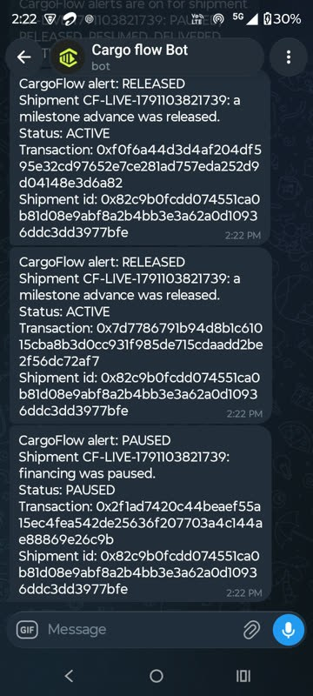
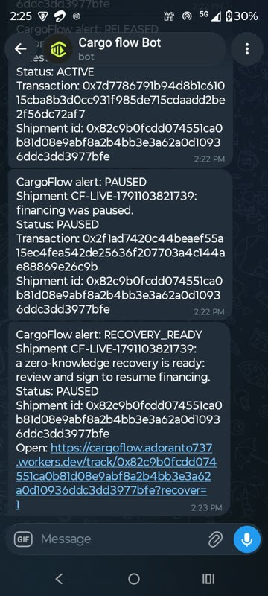
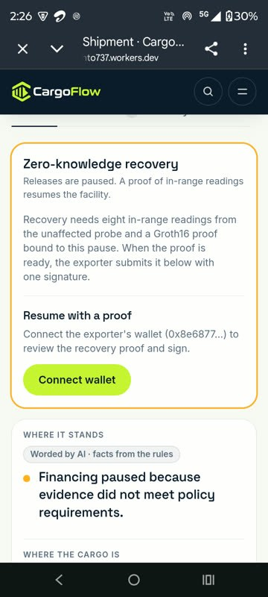
10 · ALERTS
ALERTS
Alerts on Telegram, email, Slack and webhooks.
Recorded on a real phone during a live testnet run. RELEASED and PAUSED arrive within seconds of the chain events; RECOVERY_READY opens the recovery card, ready to sign.
Alerts on
Released, paused
Recovery ready
One tap to sign
Bot: @Cargo_FlowBot
Shipment CF-LIVE-1791103821739 · pause 0x2f1ad742… · releases 0xf0f6a44d… and 0x7d778679… · also in-app
Notes:
Every party can subscribe a shipment's alerts to Telegram, email, Slack or a signed webhook. This was recorded on a real phone during a live testnet run: two RELEASED alerts and a PAUSED alert arrive with their transactions within seconds of the chain events. About a minute later RECOVERY_READY arrives, and its link opens the shipment straight on the recovery card for Meera to sign.

Slide 11
11 · TECHNOLOGY AND MOAT
TECHNOLOGY AND MOAT
Five mechanisms that enforce each other.
01
02
03
04
05
Signed readings
Fusion score
Bound ZK proof
Locked vault
Title with payment
Each device signs; every epoch records its source.
Dempster-Shafer fusion with a published formula.
Groth16, bound to the contract's own signals.
Only the controller's rules release USDG.
The bill of lading moves inside the payment.
A copy needs all five, tested together: 366 contract tests and 25 circuit tests.
Groth16: 13,494 constraints, about 1 s to prove, about 0.25 M gas to verify · immutable core, eight fuzzed invariants · docs/architecture.md, docs/benchmarks.md
Notes:
The moat is not one feature but the chain of them. Signed device readings feed a published fusion score; a Groth16 proof is bound to the contract's own public signals, so it cannot be replayed; only the controller can release the vault; and title moves inside the payment. A copy needs all five working together, which is what the 366 contract tests and 25 circuit tests cover.

Slide 12
12 · TRACTION
TRACTION
Production build live on Robinhood Chain Testnet.
Mainnet release next.
10
4
25
3
contracts source-verified on chain
packages published on npm and PyPI
MCP tools on a public remote server
extensions on Arbitrum Sepolia
TESTS, ALL PASSING
366
25
296
18
92
27
36
25
contract
circuit
frontend
end-to-end
SDK
MCP
gateway
Python
@cargoflow/sdk, @cargoflow/mcp, @cargoflow/gateway on npm and cargoflow on PyPI (0.1.0) · Fhenix and GMX Sourcify-verified, Stylus engine · /deployments
Notes:
The production build is live on Robinhood Chain Testnet, and the mainnet release is next. Ten contracts are source-verified, four packages are published on npm and PyPI, a public MCP server exposes 25 tools to claude.ai, and three extensions run on Arbitrum Sepolia. Every suite passes: 366 contract tests, 25 circuit tests, 296 frontend unit tests and 18 end-to-end tests, plus the package suites.

Slide 13
13 · LIVE RUNS
LIVE RUNS
Full lifecycles settled on chain, with receipts.
CF-SG-VAX-0202
Website run: excursion, automatic ZK recovery, settlement.
proof 0x79c68fc0…
settle 0xabba66b6…
CF-SG-VAX-0401
The buyer paid with a passkey: three ERC-4337 user operations.
account 0xBCf28437…
settle 0xee1d5ba8…
CF-LIVE-1791029236301
v3 reference run through the hosted API, each party signing.
proof 0xadfe3b2f…
paid 0x37571b49…
v1 hero run
22 transactions in 116 seconds, proof verified on chain.
proof 0x3910c2a5…
settle 0xcb11761c…
Every hash links to explorer.testnet.chain.robinhood.com · full transaction tables in the README, "Live on Robinhood Chain Testnet"
Notes:
These are full lifecycles on the public chain, and every hash on the slide is a link. The film's shipment ran through the website with each party in its own session, including an excursion and an automatic ZK recovery; another shipment was paid by the buyer with a passkey. The v3 reference run went from registration to settlement through the hosted API, and the original CLI run did 22 transactions in 116 seconds.

Slide 14
14 · MARKET
MARKET SIZE, BOTTOM-UP
Start with one corridor inside a $2.5T gap.
TAM
Unmet trade finance demand in 2025 (ADB).
TAM
$2.5T
$2.5T
SAM
India's pharma exports, $30.47B, × 50% sold on credit.
A1
~$15.2B
SOM
1% of SAM financed through CargoFlow by year 3.
A2
SAM
~$152M
~$15.2B
REVENUE
A planned 30 to 50 bps fee on that volume, per year.
A3
$0.46–0.76M
SOM
~$152M
CAPITAL
Financier capital outstanding at 52-day terms.
A4
~$22M
Assumptions: A1 Atradius' India-wide B2B credit share applies to pharma · A2 1% is a target · A3 planned fee level · A4 365 / 52, about 7 turns a year · PIB, FY 2024-25 pharma exports · ADB · Atradius
Notes:
We size the market bottom-up from one corridor. India exported 30.47 billion dollars of pharmaceuticals in FY 2024-25, and half of B2B sales are made on credit, which gives a serviceable market of about 15.2 billion a year. One percent of that by year three is about 152 million financed a year, which at a planned 30 to 50 basis points is 0.46 to 0.76 million of revenue; the assumptions A1 to A4 are on the slide.

Slide 15
15 · BUSINESS MODEL
BUSINESS MODEL
Paid when capital moves, not before.
01
02
03
Protocol fee
Cover premiums
Software and data
30 to 50 bps of each drawn facility, inside the settlement waterfall (A3).
A share of default and parametric cover written through the CoverPool.
Portfolio risk, evidence API and MCP for funds and insurers.
ONE 100,000 USDG PAYMENT, SPLIT ON CHAIN (REFERENCE FACILITY)
58,800 to the exporter
40,000 principal
1,200
Principal and the 3% fee go to the financier. The protocol fee is one more line in this split.
Non-custodial: the ReceivableVault is the sole USDG custodian · fee levels are planned (A3) · contracts/src/ReceivableVault.sol, CoverPool.sol, packages/python
Notes:
CargoFlow is paid when capital moves, not before. The primary line is a protocol fee of 30 to 50 basis points on drawn volume, taken inside the settlement waterfall the contract already runs; then a share of cover premiums written through the CoverPool, and software and data for funds and insurers. The software is non-custodial: the vault is the only USDG custodian, and the protocol fee ships with the mainnet release.

Slide 16
16 · COMPETITION
LANDSCAPE, BY CATEGORY
Each category solves one piece. CargoFlow joins them.
Sees cargo condition
Releases on evidence
Payment and title together
Private telemetry
Stablecoin settlement
Bank trade finance
letters of credit, collections
Factoring fintechs
advance on the buyer's credit
Cold-chain monitoring
loggers and visibility
On-chain RWA credit
pooled private credit
CargoFlow
a facility per shipment
yes
partly, on documents
not a design goal of the category
Categories described by their typical design, not by any one company. Ratings are CargoFlow's assessment; individual providers may differ.
Notes:
Each category solves one piece. Banks have the cheapest capital but work on paper; factoring fintechs underwrite the buyer, not the goods; cold-chain vendors see the cargo but their data does not move money; and on-chain credit protocols settle in stablecoins but underwrite off chain. CargoFlow is the combination: evidence that releases money, with title and payment moving together. Logger vendors are partners, not rivals.

Slide 17

17 · GO-TO-MARKET
GO-TO-MARKET
One corridor first: India pharma to Singapore.
DOOR 1 · LOGGER VENDORS
Make existing loggers finance-ready
@cargoflow/gateway signs and sends logger exports.
DOOR 2 · CREDIT FUNDS
Short-tenor USDG yield, evidence attached
The market suggests a fee band per request.
DOOR 3 · FORWARDERS, INSURERS
Reach exporters through who they use
The Pharma template sets 2 to 8 °C in one click.
Nhava Sheva
Colombo
Singapore
Pilot target: 3 exporters, 1 financier and 1 logger vendor on this lane, then more lanes and cold-chain categories · India pharma exports $30.47B in FY 2024-25 (PIB)
Notes:
We start with one corridor: India pharma to Singapore at 2 to 8 degrees. There are three doors: logger vendors, whose exports our gateway already signs and sends; credit funds looking for short-tenor USDG yield with evidence attached; and forwarders and insurers who already work with exporters. The pilot target is three exporters, one financier and one logger vendor on this lane.

Slide 18
18 · ROADMAP
ROADMAP, EACH MILESTONE WITH AN EXIT TEST
From production build to the first real facility.
M0 done: contracts v3 verified, live app, API and MCP, passkey payments, ZK recovery, four packages.
M1
M2
M3
M4
M5
Security
Real evidence
Mainnet
Legal and title
Scale
Independent audit and a public ZK ceremony
Logger pilots and a secure-element board
Real USDG on Robinhood Chain, protocol fee
MLETR opinion on the bill of lading
Calibrated scoring, a second corridor
35% OF GRANT
25% OF GRANT
20% OF GRANT
10% OF GRANT
AFTER THE GRANT
Exit tests: audit report published · 3 real shipments evidenced from physical loggers · first outside-financier facility settled in real USDG · written legal opinion · second corridor live
Notes:
M0 is done: contracts verified, the app, API and MCP live, passkey payments and ZK recovery working, four packages published. Next, M1 is an independent audit and a public ZK ceremony, M2 runs real logger pilots and a secure-element board, M3 is the mainnet release with real USDG and the protocol fee, and M4 is a legal opinion on the bill of lading. Each milestone has an exit test, listed at the bottom, so funding can follow evidence.

Slide 19
19 · THE ASK
THE ASK: THE MILESTONE-BASED GRANT
A 30,000 USDG grant funds M1 to M4.
35%
25%
20%
10%
10%
Security audit and public ZK ceremony
M1
10,500 USDG
Pilots and logger hardware
M2
7,500 USDG
Mainnet launch and first facilities
M3
6,000 USDG
Legal: MLETR opinion and structuring
M4
3,000 USDG
Team and infrastructure, six months
ALL
3,000 USDG
Released like a CargoFlow facility: each tranche follows a milestone's exit test.
Arbitrum Open House Singapore Online Buildathon (HackQuest): 115,000 USDG in prizes, including up to 30,000 USDG in milestone-based grants · any prize follows the same split
Notes:
Our ask is the buildathon's milestone grant of up to 30,000 USDG, split across M1 to M4. Thirty-five percent goes to the security audit and ZK ceremony, 25 to pilots and logger hardware, 20 to the mainnet launch and first facilities, and 10 each to legal and to infrastructure. We propose releasing it the way CargoFlow releases capital: each tranche against a milestone's exit test.

Slide 20
20 · BUILDATHON FIT
ARBITRUM OPEN HOUSE SINGAPORE
Every criterion, with something to click.
Deployed on an Arbitrum chain
Smart contract quality
10 contracts verified on Robinhood Chain Testnet (46630).
366 tests, eight invariants, an immutable core with no proxy.
Product-market fit
Innovation
A sourced problem, five role portals, four published packages.
Evidence-gated capital, bound ZK recovery, a keyless Claude co-pilot.
Real problem solving
Paxos USDG
End-to-end runs with every transaction linked.
The only money CargoFlow moves.
Robinhood Chain
Read the HackQuest listing
Its RIP-7212 precompile carries the passkey flow.
Evidence: README "Built for Arbitrum Open House Singapore", "Live on Robinhood Chain Testnet", "Measured, not claimed" · docs/project/21-hackathon-alignment.md
Notes:
Against the buildathon's criteria: every core contract is deployed and verified on Robinhood Chain Testnet, the contract suite has 366 tests including eight invariants, and the product has portals for every party plus four published packages. USDG is the only money CargoFlow moves, and Robinhood Chain's P-256 precompile carries the passkey flow. Each line links to evidence in the README.

Slide 21
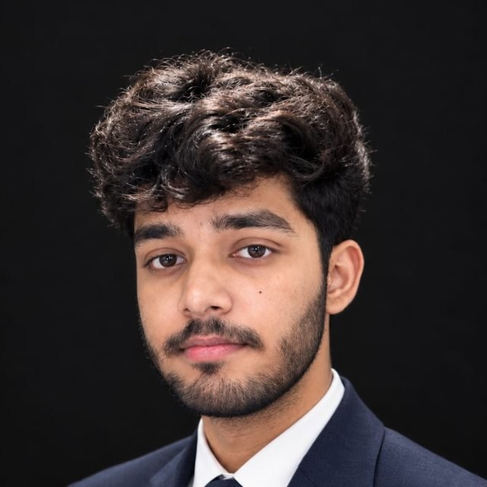
21 · TEAM AND CONTACT
TEAM AND CONTACT
Built by its founder, live and open.
WEBSITE
cargoflow.adoranto737.workers.dev
GITHUB
github.com/LSUDOKO/CargoFlow
NPM
@cargoflow/sdk · mcp · gateway
Arpit Singh
PYPI
pypi.org/project/cargoflow
Founder
CLAUDE
cargoflow-mcp.adoranto737.workers.dev/mcp
github.com/LSUDOKO
MIT licensed · Telegram alerts: @Cargo_FlowBot · API: cargoflow-api-75ul.onrender.com
Notes:
CargoFlow is built by its founder, Arpit Singh, and everything is live and open source under MIT. You can try the web app, read the code on GitHub, install the SDK, MCP server and gateway from npm or the Python package from PyPI, and connect Claude to the remote MCP server. Thank you; I would be glad to walk through a live shipment.

