Slide 1
ILUSTRTTION
WELCOME TO
SRent

Slide 2
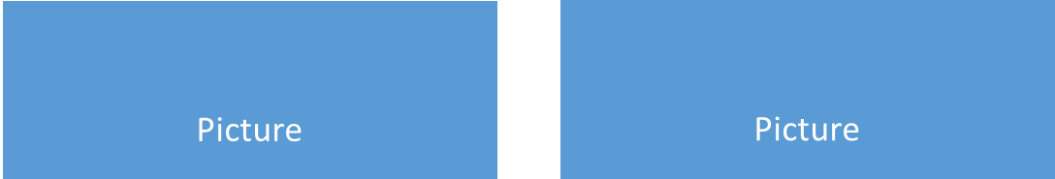
SRent – Home
Bus
Picture
Picture
Model Description
Model Description
Price
Price
Van
Picture
Picture
Model Description
Model Description
Price
Price

Slide 3

SRent – Vehicle Data
Picture
Model Description
Price
Start Date
End Date
Include a Driver
Passenger Amount
Origin Address
Destiny Address
REQUEST VEHICLE

Slide 4

SRent – Vehicle Requests
Requests
Picture
Picture
Model Description
Model Description
Price
Price
Picture
Picture
Model Description
Model Description
Price
Price
Picture
Picture
Model Description
Model Description
Price
Price

