Slide 1
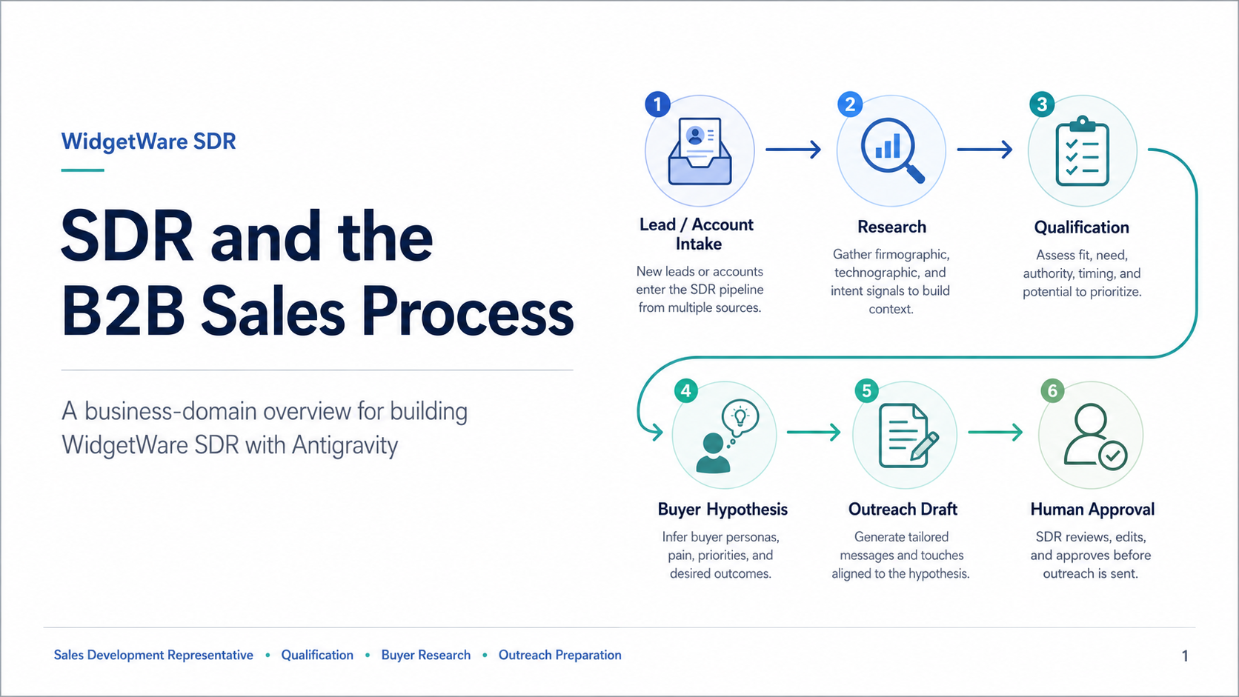
Notes:
Open the session by framing WidgetWare SDR as a business-domain example, not as a coding exercise yet. The important sequence is intake, research, qualification, buyer hypothesis, outreach draft, and human approval. Emphasize that this deck gives students enough sales-process context to understand what they will later build in Antigravity IDE.

Slide 2
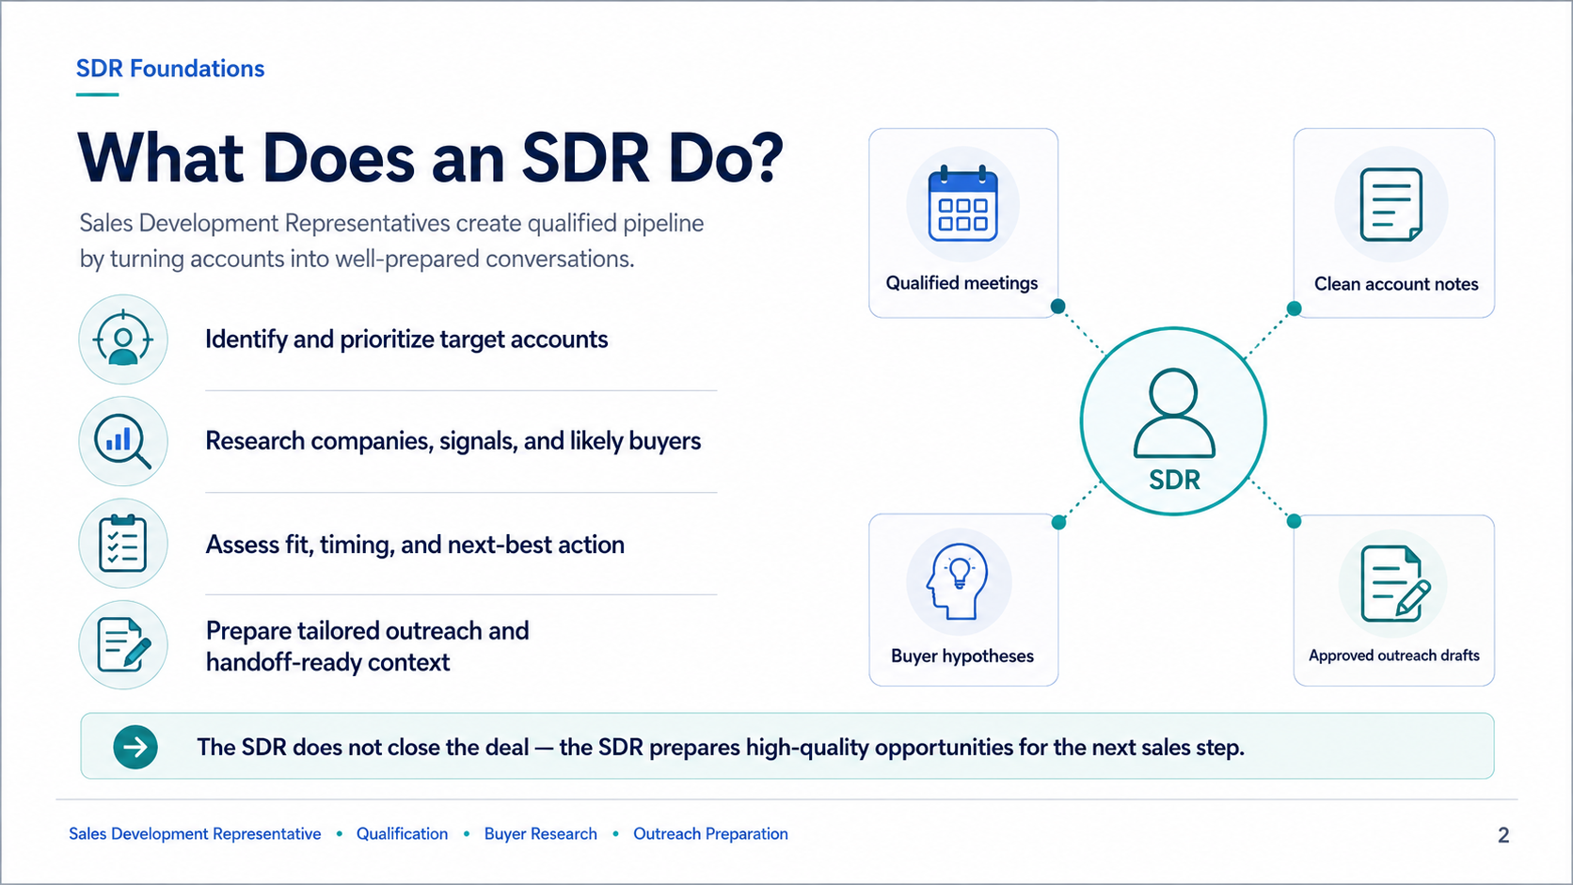
Notes:
Explain that an SDR creates qualified pipeline by turning raw accounts or leads into well-prepared conversations. The SDR does not close the deal. The SDR identifies accounts, researches signals, assesses fit, prepares context, and hands off a cleaner opportunity or meeting to the next sales role.

Slide 3
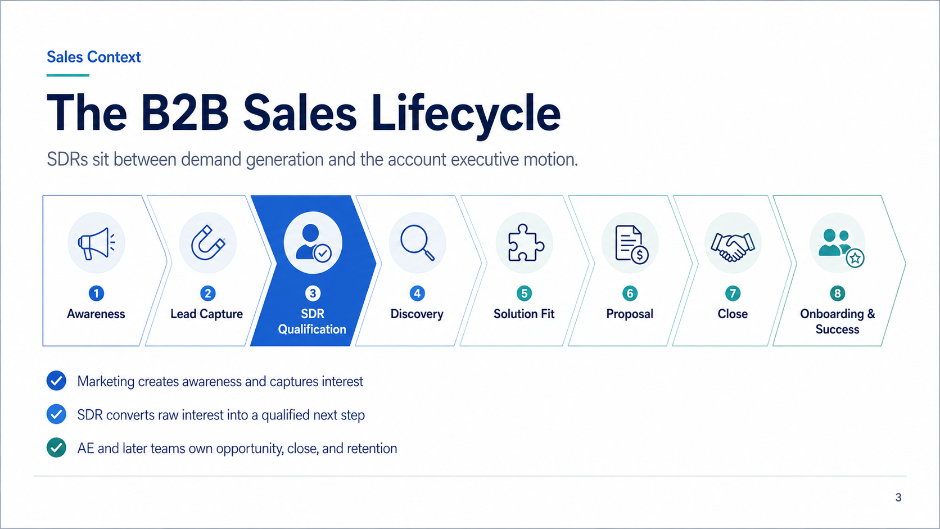
Notes:
Walk through the revenue lifecycle from awareness to onboarding. Highlight that SDR qualification is a bridge between marketing demand and account-executive selling. The output is not revenue by itself; the output is qualified momentum, clean context, and a reason to proceed.

Slide 4
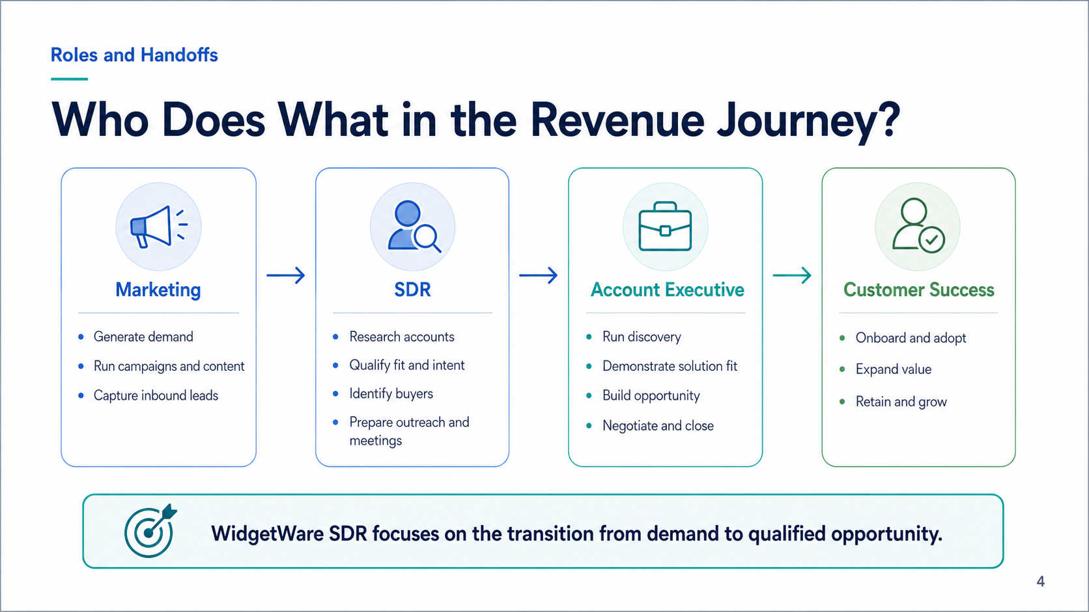
Notes:
Clarify role boundaries. Marketing creates demand, SDR qualifies and prepares, the account executive owns discovery and close, and customer success owns adoption and expansion. WidgetWare SDR focuses only on the SDR portion of the journey, especially the handoff from demand to qualified opportunity.

Slide 5
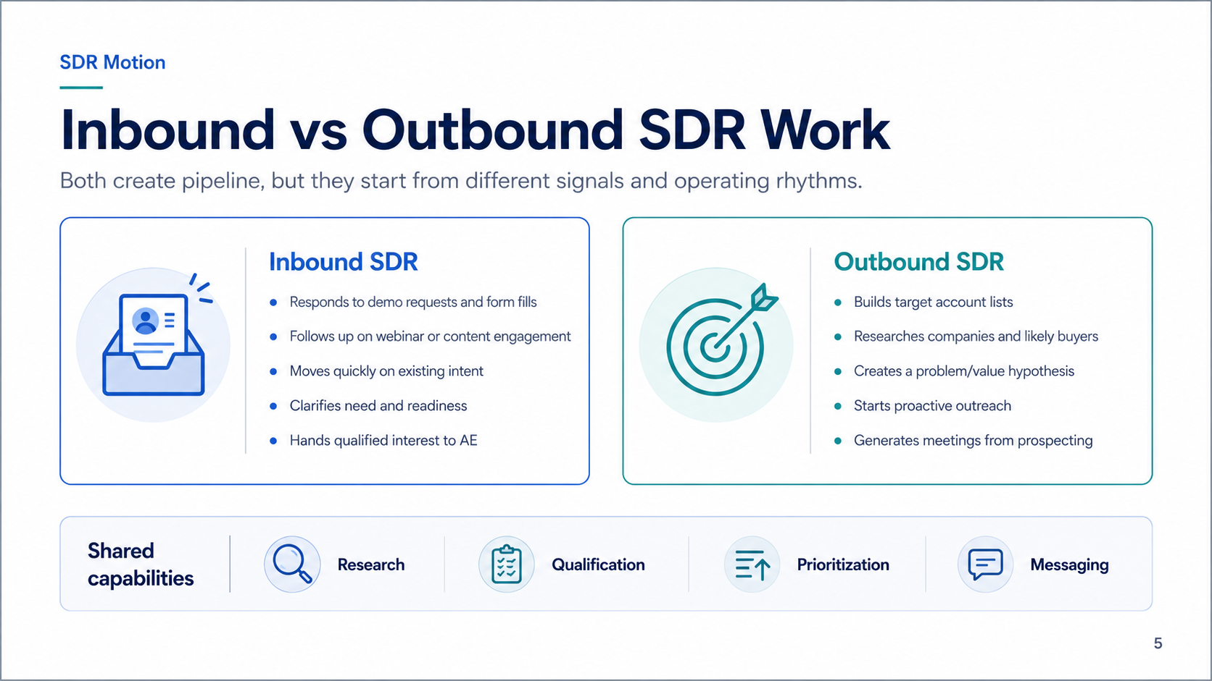
Notes:
Compare inbound and outbound motions. Inbound SDRs react to known intent such as demo requests or content engagement. Outbound SDRs construct target-account lists and start with research and a value hypothesis. Both motions require research, qualification, prioritization, and messaging.

Slide 6
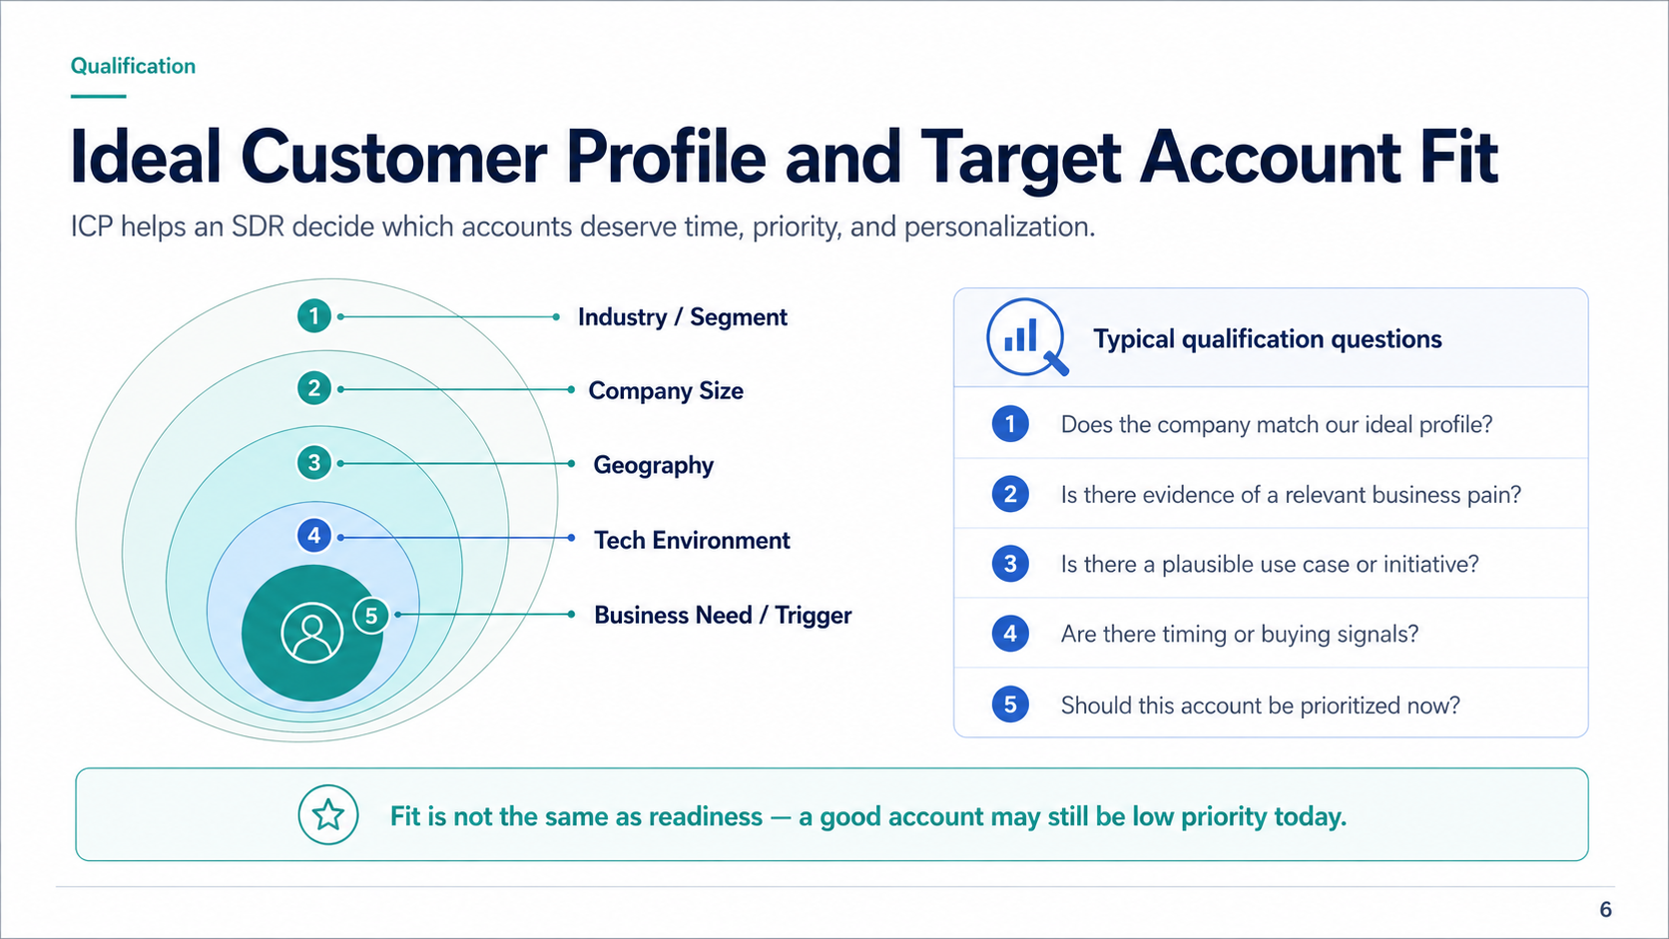
Notes:
Introduce ICP as the decision filter. Fit includes industry, company size, geography, technology environment, and business trigger. Stress the difference between fit and readiness. A company can be a great fit but still not worth immediate SDR attention without timing or pain evidence.

Slide 7
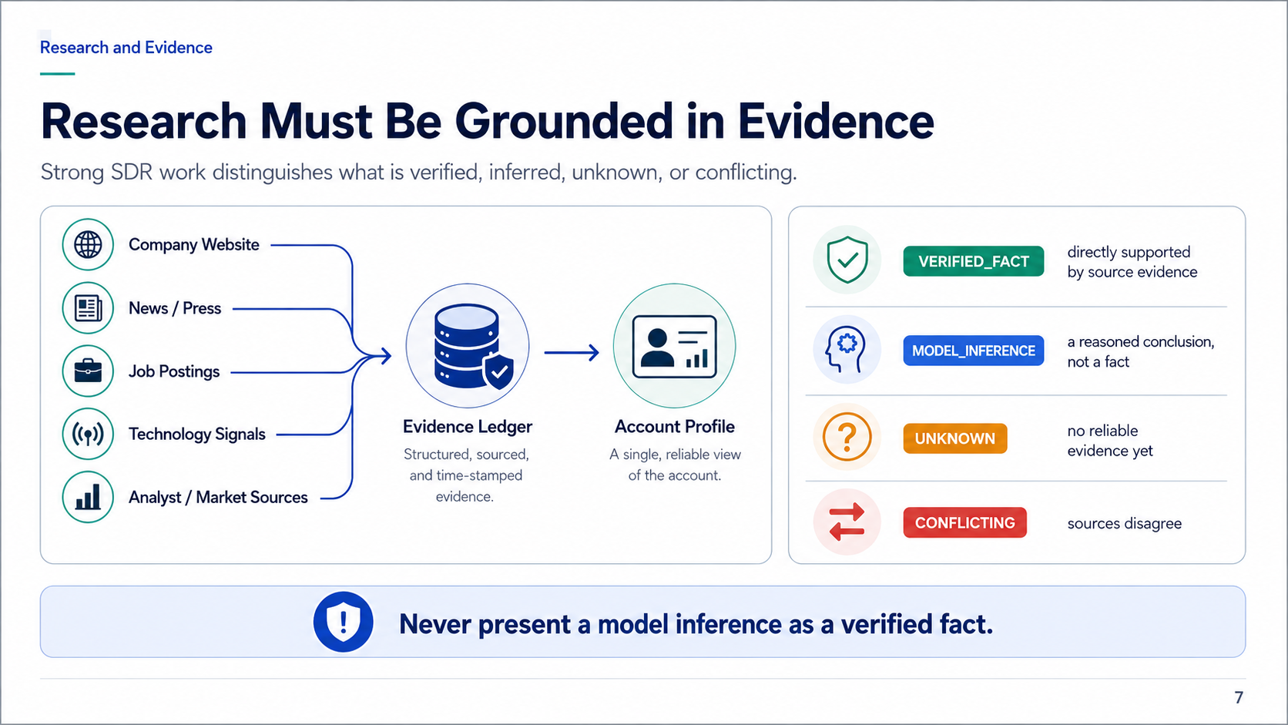
Notes:
This is the most important governance slide. Every material claim needs evidence classification: verified fact, model inference, unknown, or conflicting. Model-generated reasoning is useful, but it must not be presented as a verified fact. This becomes a core design rule for WidgetWare SDR.

Slide 8
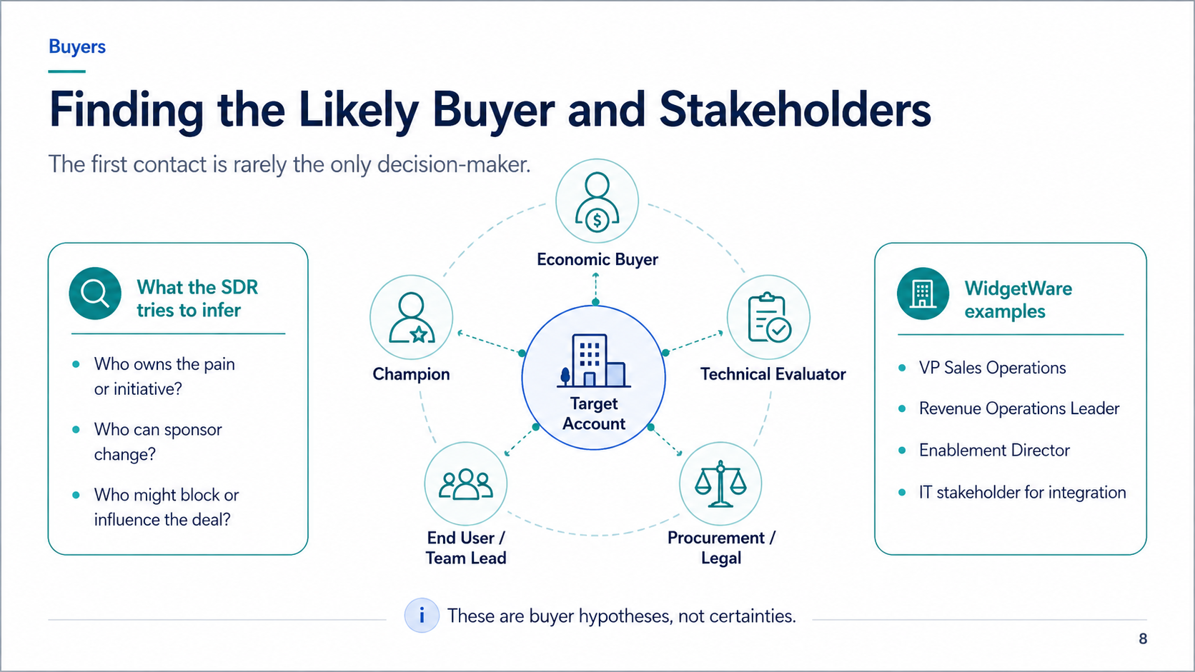
Notes:
Explain that B2B buying is rarely one person. The SDR is forming a buyer hypothesis, not declaring certainty. For WidgetWare, plausible roles include sales operations, revenue operations, enablement, and IT stakeholders. The agent should surface a hypothesis and the evidence behind it.

Slide 9
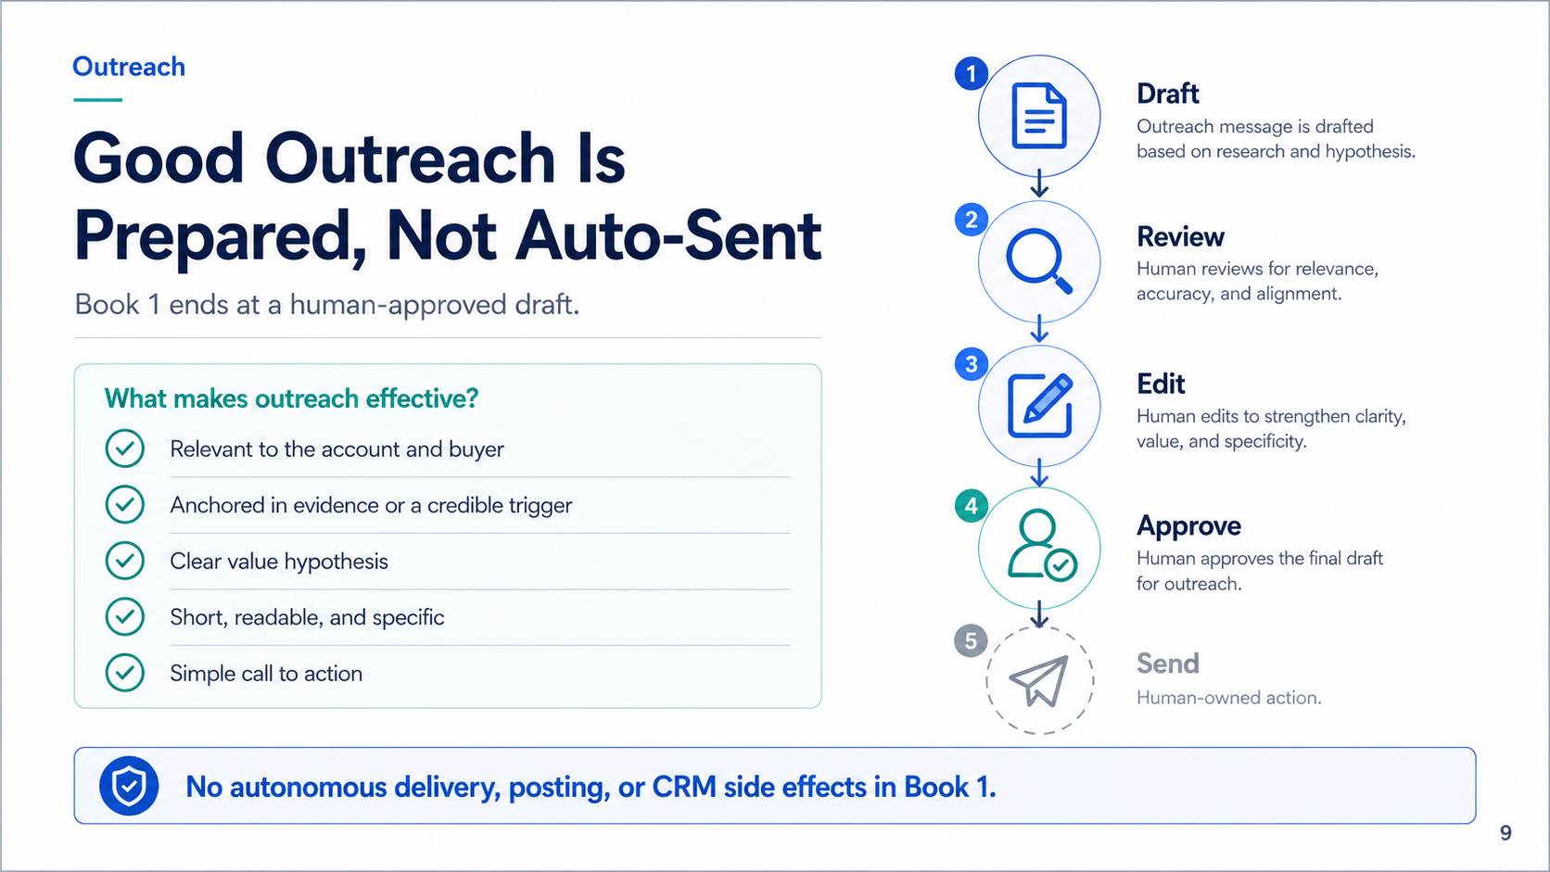
Notes:
Reinforce the autonomy boundary. Good outreach is prepared, reviewed, edited, and approved. In Book 1, the system stops at a human-approved draft or approval package. It does not send email, post messages, or write back to CRM. Delivery remains a human-owned action.

Slide 10
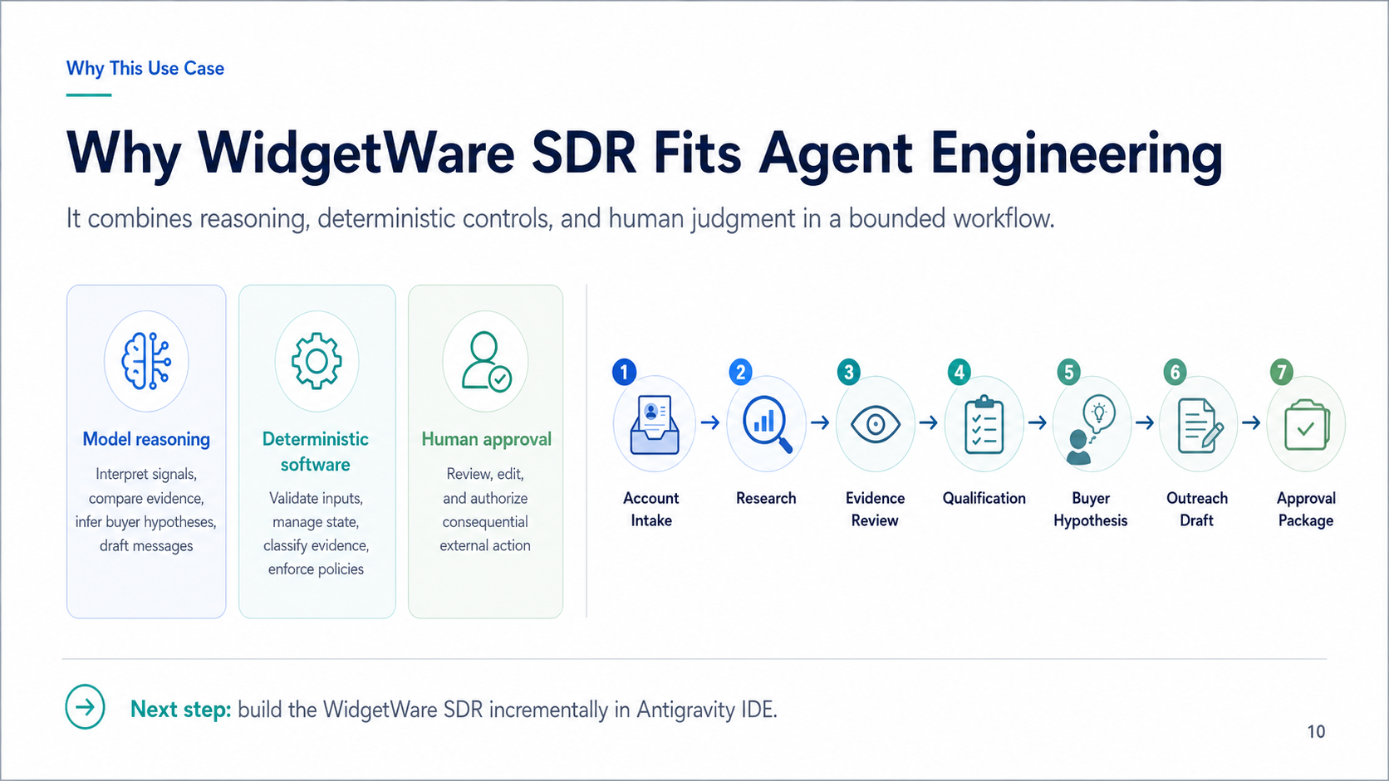
Notes:
Close by connecting the domain to Agent Engineering. The model interprets signals and drafts. Deterministic software validates inputs, manages state, classifies evidence, and enforces policy. Humans review and authorize external action. This is why WidgetWare SDR is an ideal first Antigravity IDE build.

