Slide 1
AGENT ENGINEERING WITH GOOGLE ADK
From one agent
to an orchestrated team
A
A
A
Single agents, delegated multi-agent systems, sequential pipelines, iterative loops, and parallel branches
A
Class 02B | Concept + Build
Notes:
Landing Sentence: Today we will grow one useful agent into a controlled team of agents.
Talking Points:
- Begin with the simplest architecture that can do the job.
- Separate adaptive delegation from deterministic workflow control.
- Use state to pass durable facts and outputs between specialists.
- Use sequence for dependency, loop for refinement, and parallel branches for independence.
- The movie-pitch lab gives us one concrete system that combines all three patterns.
Takeaway: By the end, each orchestration choice should feel like an engineering decision, not a vocabulary exercise.
[Sources]
- User-supplied lab package: class-02B.zip
- User-supplied PDF: Build Multi-Agent Systems with ADK | Google Skills
[/Sources]

Slide 2
AGENT ENGINEERING
The lesson follows the architecture as it grows
1
2
3
4
5
Single
Multi-agent
Sequential
Loop
Parallel
One job
Delegate
Order
Refine
Branch
Complexity is added only when the control problem demands it.
ADK multi-agent systems
02
Notes:
Landing Sentence: We will add orchestration one control problem at a time.
Talking Points:
- A single agent establishes the basic agent contract.
- A multi-agent hierarchy adds specialization and delegation.
- A sequential workflow fixes the order of dependent work.
- A loop adds bounded improvement and a quality gate.
- Parallel execution adds independent branches and a gather step.
- The progression is cumulative; later patterns can contain earlier ones.
Takeaway: Do not start with the most complex topology; earn each layer of orchestration.
[Sources]
- User-supplied PDF: Build Multi-Agent Systems with ADK | Google Skills
[/Sources]

Slide 3
AGENT ENGINEERING
An agent is a model operating inside a harness
HARNESS
MODEL
+
Instructions
Tools
Role, boundaries, success criteria
Actions beyond text generation
Context + state
Runtime
Conversation and remembered facts
Events, retries, callbacks, control
The model supplies intelligence; the harness makes behavior usable and governable.
ADK multi-agent systems
03
Notes:
Landing Sentence: The model is only one part of an agent; engineering lives in the harness around it.
Talking Points:
- Instructions define the job and the boundaries of the job.
- Tools allow the agent to read, calculate, call services, or write artifacts.
- Context includes the prompt, conversation history, retrieved knowledge, and state.
- The runtime decides how work is invoked, observed, retried, and stopped.
- A strong model with a weak harness is still an unreliable system.
Takeaway: Treat agent quality as a system property, not a model property.
[Sources]
- Google ADK overview: https://google.github.io/adk-docs/
- User-supplied PDF: Build Multi-Agent Systems with ADK | Google Skills
[/Sources]

Slide 4
AGENT ENGINEERING
Start with one agent when one owner can finish the task
SINGLE AGENT
USER
Understand
Choose tools
Respond
RESULT
One coherent objective
A small tool set
Low coordination overhead
ADK multi-agent systems
04
Notes:
Landing Sentence: A single agent is not a toy; it is the correct architecture for a bounded job.
Talking Points:
- The user has one conversation partner and one decision-maker.
- The agent may still use several tools and maintain state.
- The design is easy to observe because ownership is unambiguous.
- It is usually cheaper and faster than coordinating multiple agents.
- Move beyond one agent only when specialization or control produces a real benefit.
Takeaway: Prefer one capable agent until its responsibilities stop being coherent.
[Sources]
- Google ADK agents overview: https://google.github.io/adk-docs/agents/
[/Sources]

Slide 5
AGENT ENGINEERING
One agent becomes fragile when every responsibility competes
Symptoms
The engineering response
Instructions become long and contradictory
Split work by capability
Tool choice becomes ambiguous
Give each role a crisp description
Failures are hard to isolate
Control handoffs explicitly
Changes in one behavior disturb another
Share only the state each step needs
Multi-agent design trades local simplicity for system-level clarity.
ADK multi-agent systems
05
Notes:
Landing Sentence: Multi-agent architecture is justified by conflicting responsibilities, not by fashion.
Talking Points:
- A long prompt often hides several distinct jobs.
- Many tools increase the chance of the wrong tool being chosen.
- Specialists create smaller surfaces for testing and improvement.
- Descriptions become routing metadata, not just documentation.
- The cost is coordination, latency, and more state to observe.
Takeaway: Split an agent only when the resulting boundaries are clearer than the coordination cost.
[Sources]
- User-supplied PDF: Build Multi-Agent Systems with ADK | Google Skills
[/Sources]

Slide 6
AGENT ENGINEERING
A multi-agent system is a team with a coordination contract
ROLES
ROUTING
Specialists own narrow outcomes
A parent delegates to the right specialist
STATE
CONTROL
Shared facts connect turns and agents
Workflow agents constrain execution
ADK multi-agent systems
06
Notes:
Landing Sentence: Multiple agents become a system only when we define how they coordinate.
Talking Points:
- Roles answer who owns each part of the outcome.
- Routing answers who acts next when the choice is adaptive.
- State answers how outputs and decisions survive across the workflow.
- Control answers which paths are allowed and when execution stops.
- Observability lets us inspect which agent acted and why.
Takeaway: The agents are components; the coordination contract is the architecture.
[Sources]
- Google ADK multi-agent workflows: https://google.github.io/adk-docs/agents/multi-agents/
- User-supplied PDF: Build Multi-Agent Systems with ADK | Google Skills
[/Sources]

Slide 7
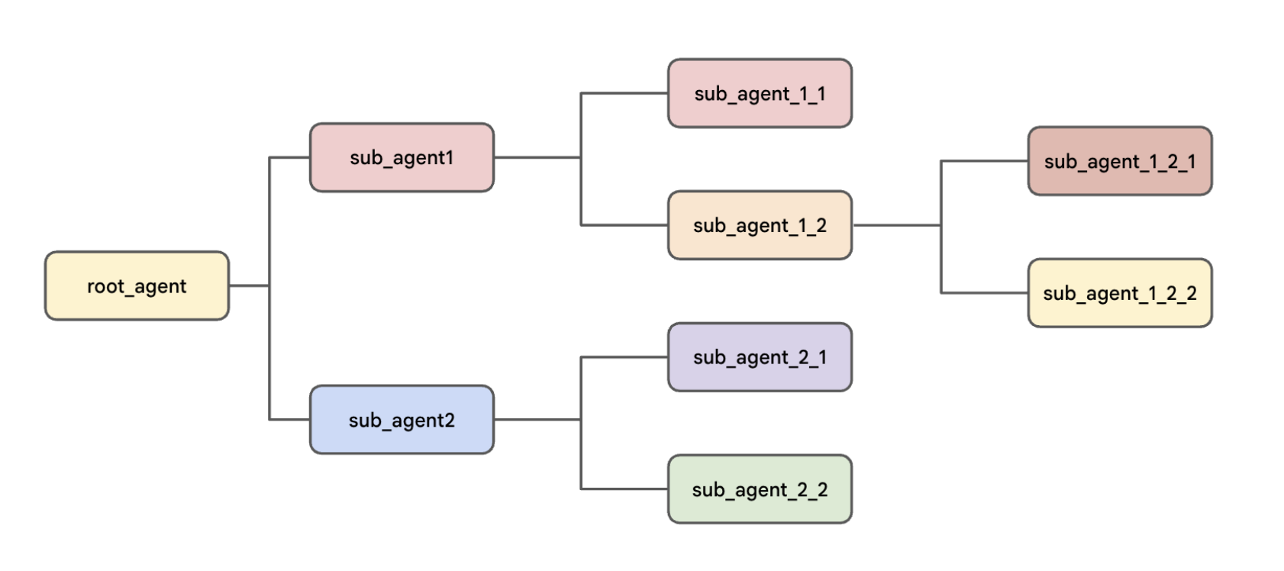
AGENT ENGINEERING
The hierarchy limits possible handoffs and makes routing legible
ADK multi-agent systems
07
Notes:
Landing Sentence: ADK organizes delegated agents as a tree rooted at root_agent.
Talking Points:
- The conversation begins with the object assigned to root_agent.
- A parent lists its sub-agents; sub-agents do not need a parent parameter.
- Descriptions help the parent decide which specialist should receive control.
- Sub-agents can themselves be parents, producing nested teams.
- The tree narrows possible routes and makes debugging easier.
- Peer transfers can be allowed or restricted based on the design.
Takeaway: Hierarchy is a control surface for delegation, not merely an organization chart.
[Sources]
- Visual: user-supplied c411ea1c-03d0-4f09-bf86-f1e7ceb7bbee.png
- User-supplied PDF: Build Multi-Agent Systems with ADK | Google Skills
[/Sources]

Slide 8
AGENT ENGINEERING
Delegation chooses the route; workflows enforce it
LLM-directed delegation
Deterministic workflow
Parent reads descriptions
Orchestrator owns control flow
Model selects a handoff
Order is defined in code
User may remain in the conversation
No user turn between steps
Best for adaptive specialist routing
Best for repeatable processes
Both can exist in the same system.
ADK multi-agent systems
08
Notes:
Landing Sentence: The crucial distinction is who decides what happens next.
Talking Points:
- In delegated routing, an LLM interprets the request and selects a specialist.
- The parent uses agent names, descriptions, and instructions as routing context.
- In workflow orchestration, code defines sequence, repetition, or concurrency.
- Workflow agents do not need an LLM to decide their own execution pattern.
- The movie-pitch example uses both: the greeter transfers, then workflows take over.
Takeaway: Use model judgment for ambiguity and code for guarantees.
[Sources]
- Google ADK template workflows: https://google.github.io/adk-docs/agents/workflow-agents/
- User-supplied PDF: Build Multi-Agent Systems with ADK | Google Skills
[/Sources]

Slide 9
AGENT ENGINEERING
Session state is the shared workbench between agents
SESSION STATE
Agent writes
state["PROMPT"]
state["research"]
state["PLOT_OUTLINE"]
state["CRITICAL_FEEDBACK"]
Next agent reads
Tools update state | { key? } injects state into instructions | output_key stores a full response
ADK multi-agent systems
09
Notes:
Landing Sentence: State is how agents coordinate without stuffing every detail into a new user message.
Talking Points:
- Every agent in a session can access the same session state dictionary.
- A tool can update state through ToolContext and produce a state delta event.
- Instruction templating such as { PLOT_OUTLINE? } reads a state value safely.
- The question mark avoids failure when an optional key is absent.
- output_key stores an agent's final response under a named state key.
- In the Dev UI, inspect both events and state to understand the handoff.
Takeaway: State turns a set of agents into a coordinated workflow with explicit intermediate artifacts.
[Sources]
- Google ADK state documentation: https://google.github.io/adk-docs/sessions/state/
- User-supplied PDF: Build Multi-Agent Systems with ADK | Google Skills
[/Sources]

Slide 10
AGENT ENGINEERING
Three workflow shapes solve three different control problems
SequentialAgent
Run every sub-agent in a fixed order when later work depends on earlier output.
LoopAgent
Repeat a defined sequence until a bounded limit or an explicit exit condition.
ParallelAgent
Run independent branches concurrently, then gather their outputs downstream.
ADK multi-agent systems
10
Notes:
Landing Sentence: Sequential, loop, and parallel are not competing products; they encode different dependencies.
Talking Points:
- Sequential makes ordering explicit and predictable.
- Loop makes repeated improvement explicit and bounded.
- Parallel makes independence explicit and can reduce elapsed time.
- The workflow object controls the pattern without consulting a model.
- Each sub-agent inside the pattern may still be model-driven.
- Nested workflows let one system use all three patterns.
Takeaway: Choose the workflow shape from the dependency structure of the work.
[Sources]
- Google ADK template workflows: https://google.github.io/adk-docs/agents/workflow-agents/
[/Sources]

Slide 11
AGENT ENGINEERING
SequentialAgent guarantees the order of dependent work
1
2
3
Research
Draft
Write file
Shared invocation context lets later steps read state produced earlier in the same run.
ADK multi-agent systems
11
Notes:
Landing Sentence: Use a sequence when the output of one step is an input to the next.
Talking Points:
- The sub_agents list is the execution order.
- The orchestrator calls each sub-agent one after another.
- The movie workflow researches before it drafts and drafts before it writes.
- State keys provide explicit intermediate outputs between the steps.
- A deterministic sequence reduces the chance that a model skips a required stage.
Takeaway: If step B cannot be correct before step A finishes, model the work as a sequence.
[Sources]
- Google ADK SequentialAgent: https://google.github.io/adk-docs/agents/workflow-agents/sequential-agents/
- User-supplied PDF: Build Multi-Agent Systems with ADK | Google Skills
[/Sources]

Slide 12
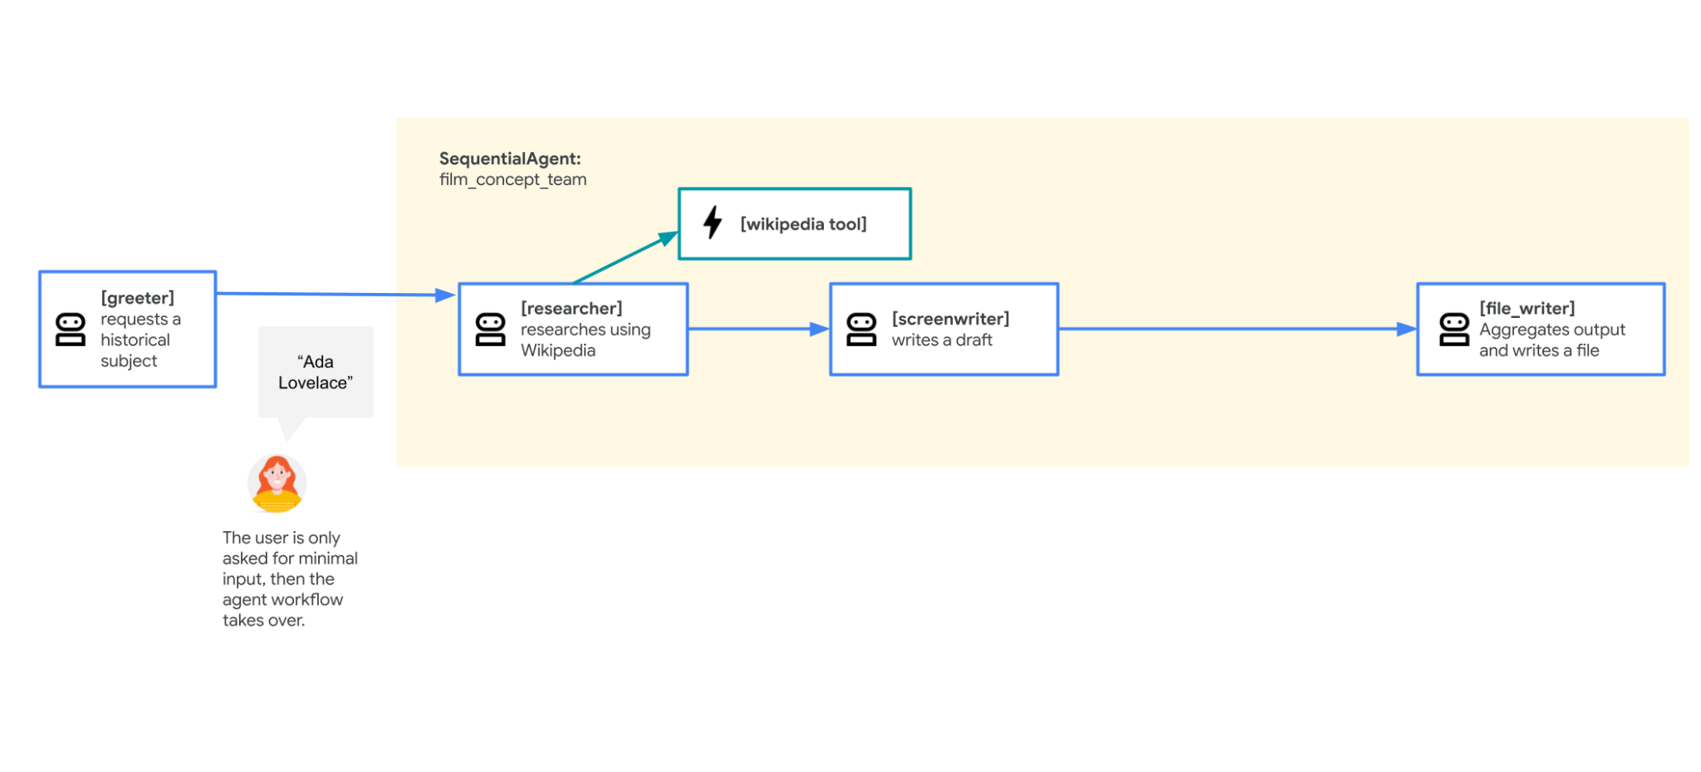
AGENT ENGINEERING
The first movie-pitch workflow is a straight pipeline
ADK multi-agent systems
12
Notes:
Landing Sentence: The starter workflow turns a small user request into a complete file without another user turn.
Talking Points:
- The greeter asks for a historical subject and stores it in PROMPT.
- The researcher uses Wikipedia and appends findings to research state.
- The screenwriter creates a logline and three-act outline in PLOT_OUTLINE.
- The file_writer turns the accumulated state into a saved pitch file.
- The sequence owns the handoff; the user does not manually advance the steps.
Takeaway: The pipeline is simple because every downstream step depends on the one before it.
[Sources]
- Visual: user-supplied bc7bd81e-c6e7-499c-bc0f-fecc681f55e9.png
- User-supplied PDF: Build Multi-Agent Systems with ADK | Google Skills
[/Sources]

Slide 13
AGENT ENGINEERING
LoopAgent adds bounded refinement and an explicit quality gate
Researcher
Screenwriter
Add stronger evidence
Improve the draft
Critic
Exit or add feedback
Stop on quality OR max_iterations
ADK multi-agent systems
13
Notes:
Landing Sentence: A loop is useful only when it knows both how to improve and how to stop.
Talking Points:
- The loop repeats its listed sub-agents in the same order.
- Researcher and screenwriter improve the shared artifact each pass.
- The critic uses exit_loop when the quality questions are satisfied.
- Otherwise the critic writes CRITICAL_FEEDBACK for the next pass.
- max_iterations is a safety boundary even when an exit tool exists.
- Without a quality signal, a loop is repetition rather than refinement.
Takeaway: Every production loop needs a quality condition and a hard execution cap.
[Sources]
- Google ADK LoopAgent: https://google.github.io/adk-docs/agents/workflow-agents/loop-agents/
- User-supplied PDF: Build Multi-Agent Systems with ADK | Google Skills
[/Sources]

Slide 14
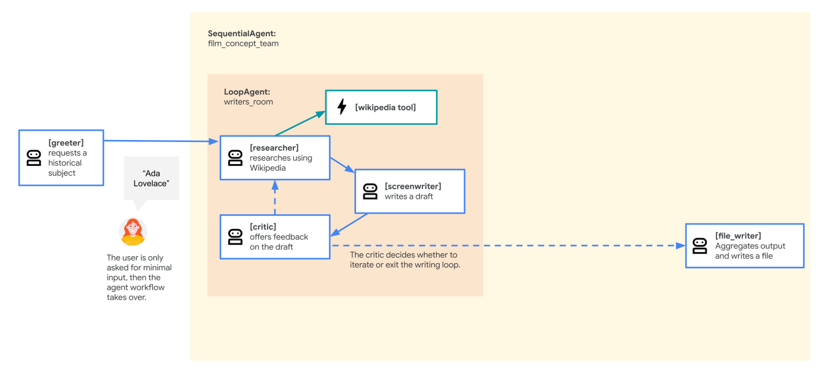
AGENT ENGINEERING
The writers' room turns one pass into a quality loop
ADK multi-agent systems
14
Notes:
Landing Sentence: The writers_room nests a loop inside the larger film_concept_team sequence.
Talking Points:
- The outer sequence still begins with the writers_room and ends with file_writer.
- Inside the loop, researcher, screenwriter, and critic run in order.
- The critic either adds feedback or calls exit_loop.
- State preserves research, outline revisions, and critical feedback across passes.
- When the loop exits, control returns to the outer sequence automatically.
Takeaway: Nesting lets a bounded iterative process behave like one step in a larger pipeline.
[Sources]
- Visual: user-supplied f5396842-7ba7-43f1-afd9-c965e3b13328.png
- User-supplied PDF: Build Multi-Agent Systems with ADK | Google Skills
[/Sources]

Slide 15
AGENT ENGINEERING
ParallelAgent is for independent branches, not dependent steps
Box office branch
Independent market analysis
PLOT OUTLINE
GATHER
Casting branch
Independent casting ideas
Parallel results may complete in any order; write them to separate state keys.
ADK multi-agent systems
15
Notes:
Landing Sentence: Parallel execution works when branches can start from the same input without waiting on one another.
Talking Points:
- All parallel sub-agents are started at approximately the same time.
- Each branch runs independently and completion order is not guaranteed.
- The box-office and casting analyses both depend on the plot, not on each other.
- Each branch writes to a separate output_key to avoid collisions.
- A later file_writer gathers both results into the final artifact.
- Do not place a dependent step in a parallel branch just to gain speed.
Takeaway: Parallelize independence; sequence dependency.
[Sources]
- Google ADK ParallelAgent: https://google.github.io/adk-docs/agents/workflow-agents/parallel-agents/
- User-supplied PDF: Build Multi-Agent Systems with ADK | Google Skills
[/Sources]

Slide 16
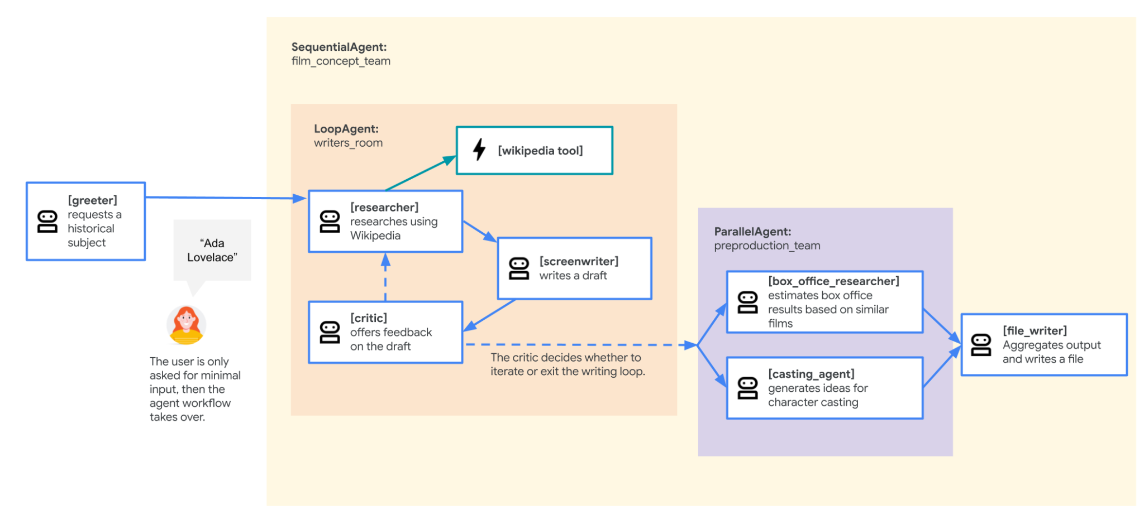
AGENT ENGINEERING
The preproduction team fans out, then the file writer gathers
ADK multi-agent systems
16
Notes:
Landing Sentence: The final lab architecture adds parallel enrichment after the writers' room finishes.
Talking Points:
- The completed PLOT_OUTLINE becomes the shared input to both branches.
- box_office_researcher writes box_office_report.
- casting_agent writes casting_report.
- The ParallelAgent waits for its sub-agents to complete before the outer sequence advances.
- file_writer gathers the outline and both reports into one saved pitch.
- This is the classic fan-out and gather pattern.
Takeaway: A gather step turns independent parallel outputs into one useful deliverable.
[Sources]
- Visual: user-supplied 4c86ce65-7b7c-4e8e-bebc-5fed2697b38e.png
- User-supplied PDF: Build Multi-Agent Systems with ADK | Google Skills
[/Sources]

Slide 17
AGENT ENGINEERING
A real system composes patterns instead of choosing only one
ADK multi-agent systems
17
Notes:
Landing Sentence: The architecture is one outer sequence containing a loop and a parallel branch set.
Talking Points:
- The greeter provides adaptive transfer from user interaction into the workflow.
- film_concept_team guarantees the macro order.
- writers_room performs iterative improvement as one nested stage.
- preproduction_team performs independent enrichment as the next stage.
- file_writer gathers state and persists the final result.
- The topology mirrors the dependency graph of the work.
Takeaway: Good orchestration is compositional: each pattern handles the part of control it is best at.
[Sources]
- Visual: user-supplied 343207aa-251d-49cb-94c9-ca915b36f0ea.png
- User-supplied PDF: Build Multi-Agent Systems with ADK | Google Skills
[/Sources]

Slide 18
AGENT ENGINEERING
The orchestration code is mostly composition
root_agent = Agent(
name="steering",
sub_agents=[brainstormer, planner]
)
film_team = SequentialAgent(
sub_agents=[writers_room,
preproduction_team, file_writer]
)
writers_room = LoopAgent(
sub_agents=[researcher, screenwriter, critic],
max_iterations=5
)
preproduction_team = ParallelAgent(
sub_agents=[box_office_researcher,
casting_agent]
)
ADK multi-agent systems
18
Notes:
Landing Sentence: ADK makes the topology visible in a few composition objects.
Talking Points:
- Agent sub_agents establish the delegated hierarchy.
- SequentialAgent expresses the required order directly in a list.
- LoopAgent adds max_iterations and relies on exit_loop for early completion.
- ParallelAgent lists branches that may run concurrently.
- The agents' instructions and state keys define the data contract across this topology.
- Readable composition is one reason to prefer several focused agents over one tangled prompt.
Takeaway: The topology should be understandable from the composition code before reading every prompt.
[Sources]
- User-supplied starter source: class-02B.zip
- User-supplied PDF: Build Multi-Agent Systems with ADK | Google Skills
[/Sources]

Slide 19
AGENT ENGINEERING
Build the solution in seven testable milestones
1
Expand + install
Unzip, virtual environment, dependencies
2
Choose auth
Vertex AI or API key - never both
3
Run single
Prove the root agent starts
4
Add delegation
Parent plus two specialist sub-agents
5
Add state
Inspect ToolContext and state delta
6
Add loop
Critic plus exit_loop and hard cap
7
Add branches
Parallel reports plus downstream gather
ADK multi-agent systems
19
Notes:
Landing Sentence: Each milestone should run before the next pattern is introduced.
Talking Points:
- First prove the environment and package structure.
- Select one authentication mode and validate it without printing secrets.
- Run the root agent before adding relationships.
- Test each delegation path with a deliberate prompt.
- Use the Dev UI to inspect state before adding workflow complexity.
- Add loop and parallel stages separately so failures remain local.
Takeaway: Incremental construction makes orchestration failures diagnosable.
[Sources]
- User-supplied lab package: class-02B.zip
- User-supplied PDF: Build Multi-Agent Systems with ADK | Google Skills
[/Sources]

Slide 20
AGENT ENGINEERING
Run, inspect, and prove each handoff
cd adk_multiagent_systems
adk run parent_and_subagents
cd adk_multiagent_systems
adk web --port 8000
CLI
Events
Artifacts
Fast conversation and transfer check
Agent names, tool calls, state deltas
Inspect movie_pitches output
A response is not proof of the intended route - inspect the trace.
ADK multi-agent systems
20
Notes:
Landing Sentence: A plausible final answer can hide the wrong route, skipped tools, or missing state updates.
Talking Points:
- Use adk run for a quick terminal conversation.
- Use adk web from the directory containing the agent folders.
- In the Dev UI, confirm which named agent produced each event.
- Open tool events and verify state_delta contains the expected changes.
- Inspect the State tab for PROMPT, research, outline, feedback, and branch reports.
- Finally inspect the saved file, because persistence is part of the requirement.
Takeaway: Validate the execution path and intermediate state, not only the prose at the end.
[Sources]
- Google ADK web interface: https://google.github.io/adk-docs/runtime/web-interface/
- Google ADK command line: https://google.github.io/adk-docs/runtime/command-line/
- User-supplied PDF: Build Multi-Agent Systems with ADK | Google Skills
[/Sources]

Slide 21
AGENT ENGINEERING
Choose exactly one authentication route
Vertex AI
Gemini API key
GOOGLE_GENAI_USE_VERTEXAI=TRUE
GOOGLE_CLOUD_PROJECT=my-project
GOOGLE_CLOUD_LOCATION=global
MODEL=gemini-2.5-flash
GOOGLE_GENAI_USE_VERTEXAI=FALSE
GOOGLE_API_KEY=replace_me
MODEL=gemini-2.5-flash
Uses Google Cloud credentials and project-scoped model access.
Uses a Google AI Studio key; keep .env out of source control.
Do not place both credential strategies in the same active .env file.
ADK multi-agent systems
21
Notes:
Landing Sentence: Both environment modes can run the same agent code, but the credential source must be unambiguous.
Talking Points:
- Vertex AI mode sets GOOGLE_GENAI_USE_VERTEXAI to TRUE.
- It also needs a project, location, and Application Default Credentials.
- API-key mode sets GOOGLE_GENAI_USE_VERTEXAI to FALSE and supplies GOOGLE_API_KEY.
- MODEL remains an environment variable so the code is portable.
- The starter's Cloud Logging initialization should fall back to standard logging in API-key-only environments.
- Never commit a real API key or a populated .env file.
Takeaway: One codebase can support both routes when authentication and logging are cleanly separated.
[Sources]
- Google ADK Gemini authentication: https://google.github.io/adk-docs/agents/models/google-gemini/
- User-supplied PDF: Build Multi-Agent Systems with ADK | Google Skills
[/Sources]

Slide 22
AGENT ENGINEERING
Reliability controls belong around every agent and workflow
Callbacks
Retries
Log the query, response, and tool call
Bound transient model failures
Loop caps
429 fallback
max_iterations prevents runaway work
Return a controlled failure message
Control flow without observability is difficult to trust and expensive to debug.
ADK multi-agent systems
22
Notes:
Landing Sentence: Orchestration increases the number of places a run can fail, so controls must scale with topology.
Talking Points:
- before_model_callback and after_model_callback expose model interactions.
- HttpRetryOptions handles transient failures with bounded attempts and delays.
- max_iterations puts a hard ceiling on iterative workflows.
- The supplied Graceful429Plugin converts quota exhaustion into a controlled response.
- State and event inspection reveal partial progress before a failure.
- The goal is not to hide failure; it is to make failure understandable and recoverable.
Takeaway: Every new branch, loop, or handoff should add a corresponding observation and boundary.
[Sources]
- User-supplied source files: callback_logging.py and adk_utils/plugins.py
- Google ADK logging: https://google.github.io/adk-docs/observability/logging/
- Google ADK callbacks: https://google.github.io/adk-docs/callbacks/types-of-callbacks/
[/Sources]

Slide 23
AGENT ENGINEERING
Choose the pattern by asking what the next step depends on
Dependency question
Pattern
One owner can finish
Single agent
Intent selects a specialist
Parent + sub-agents
B depends on A
SequentialAgent
Quality needs another pass
LoopAgent
Tasks share input, not each other
ParallelAgent
ADK multi-agent systems
23
Notes:
Landing Sentence: The topology is a direct answer to the dependency structure of the work.
Talking Points:
- If one coherent owner can finish, keep one agent.
- If intent determines the specialist, use delegated routing.
- If outputs form a dependency chain, use a sequence.
- If the same artifact needs repeated improvement, use a bounded loop.
- If tasks can start independently from the same input, use parallel branches.
- If none of these express the requirement, consider a custom or graph workflow.
Takeaway: Name the dependency first; the right orchestration pattern usually follows.
[Sources]
- Google ADK multi-agent workflows: https://google.github.io/adk-docs/agents/multi-agents/
- Google ADK custom workflows: https://google.github.io/adk-docs/agents/custom-agents/
[/Sources]

Slide 24
BUILD PRINCIPLE
One agent when simple.
A team when structure earns its cost.
Delegate ambiguity. Sequence dependencies. Loop for quality. Branch for independence.
Your build challenge: prove every handoff, state update, exit condition, branch output, and final artifact.
Notes:
Landing Sentence: The goal is not more agents; the goal is clearer, more reliable work.
Talking Points:
- A single agent is the default when one responsibility remains coherent.
- Delegation uses model judgment to select specialists.
- Workflow agents use code to guarantee sequence, repetition, and concurrency.
- State carries explicit intermediate artifacts across the team.
- Boundaries, traces, retries, and stop conditions make the system operable.
- The build is complete only when the intended path is visible and testable.
Takeaway: Design the smallest team whose topology makes the work easier to understand, test, and trust.
[Sources]
- Google ADK documentation: https://google.github.io/adk-docs/
- User-supplied PDF: Build Multi-Agent Systems with ADK | Google Skills
[/Sources]

