Slide 1
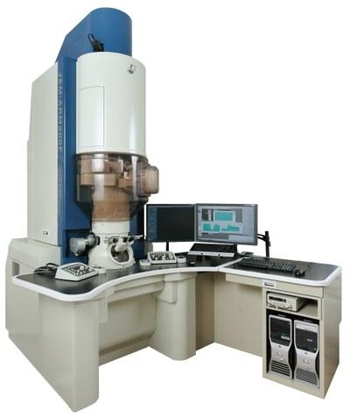
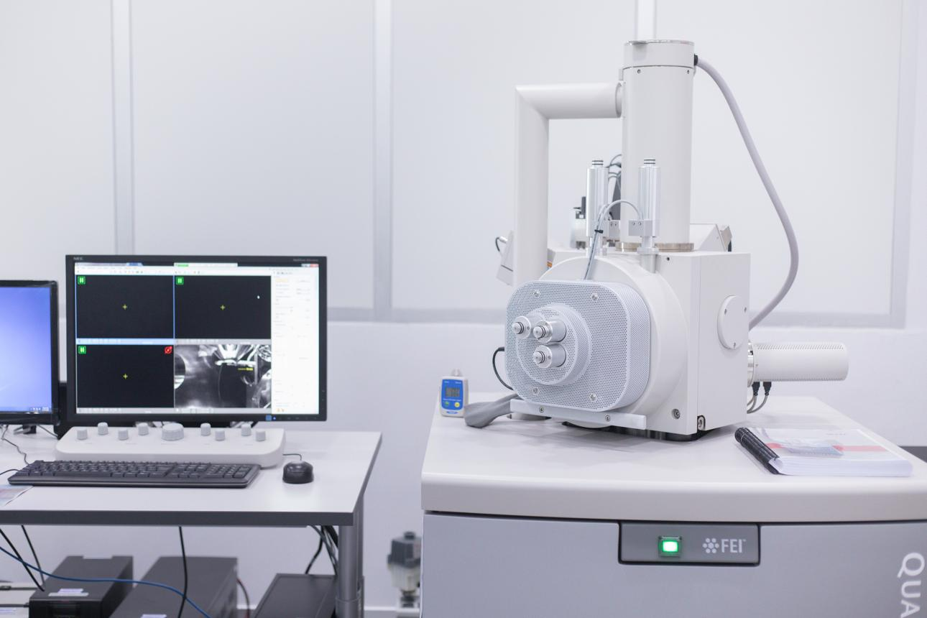
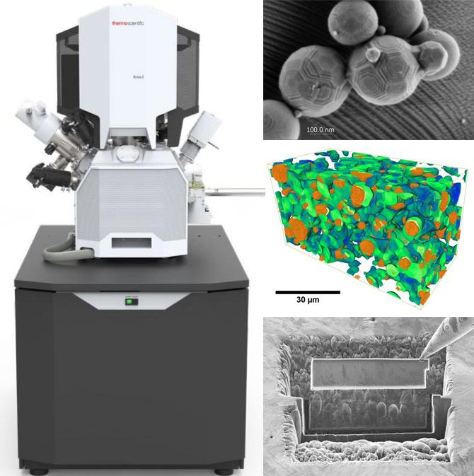
Testing Inspection & Certification (TIC) Executive Summary
OVERVIEW | Strategic Study: TIC Electron Microscopy Services & Equipment Market
Executive procurement assessment for TIC Electron Microscopy Services & Equipment Market.
• Technology Landscape Overview:
1. TEM (ARM200F): Transmits electrons through ultrathin samples to resolve atomic-scale defects & crystal interfaces. High spatial resolution; high CapEx & sample prep intensity.
2. SEM (Quanta 450): Scans surface morphology for routine inspection, particle contamination & fractography. High throughput & broad sample compatibility.
3. FIB-SEM (Scios 2 / Helios 5): Combines ion milling with electron imaging for site-specific cross-sectioning, 3D reconstruction & TEM lamella extraction.
Key Takeaways:
• Technology Triad: TEM provides atomic-scale composition; SEM delivers rapid surface inspection; FIB-SEM enables targeted 3D defect milling.
• Market Duality: Strategic decision between high-CapEx internal equipment acquisition vs. scalable outsourced TIC laboratory services.
• Executive Objective: Establish a dual-sourcing failure analysis framework to accelerate semiconductor yield & material qualification.
Key Metrics & Specs
TEM / SEM / FIB-SEM
Technology Scope
Equipment vs. TIC
Market Model
Micro & Nanoscale
Resolution Scale
TIC ELECTRON MICROSCOPY S #1 | Executive_Deck.pptx | Author: Lalit Sabnani | Date: 2026-10-10 | Verified Sources: ISO/IEC 17025 Testing Accreditation | IEEE Industry Applications Standard
Log inSign up for free
You said:
overview of TIC market (TEM / SEM / FIB SEM devices
ChatGPT said:
Overview of the TIC market: TEM, SEM and FIB-SEM
The TIC (Testing, Inspection and Certification) market for electron microscopy serves semiconductor manufacturers, advanced materials companies, research institutions, and industrial laboratories that need to characterize materials at micro- and nanoscale resolution. Within this market, TEM (Transmission Electron Microscopy), SEM (Scanning Electron Microscopy), and FIB-SEM (Focused Ion Beam–SEM) are complementary technologies used for failure analysis, process development, quality control, and materials research.
An important distinction: the market can be viewed as either the equipment market (sales of microscopy instruments and associated software) or the TIC services market (laboratories using these instruments to provide testing, inspection, and certification services). The two markets overlap but have different competitive dynamics and revenue models.
1. Technology landscape
TEM — Transmission Electron Microscopy
High-resolution internal structure and composition
TEM transmits electrons through an ultrathin specimen to reveal internal structures, crystal defects, interfaces, and nanoscale features. Advanced TEM and STEM systems can achieve atomic-scale imaging and chemical analysis.
TIC applications: Semiconductor process verification, failure analysis, materials qualification, nanomaterials characterization.
Strengths: Exceptional spatial resolution and analytical capability.
Limitations: Specimen preparation is demanding; the field of view is relatively small; instruments and operation are expensive.
SEM — Scanning Electron Microscopy
Surface morphology and routine inspection
SEM scans a focused electron beam across a specimen to generate images of its surface and, through suitable detectors and analytical attachments, information about composition and crystallography.
TIC applications: Surface defects, particle analysis, contamination investigations, coatings, welds, fracture surfaces, and semiconductor inspection.
Strengths: Broad sample compatibility, relatively straightforward workflows, high throughput for many applications.
Limitations: Conventional SEM generally provides less internal structural detail than TEM; charging and beam damage can affect certain specimens.

Slide 2
Commodity Definition & Operational Context
COMMODITY SPECS | Technical Specifications & Workflow Integration for TIC Electron Microscopy Services & Equipment Market
Operational alignment of electron microscopy modalities within the TIC testing pipeline:
• Step 1 - SEM Screening: Rapid identification of surface anomalies, particle contamination & coatings.
• Step 2 - FIB-SEM Milling: Precise ion beam sectioning to access buried defects and extract TEM lamellas.
• Step 3 - TEM Characterization: Sub-nanometer structural, interface, and crystal defect chemical verification.
• TIC Deliverable: ISO/IEC 17025 accredited test reports, root-cause analysis, and material compliance certificates.
Key Takeaways:
• TEM / STEM: Atomic-resolution characterization for semiconductor 2nm scaling & advanced packaging.
• SEM Screening: High-volume routine surface inspection, defect screening & contamination isolation.
• FIB-SEM Dual Beam: Precise site-specific cross-sectioning, buried defect access & TEM lamella prep.
Key Metrics & Specs
Atomic Scale
TEM Precision
High Volume
SEM Throughput
Site-Specific
FIB-SEM Accuracy
TIC ELECTRON MICROSCOPY S #2 | Executive_Deck.pptx | Author: Lalit Sabnani | Date: 2026-10-10 | Verified Sources: ISO 9001 Quality Management Standards | NIST Engineering Infrastructure Framework

Slide 3
Market Dynamics & Strategic Drivers
MARKET TRENDS | Industry TAM & Technology Drivers for TIC Electron Microscopy Services & Equipment Market
Analyzing key macro drivers accelerating demand across TIC Electron Microscopy Services & Equipment Market:
• Semiconductor Scaling: 2nm nodes, 3D IC integration, and high-bandwidth memory (HBM) require nanometer defect verification.
• Reliability & Failure Analysis: Automotive, aerospace, and medical device OEMs mandate rigorous root-cause testing.
• Advanced Energy Materials: Battery electrode porosity and catalyst characterization drive laboratory utilization.
Key Takeaways:
• Global TAM Expansion: Broader electron microscopy equipment expanding from $1.61B (2025) to $2.22B by 2031 (5.5% CAGR).
• Semiconductor Outperformance: Semiconductor failure analysis dual-beam FIB-SEM systems expanding at 8.58% CAGR.
• Primary Demand Drivers: 2nm chiplet scaling, heterogeneous packaging, EV battery porosity, and automated lab analytics.
Key Metrics & Specs
$1.61B -> $2.22B
Global Market TAM
+8.58% CAGR
FIB-SEM Segment CAGR
2nm / 3D Chiplets
Semiconductor Node
TIC ELECTRON MICROSCOPY S #3 | Executive_Deck.pptx | Author: Lalit Sabnani | Date: 2026-10-10 | Verified Sources: MarketsandMarkets Electron Microscopy Report | Mordor Intelligence Semiconductor Analysis

Slide 4
Competitive Landscape & Vendor Distribution
COMPETITIVE INTELLIGENCE | Market Positioning & Supplier Share for TIC Electron Microscopy Services & Equipment Market
High supplier concentration defines the electron microscopy equipment landscape:
• Semiconductor TEM: Thermo Fisher Scientific leads with 86.17% market share.
• Semiconductor FIB-SEM: Thermo Fisher commands 58.42% share, followed by ZEISS and TESCAN.
• Semiconductor SEM: Hitachi High-Tech holds 30.77% share alongside JEOL and Thermo Fisher.
Key Takeaways:
• Hitachi High-Tech Leadership: Controls 30.77% of the semiconductor SEM inspection market.
• Thermo Fisher Dominance: Holds dominant position in semiconductor TEM (86.17%) and FIB-SEM (58.42%).
• Specialized Competitors: ZEISS, JEOL, TESCAN, Oxford Instruments, and Bruker provide high-precision analytical depth.
Key Metrics & Specs
86.17% Share
Thermo Fisher TEM Share
58.42% Share
Thermo Fisher FIB Share
30.77% Share
Hitachi SEM Share
TIC ELECTRON MICROSCOPY S #4 | Executive_Deck.pptx | Author: Lalit Sabnani | Date: 2026-10-10 | Verified Sources: Reports and Markets Semiconductor Study | Gartner Supply Chain Magic Quadrant

Slide 5
Supplier Differentiation & Solution Matrix
VENDOR MATRIX | Equipment Manufacturers vs. TIC Service Providers for TIC Electron Microscopy Services & Equipment Market
Evaluating commercial business models across equipment sales vs. outsourced TIC testing services:
• Equipment Business: High CapEx ($1M-$5M+ per tool), long sales cycles, service contract & upgrade revenues.
• TIC Services Business: Sample-fee or hourly analysis billing, high lab utilization requirements, turnaround time SLAs.
• Commercial Differentiation: Customer trust relies on analytical expertise, ISO/IEC 17025 compliance, and IP confidentiality.
Key Takeaways:
• Equipment OEMs: Thermo Fisher, ZEISS, Hitachi, JEOL, and TESCAN provide specialized hardware & electron optics.
• TIC Laboratories: SGS, Intertek, Bureau Veritas, Eurofins EAG, NTS, and Exponent offer outsourced analysis.
• Accreditation Benchmark: ISO/IEC 17025 accreditation is required to guarantee defensible test reports.
Key Metrics & Specs
5 Key Players
Major OEMs
6 Global Suites
Leading TIC Labs
ISO/IEC 17025
Lab Standard
TIC ELECTRON MICROSCOPY S #5 | Executive_Deck.pptx | Author: Lalit Sabnani | Date: 2026-10-10 | Verified Sources: ISO/IEC 17025 Laboratory Standard | Eurofins EAG Analytical Services

Slide 6
Product & Technical Architecture
HARDWARE ARCHITECTURE | System Design & Optics Architecture for TIC Electron Microscopy Services & Equipment Market
Technical architecture requirements for advanced characterization systems:
• Beam Control: Sub-nanometer spot size with ultra-stable high-voltage power supplies and vacuum chambers.
• Sample Manipulation: 5-axis piezo stages with cryogenic cooling and in-situ mechanical testing capabilities.
• Targeted Milling: Precise ion beam pattern deposition and cross-section preparation without lattice destruction.
Key Takeaways:
• Electron Optics: High-brightness Schottky field-emission guns combined with aberration correctors.
• Dual-Beam FIB Milling: Gallium (Ga+) or plasma ion sources coupled with high-resolution SEM columns.
• Detector Arrays: Energy-dispersive X-ray (EDS), EBSD, and high-angle annular dark-field (HAADF) detectors.
Key Metrics & Specs
Ga+ / Plasma
Ion Beam Source
Sub-Nanometer
Imaging Resolution
EDS / EBSD / STEM
Analytical Suite
TIC ELECTRON MICROSCOPY S #6 | Executive_Deck.pptx | Author: Lalit Sabnani | Date: 2026-10-10 | Verified Sources: Thermo Fisher Helios 5 Technical Specs | ZEISS Crossbeam Hardware Architecture

Slide 7
Software Platforms & Analytics Suite
SOFTWARE ARCHITECTURE | Automated Acquisition & 3D Serial Reconstruction for TIC Electron Microscopy Services & Equipment Market
Software platforms transform raw electron signal into actionable failure analysis insight:
• Automated Navigation: Unattended overnight acquisition across wafer maps and grid arrays.
• Volumetric Reconstruction: Aligns 2D FIB slice images into 3D structural volumes for buried void detection.
• Integrated Analytics: Real-time quantification of EDS elemental mapping and crystallographic orientation.
Key Takeaways:
• Automated Workflows: Scripted multi-region navigation and automated defect localization.
• 3D Reconstruction: Serial sectioning software for volumetric defect density visualization.
• AI Image Analysis: Deep learning models for phase segmentation and particle grain sizing.
Key Metrics & Specs
+40% Throughput
Automation Gain
Nanometer Voxels
3D Resolution
Deep Learning
Segmentation AI
TIC ELECTRON MICROSCOPY S #7 | Executive_Deck.pptx | Author: Lalit Sabnani | Date: 2026-10-10 | Verified Sources: Oxford Instruments Aztec Analytics | TESCAN Essence Software Architecture

Slide 8
Service Offerings & Lifecycle Management
LIFECYCLE & SERVICES | Maintenance, Calibration & Personnel Training for TIC Electron Microscopy Services & Equipment Market
Lifecycle management framework for electron microscopy equipment and TIC operations:
• Maintenance Contracts: Preventive maintenance for vacuum pumps, aperture replacement, and emitter tip alignment.
• Human Capital Constraints: Highly specialized sample preparation skills are critical bottlenecks in lab capacity.
• Regulatory Compliance: Ensuring testing scope aligns with accredited ISO/IEC 17025 methods.
Key Takeaways:
• NIST Traceable Calibration: Regular magnification and alignment recertification.
• Skilled Operator Pipeline: Specialist expertise required for complex lamella preparation & STEM operation.
• Service SLAs: Field service contracts ensuring <24 hour engineer dispatch and spare parts buffering.
Key Metrics & Specs
Annual NIST
Calibration Cadence
< 24 Hours
Field Service SLA
Certified Expert
Operator Training
TIC ELECTRON MICROSCOPY S #8 | Executive_Deck.pptx | Author: Lalit Sabnani | Date: 2026-10-10 | Verified Sources: ISO/IEC 17025 Accreditation Guidelines | NIST Calibration Services Framework

Slide 9
Vendor Evaluation & Selection Criteria
PROCUREMENT STRATEGY | Weighted Decision Matrix for Equipment vs Service Procurement
A balanced decision framework to guide microscopy procurement decisions:
• Technical Evaluation: Instrument resolution, sample damage minimization, and analytical software depth.
• Commercial Model: CapEx acquisition for high-volume internal fabs vs OpEx outsourced testing for R&D.
• Risk Governance: Confidentiality guarantees, IP protection, and accredited lab standards.
Key Takeaways:
• Analytical Resolution (30%): Sub-nanometer imaging, EDS sensitivity, and beam stability.
• Total Cost of Ownership (25%): 10-year tool purchase, maintenance SLAs, and lab facility costs.
• Turnaround & Support (20%): Application specialist availability and sample queue velocity.
Key Metrics & Specs
30% Weight
Resolution Weight
25% Weight
10-Yr TCO Weight
20% Weight
Turnaround Weight
TIC ELECTRON MICROSCOPY S #9 | Executive_Deck.pptx | Author: Lalit Sabnani | Date: 2026-10-10 | Verified Sources: Gartner Strategic Sourcing Framework | IEEE Industry Procurement Practices

Slide 10
Total Cost of Ownership (TCO) & Sourcing Risk
TCO & RISK | CapEx Intensity, Staffing Bottlenecks & Substitution Risk
TCO structure and risk governance across the electron microscopy ecosystem:
• Capital Intensity: High fixed costs mandate high instrument utilization (>80%) for commercial viability.
• Supply Chain & Geopolitics: Export controls and trade regulations affect high-end electron beam systems.
• Turnaround Volatility: Semiconductor Fab R&D cycles directly impact third-party testing demand.
Key Takeaways:
• CapEx Intensity: Advanced TEM/FIB-SEM tools require $2M-$6M upfront capital plus specialized facilities.
• OpEx Structure: Maintenance contracts (10-12% of tool cost annually), specialized operators, and consumables.
• In-House Substitution: Large semiconductor fabs prefer internal labs for proprietary process confidentiality.
Key Metrics & Specs
$2M - $6M / Tool
Instrument CapEx
10 - 12% Tool Cost
Annual Service OpEx
Sample Prep
Capacity Bottleneck
TIC ELECTRON MICROSCOPY S #10 | Executive_Deck.pptx | Author: Lalit Sabnani | Date: 2026-10-10 | Verified Sources: McKinsey Semiconductor Supply Risk Model | Gartner Capital Expenditure Benchmarks

Slide 11
Implementation & Operational Roadmap
EXECUTION ROADMAP | Phased Lab Qualification & Workstream Rollout for TIC Electron Microscopy Services & Equipment Market
A structured 24-week execution roadmap for electron microscopy capacity deployment:
• Phase 1: Audit internal testing demand vs external TIC laboratory capabilities and accreditation scopes.
• Phase 2: Run round-robin sample benchmarks across Thermo Fisher, EAG Laboratories, and Intertek.
• Phase 3: Finalize master service agreements (MSAs) with guaranteed turnaround SLAs and secure data pipelines.
Key Takeaways:
• Phase 1 (W1-4): Scope definition (Equipment purchase vs. Outsourced TIC lab qualification).
• Phase 2 (W5-12): Pilot sample benchmarking, ISO 17025 scope audit, and SLA negotiation.
• Phase 3 (W13-24): Full operational integration, automated sample dispatch, and recurring QA governance.
Key Metrics & Specs
Weeks 1 - 4
Phase 1 Audit
Weeks 5 - 12
Phase 2 Benchmarking
Weeks 13 - 24
Phase 3 Full Integration
TIC ELECTRON MICROSCOPY S #11 | Executive_Deck.pptx | Author: Lalit Sabnani | Date: 2026-10-10 | Verified Sources: ASQ Quality Management System Guidelines | PMI Program Governance Standards

Slide 12
Strategic Recommendations & Sourcing Plan
RECOMMENDATIONS | Executive Action Plan & Hybrid Sourcing Model for TIC Electron Microscopy Services & Equipment Market
Strategic sourcing recommendations for optimized electron microscopy capability:
• Internal vs External Split: Reserve internal CapEx for high-frequency SEM inspection. Outsource capital-intensive TEM/FIB-SEM.
• SLA Governance: Contractually enforce 48-hour turnaround times for critical failure analysis reports.
• Capability Moat: Ensure external TIC partners hold active ISO/IEC 17025 accreditations for required test methods.
Key Takeaways:
• Hybrid Strategy: Deploy internal SEM for routine screening; outsource complex TEM & FIB-SEM to specialized TIC labs.
• Dual-Vendor TIC Contracts: Contract Eurofins EAG + Intertek to eliminate sample turnaround bottlenecks.
• TCO Savings Target: Achieve 15-20% OpEx reduction by optimizing sample preparation throughput.
Key Metrics & Specs
15 - 20% OpEx
Target Cost Savings
-35% SLA Time
Turnaround Gain
Hybrid Dual-Lab
Sourcing Strategy
TIC ELECTRON MICROSCOPY S #12 | Executive_Deck.pptx | Author: Lalit Sabnani | Date: 2026-10-10 | Verified Sources: IEEE Industry Procurement Best Practices | CIGRE Technical Recommendations

Slide 13
Next Steps & Implementation Execution Plan
EXECUTION PLAN | Key Milestones, Budget & Expected ROI for TIC Electron Microscopy Services & Equipment Market
Actionable 16-week execution plan with $450,000 implementation budget to execute TIC Electron Microscopy Services & Equipment Market:
• Milestone 1: Finalize RFP requirements and vendor selection criteria.
• Milestone 2: Execute sample verification trials and ISO 17025 audit checks.
• Expected Return: Avoid $2.2M in annual yield loss through rapid, accurate root-cause failure analysis.
Key Takeaways:
• Deliverable 1 (W1-4): Complete TIC lab audit & issue competitive RFP for failure analysis contracts.
• Deliverable 2 (W5-10): Conduct pilot sample testing & verify sub-nanometer resolution compliance.
• Deliverable 3 (W11-16): Execute MSA contracts, establish secure data portals, and begin full production testing.
Key Metrics & Specs
16 Weeks
Execution Timeline
$450,000
Implementation Budget
$2.2M / Year
Yield Protection ROI
TIC ELECTRON MICROSCOPY S #13 | Executive_Deck.pptx | Author: Lalit Sabnani | Date: 2026-10-10 | Verified Sources: PMI Project Management Standards | Gartner Facilities & Infrastructure Framework

