Slide 1
Bird Sound Recognition
Course presentation for Probabilistic Models for Inference and Estimation (ECE443)
Dec14th,2016
Ning Zhang
Department of Data Science
Chen Wang
Department of Chemical Engineering
University of Rochester

Slide 2
Contents
Introduction
Data collection
etc.

Slide 3
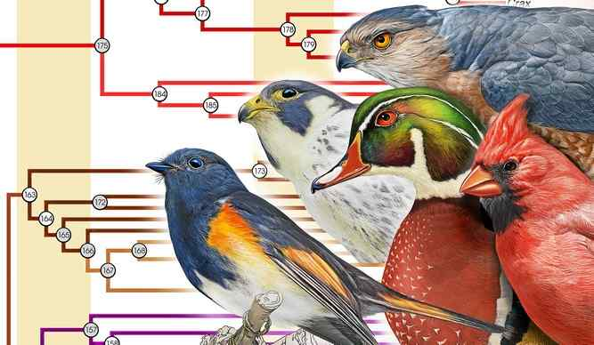
Introduction
Recognition of bird species is an important topic for both biological research and environmental protection.
While it is not always able to have target birds sighted, the sound they make is easy to catch by recorders.
Recognition based on sound recordings traditionally requires experienced ornithologists.
As IT develops, it tends to be easier to gain massive amount of bird recordings while the recognition remains to be slow and low-effective.
Thus the topic of automatic recognition interests more and more people.

Slide 4
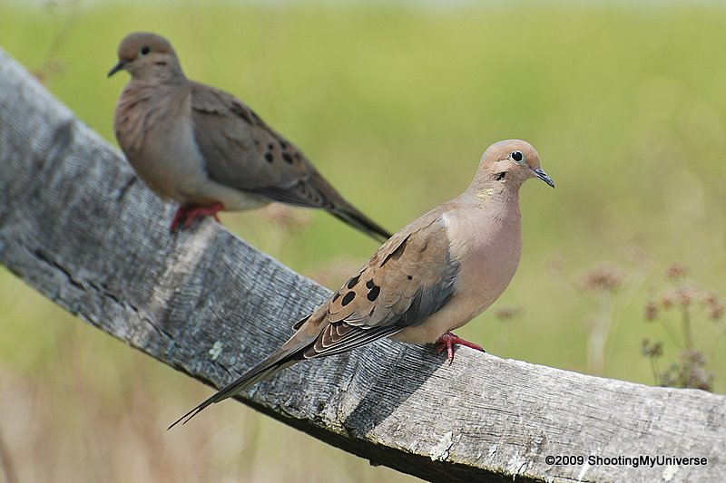
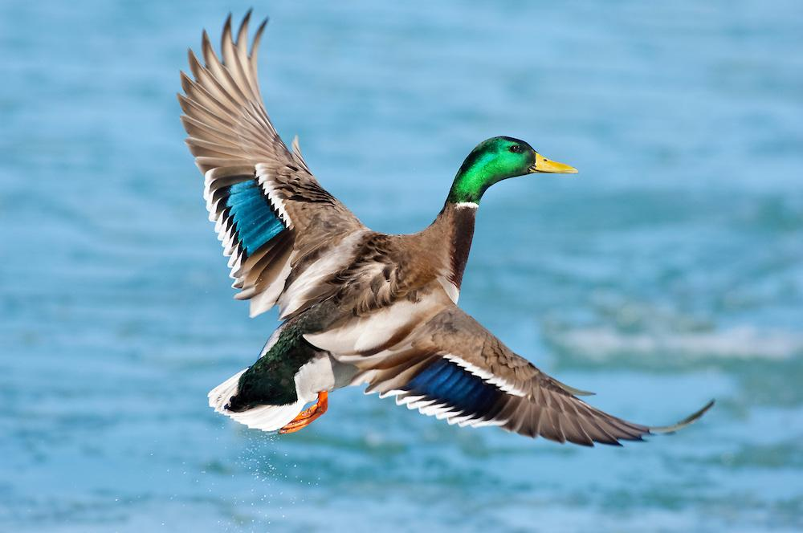
Data collection
The data are fetched from xeno-canto.org
We choose 8 species among 9676 under some criteria(must be cute enough)
mourning dove(Zenaida Macroura)
mallard (Anas Platyrhynchos)

Slide 5
Data pre-process(I):format normalization
Source Data:
.mp3 format
various samp. rate
stereo/mono
various bit depth
Aim Data:
.wav format
samp. rate=44100Hz(fixed)
mono(merge stereo)
8bit bitdepth(fixed)

Slide 6
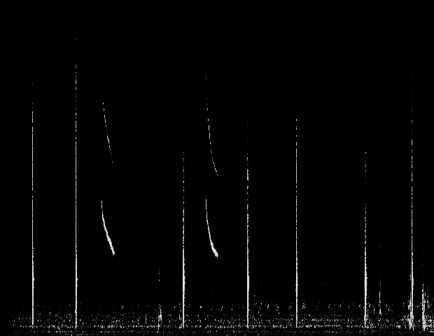
Data pre-process(II):Spectrogram
Cut signal into fixed-length segments
Apply a window function
Take FFT of the segments
Arrange results by time sequence
Spectrogram of Agelaius phoeniceus(Red Wing Black Bird)(part)

Slide 7
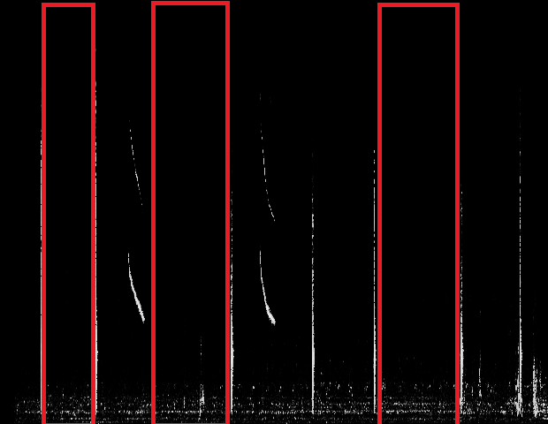
Data pre-process(III):Mute Area Skipping
Mute Area:
Areas in which the maximum amplitude is always smaller than some threshold and the length of which is shorter than some threshold are treated as they only contain noises and are skipped.
In our procedure, the amplitude threshold is mostly -35dB and the time threshold is 500ms.
Mute Areas

Slide 8

Feature Extration :Style(I) Starting from the Simplest
0 | 0 | 19 | 0 | 0
0 | 5 | 19 | 0 | 0
0 | 7 | 8 | 0 | 0
0 | 3 | 16 | 0 | 0
0 | 0 | 16 | 0 | 0
0 | 0 | 16 | 0 | 0
The maximum amplitude in every column(time segment) and the corresponding frequency(row) are picked as desired feature

Slide 9
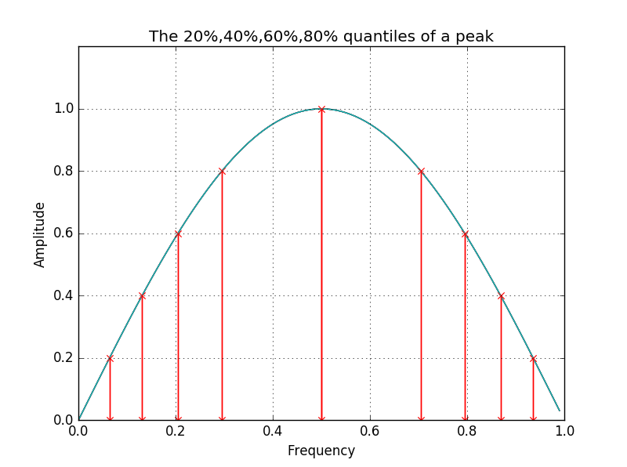
Feature Extration: Style(II) Quantiles
—— A rough scratch of the peak shape
The frequencies with which the amplitude reaches 20%(and 40%,60%,etc) value of the maximum are picked as desired feature. This roughly scratches the shape of the peak.

Slide 10
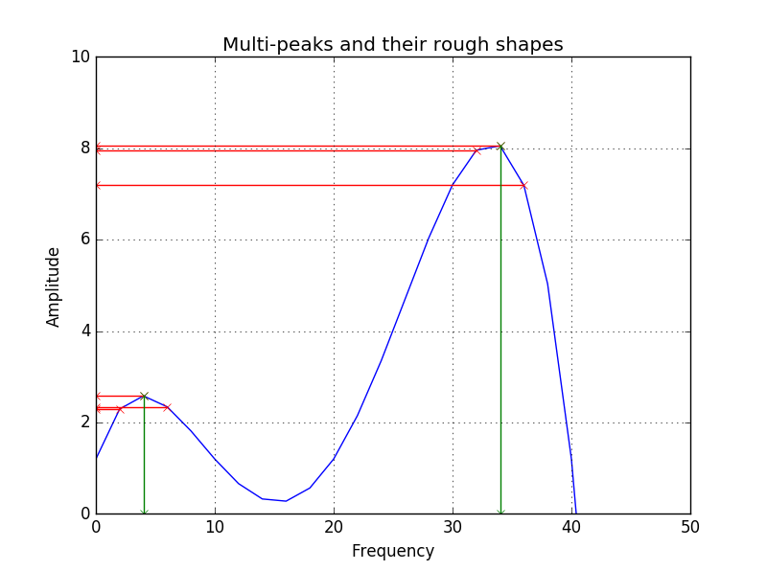
Feature Extration:Style(III) Peaks
The frequency of N largest peaks and the amplitudes near the peaks are picked as desired feature. This should better describe spectrogram with more complicated shapes.

Slide 11
Modeling(I):Hiden Markov Model
Basic Problem Types
Problem 1
Given model parameters
Calculate probability that a certain sequence can occur
[forward-backward algorithm]
Problem 2
Given model parameters
Calculate sequence of observations
that most likely to occur
[viterbi algorithm]
Problem 3
Given sequence of observations
Calculate model parameters
[EM algorithm]
Model Predicting
Sound regenerating
Model Training

Slide 12
How Does Our Model Work?
HMM Network
HMM fit to Bird A
…
Predicting
Testing Data
Result
solving HMM problem 1
HMM fit to Bird H

Slide 13
0 | 1
25.91 | 191.41 | 190.04 | 189.51 | 188.48 | 184.91 | 201.98 | 213.31 | 229.38 | 284.42
state | 0 | 1
0 | 0.8919 | 0.1081
1 | 0.1497 | 0.8503
Emission Probability Matrix of State 0
1320.58 | 0.0 | 0.0 | 0.0 | 0.0 | 0.0 | 0.0 | 0.0 | 0.0 | 0.0
0.0 | 260.96 | 0.0 | 0.0 | 0.0 | 0.0 | 0.0 | 0.0 | 0.0 | 0.0
0.0 | 0.0 | 265.55 | 0.0 | 0.0 | 0.0 | 0.0 | 0.0 | 0.0 | 0.0
0.0 | 0.0 | 0.0 | 266.48 | 0.0 | 0.0 | 0.0 | 0.0 | 0.0 | 0.0
0.0 | 0.0 | 0.0 | 0.0 | 270.26 | 0.0 | 0.0 | 0.0 | 0.0 | 0.0
0.0 | 0.0 | 0.0 | 0.0 | 0.0 | 297.58 | 0.0 | 0.0 | 0.0 | 0.0
0.0 | 0.0 | 0.0 | 0.0 | 0.0 | 0.0 | 364.40 | 0.0 | 0.0 | 0.0
0.0 | 0.0 | 0.0 | 0.0 | 0.0 | 0.0 | 0.0 | 413.42 | 0.0 | 0.0
0.0 | 0.0 | 0.0 | 0.0 | 0.0 | 0.0 | 0.0 | 0.0 | 451.77 | 0.0
0.0 | 0.0 | 0.0 | 0.0 | 0.0 | 0.0 | 0.0 | 0.0 | 0.0 | 8662.11

Slide 14
Modeling(II):Model Training
Experiment 1
Training data using 2 features
Confusion Matrix
Hidden states: 2
Accuracy: 0.786
Prediction
2 | 0 | 0 | 0 | 0 | 0 | 0 | 0
0 | 1 | 0 | 0 | 0 | 0 | 0 | 0
0 | 0 | 1 | 0 | 0 | 0 | 0 | 0
0 | 0 | 0 | 0 | 0 | 2 | 0 | 0
0 | 0 | 0 | 0 | 2 | 0 | 0 | 0
0 | 0 | 0 | 0 | 0 | 1 | 0 | 1
0 | 0 | 0 | 0 | 0 | 0 | 1 | 0
0 | 0 | 0 | 0 | 0 | 0 | 0 | 3
Ground Truth

Slide 15
Modeling(II):Model Training
Experiment 2
Training data using 10 features
Confusion Matrix
Hidden states: 2
Accuracy: 0.643
Prediction
1 | 1 | 0 | 0 | 0 | 0 | 0 | 0
0 | 1 | 0 | 0 | 0 | 0 | 0 | 0
0 | 0 | 0 | 0 | 0 | 1 | 0 | 0
0 | 0 | 0 | 0 | 0 | 1 | 0 | 1
0 | 0 | 0 | 0 | 2 | 0 | 0 | 0
0 | 0 | 0 | 0 | 0 | 0 | 0 | 2
0 | 0 | 0 | 0 | 0 | 0 | 0 | 1
0 | 0 | 0 | 0 | 0 | 0 | 0 | 3
Ground Truth

Slide 16
Modeling(II):Model Training
Experiment 3
Training data using 20 features
Confusion Matrix
Hidden states: 2
Accuracy: 0.571
Prediction
2 | 0 | 0 | 0 | 0 | 0 | 0 | 0
0 | 1 | 0 | 0 | 0 | 0 | 0 | 0
0 | 0 | 0 | 0 | 0 | 0 | 1 | 0
0 | 0 | 0 | 0 | 0 | 1 | 0 | 1
0 | 0 | 0 | 0 | 2 | 0 | 0 | 0
0 | 0 | 0 | 0 | 0 | 1 | 0 | 1
0 | 0 | 0 | 0 | 0 | 1 | 0 | 0
0 | 0 | 0 | 0 | 0 | 1 | 0 | 2
Ground Truth

Slide 17
Modeling(III):Predicting
Method | Hidden States | Accuracy
Method 1 | 2 | 0.786
Method 1 | 4 | 0.714
Method 1 | 8 | 0.714
Method 1 | 16 | 0.714
Method 2 | 2 | 0.643
Method 2 | 4 | 0.571
Method 2 | 8 | 0.571
Method 2 | 16 | 0.5
Method 3 | 2 | 0.571
Method 3 | 4 | 0.571
Method 3 | 8 | 0.571
Method 3 | 16 | 0.571

Slide 18
Conclusion
1, simpler model performs better.
2, our model performs well in predicting bird sounds with high pitches, and robust to sound types (calls and songs)
3, all models make wrong predictions on Bird D, Red-winged blackbird

Slide 19
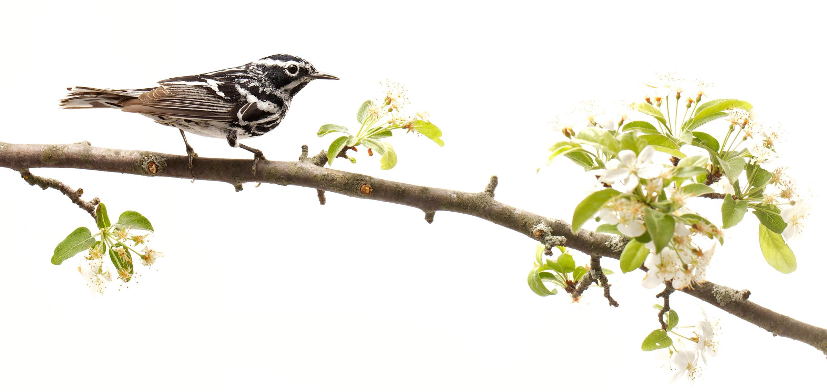
Thank you!

