Slide 1

FreakOlympics
Collaborators: Lacy SoRelle / Doris Batalia / Brijesh Patel / Yahia Zemoura

Slide 2

Male Gold Olympic Gymnasts are naturally Gifted
Why this topic:
The group chose this project to prove whether it takes more than genetics to be an Olympic Gold Medal Athlete…and because we are FreakOlympics
Hypothesis:
If age, height and lighter weight athletes have a higher chances of winning the gold medal in male gymnastics

Slide 3
Data Analysis Process
Objective
The objective of the study is to analyze athlete’s age, height and weight characteristics in relations to gold winning male gymnastics
Funnel approach – Top to Bottom
- The US & Russia dominate the Olympic Male Gymnastics.
- We have identified the main athletes and their characteristics
The analysis assumptions
The athletes age (younger) has higher chance of winning Gold in Gymnastics
Heavier weight athletes have less chance to win Gold
Lighter weight athletes have a higher chance to win Gold
Trend of Age, Weight and height overtime to verify patterns and step changes

Slide 4
Source, Data Cleanup & Challenges
1
Data Source:
Kaeggel: 120 years of Olympics data
Website: https://www.kaggle.com/heesoo37/120-years-of-olympic-history-athletes-and-results
2
Data Cleanup:
Pivot.Panda platform was used to cleaned up the data
Group by to recreate useful Dataframe that are used for Visualization
Three main variables selected;
Age of athletes
Height of athletes
Weight of athletes
The data was filtered on the following:
Single sports: Gymnastics
Summer Event
Male Athletes
Gold Medals
3
Challenges:
Too many API’s
Data scarcity: The event happens every 4 years
Data Format: We add to reformat quite a lot of data but the main issue remained with Age and the scatter plot R square value

Slide 5
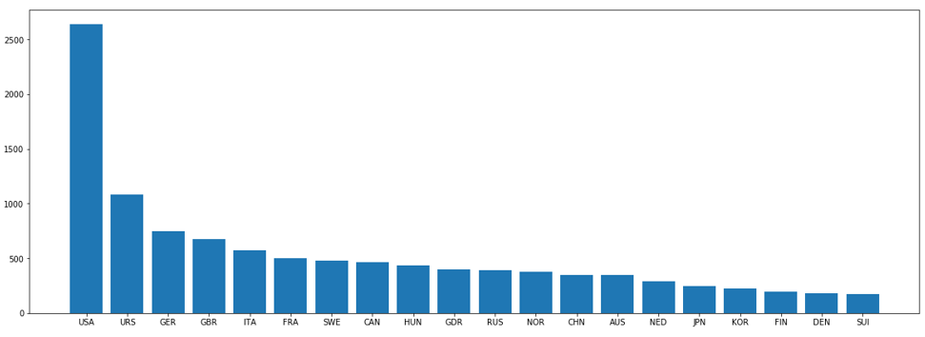
The US & Russia dominate the Olympic Male Gymnastics
Top 20 Countries by Gold Medal Count

Slide 6
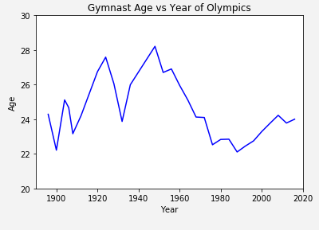
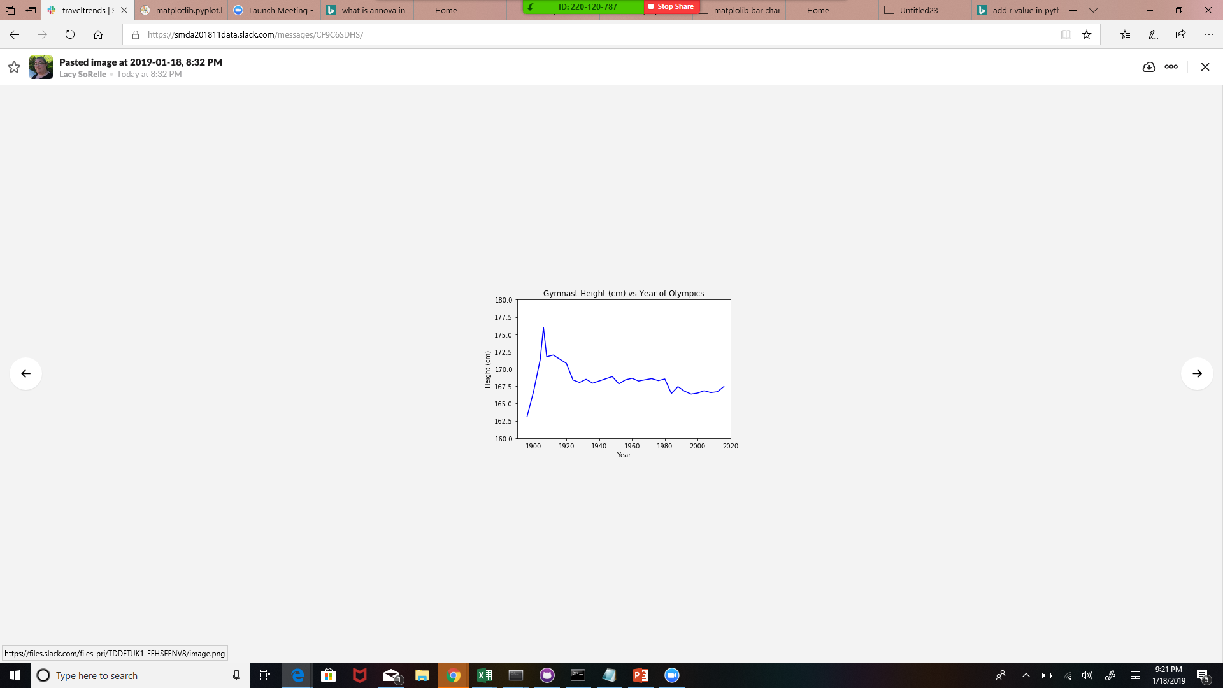
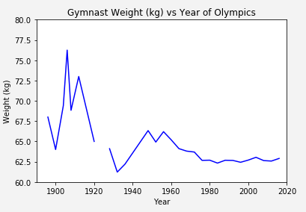
However, we are noticing a step changes within these 3 parameters
Age p-value=0.291
Height p-value=0.031
Weight p-value=0.023

Slide 7
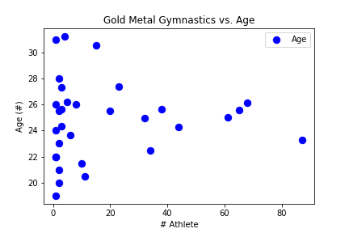
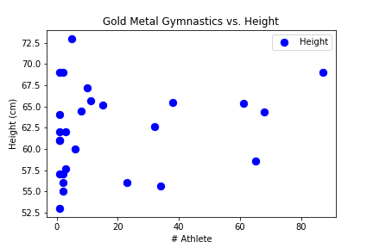

There is no correlation between Age/Height/Weight and winning Gold in the Olympics
It takes more than genetics win gymnastics in Olympic

Slide 8
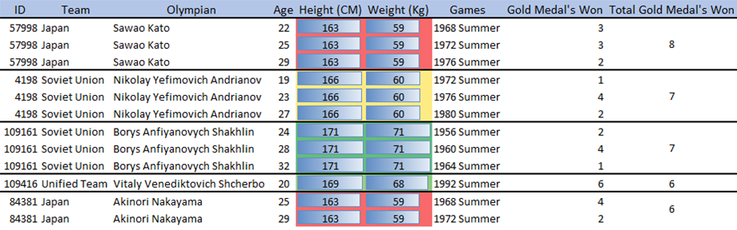
Top Gold Medals Male Gymnastics Winner for the last 120 years

Slide 9
Observations and Conclusion
SCOPE: TOP 20 Gold Winners in Male gymnastics within 120 years
The United States and Russia have been dominating the discipline over time, with the USA far ahead of everybody.
SCOPE: Major findings for trends over time:
There is no correlation in age and winning, however that might be because of the same person winning gold over several years of their career
Height and Weight of competitors have quickly narrowed over time
SCOPE: Correlation of Age, Weight, height vs Winning Gold
Correlations analysis, we observed that there is no correlation between age, height and weight and
Winning Olympic in male gymnastics. Therefore, athlete probability of winning is merely random.
Athletes have equal chances of winning the medals.
SCOPE: Top Gold Medals Male Gymnastics Winner for the last 120 years
We observed a sweet spot for winning the most amount of gold medal and it is between age 20-24 but there are other athletes whom have won high number of Gold Medals at later age.
With More time
We would have looked into women’s gymnastics
We would have look at more events and do further analysis on Silver and Bronze Medal won by top athletes.

Slide 10
Questions and Answers

