Slide 1


Intro to html
Luke sprecher

Slide 2

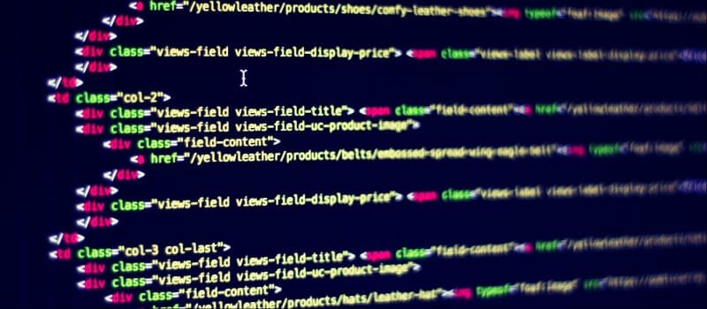
What is HTml?
HTML (Hypertext Markup Language) is a coding language that gives a website its basic structure.
It uses tags to define content such as headings, paragraphs, and images.
HTML was invented by Tim Berners-Lee in 1989 and is a fundamental part of the World Wide Web.
Luke Sprecher

Slide 3
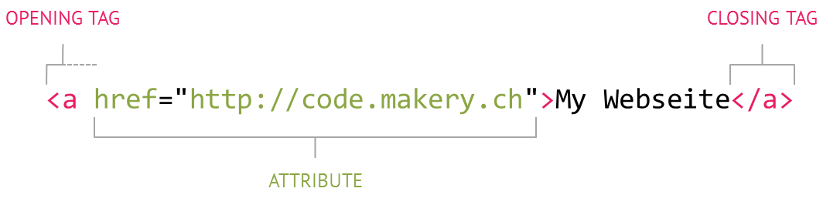
How HTML works
Tags: HTML uses “markup” to annotate text, images and other content for display in a web browser. They are enclosed in tags, which is the element name surrounded in angle brackets (ex. <p> for a paragraph).
Structure: The tags tell the browser how to interpret and present the content. For example, the <h1> tag means a main heading, while <img> embeds an image.
Elements: HTML elements are the building blocks of a web page and are often nested within each other to create structured order.
Luke Sprecher

Slide 4
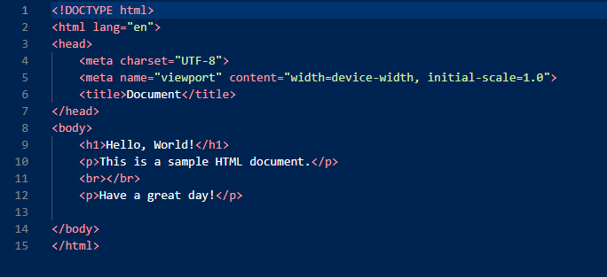
Visual example
This is the most basic example of HTML code.
It includes its starting structure (<!DOCTYPE html>, <head>, and <body> tags.)
Defines how the webpage is structured.
Luke Sprecher

Slide 5
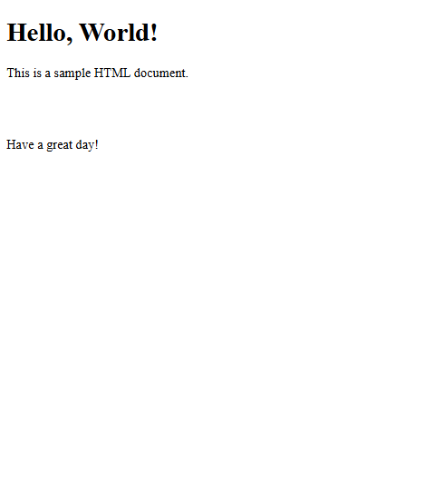
Visual example (continued)
When we run the code from the previous slide, we get this in return
The <h1> tag displays Hello, World!
The <p> tags are displaying the below text.
Luke Sprecher

Slide 6
Common mistakes to avoid
Mistake | Explanation
Missing/Incorrect Doctype Declaration | Failing to declare the right version can lead to inconsistent rendering in different browsers.
Forgetting to Close Tags | Unclosed tags can cause some properties to not be formatted correctly, or in some cases, not load.
Not putting “Alt” tags on images | Removing the “alt” input on image tags hinders accessibility for visually impaired users.
Not using semantic elements | Using generic <div> elements excessively makes it more difficult to label and format elements of your web page.
Luke Sprecher

Slide 7
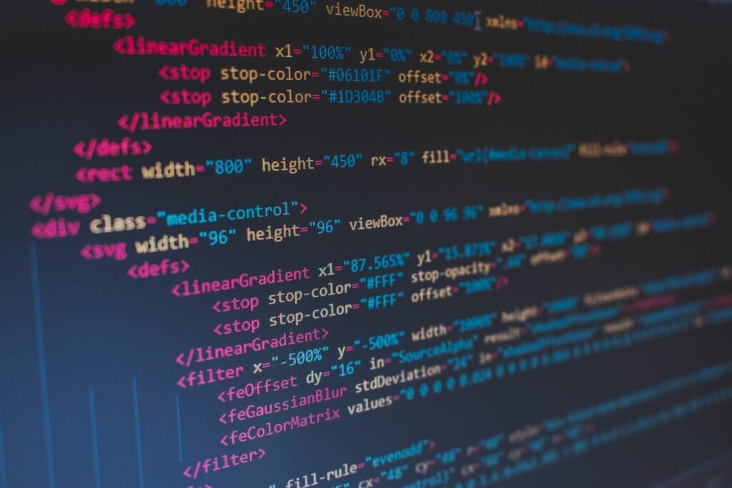
Key Takeaways
HTML is the base for creating anything on the world wide web
HTML links elements together and provides basic structure for websites.
All modern search engines use HTML to understand content and hierarchy of a webpage. Without HTML, browsers couldn’t crawl and index pages properly
Luke Sprecher

