Slide 1

I · THE SILENCE
Since 1867, Canada has asked its people
three questions.
THREE. IN 159 YEARS. THE LAST · 1992 · CHARLOTTETOWN
REPRESENT
01 / 16
Notes:
Cold open — no greeting slide, no agenda. "Not three a year. Three, ever. Three national referendums since Confederation. The last one was 1992 — Charlottetown. That is the entire record of my country turning to its citizens and saying: what do you think? Everything else — every war, every treaty, every budget — was decided about us, without asking us."

Slide 2
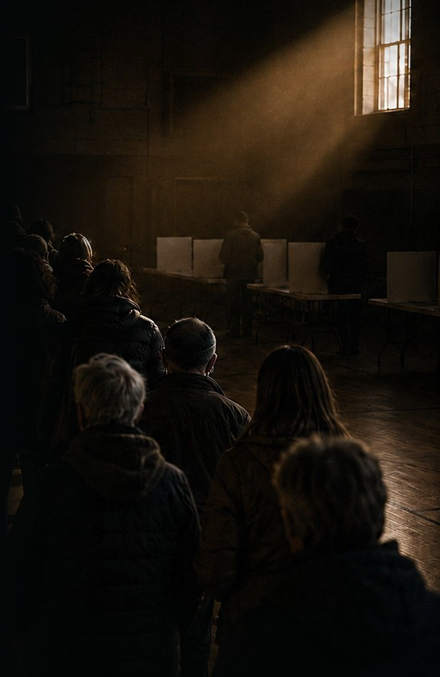
If you’re under 52, your country
has never asked you anything.
Notes:
"If you are under about fifty-two, you have never once been asked a question by Canada. Look at this line. Everybody in it knows one vote every four years changes almost nothing — and they show up anyway, carrying the same small, stubborn hope. That hope has had nowhere to go for an entire generation."

Slide 3
I · THE SILENCE
HOW OFTEN DOES A COUNTRY ASK ITS PEOPLE?
3
3
0
CANADA · SINCE 1867
UNITED KINGDOM · EVER
UNITED STATES · NO LEGAL MECHANISM
It’s not broken. It was never built.
REPRESENT
03 / 16
Notes:
"This is not a Canadian quirk. The United Kingdom has managed three referendums in its entire history. And the United States has held zero national referendums — and here is the part people don’t believe: there is no legal mechanism to hold one. It’s not broken. It was never built."

Slide 4
I · THE SILENCE
THE LAST TIME A CITY ASKED · CALGARY, 2018
One question.
TO RUN ONE VOTE
COMMITTEE TO ANSWER
PEOPLE ANSWERED
$2.2M
3 years
304,582
Dismantled the next day. On Represent: approximately nothing, and days — not years.
REPRESENT
04 / 16
Notes:
"My city ran one plebiscite — should Calgary bid for the Olympics? Roughly three years from committee to answer. $2.2 million to run one vote. And 304,582 Calgarians showed up — 171,750 no, 132,832 yes. The demand is not hypothetical: when people are actually asked, they answer. Then the whole apparatus was torn down the next day. Being asked feels like being respected. We make it feel like a once-in-a-generation event."

Slide 5
I · THE SILENCE
It’s not that they won’t listen.
It’s that they can’t.
Even an honest representative cannot hear 300,000 constituents. There is no instrument — in either direction.
REPRESENT
05 / 16
Notes:
"Here is the uncomfortable truth: even an honest representative cannot hear 300,000 constituents. There is no instrument. Emails, petitions, town halls — all dismissible, because none of it is verified. You are the opinion of one, and the opinion of one is nothing. The failure isn’t moral. It’s infrastructure. In both directions, the channel simply does not exist."

Slide 6
I · THE SILENCE
Civic apps die of the same two wounds.
BRIGADE
Roughly $9M raised. Unverifiable opinion.
COUNTABLE
Dismissible as bots, at any scale.
VOTIZEN
No one ever had to pay.
REPRESENT
06 / 16
Notes:
"You’ve seen this pitch before, and it ended badly. Brigade — Sean Parker, roughly nine million dollars, dead. Countable. Votizen. Civic tech is a famous tar pit, and I’m naming it before you do. They all died of exactly two wounds: their product was unverifiable opinion — one bot accusation and it evaporates — and nobody had to pay for it. Hold those two wounds in mind. The rest of this deck closes both."

Slide 7
II · THE INSTRUMENT
WHY NOW
THEN
NOW
Impossible.
~3 minutes.
Remote proof that a voter is one real person, in one real place.
And a few dollars — only in the last couple of years. Government ID plus a liveness check, from a phone.
Brigade wasn’t wrong. It was early.
REPRESENT
07 / 16
Notes:
"Phones, databases, cryptography — all of it existed for twenty-five years. What didn’t exist was cheap, remote proof that a voter is one real person in one real place. That collapsed from impossible to about three minutes and a few dollars only in the last couple of years. Brigade was early. This is the moment the product they wanted becomes buildable — and we’ve already built it."

Slide 8
You get one day every four years.
We built the other 1,460.
Notes:
PAUSE before advancing to this slide. Then: "This is Represent. Live on the App Store today. Every voter verifies once with government ID and a liveness check. Your region comes from your ID — so a Calgary question is answered only by verified Calgarians. One person, one vote. You cannot verify twice. Democracy gives you one day every four years. We built the other one thousand, four hundred and sixty."

Slide 9
II · THE INSTRUMENT
Not opinion.
Evidence.
VERIFIED HUMAN
gov ID + liveness · docs never stored
REGION FROM ID
a Calgary ballot — Calgarians only
ONE PERSON, ONE VOTE
you cannot verify twice
PUBLIC LEDGER (PILOT)
receipts · auditable without trusting us
SEALED UNTIL 10 VERIFIED BALLOTS
REPRESENT
09 / 16
Notes:
"We designed for a hostile audience. Results stay sealed until ten verified ballots — no bandwagons, no fake landslides. Every count is written to a public ledger — currently a pilot on a test network — with per-voter receipts, so a skeptic can audit the tally without trusting Represent at all. Verification runs through Didit; we never store your documents. Yes/no, multiple-choice, ranked-choice, private organizational ballots. This isn’t opinion. It’s evidence. That’s wound number one, closed."

Slide 10
II · THE INSTRUMENT
Small numbers. Real ones.
PUBLIC QUESTIONS
~157
LIVE
VERIFIED BALLOTS
~190
HUMAN, PROVEN
VERIFIED VOTERS
a few dozen
GOV-ID
CAPITAL
CAD $1M
COMMITTED · STAGED
Every ballot above is a government-ID-verified human — a claim the graveyard could never make at any scale.
REPRESENT
10 / 16
Notes:
"Here is exactly where we are, with no inflation: about 157 public questions on the record, about 190 verified ballots cast, a few dozen verified users. Small — but every single one of those ballots is a government-ID-verified human being, which is a claim Brigade could never make at any scale. Everything in this deck holds itself to that standard. Verified numbers only." [FOUNDER: pull the exact live counts from the database on the morning of the pitch and update this slide — exact beats approximate, and it is on-brand to be exact.]

Slide 11
III · THE BUSINESS
Citizens never pay to vote.
Organizations do.
FREE
PRO
PLUS
BUSINESS
$0
$59
$179
$499
up to 25 members
up to 250 members
up to 1,000 members
up to 5,000 members
RATIFICATIONS · ELECTIONS · BYLAW VOTES · ONE-TIME VERIFICATION UNLOCKS $199–$999
ElectionBuddy and Simply Voting are profitable in exactly this market. Neither verifies identity. Neither has a public ledger.
REPRESENT
11 / 16
Notes:
"Citizens never pay to vote — permanent principle. Organizations pay: unions, associations, co-ops, boards running ratifications, elections, bylaw votes. Fifty-nine to four ninety-nine a month by size, plus one-time verification unlocks from one ninety-nine to nine ninety-nine. And this buyer isn’t theoretical — ElectionBuddy and Simply Voting are profitable companies in exactly this market. Neither offers government-ID-verified voters or a public auditable ledger. That’s wound number two, closed." [Q&A ARMOR: if asked ‘they’re profitable without verification, why is it a premium?’ — answer: the expensive part of an internal vote is the argument afterwards; a disputed ratification costs an org far more than $499/month, and only a verified roll ends the dispute.]

Slide 12
III · THE BUSINESS
You can ignore one voice.
You cannot ignore a verified majority.
01
ORGANIZATIONS FUND THE BUSINESS
02
EVERY MEMBER VERIFIED ADDS TO THE NETWORK
03
VERIFIED DENSITY CONCENTRATES — ALBERTA FIRST
04
NOTHING LEFT TO DISMISS
REPRESENT
12 / 16
Notes:
"Organizations fund the business. Density wins the mission. We concentrate on Alberta first: build verified density in one place, and a politician facing a verified majority of their own constituents has nothing left to dismiss — not bots, not a loud minority, not the opinion of one. That’s the flywheel: paid on one side, unignorable on the other."

Slide 13
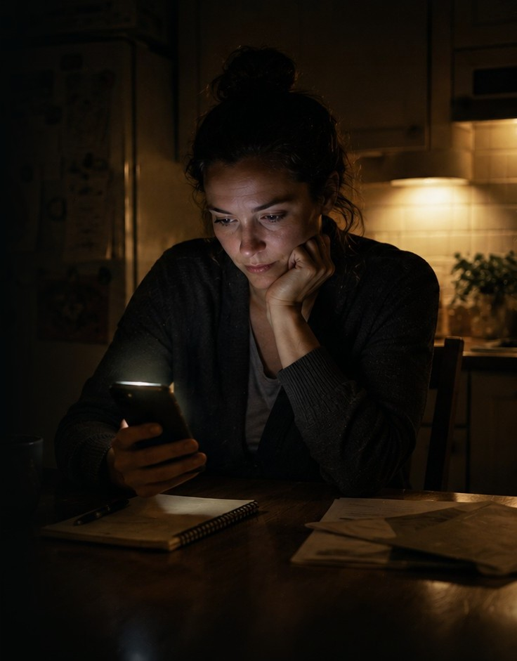
Started at a kitchen table
in Calgary.
FOUNDER
Lance Morrison · self-funded start
COFOUNDER
recently joined
CAPITAL
CAD $1M committed · milestone tranches
Notes:
"I’m Lance Morrison. I started this with my own money, in Calgary, and a cofounder recently joined me. An angel has committed one million Canadian dollars — and I want to be precise: committed, not raised, released in tranches tied to verified-user milestones. Someone has already looked at these small honest numbers and staked a million dollars on where they go. The terms hold me accountable, and I like it that way."

Slide 14
The majority chooses good.
Notes:
Two seconds of silence before speaking. Then: "Three referendums in 159 years — not because people didn’t want to answer, but because asking cost millions and took years. It doesn’t anymore. When people get the chance to decide for themselves, the majority chooses good. We’re building the instrument that finally lets them." Hold again after.

Slide 15
III · THE BUSINESS
THE CAPITAL, PRECISELY
CAD $1M
COMMITTED · IN TRANCHES TIED TO VERIFIED-USER MILESTONES
JOB ONE
the first verified constituency
ALBERTA
JOB TWO
the first paying organizations
SIGNED
Canada asked three questions in 159 years. Help us ask the fourth.
REPRESENT
15 / 16
Notes:
[FOUNDER — REQUIRED BEFORE PITCH DAY: state your one true ask out loud here. Pick the sentence that is actually true, e.g. “We’re raising a further $X alongside the committed $1M,” or “We’re looking for co-investors on the same milestone terms,” or “We want introductions to organizations and to your civic-minded LPs.” Never say ‘portions.’] Then: "The million is committed, in tranches tied to verified-user milestones. It buys two proofs: the first verified constituency — Alberta — and the first paying organizations. One proves the flywheel. The other proves the business. Canada asked three questions in 159 years. Help us ask the fourth — and every one after it."

Slide 16
Stop being counted. Start counting.
LIVE ON THE APP STORE · REPRESENTVOTE.COM
Notes:
Say nothing. Let the room break the silence.

