Slide 1


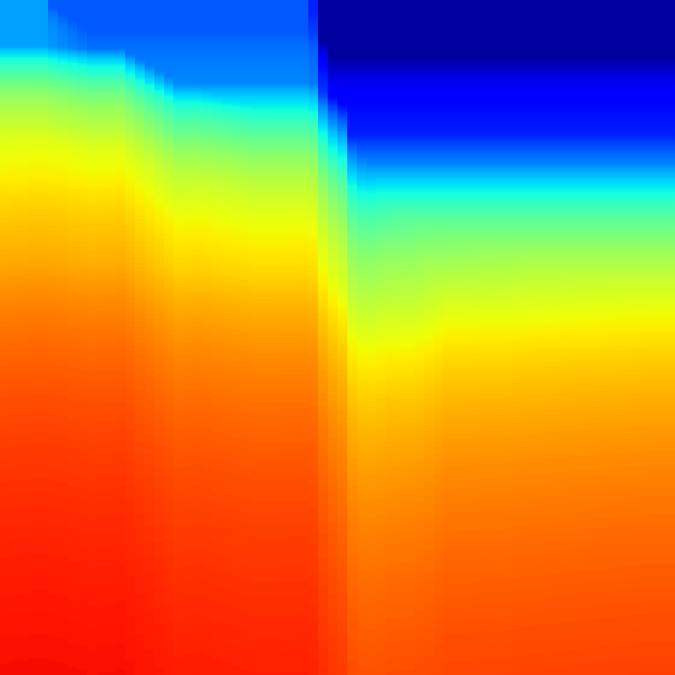


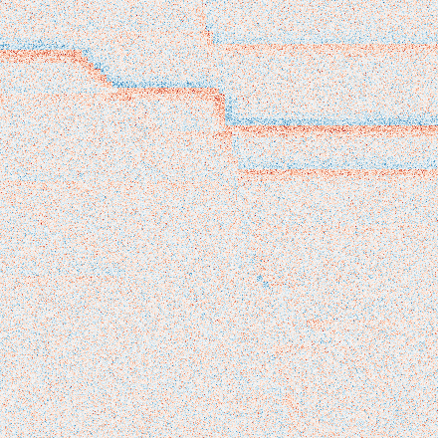
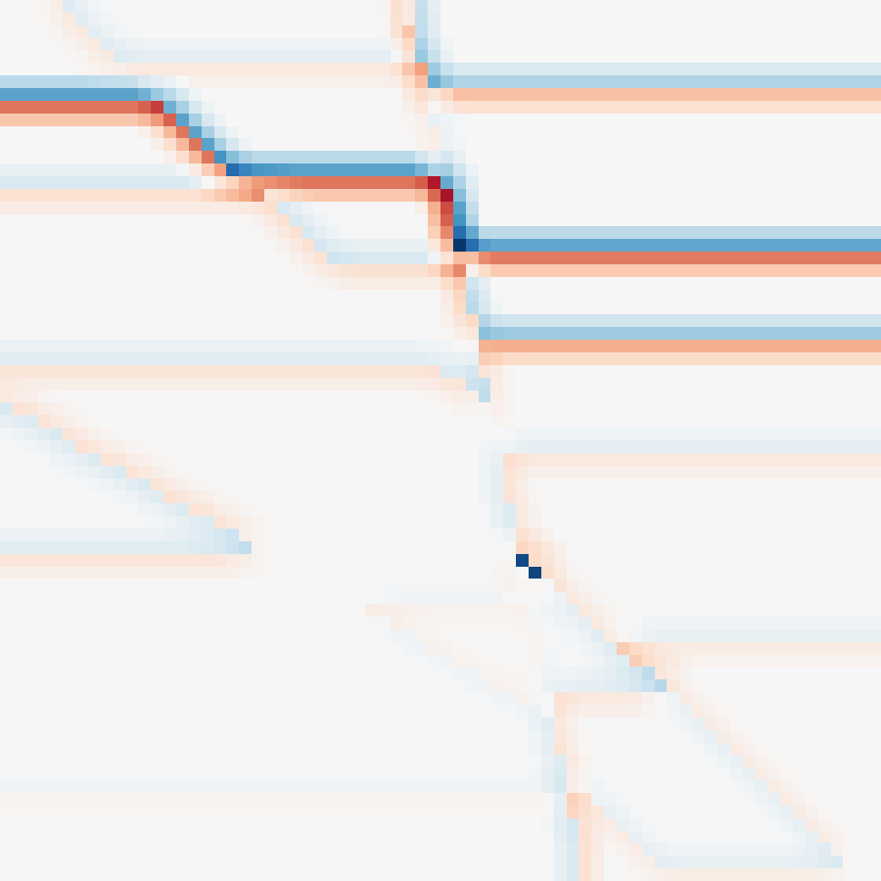


p_PD(b,r|XΩ) = δ[b=f_B(C_B)] pθ(r|C_S,b)
deterministic background + distributional residual
(a) Physics-Decoupled Condition Contract
Solid arrows: inference computation
Dashed orange: training-only supervision
asymmetric evidence
(b) Prediction-Consistent Residual Transport
restricted routing
C_B
Background U-Net
B̂
+
role heads
f_B(C_B)
V̂ = B̂ + R̂
Modality
Evidence
Encoder
C_B
B_m
PoSTM
Horizon
∇ωB L_R = 0
V̂-V=R̂-R_{B̂}
B̄=sg[B̂]
S_m
C_S
E_m
U_m
C_S
c=[C_S;ψ_B(B̄)]
reliability
fusion
RMS
Well
U_m: separation only
velocity-space FiLM
Residual Flow Matching
training-only anchors
V (training only)
ξ
R_t
R_{B̂}
A_B=W_L(V), A_S=W_H(V)
not available at inference
learned role maps
R_{B̂}=V-B̄
R_t=(1-t)ξ+tR_{B̂}
u_t=R_{B̂}-ξ
E||u_R||² < E||u_V||²
iff E||V-B̂||² < E||V||²

