Slide 1
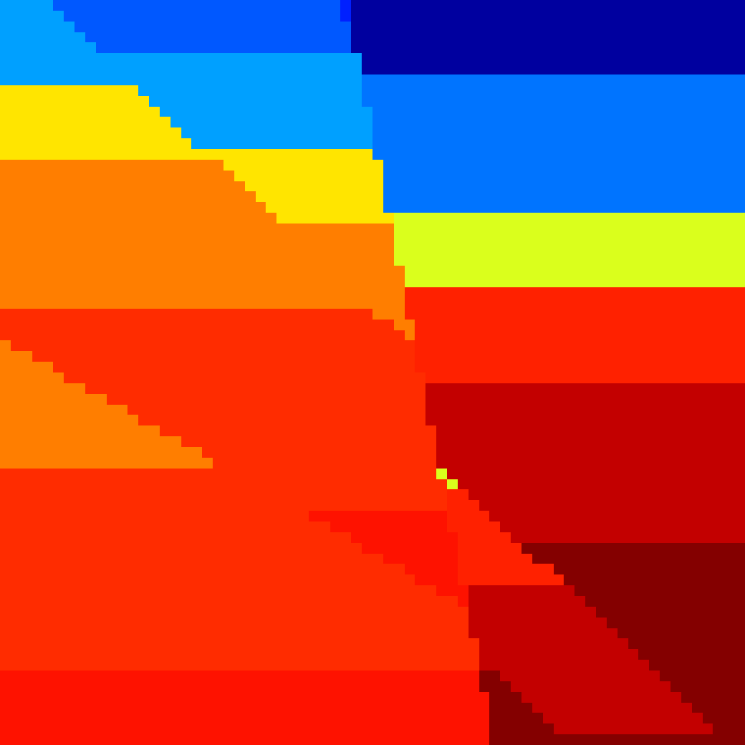
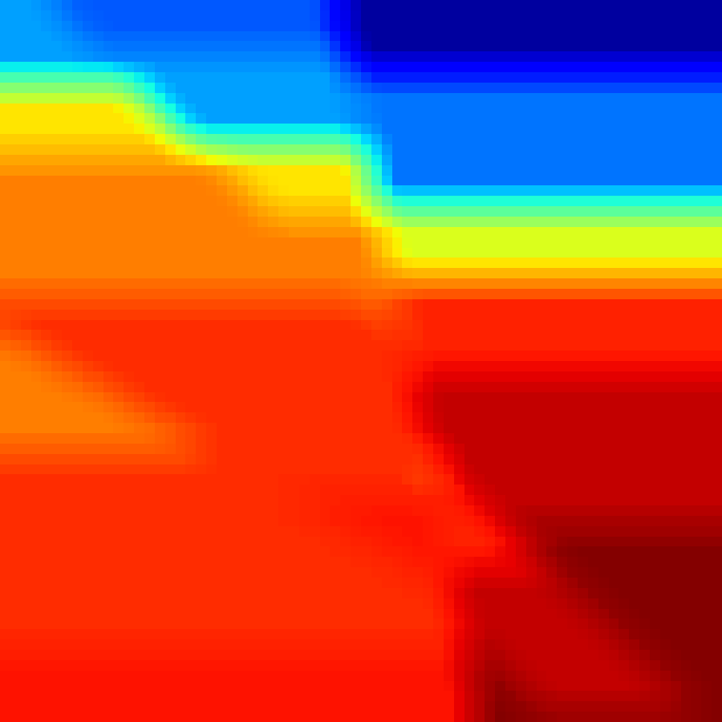
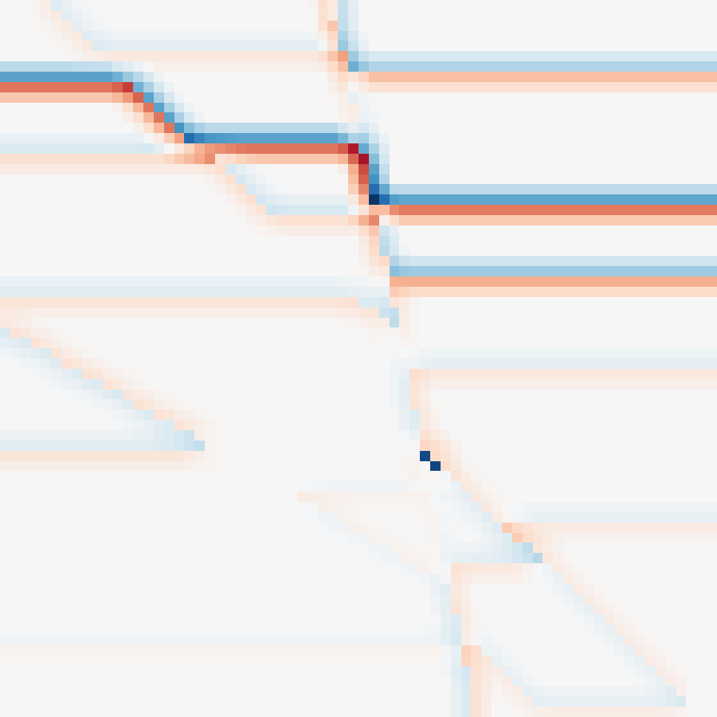
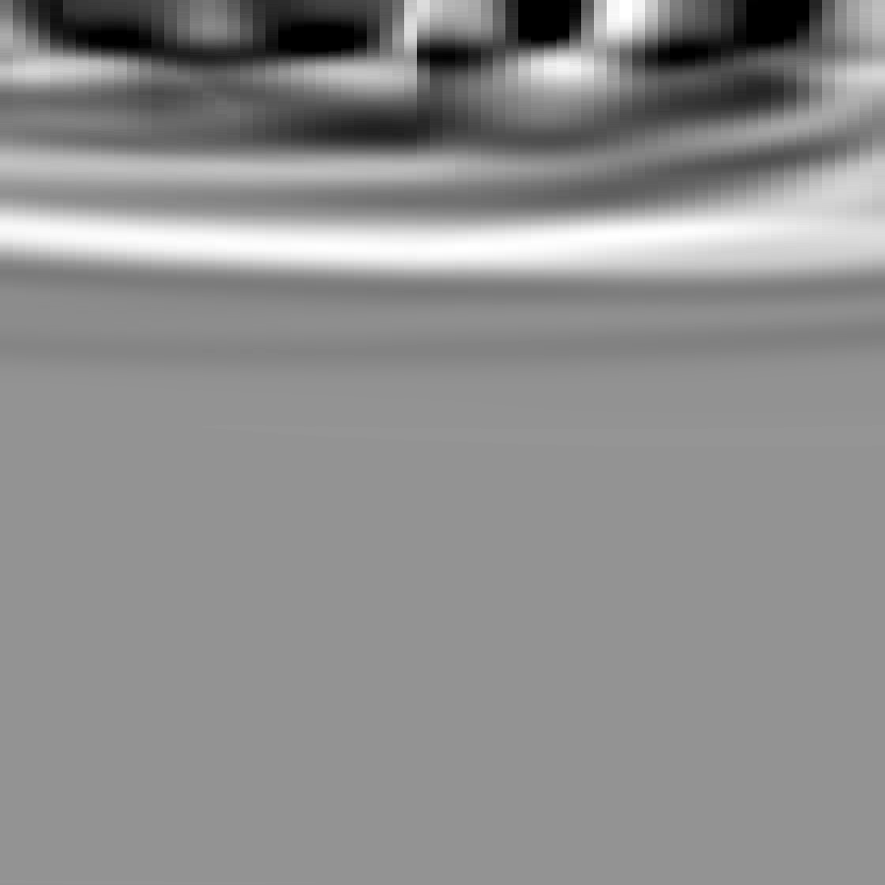
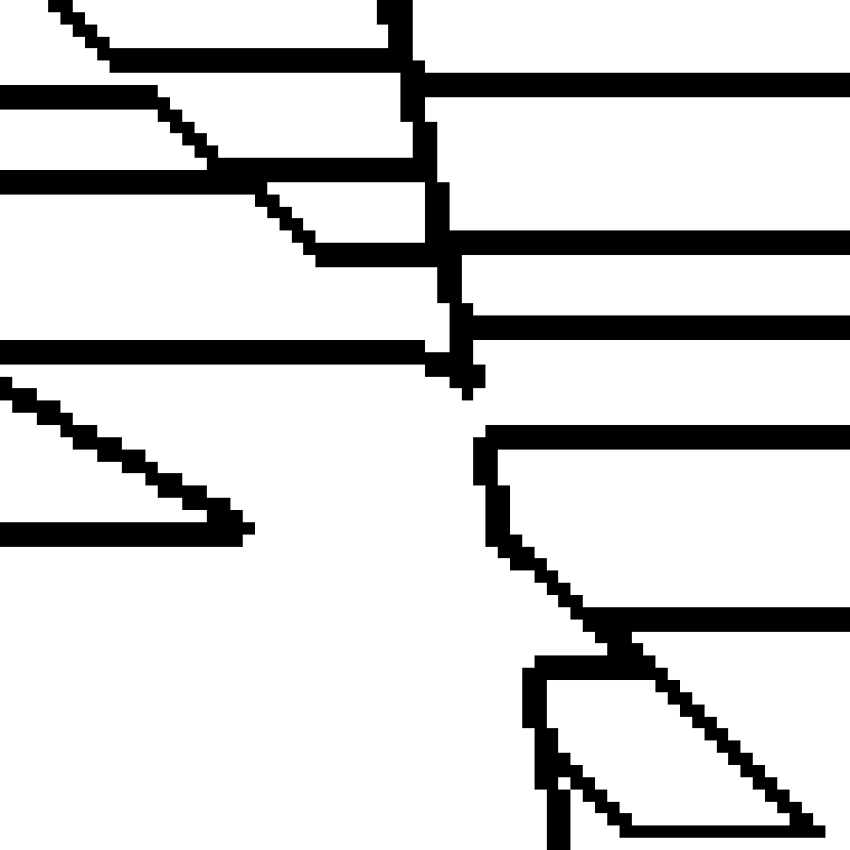
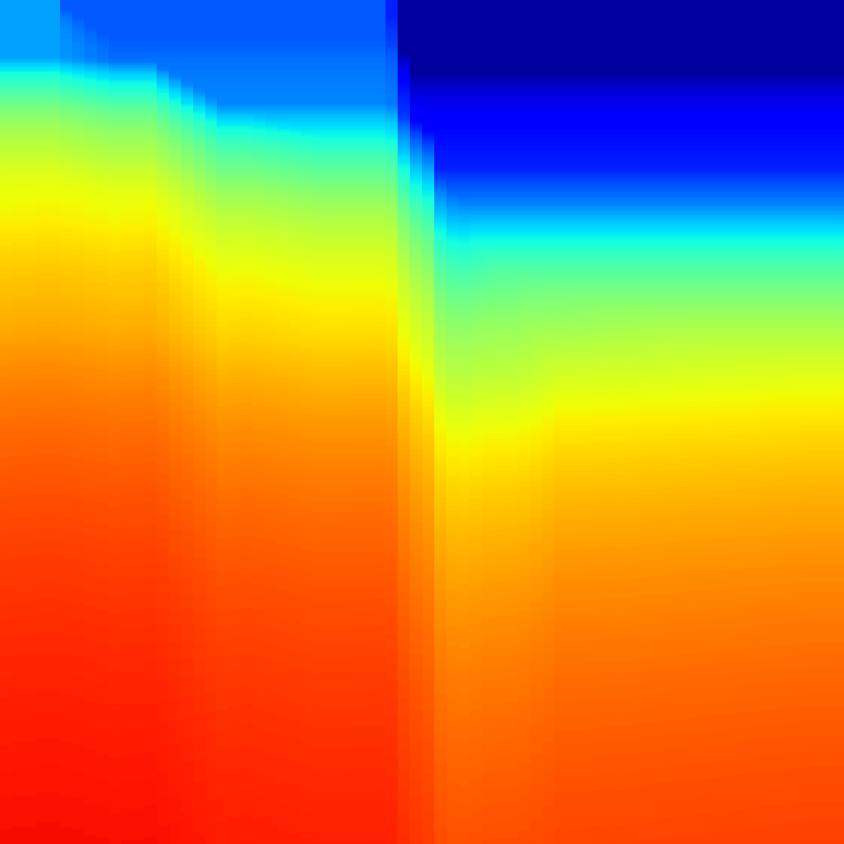
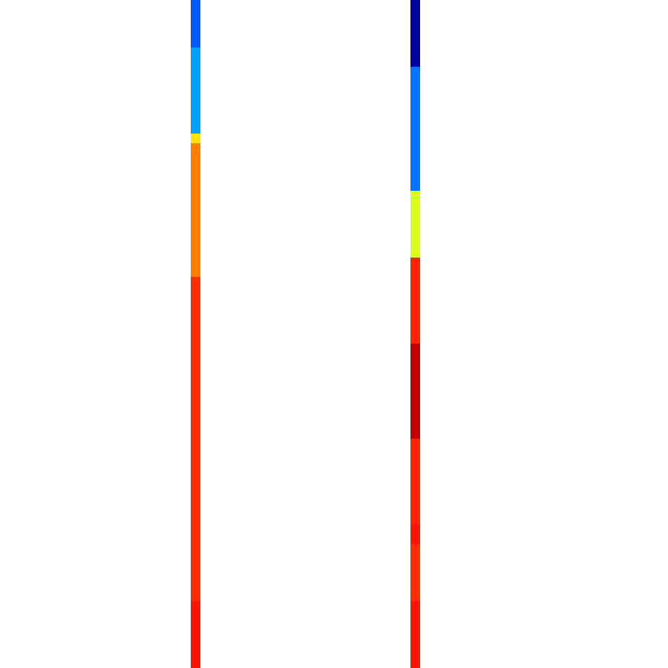



(a) Modality-component alignment
1.0
PoSTM
0.31
0.30
0.8
Horizon
0.15
0.37
0.6
Effective rank
500
Median RBF CKA
RMS velocity
0.82
0.50
0.4
100
0.2
Training-free statistics over eight OpenFWI subsets
Well log + mask
0.04
0.09
r_eff
0
Length (km)
0.7
Background B
Depth (km)
Structure S
0.0
10
$$V=B+S$$
0.7
Velocity Model
Background $B=P_{L}\left(V\right)$
Structure $S=V−B$
1
B
S
(a) Role-asymmetric evidence
(b) Component effective dimension
0
Length (km)
0.7
0
Length (km)
0.7
1.0
Time (s)
Depth (km)
0.8
1
PoSTM
reflector cues
0.7
Horizon
interfaces
0.6
Cumulative explained variance
0
Length (km)
0.7
0
Length (km)
0.7
0.4
Time (s)
Depth (km)
0.2
0.43
0.2
0.7
Background B
1
RMS Velocity
smooth trend
Well log
sparse scale
0.0
Structure S
1
10
100
1000
Principal components

