Slide 1
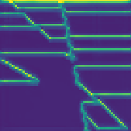
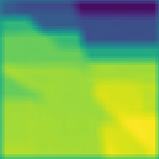






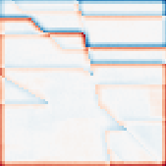






Prediction-Consistent Residual Flow Trajectory
(a) Conditioning
(b) Euler trajectory
(c) Composition
R_(k+1) = R_k + dt v_k, dt = 1/50
C_str (channel RMS)
R_0=\xi
R_{10}
R_{25}
R_{40}
R_{50}=\hat R
B_hat
psi_bg(B_hat)
c_R = [C_str ; psi_bg(B_hat)]
v_0
v_{10}
v_{25}
v_{40}
v_{49}
R_hat
R_t = (1-t) xi + t(V - B_hat); v_theta(R_t,t,c_R)
V_hat = B_hat + R_hat
Feature maps are channel RMS (no velocity units); tile images are embedded data assets, while labels, equations, and arrows remain editable.

