Slide 1
Technical Debt
Chapter 5
Notes:
<*s*o*u*r*c*e*>*9*4*4*a*2*-*4*-*1*<*/*s*o*u*r*c*e*>

Slide 2
Chapter Objectives
In this chapter, you will learn
What technical debt is
The impact of technical debt
How to recognize technical debt
How to explain the importance of eliminating technical debt
How to address technical debt
Notes:
<*s*o*u*r*c*e*>*9*4*4*a*2*-*4*-*2*<*/*s*o*u*r*c*e*>

Slide 3
Chapter Contents
What Is Technical Debt?
How to Recognize Technical Debt
Explaining Technical Debt to Stakeholders
Addressing Technical Debt
Notes:
<*s*o*u*r*c*e*>*9*4*4*a*2*-*4*-*3*<*/*s*o*u*r*c*e*>

Slide 4
What Is Technical Debt?
Term was coined by Ward Cunningham
Refers to the eventual consequences of slapdash software design and quick-and-dirty software development
Uses a financial debt metaphor to describe the extra time and cost that will eventually be needed to get the code back into optimum condition
Known as interest
According to Informit.com, most companies spend 80 percent of their software development budget on maintenance
Famous last words
We’ll fix it after we release
We’ll write some glue code for now
Don’t worry about the documentation for now
Notes:
<*s*o*u*r*c*e*>*9*4*4*a*2*-*4*-*4*<*/*s*o*u*r*c*e*>

Slide 5
What Is Technical Debt: Good Technical Debt
Serves a purpose
Results from a conscious decision to take it on
Okay as long as there is either a plan to deal with it
Or a conscious, supportable decision to live with it
Can you think of some examples of good technical debt?
Notes:
<*s*o*u*r*c*e*>*9*4*4*a*2*-*4*-*5*<*/*s*o*u*r*c*e*>
Instructors Notes:
Examples of good technical debt
MVP to garner quick feedback
Need to ship now or face penalties
Need to ship before the competition
Preserve startup capital
Long-term cost of maintaining less than the cost of doing it right
Code is throw-away, such as a data migration script
New learnings
Integrating new technologies
Firm plan to refactor later
Hot fix

Slide 6
What Is Technical Debt: Bad Technical Debt
Serves no justifiable purpose
Results from rationalizations, lack of skill, or ignorance
No firm plan to deal with it
Can you think of some examples of bad technical debt?
Notes:
<*s*o*u*r*c*e*>*9*4*4*a*2*-*4*-*6*<*/*s*o*u*r*c*e*>
Instructors Notes:
Examples of bad technical debt
Using cheap poorly skilled developers, designers, etc.
Little or no design because 'we're agile'
Little or no documentation because 'we're agile'
Winchester Mansion architecture
Quick delivery of business value overrides spending the time to do it right
No coding standards
Test-Last-Development
Coding to unrealistic deadlines
Sloppy coding and short cuts
Rationalizing that will refactor later with no firm plan to do so
Short-sighted business decisions
Implementing a solution before fully understanding the problem
Gold-plating
Using obscure languages and tools
Bleeding edge
Honest mistakes – forgivable but still needs to be dealt with

Slide 7
What Is Technical Debt: Getting Deeper in Debt
Reduced Productivity
Less Gets Done
Take on Debt
Behind Schedule
Management
Pressure
Notes:
<*s*o*u*r*c*e*>*9*4*4*a*2*-*4*-*7*<*/*s*o*u*r*c*e*>
Image created by T.Guay

Slide 8
Group Exercise 5.1
As individuals, spend 10 minutes picking the biggest technical debt challenge your company faces
Think about why it is the biggest challenge
As a group, spend 10 minutes sharing your findings with each other
As a group, pick the greatest challenge to share with the class
Notes:
<*s*o*u*r*c*e*>*9*4*4*a*2*-*4*-*8*<*/*s*o*u*r*c*e*>

Slide 9
Chapter Contents
What Is Technical Debt?
How to Recognize Technical Debt
Explaining Technical Debt to Stakeholders
Addressing Technical Debt
Notes:
<*s*o*u*r*c*e*>*9*4*4*a*2*-*4*-*9*<*/*s*o*u*r*c*e*>

Slide 10
How to Recognize Technical Debt
Smells can come from design, code, test, documentation, and unfixed bugs
Course focus will be on design smells
Design smells result in the violation of fundamental Object-Oriented Design (OOD) principles
Abstraction
Encapsulation
Modularity
Hierarchy
Notes:
<*s*o*u*r*c*e*>*9*4*4*a*2*-*4*-*1*0*<*/*s*o*u*r*c*e*>

Slide 11
How to Recognize Technical Debt: Design Smells
Grime is the accumulation of non-pattern code in classes originally developed using a design pattern
As grime builds up, more test cases break
Breaks the integrity of the design
Leads to test and design debt
STUPID: encompasses both design and code smells
Singleton
Tight Coupling
Untestability
Premature Optimization
Indescriptive Naming
Duplication
Notes:
<*s*o*u*r*c*e*>*9*4*4*a*2*-*4*-*1*1*<*/*s*o*u*r*c*e*>
Instructors Notes;
Tell students we will now take a more detailed look at design smells

Slide 12
How to Recognize Technical Debt: Design Smells
Abstraction Smell | How Smell Occurs
Multifaceted Abstraction | Arises when more than one responsibility is assigned to the abstraction
Incomplete Abstraction | The abstraction does not fully support the responsibility
Imperative Abstraction | When an operation (or method) that belongs to an existing abstraction is turned into a separate abstraction (or class)
Unutilized Abstraction | An abstraction is unused or is unreachable
Controlling Abstraction | When an abstraction over-controls other abstractions
Duplicate Abstraction | Two or more abstractions share the same name and/or implementation
Notes:
<*s*o*u*r*c*e*>*9*4*4*a*2*-*4*-*1*2*<*/*s*o*u*r*c*e*>

Slide 13
How to Recognize Technical Debt: Design Smells
Example: Imperative Abstraction smell
Notes:
<*s*o*u*r*c*e*>*9*4*4*a*2*-*4*-*1*3*<*/*s*o*u*r*c*e*>

Slide 14
How to Recognize Technical Debt: Design Smells
Encapsulation Smell | How Smell Occurs
Deficient Encapsulation | When implementation details of an abstraction are exposed or poorly protected by its interface
Lenient Encapsulation | The declared accessibility of one or more abstraction members are more permissive than required
Unexploited Encapsulation | When client code uses explicit type checks instead of using the type variations encapsulated within a hierarchy
Unrestrained Encapsulation | When state is made globally visible to abstractions
Notes:
<*s*o*u*r*c*e*>*9*4*4*a*2*-*4*-*1*4*<*/*s*o*u*r*c*e*>

Slide 15
How to Recognize Technical Debt: Design Smells
Example: Lenient Encapsulation smell
Notes:
<*s*o*u*r*c*e*>*9*4*4*a*2*-*4*-*1*5*<*/*s*o*u*r*c*e*>
Instructors Note: Walk through the easy fix on screen

Slide 16
How to Recognize Technical Debt: Design Smells
Modularization Smell | How Smell Occurs
Unused Modularization | When the client code depends on the implementation instead of the interface (tight coupling)
Insufficient Modularization | An existing abstraction could be further decomposed
Broken Modularization or Split Modularization | When data and methods which should be in a single abstraction are spread across multiple abstractions (tight coupling)
Cyclic-Dependency Modularization | Two or more class-level abstractions depend on each other, either directly or indirectly (tight coupling)
Central-Dependency Modularization | A class-level abstraction is dependent on a large number of other class-level abstractions
Notes:
<*s*o*u*r*c*e*>*9*4*4*a*2*-*4*-*1*6*<*/*s*o*u*r*c*e*>

Slide 17
How to Recognize Technical Debt: Design Smells
Example: Cyclic-Dependency Modularization smell
Notes:
<*s*o*u*r*c*e*>*9*4*4*a*2*-*4*-*1*7*<*/*s*o*u*r*c*e*>
Instructors Note: Ask if they see another issue

Slide 18
How to Recognize Technical Debt: Design Smells
Hierarchy Smell | How Smell Occurs
Inverted Hierarchy | The supertype-subtype relationship is inverted
Folded Hierarchy | When an abstraction should have more generalization or factoring in a hierarchy
Missing Hierarchy | An abstraction uses conditional logic or embedded features to select a behavior (unexploited IS-A relationship)
Complex Hierarchy | The inheritance graph is too wide, too deep, tangled, or skewed
Unnecessary Hierarchy | A hierarchy has one or more unnecessary abstractions
Rebellious Hierarchy | A subtype rejects or invalidates a method provided by the supertype
Polygonal Hierarchy | A supertype is repeatedly inherited in descendent abstractions forming a polygon in the inheritance graph
Cyclic Hierarchy | A supertype refers to one of its subtypes
Broken Hierarchy | A supertype and subtype do not share an IS-A relationship
Notes:
<*s*o*u*r*c*e*>*9*4*4*a*2*-*4*-*1*8*<*/*s*o*u*r*c*e*>

Slide 19
How to Recognize Technical Debt: Design Smells
Example: Deep Hierarchy smell
Notes:
<*s*o*u*r*c*e*>*9*4*4*a*2*-*4*-*1*9*<*/*s*o*u*r*c*e*>
Instructors Note: Walk through the easy fix on screen

Slide 20
Refactoring Cycle: IMPaCT
IM – Identify and Mark refactoring candidates
P – Plan refactorings
C – Carry out refactorings
T – Test to ensure behavior unchanged
Notes:
<*s*o*u*r*c*e*>*9*4*4*a*2*-*4*-*2*0*<*/*s*o*u*r*c*e*>

Slide 21
Refactor to Patterns
Marries refactoring with design patterns to improve existing code
Improves existing design using iterative rounds of pattern refactoring
Considered a better approach than throwing it away and starting from scratch
Same pros and cons from using patterns discussed earlier
Starts by identifying areas of code in need of pattern refactoring
Look for code and design smells
Start with one smell and iteratively refactor it—then on to the next
Notes:
<*s*o*u*r*c*e*>*9*4*4*a*2*-*4*-*2*1*<*/*s*o*u*r*c*e*>

Slide 22
Hands-On Exercise 5.2
In this exercise, you will Identify design technical debt and refactor to fix
In your Workbook, please refer to Hands-On Exercise 5.2: Refactor Design Smells
Notes:
<*s*o*u*r*c*e*>*9*4*4*a*2*-*4*-*2*2*<*/*s*o*u*r*c*e*>

Slide 23
Chapter Contents
What Is Technical Debt?
How to Recognize Technical Debt
Explaining Technical Debt to Stakeholders
Addressing Technical Debt
Notes:
<*s*o*u*r*c*e*>*9*4*4*a*2*-*4*-*2*3*<*/*s*o*u*r*c*e*>

Slide 24
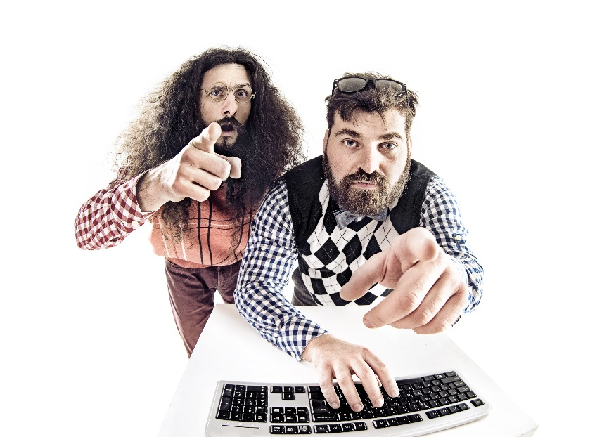
Explaining Technical Debt to Non-Technical Stakeholders
Key to addressing technical debt is engaging non-technical stakeholders
A key player in gaining organizational buy-in is the Product Owner
Discussion must focus on ROI, TCO, business need, and benefit
Should also address security, support, and reliability issues
NO TECHSPEAK!
ROI = return on investment
Notes:
<*s*o*u*r*c*e*>*9*4*4*a*2*-*4*-*2*4*<*/*s*o*u*r*c*e*>
Instructor notes:
PO should have the necessary credibility with the business
PO owns the product and have the final say on what the team will focus on
ROI, TCO, Security and Support
Reduced maintenance costs
Improved productivity
More time to work on new business value
On-time and on-budget
Reduced risk of security breaches
Less production issues
Reduced support costs

Slide 25
Explaining Technical Debt to Stakeholders
Identify and inventory the technical debt using code scanning tools such as
SonarQube with the technical debt plug-in
CAST AIP
Configure your tools to focus on your pain points
Key metrics
Code coverage—the percentage of the code covered by tests
Cyclomatic complexity—the number of possible paths through a functional unit of code
Smells
Notes:
<*s*o*u*r*c*e*>*9*4*4*a*2*-*4*-*2*5*<*/*s*o*u*r*c*e*>

Slide 26
Explaining Technical Debt to Stakeholders
Perform an impact assessment to prioritize the technical debt
Quantify the consequences of not addressing technical debt
Quantifying the cost of fixing technical debt
Use the cost of fixing the technical debt compared to the cost of the consequences to determine ROI and new TCO
When explaining technical debt to developers, focus on their pain-points
Difficulty understanding the code
Broken builds
Difficulty debugging
Difficulty adding new features
Trapped in maintenance when they would much rather work on new features
Appeal to their sense of craftsmanship
(man hours to refactor X labor cost) + Hardware Costs + Software Costs + Deployment Costs + Training Costs
Notes:
<*s*o*u*r*c*e*>*9*4*4*a*2*-*4*-*2*6*<*/*s*o*u*r*c*e*>

Slide 27
Group Exercise 5.3
In your Workbook, please refer to Hands-On Exercise 5.3: Technical Debt Stories
Notes:
<*s*o*u*r*c*e*>*9*4*4*a*2*-*4*-*2*7*<*/*s*o*u*r*c*e*>

Slide 28
Chapter Contents
What Is Technical Debt?
How to Recognize Technical Debt
Explaining Technical Debt to Stakeholders
Addressing Technical Debt
Notes:
<*s*o*u*r*c*e*>*9*4*4*a*2*-*4*-*2*8*<*/*s*o*u*r*c*e*>

Slide 29
Addressing Technical Debt
Choice is between
Replace
Refactor
Live with it
Take more on―if it makes business sense
Boy Scout Rule
Leave code in better shape than you found it
Allocate 10 percent of the iteration/sprint to refactoring
Add technical debt stories to the backlog
Plan a clean-up release
Dedicate one team member (rotated) to technical debt clean-up
Notes:
<*s*o*u*r*c*e*>*9*4*4*a*2*-*4*-*2*9*<*/*s*o*u*r*c*e*>

Slide 30
Resources
Further reading:
Martin, Robert. Clean Code: A Handbook of Agile Software Craftsmanship. Prentice Hall, 2008.
Suryanarayana, Girish, Ganesh Samarthyam, and Tushar Sharma. Refactoring for Software Design Smells: Managing Technical Debt. Morgan Kaufmann, 2014.
For the programming side of technical debt, take Course 933, Certified Professional in Agile Programming
Notes:
<*s*o*u*r*c*e*>*9*4*4*a*2*-*4*-*3*0*<*/*s*o*u*r*c*e*>
Jogger text: Chapter Quiz
Direction: Right
Quiz (5 mins)
Instructor notes:

Slide 31

Chapter Quiz
What is good technical debt?
What is bad technical debt?
Name a design smell.
What is one approach for dealing with technical debt?
How do you discuss technical debt with stakeholders?
Notes:
<*s*o*u*r*c*e*>*9*4*4*a*2*-*4*-*3*1*<*/*s*o*u*r*c*e*>
Jogger text: Chapter Quiz
Direction: Right
Quiz (5 mins)
Instructor notes:

Slide 32
Chapter Summary
In this chapter, you have learned
What technical debt is
The impact of technical debt
How to recognize technical debt
How to explain the importance of eliminating technical debt
How to address technical debt
Notes:
<*s*o*u*r*c*e*>*9*4*4*a*2*-*4*-*3*2*<*/*s*o*u*r*c*e*>

