Slide 1

PROBLEM DESCRIPTION
Emergency vehicles need the right unit and the right route, not simply the first line on a consumer map.
RAPIDROUTE
Intelligent Emergency
Vehicle Route Management
1
Which ambulance is free and compatible?
Problem ID
2
Which Google alternative should we send?
RIH-PS-011
Category
Software
3
What if a corridor becomes blocked mid-run?
Domain
Emergency dispatch / Smart mobility
Team name
4
How do we explain the choice, not hide it?
Fill registered name
Team ID
Fill registered ID
Google is the road atlas. RapidRoute is the control-room officer.
Notes:
Hacking Bad slide 1 style: left identity, right problem. Fill team name and ID. Do not invent stats.

Slide 2


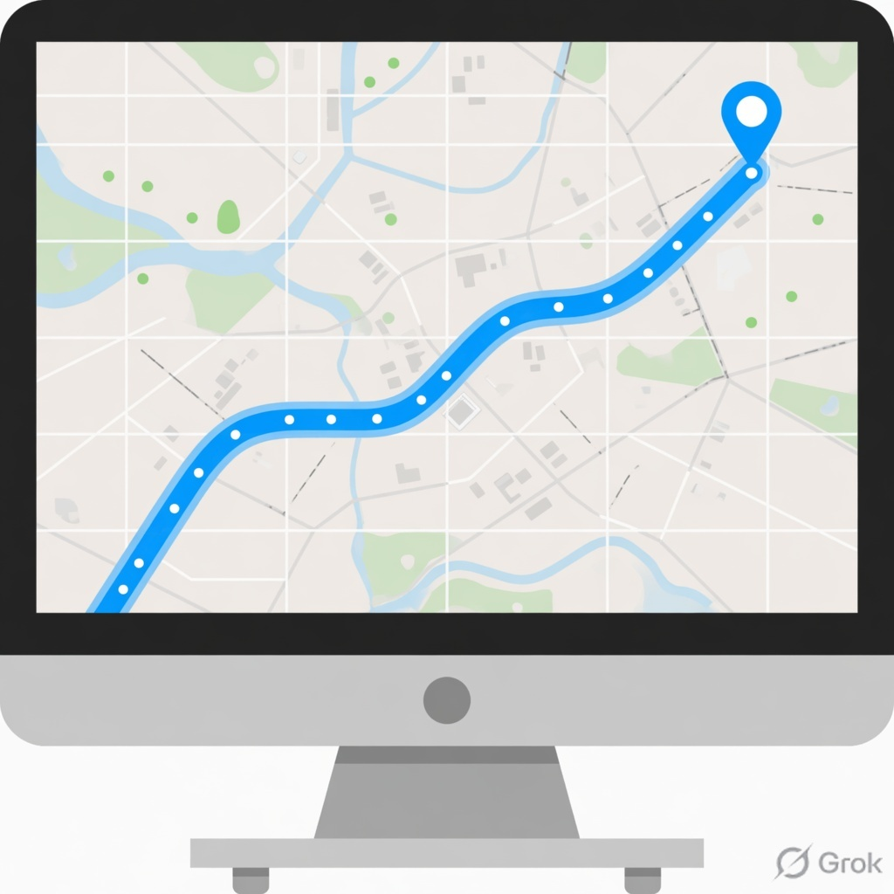
Proposed solution
• Web control-room app. Dispatcher creates an incident (origin + hospital).
SOLVED
• System assigns a free compatible unit (ambulance, fire engine, or police).
• Backend calls Google Routes. Google returns 2 to 3 real paths with ETA and traffic.
• RapidRoute scores those candidates. Lowest penalty wins. Why this route is shown.
• If a road is blocked, that candidate is removed, not traded off in the score.
• If every corridor is blocked: No suitable route available.
• Journey marker moves along Google's line as a simulation. Not live van GPS.
• Admin only can block a live corridor. Labelled DEMO SIMULATION, not a city feed.
Unique special points
Unit first
Hard block
Published formula
Honest fallback
Picks a free compatible vehicle. Google does not do that.
Blocked = ineligible. Never a score trade-off.
Weighted penalty. Not a trained AI model.
Google down? Labelled DEMO SIMULATION.
Notes:
Proposed solution bullets + four unique points. Stay on JUDGE_QA. No AI model. No live GPS.

Slide 3




How RapidRoute works
Simple chart of a live dispatch
Dispatcher
Hospital
RapidRoute app
1 Create incident
Assign · Score · Explain
3 Score routes
Origin + hospital. Search or pin on the map.
ETA + distance + traffic + road.
Lowest penalty wins.
2 Assign unit
4 If blocked
Closest free compatible vehicle.
Ambulance / fire / police.
PostgreSQL
Remove that candidate.
Re-query from current point.
Adopt a clear alternative.
Google Routes API (server only)
2 to 3 real paths · ETA · traffic-aware times
Units on the map
Admin block is DEMO SIMULATION
Notes:
Walk left to right then down. Dispatcher creates. Unit assigned. App scores Google candidates. Database stores the decision. If admin blocks, red box: remove and adopt.

Slide 4
Technology stack
Frontend
Backend
Database
React, TypeScript, Vite, Tailwind, Google Maps JS
Express, TypeScript, JWT, Zod, scoring service
PostgreSQL + Prisma
Routing
Safety
Fallback
Google Routes API on the server only
Blocked roads removed before scoring
Labelled DEMO SIMULATION if Google fails
Notes:
Two keys: browser draws the map. Server calls Routes. Frontend never calls Google Routes. Keys not on GitHub.

