Slide 1

HO CHI MINH CITY UNIVERSITY OF TECHNOLOGY
FACULTY OF ELECTRICAL & ELECTRONIC
DEPARTMENT OF TELECOMMUNICATION ENGINEERING
IMAGE PROCESSING COURSE PROJECT
MULTIPLE CHOICES SCANNER
LECTURER : Dr. Vo Tuan Kiet
ID | Name | Student ID
1 | Lam Thanh Phat | 2111974
2 | Quang Hoang Trung | 1915701

Slide 2
CONTENTS
TASK OVERVIEW
RELEVANT THEORY
OVERALL SYSTEM
COMPONENT DETAILS
5. DEMO

Slide 3
CONTENTS
TASK OVERVIEW
RELEVANT THEORY
OVERALL SYSTEM
COMPONENT DETAILS
5. DEMO

Slide 4
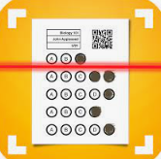
TASK OVERVIEW
TASK OVERVIEW
RELEVANT THEORY
OVERALL SYSTEM
COMPONENT DETAILS
DEMO
Automatic Multiple Choice Scanner
Automatic Multiple Choice Scanner: Automatic tool that facilitates the grading process under standardized evaluation criteria and saves time for instructors.
Target achievements for our system:
Accuracy: > 95%.
Response time for each image: < 2s.
Capable of processing input images taken from various angles.
Graphical User Interface (GUI).
Notes:
Target achievement for our system:
Accuracy: > 95%.
Response time for each image: < 3s.
Capable of processing input images taken from various angles.

Slide 5
CONTENTS
TASK OVERVIEW
RELEVANT THEORY
OVERALL SYSTEM
COMPONENT DETAILS
5. DEMO

Slide 6
RELEVANT THEORY
TASK OVERVIEW
RELEVANT THEORY
OVERALL SYSTEM
COMPONENT DETAILS
DEMO
Image processing
Machine learning/Deep learning
Filters
Thresholding
Convolutional Network
Image alignment
Contours
Morphological operations
Notes:
Target achievement for our system:
Accuracy: > 95%.
Response time for each image: < 3s.
Capable of processing input images taken from various angles.

Slide 7
CONTENTS
TASK OVERVIEW
RELEVANT THEORY
OVERALL SYSTEM
COMPONENT DETAILS
DEMO

Slide 8
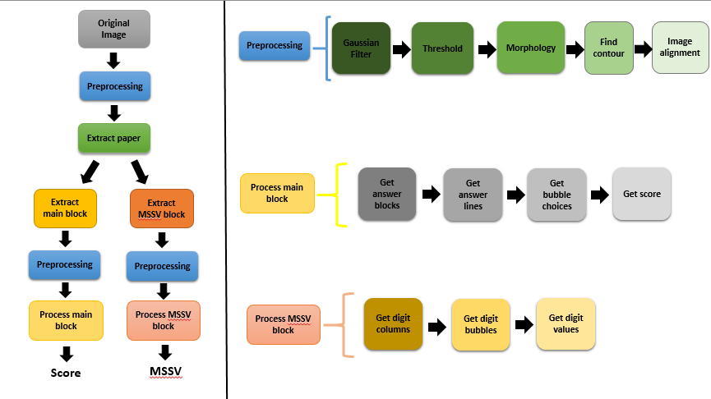
OVERALL SYSTEM
TASK OVERVIEW
RELEVANT THEORY
OVERALL SYSTEM
COMPONENT DETAILS
DEMO
Notes:
Target achievement for our system:
Accuracy: > 95%.
Response time for each image: < 3s.
Capable of processing input images taken from various angles.

Slide 9
CONTENTS
TASK OVERVIEW
RELEVANT THEORY
OVERALL SYSTEM
COMPONENT DETAILS
5. DEMO

Slide 10
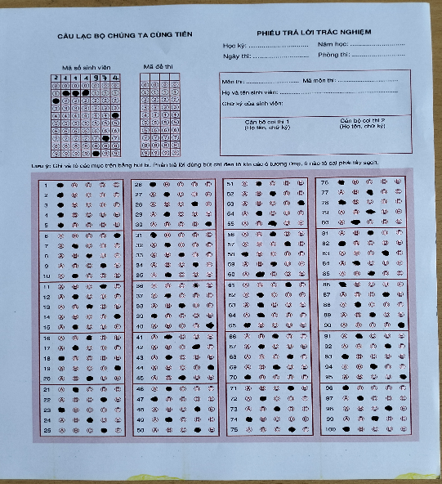
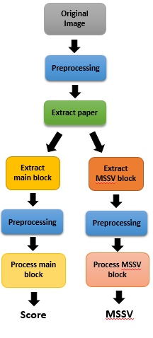
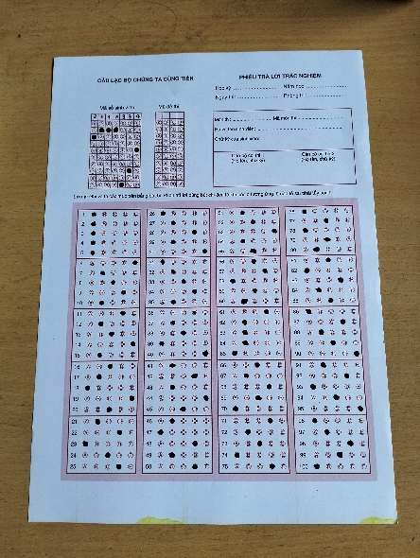
COMPONENT DETAILS
TASK OVERVIEW
RELEVANT THEORY
OVERALL SYSTEM
COMPONENT DETAILS
DEMO
Preliminary component
Component 1
Original Image
Extract paper
Gaussian Filter
Threshold
Morphology
Find contour
Image alignment
Preprocessing
Notes:
Component 1

Slide 11
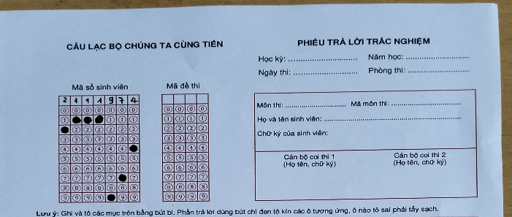
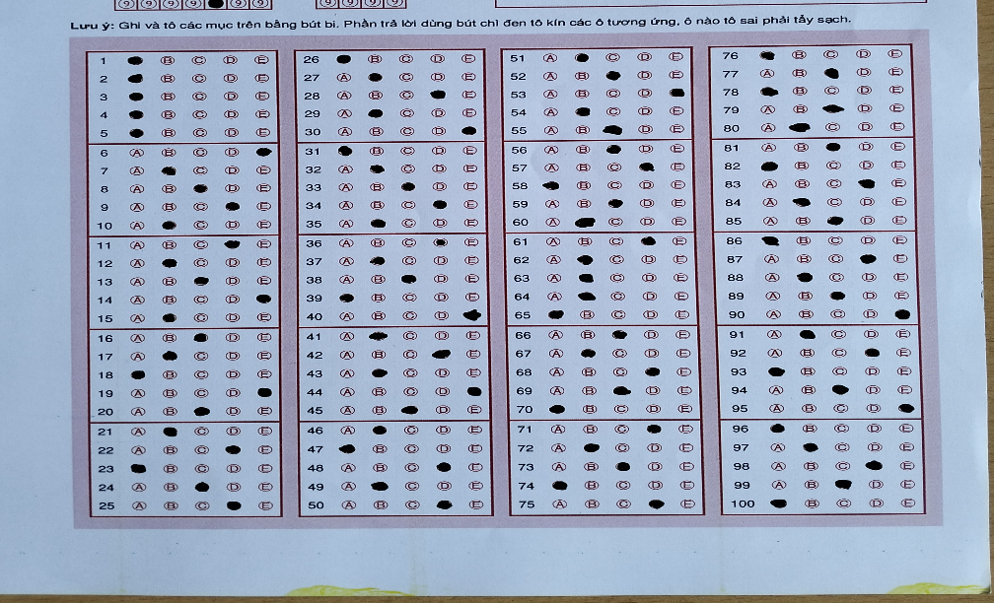
COMPONENT DETAILS
TASK OVERVIEW
RELEVANT THEORY
OVERALL SYSTEM
COMPONENT DETAILS
DEMO
Extract paper
Notes:
Component 1

Slide 12
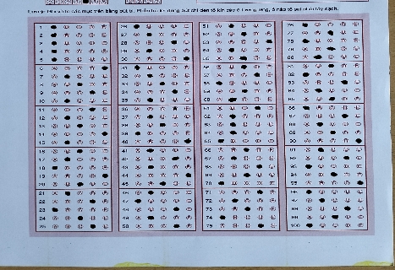
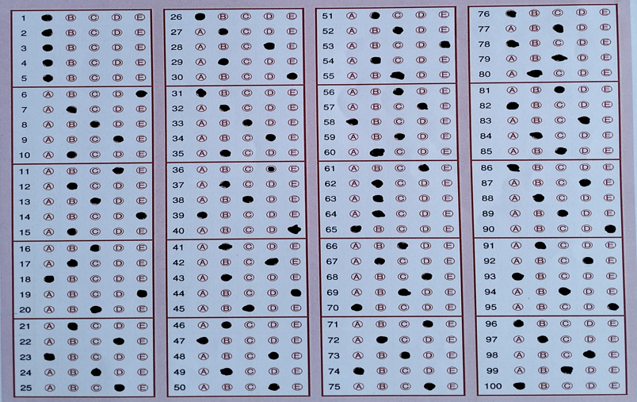
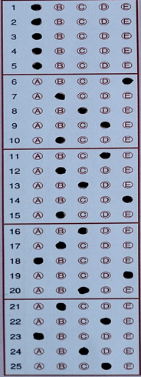
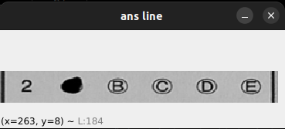


COMPONENT DETAILS
TASK OVERVIEW
RELEVANT THEORY
OVERALL SYSTEM
COMPONENT DETAILS
DEMO
Extract main block
Preprocessing
Main block component
Component 2
Get answer blocks
Get answer lines
Get bubble choices
CNN
Get score
Process main block
True answer
Notes:
CNN

Slide 13
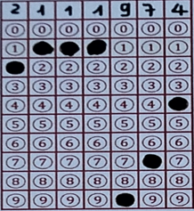



COMPONENT DETAILS
TASK OVERVIEW
RELEVANT THEORY
OVERALL SYSTEM
COMPONENT DETAILS
DEMO
Extract MSSV block
Preprocessing
MSSV Block
component
Component 3
2
Process MSSV block
Get digit columns
Get digit bubbles
Get digit values
Notes:
2

Slide 14
CONTENTS
TASK OVERVIEW
RELEVANT THEORY
OVERALL SYSTEM
COMPONENT DETAILS
5. DEMO

Slide 15
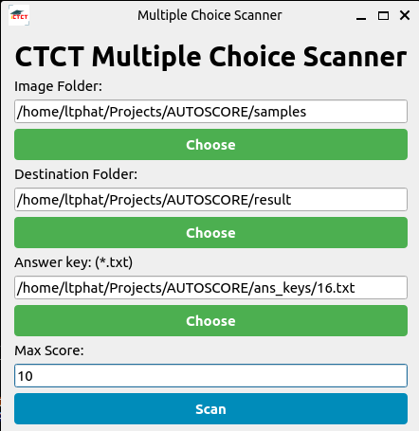
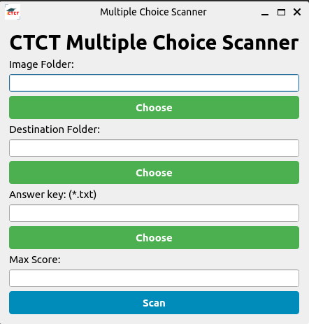
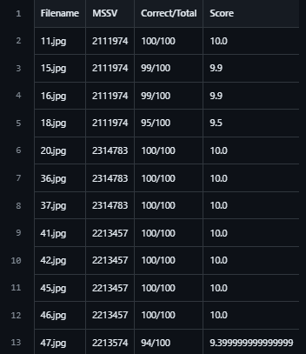
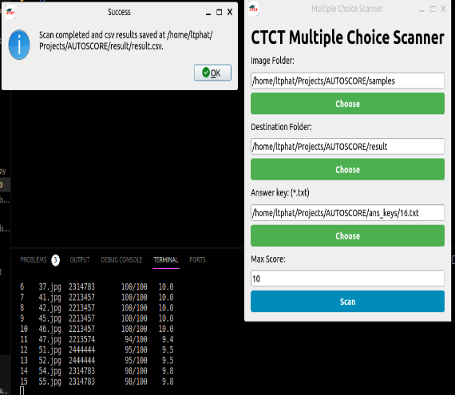
DEMO
TASK OVERVIEW
RELEVANT THEORY
OVERALL SYSTEM
COMPONENT DETAILS
DEMO
Fill information
Original GUI
Scanning & Completed
Save result
Notes:
2

Slide 16
CONCLUSIONS
THANKS FOR WATCHING !
Notes:
Hope you enjoy my presentation and Thank you so much !

