Slide 1
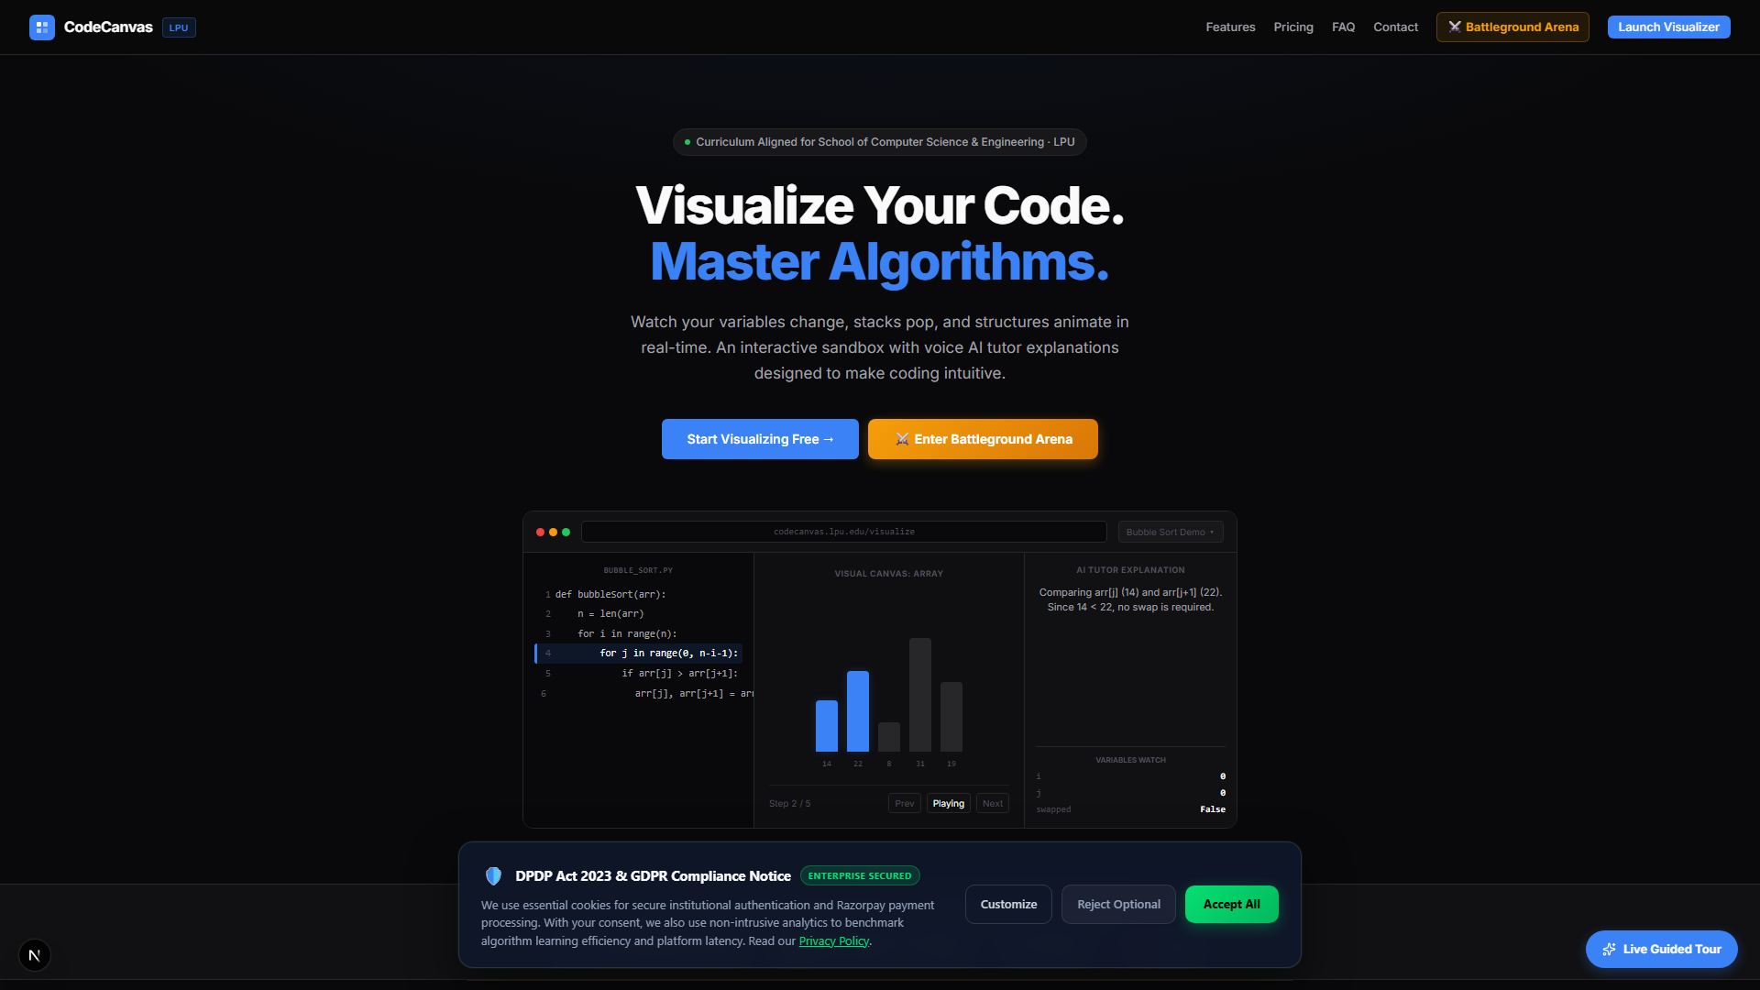
Why Do Coding Labs Feel Like a Nightmare?
CodeCanvas (LPU CodeViz)
• You write syntax, compile, and get stuck on logical bugs. • Lab instructors are busy helping 15 other students. • Debugging terminals are complex for beginners.
Notes:
Hey everyone! Let's be honest for a second. How many of you have sat in a programming lab, written code that you thought was 100% correct, only for it to return a completely wrong output? Or worse, you get a 'Segmentation Fault' or 'Index Out of Range' and have absolutely no idea which line actually broke? You raise your hand, but the lab teacher is already surrounded by 15 other students. You end up wasting half the lab session waiting for help, or coding late at night with zero support. That is the coding lab gap, and today, we're changing that.

Slide 2
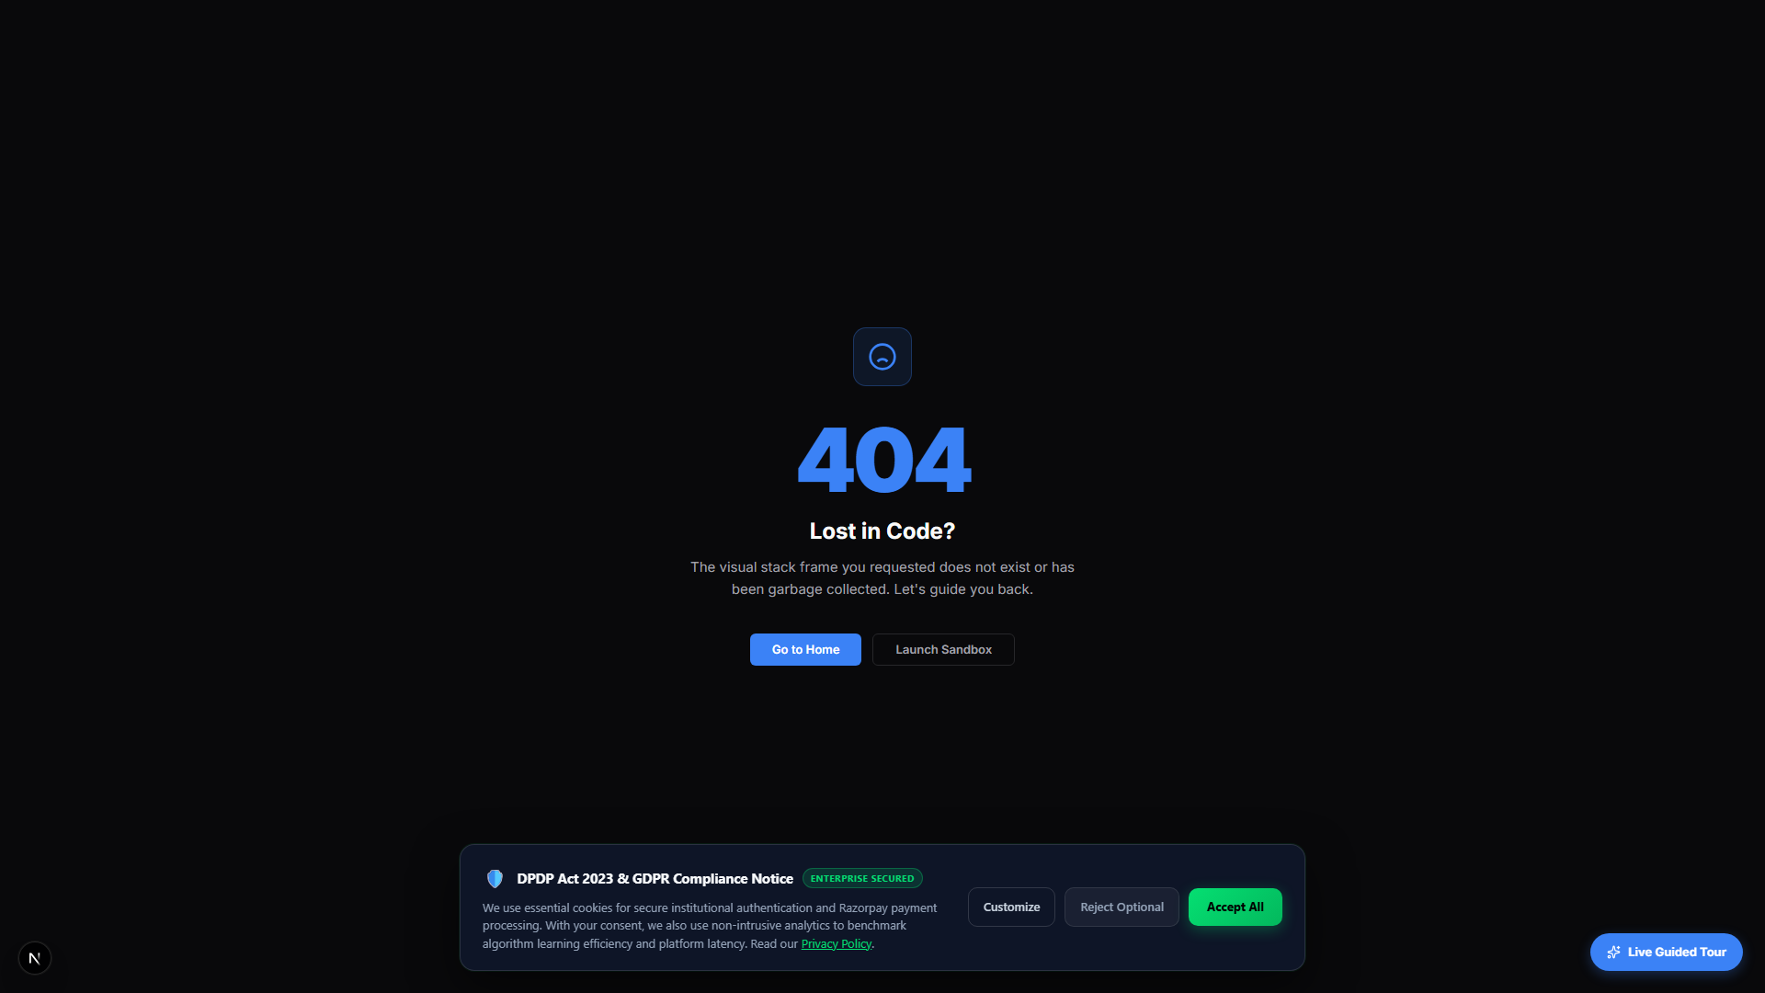
The Core Problem: Memory is Invisible
• Coding Blind: Standard code compilers run your scripts, but keep memory layouts invisible. • Theoretical Lectures: Pointers, stacks, and node links are explained statically on blackboards. • Guesswork Debugging: Beginners lack a clear mental model of memory, making debugging a guessing game.
Notes:
The reason programming feels so intimidating when you start is that computer memory is invisible. When a professor explains pointers referencing memory, nodes swapping in a linked list, or stacks popping in a recursion loop, they write it statically on a blackboard. But when you sit in front of VS Code, you can't see the memory stack. You are essentially coding blind. You compile, it fails, and you guess. What if you could actually see your variables mutating, your arrays sorting, and your linked lists linking, step-by-step in real-time?

Slide 3
The Solution: CodeCanvas (LPU CodeViz)
• Monaco Coding Editor: Paste and edit arbitrary C, Python, or SQL scripts. • 10 Animated Canvases: Play step-by-step memory animations (Arrays, Stacks, Trees, Graphs, SQL). • Variables Board: Observe variables mutating scopes in real-time. • AI Tutor Companion: Slides out to offer hint instructions, helping you debug logic errors.
Notes:
This is CodeCanvas, also known as LPU CodeViz. It's a web-based coding environment built specifically for us. You write your C, C++, Python, or SQL code in a built-in editor, click 'Visualize', and the system generates a step-by-step animated playback of your program. You can watch your array bars swap during Bubble Sort, watch your recursion call stack grow and shrink, and see variable scopes update instantly. Plus, there's a built-in AI Tutor sidebar that acts like a personal teacher, checking your specific code and guiding you to fix bugs without giving away answers.

Slide 4
What's In It For You?
• Understand Instantly: Dynamic visual debuggers establish clear, correct mental models. • Debug 24/7: Get immediate guidance late at night—no more waiting for lab office hours. • Gamified Tracking: Build coding streaks, earn XP, and unlock cryptographic certificates. • Syllabus Aligned: Matches standard LPU engineering assignments and course codes.
Notes:
So how does this help you pass your exams and build real coding skills? First, it gives you an instant mental model of memory, saving you hours of frustration. Second, you can debug your code late at night—it's like having a coding tutor in your browser 24/7. Third, we've pre-loaded it with standard syllabus exercises. Finally, it's gamified: you earn XP, build coding streaks, and once you complete a topic, you get a cryptographically verified certificate shareable on LinkedIn to stand out to recruiters.

Slide 5
Get Registered in 30 Seconds
• Visit: codecanvas.edu/register • Register: One-click sign-up with Google OAuth or Email. • Join Classroom: Input invite code: [CLASS_INVITE_CODE] • Start Coding: Visualize your code and start building your streaks today!
Notes:
Signing up is incredibly fast. Pull out your phone right now, scan the QR code on the screen, or open codecanvas.edu in your browser. Click 'Sign Up', log in instantly with your Google account, and select the 'Student' role. To join our lab section and track your outcomes, simply enter the classroom invite code shown here. It takes less than 30 seconds. Register now, start visualizing your code, and let's make coding labs a breeze this semester. Thanks everyone!

