Slide 1
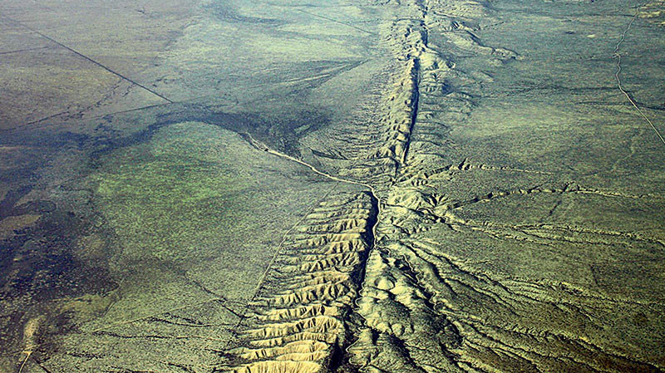
Analysis of the New Madrid Seismic Zone
By : Logan Slavens

Slide 2
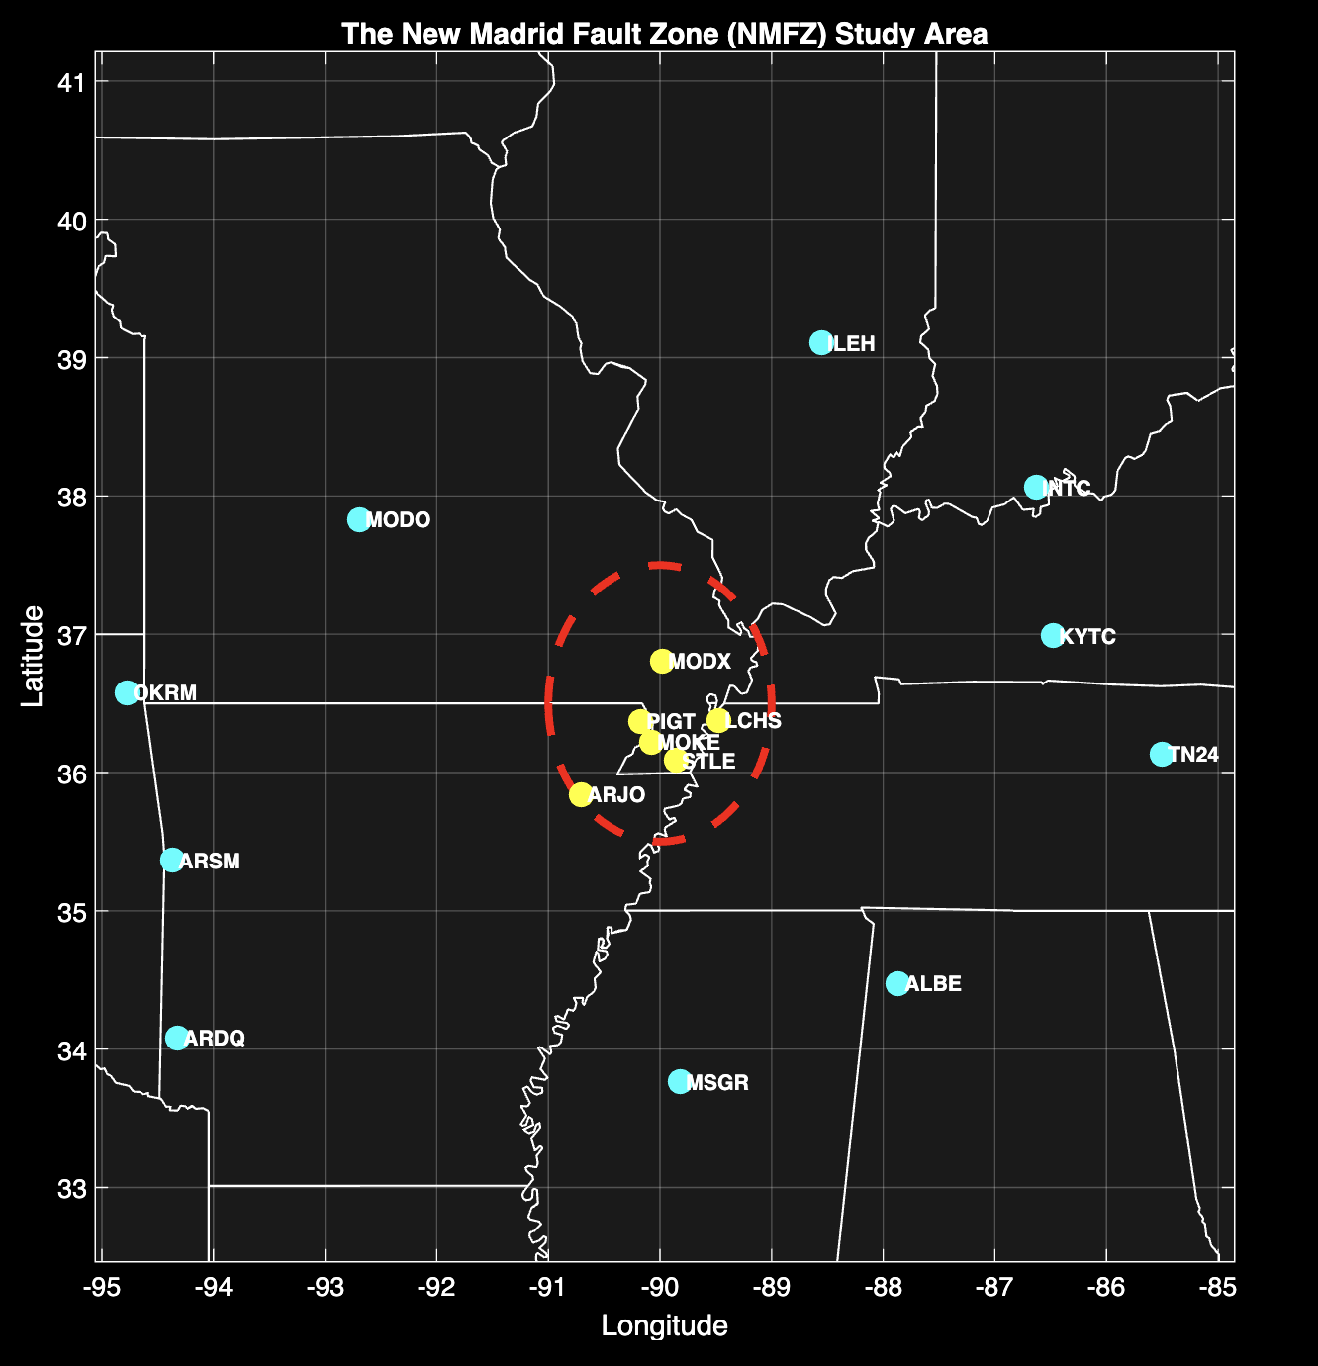

Background Information
Unlike a plate boundary, This area is focused in the middle of a plate
This zone is an aulacogen, a failed continental rift
200-250 million years ago the eastern side of the NA plate began to split down the middle. (Csontos, 2008)
The continent formed back together and left the crust thinner than the rest of the plate.
Choose this area to study because it is in my home state of Arkansas
Most Americans only associate tectonic events with the west coast.
This area is still puzzling and not entirely understood
Unlike the west coast, infrastructure in and around the NMSZ isn’t built to handle major seismic events.

Slide 3
Does current geo-station data within the NMSZ show different movement than the rest of the North American plate?
Can you predict future seismic events with this data?

Slide 4
Methods & Approach
Step 1 – Data Gathering
Researched what area in considered inside the NMSZ
Found geo-stations located within the zone
Grabbed a few stations outside the zone for comparison data
Step 2 – Calculations
Found velocities of each station due east in mm/year base on position vs time
Used polyfit function – d(t) = v * t + d_0
Found the relative velocities
Vrel = Vobs – Voutside (rest of plate)
Found the Residuals to find the difference between my calculations and gps data
R(t) = GPSd – [v * t +d]
Strain Analysis (attempted)
E = Dv / Dl
With help of lecture and AI tried to make a model to show strain in the region
Step 3 – Interpret the data and compare with outside sources
Found 2 outside sources on the MNSZ
Csontos, R., Van Arsdale, R., Cox, R., & Waldron, B. (2008). Reelfoot rift and its impact on Quaternary deformation in the central Mississippi River valley. Geosphere, 4(1), 145–158. https://doi.org/10.1130/GES00107.1
Ryan Csontos, Roy Van Arsdale; New Madrid seismic zone fault geometry. Geosphere 2008;; 4 (5): 802–813. doi: https://doi.org/10.1130/GES00141.1

Slide 5
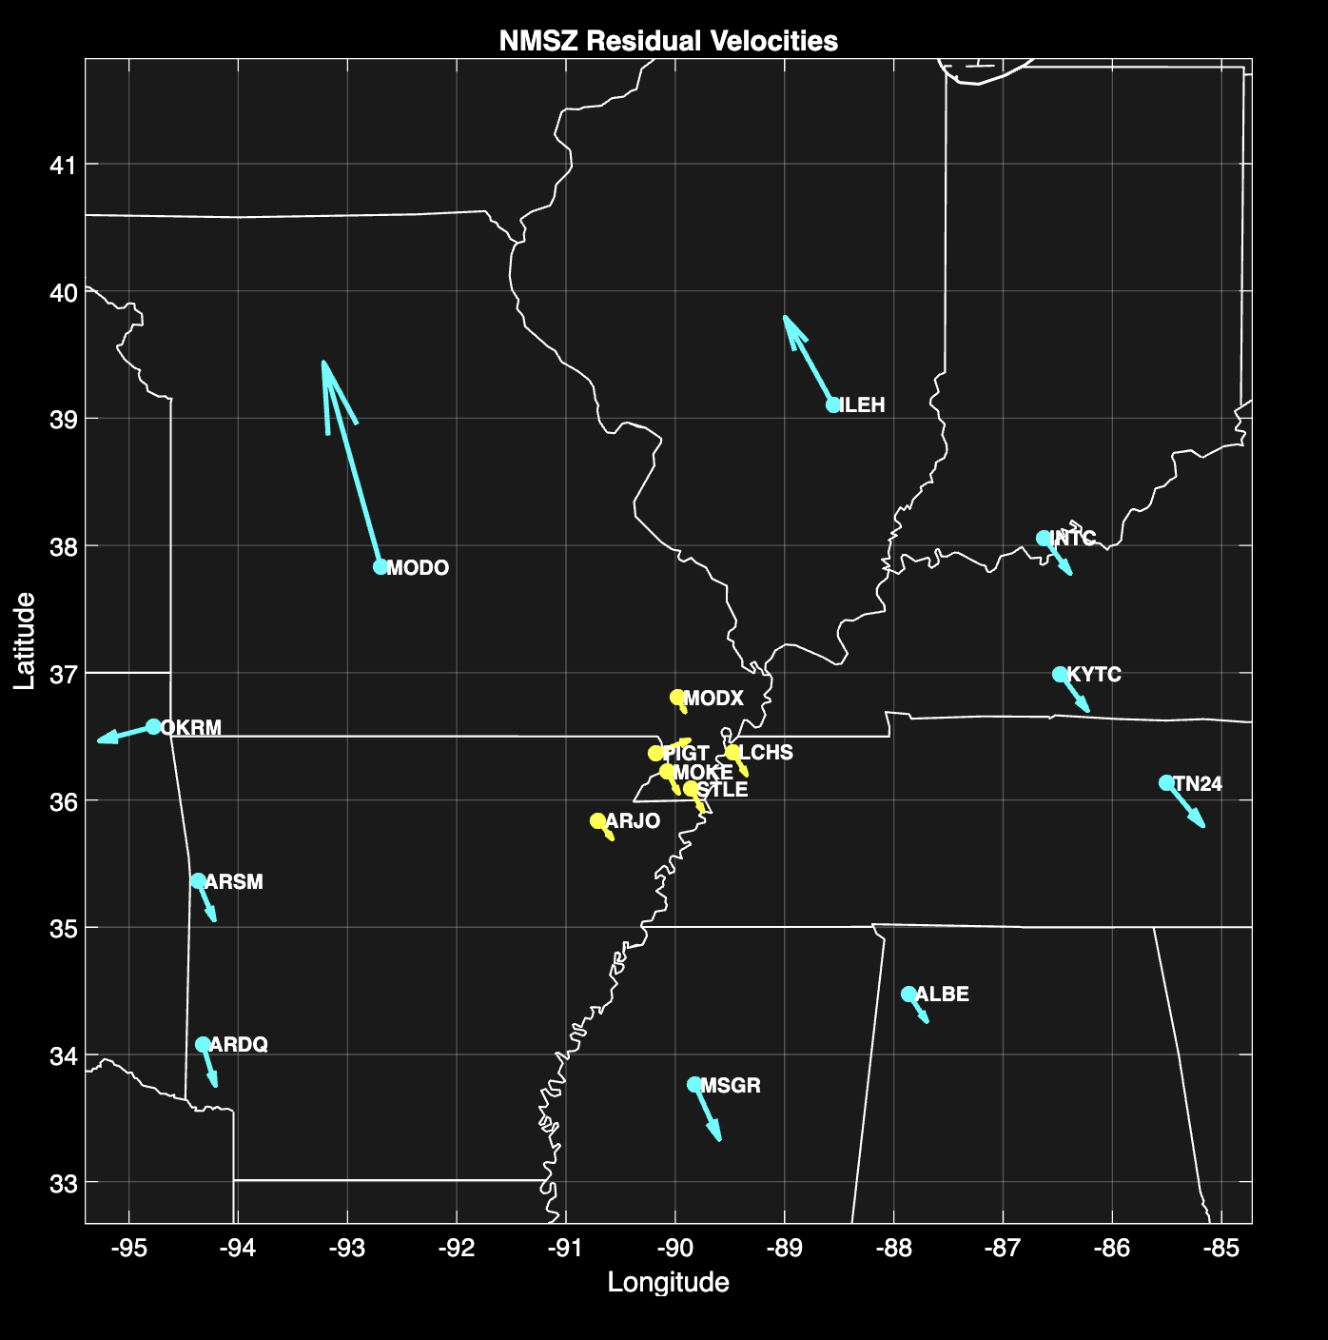
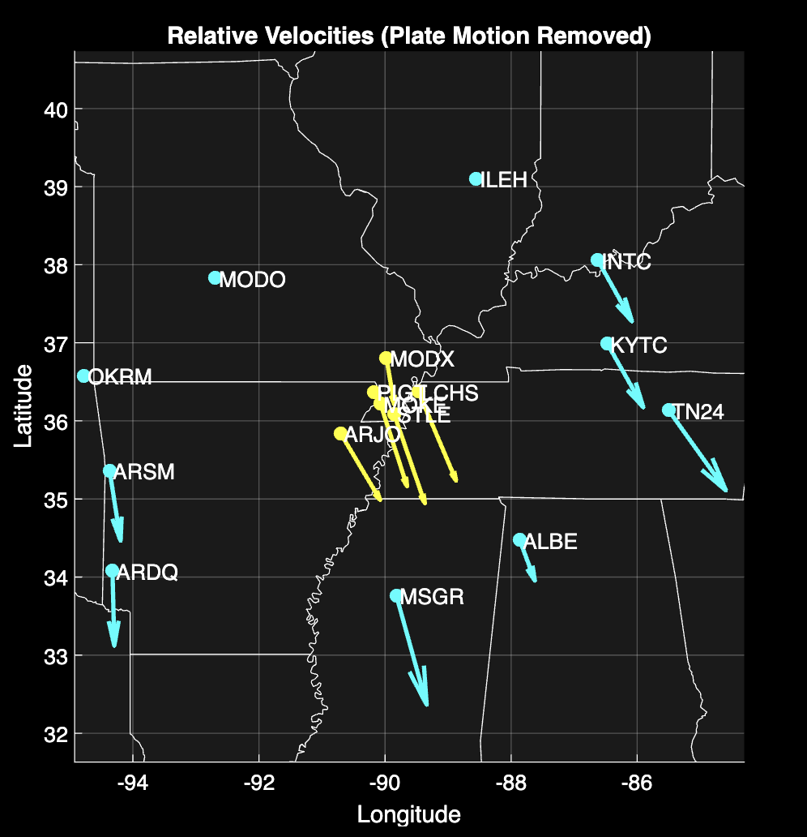
Data - Maps

Slide 6
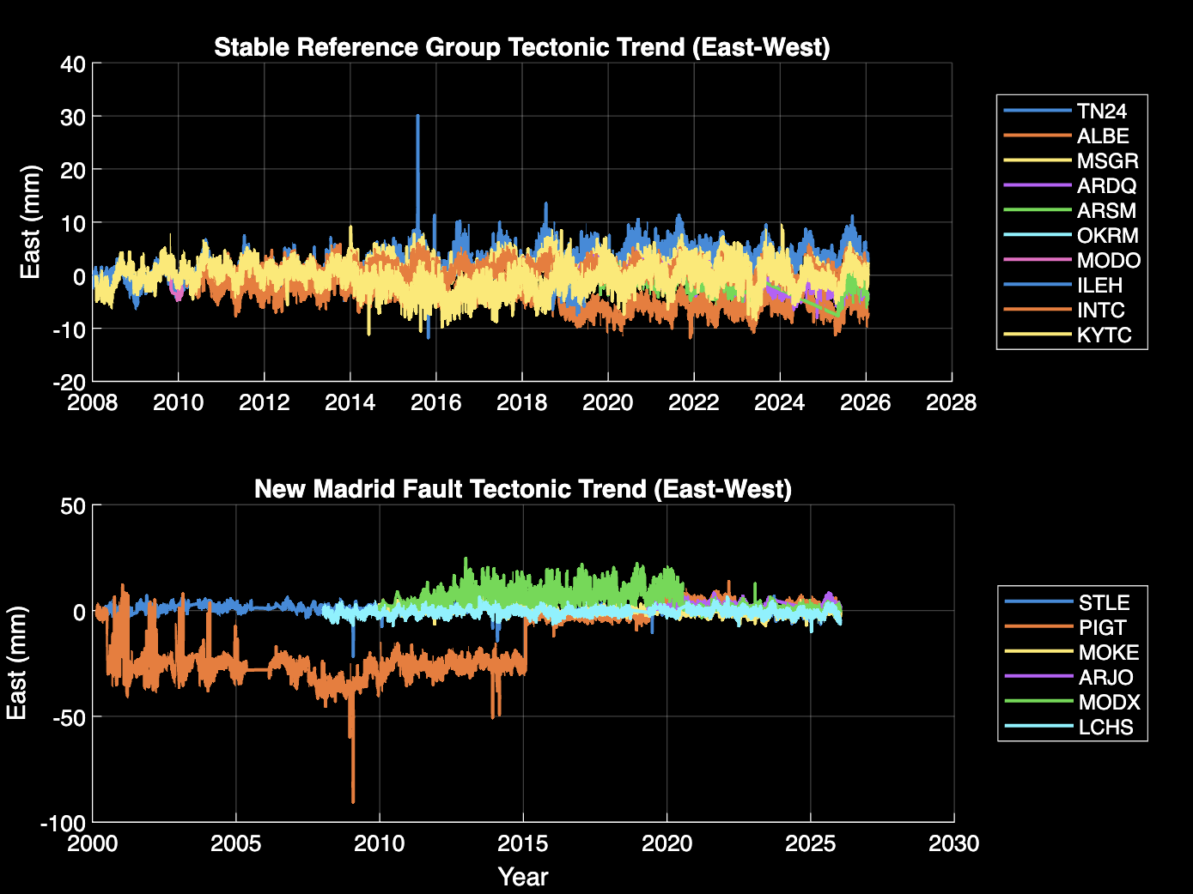
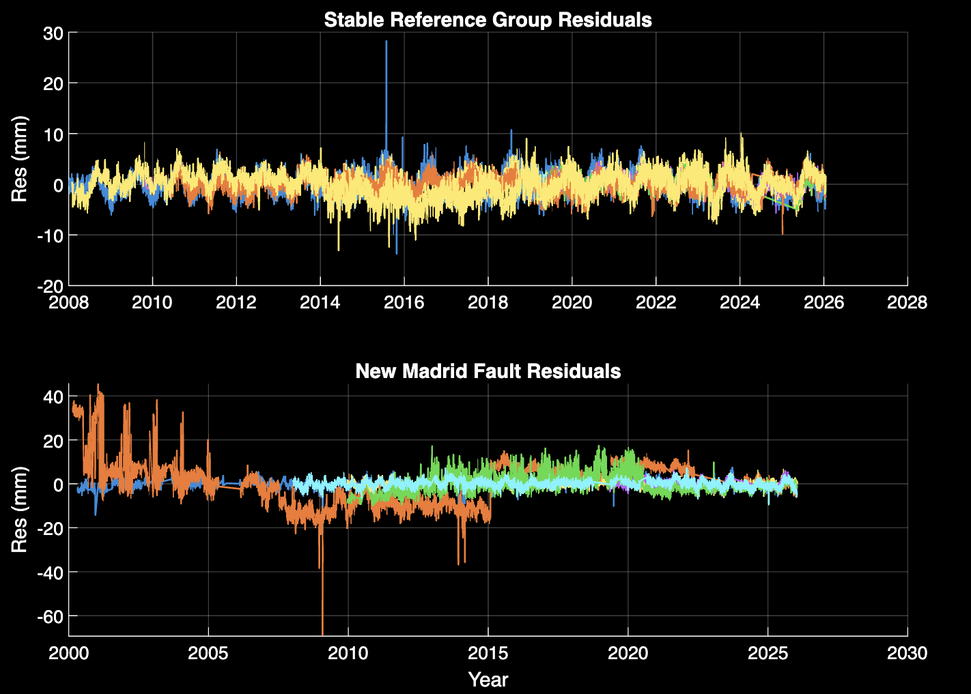
Data - Graphs

Slide 7
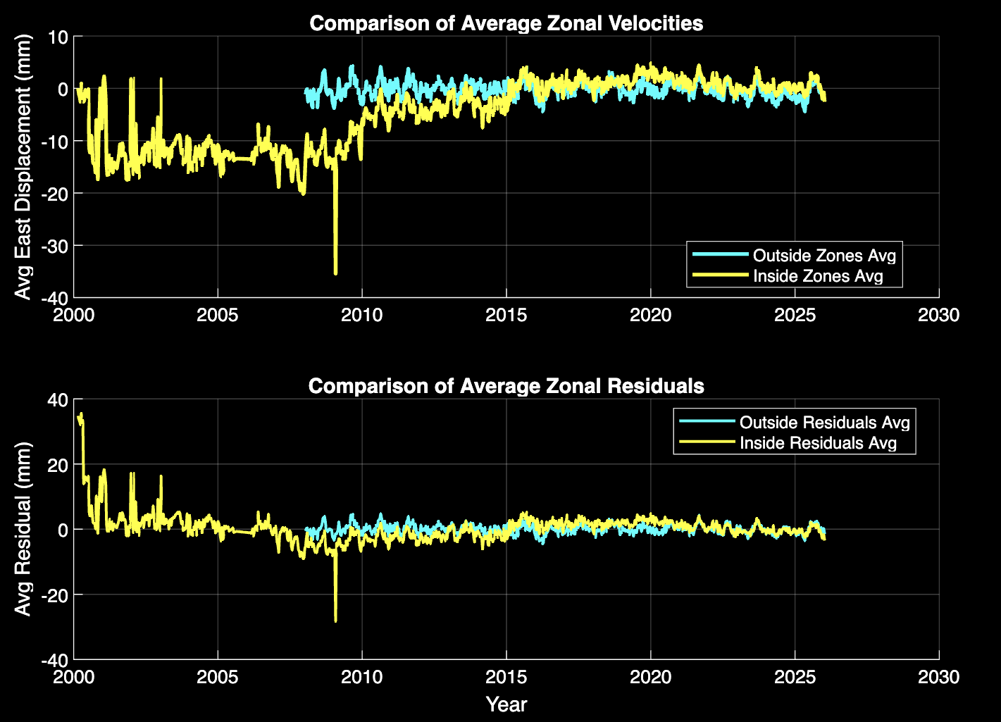
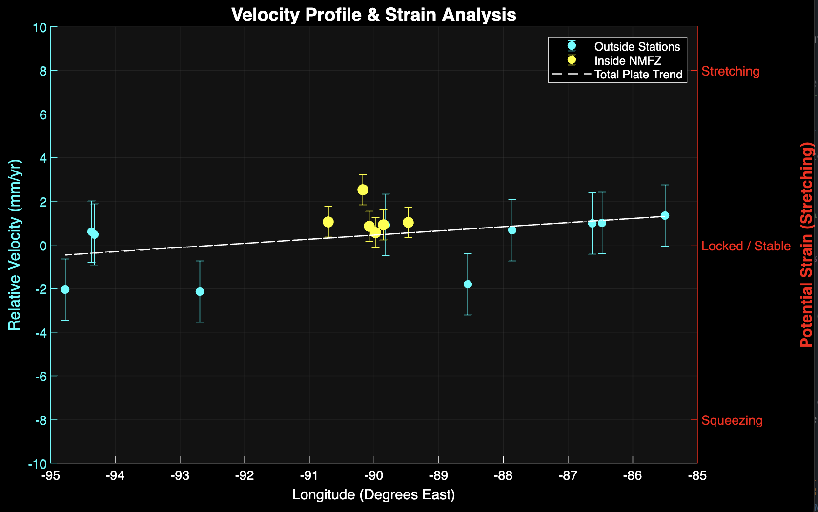
Data – Final Results

Slide 8
Conclusion
The New Madrid Seismic Zone is in similar motion to the rest of the plate
No major signs of deviations when comparing stations inside/outside the zone
You might be able to track and predict earthquake but we just don’t have data from a major earthquake in the zone to see if anything changes before or after.
Last strong Seismic event was in 1895 with a estimated magnitude of 6.7
The reason for earthquakes here are assumed to be built up pressure from the entire plate movement
They are noticed here more often from the crust being thinner here

