Slide 1


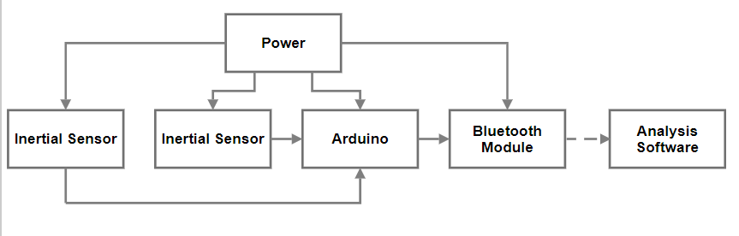
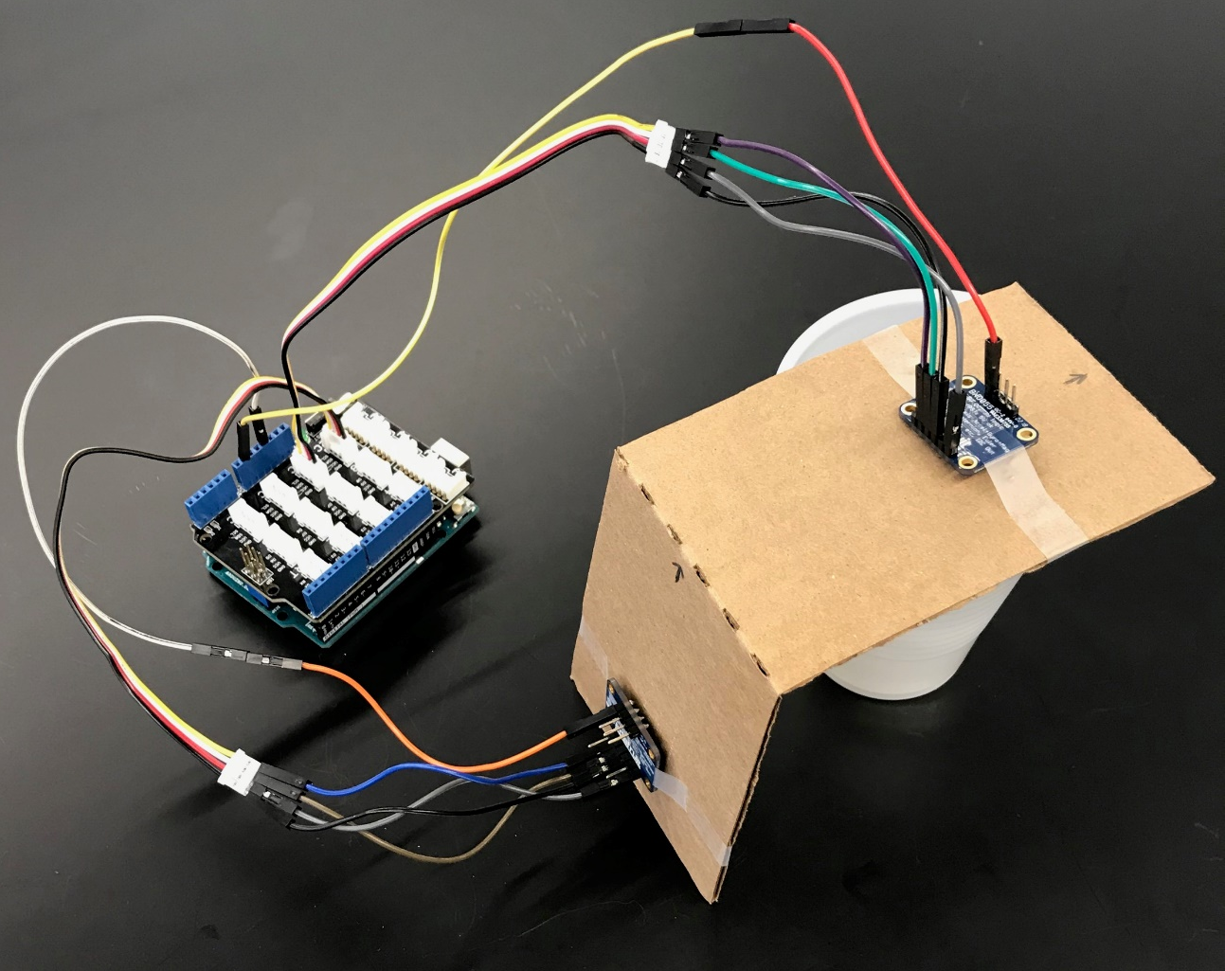
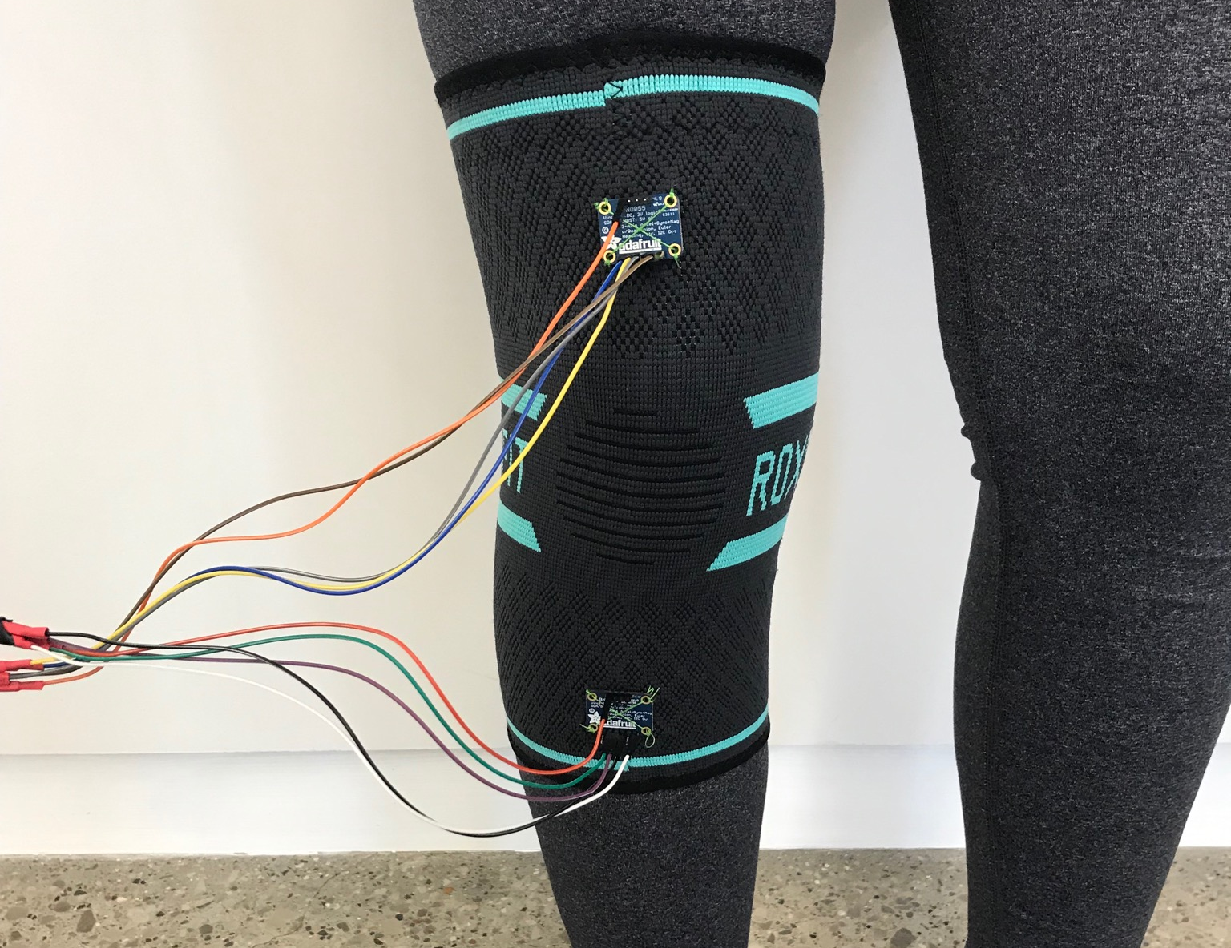
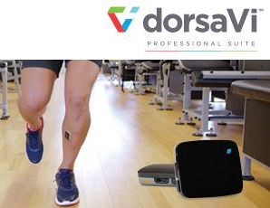
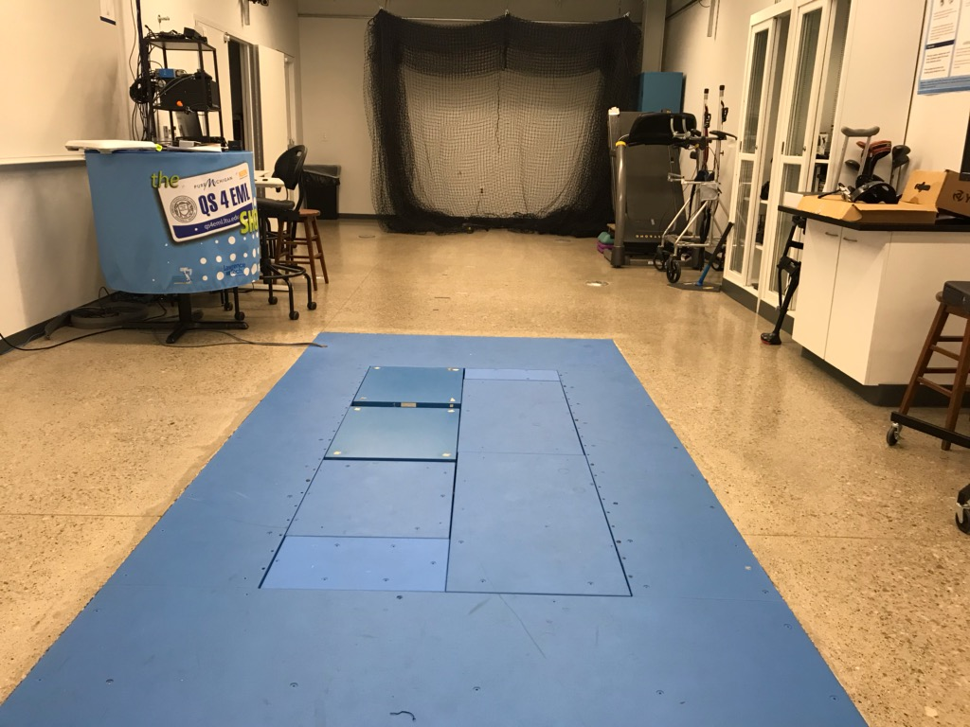

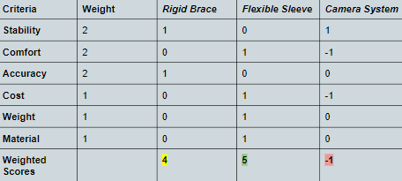
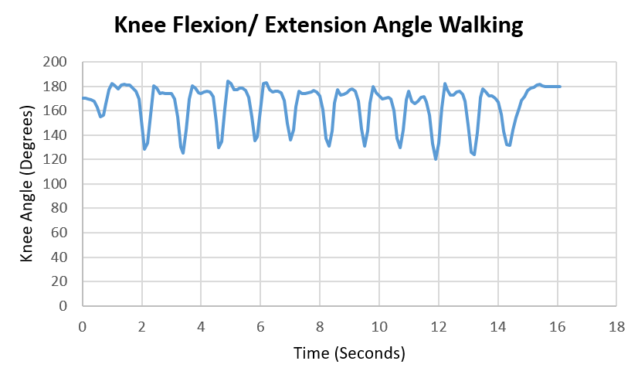
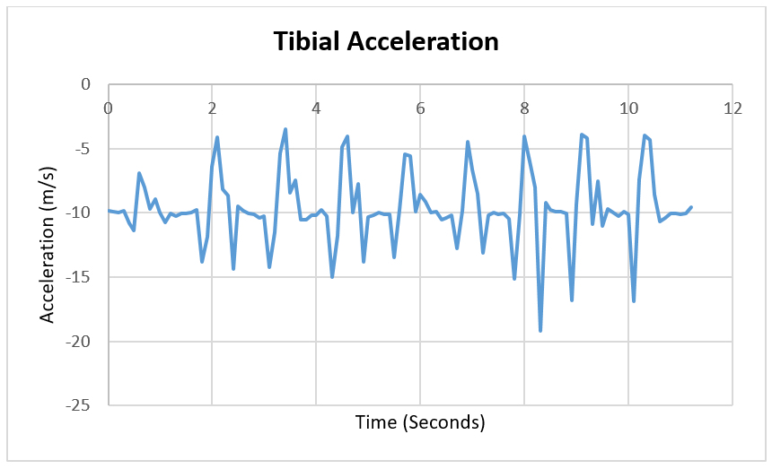
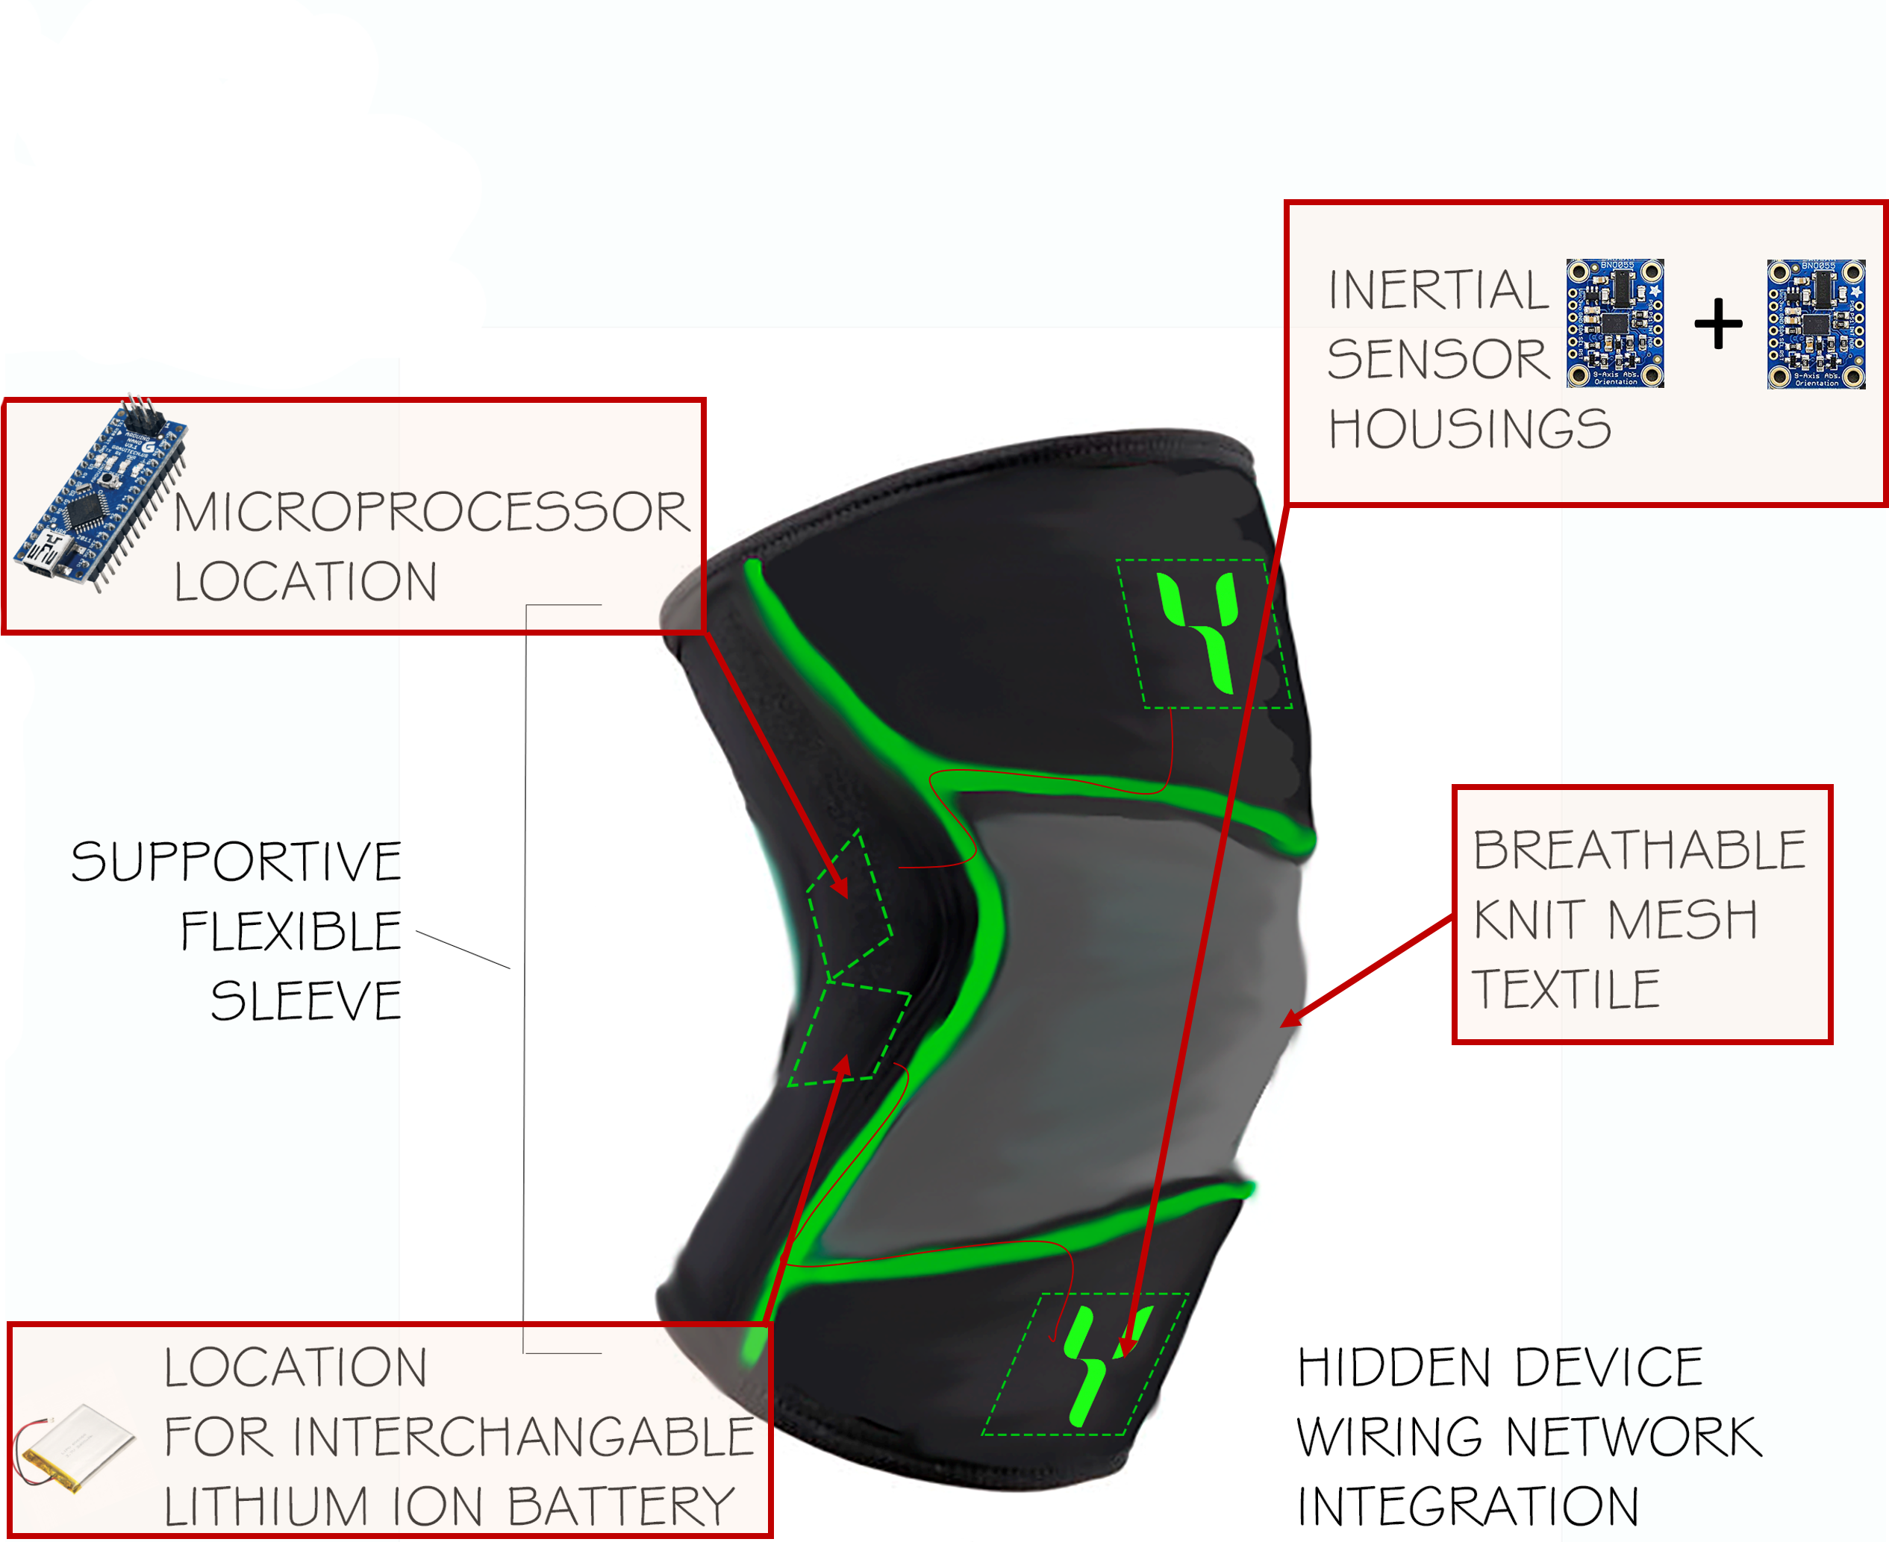
A Knee Movement
Monitoring Wearable Device
Alexis Snider, Evan Szabo, Dr. Eric Meyer
Department of Biomedical Engineering, Lawrence Technological University
Project Goal
Development
Our goal is to develop a comfortable and user-friendly wearable device that provides real-time data analysis of movements of the knee joint. This could be used for monitoring and flagging recurring movements that put an individual at risk of a knee injury.
System Diagram
Background
Anterior Cruciate Ligament (ACL) Injuries are a common sports injury that occur when the ligament of an individual is compromised due to compressive loading, valgus bending, and/or internal rotation of the tibia.
Roughly 100,00 to 250,000 ACL tears are reported annually in the United States. About half require reconstructive surgery.
Current on the market solutions are expensive and/or immobile.
Figure 1 - Current market available system for measuring various parameters of knee, however, flexion/extension isn't expressed. Cost ~$2000 + Monthly Subscription.
Figure 2 – Vicon Motion Capture System in Biomechanics Lab at Lawrence Tech University – a monitoring system that uses infrared cameras and force plates to gather dynamic angle measurements.
Figure 4 – Prototype Model (First Generation) – Two Adafruit Absolute Orientation sensors were placed on a cardboard hinge joint to validate knee angle measurement outputs.
Figure 5 – Prototype Model (Second Generation) – Two Adafruit Absolute Orientation Sensors were placed on a prefabricated sleeve and placed on human subject for preliminary data testing and collection.
Device Design
Testing and Results
Preliminary testing was performed by having a subject wear the prototype and walk. Knee flexion/ extension angles and tibial acceleration values were recorded.
Figure 3: Decision Matrix. Three brainstormed ideas were weighted using six criteria important to our device.
Figure 6 – Knee Flexion/ Extension Angle while Walking
Figure 7– Tibial Acceleration while Walking
The flexible sleeve was the top design in the decision matrix. It ranked the highest in comfort, and is expected to be the lightest and most cost effective. The sleeve would also be the least restricting and least obtrusive option.
Future testing will include validation testing with the Vicon motion capture system. The device will be worn and movements will be recorded by the sensors and the Vicon system. Flexion/ extension angles and vertical ground reaction forces will be compared between the device and the Vicon system.
The device will be worn while walking, running, and jumping. Tibial acceleration and knee flexion angles can be compared between the three movements.
Conclusion
Using the tibial acceleration values, we can find when the foot strikes the ground.
Upon foot strike, the knee flexion angle will be recoded, along with a minimum knee flexion angle. These values can be used to calculate the knee flexion range of motion.
Future Work
Additional parametric thresholds for added applicability and accuracy.
Bluetooth/ wireless enabled for free range monitoring.
Integrated desktop/ smartphone app for easy visualization of data outputs.
Two Adafruit BNO055 Absolute Orientation Sensors, which include an accelerometer, gyroscope, and magnetometer are placed on the sleeve, above and below the knee.
Acknowledgments
Dr. Eric Broadworth – Industry Professional (Interview)
Dr. Michael Lancina – Academic Advisor
Daniel Piotrowski – Technical Advisor

