Slide 1
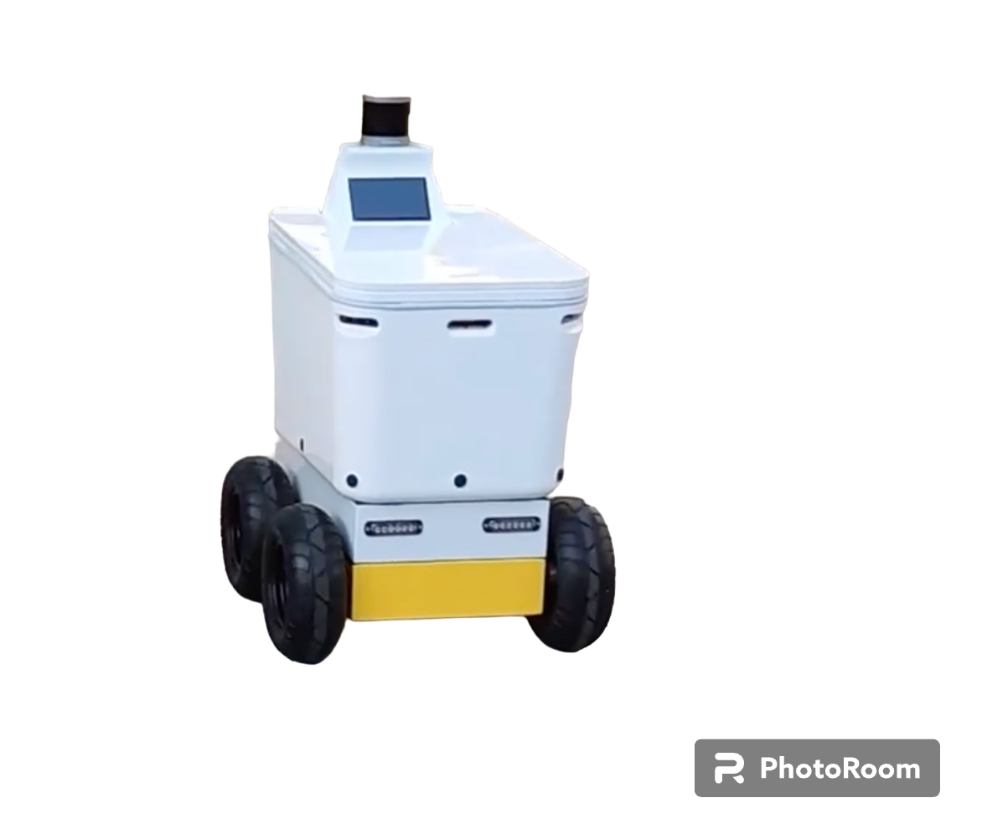







.launchfile
executes
deploys
launches
Node
- start videostream
- listen on webhook
- publish msg on
event
- fetch videostream
- make prediction
- send event via
webhook
webhook

