Slide 1

AC Magnetometry
10387 Scientific computing in quantum information science
Bendeguz Farkas

Slide 2
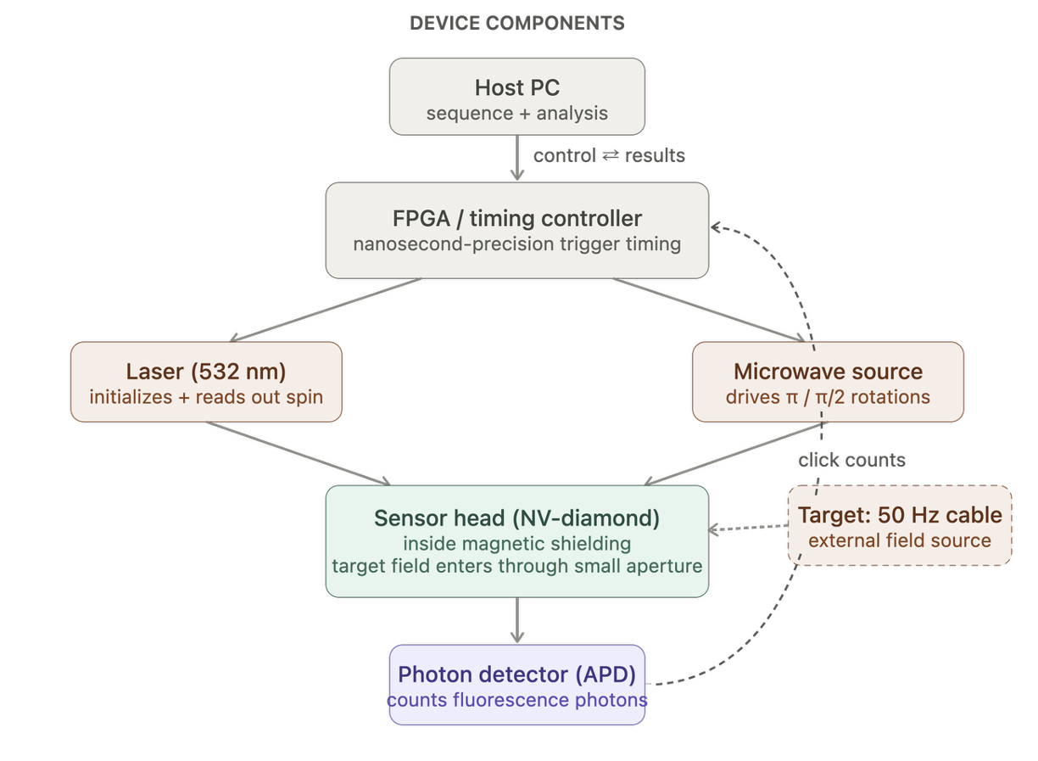

10387 Scientific computing in quantum information science

Slide 3
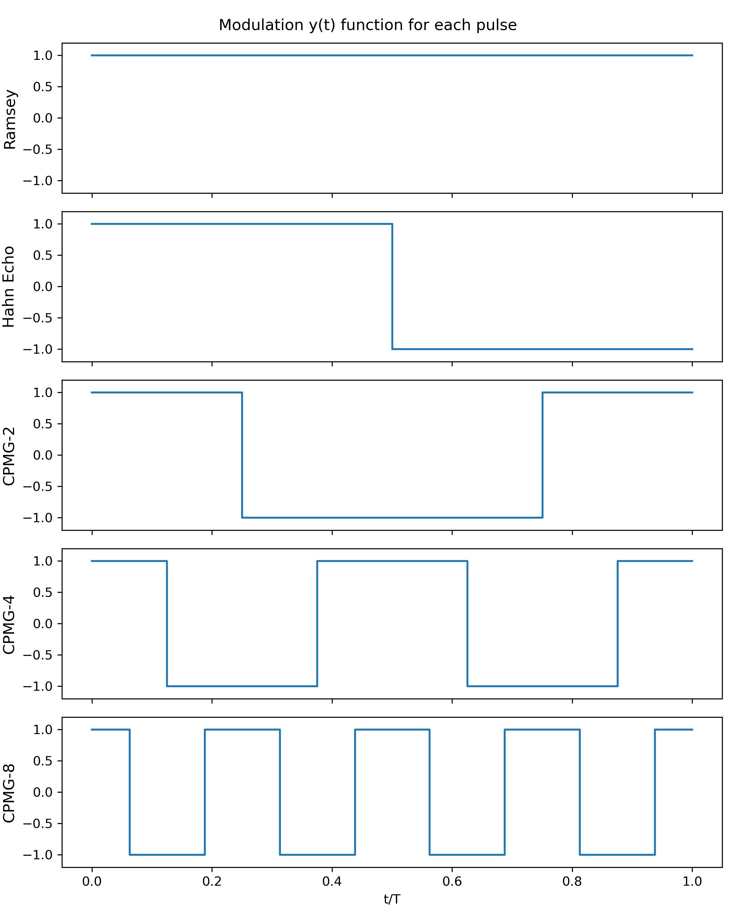
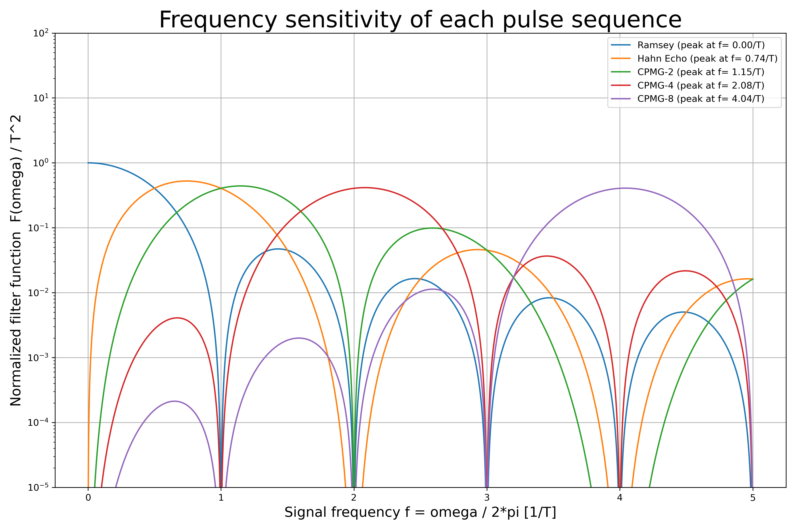
10387 Scientific computing in quantum information science

Slide 4
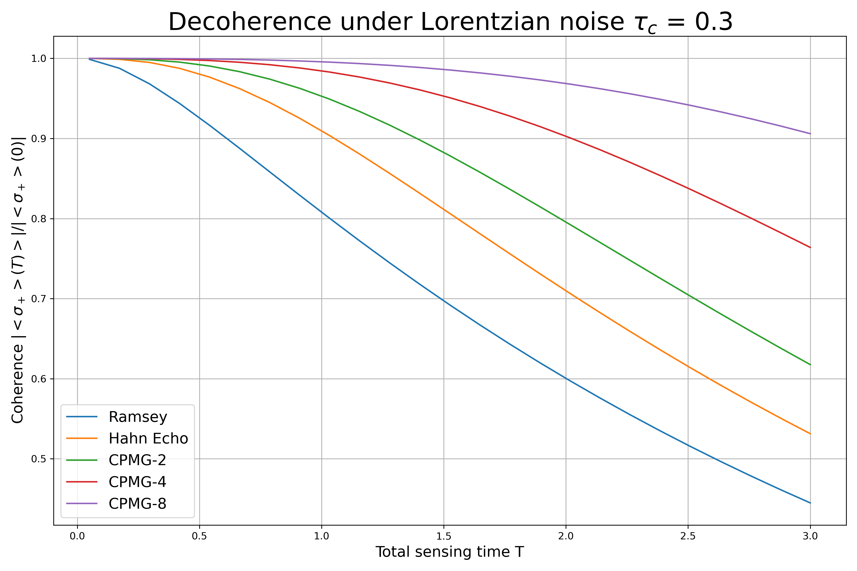
10387 Scientific computing in quantum information science

Slide 5
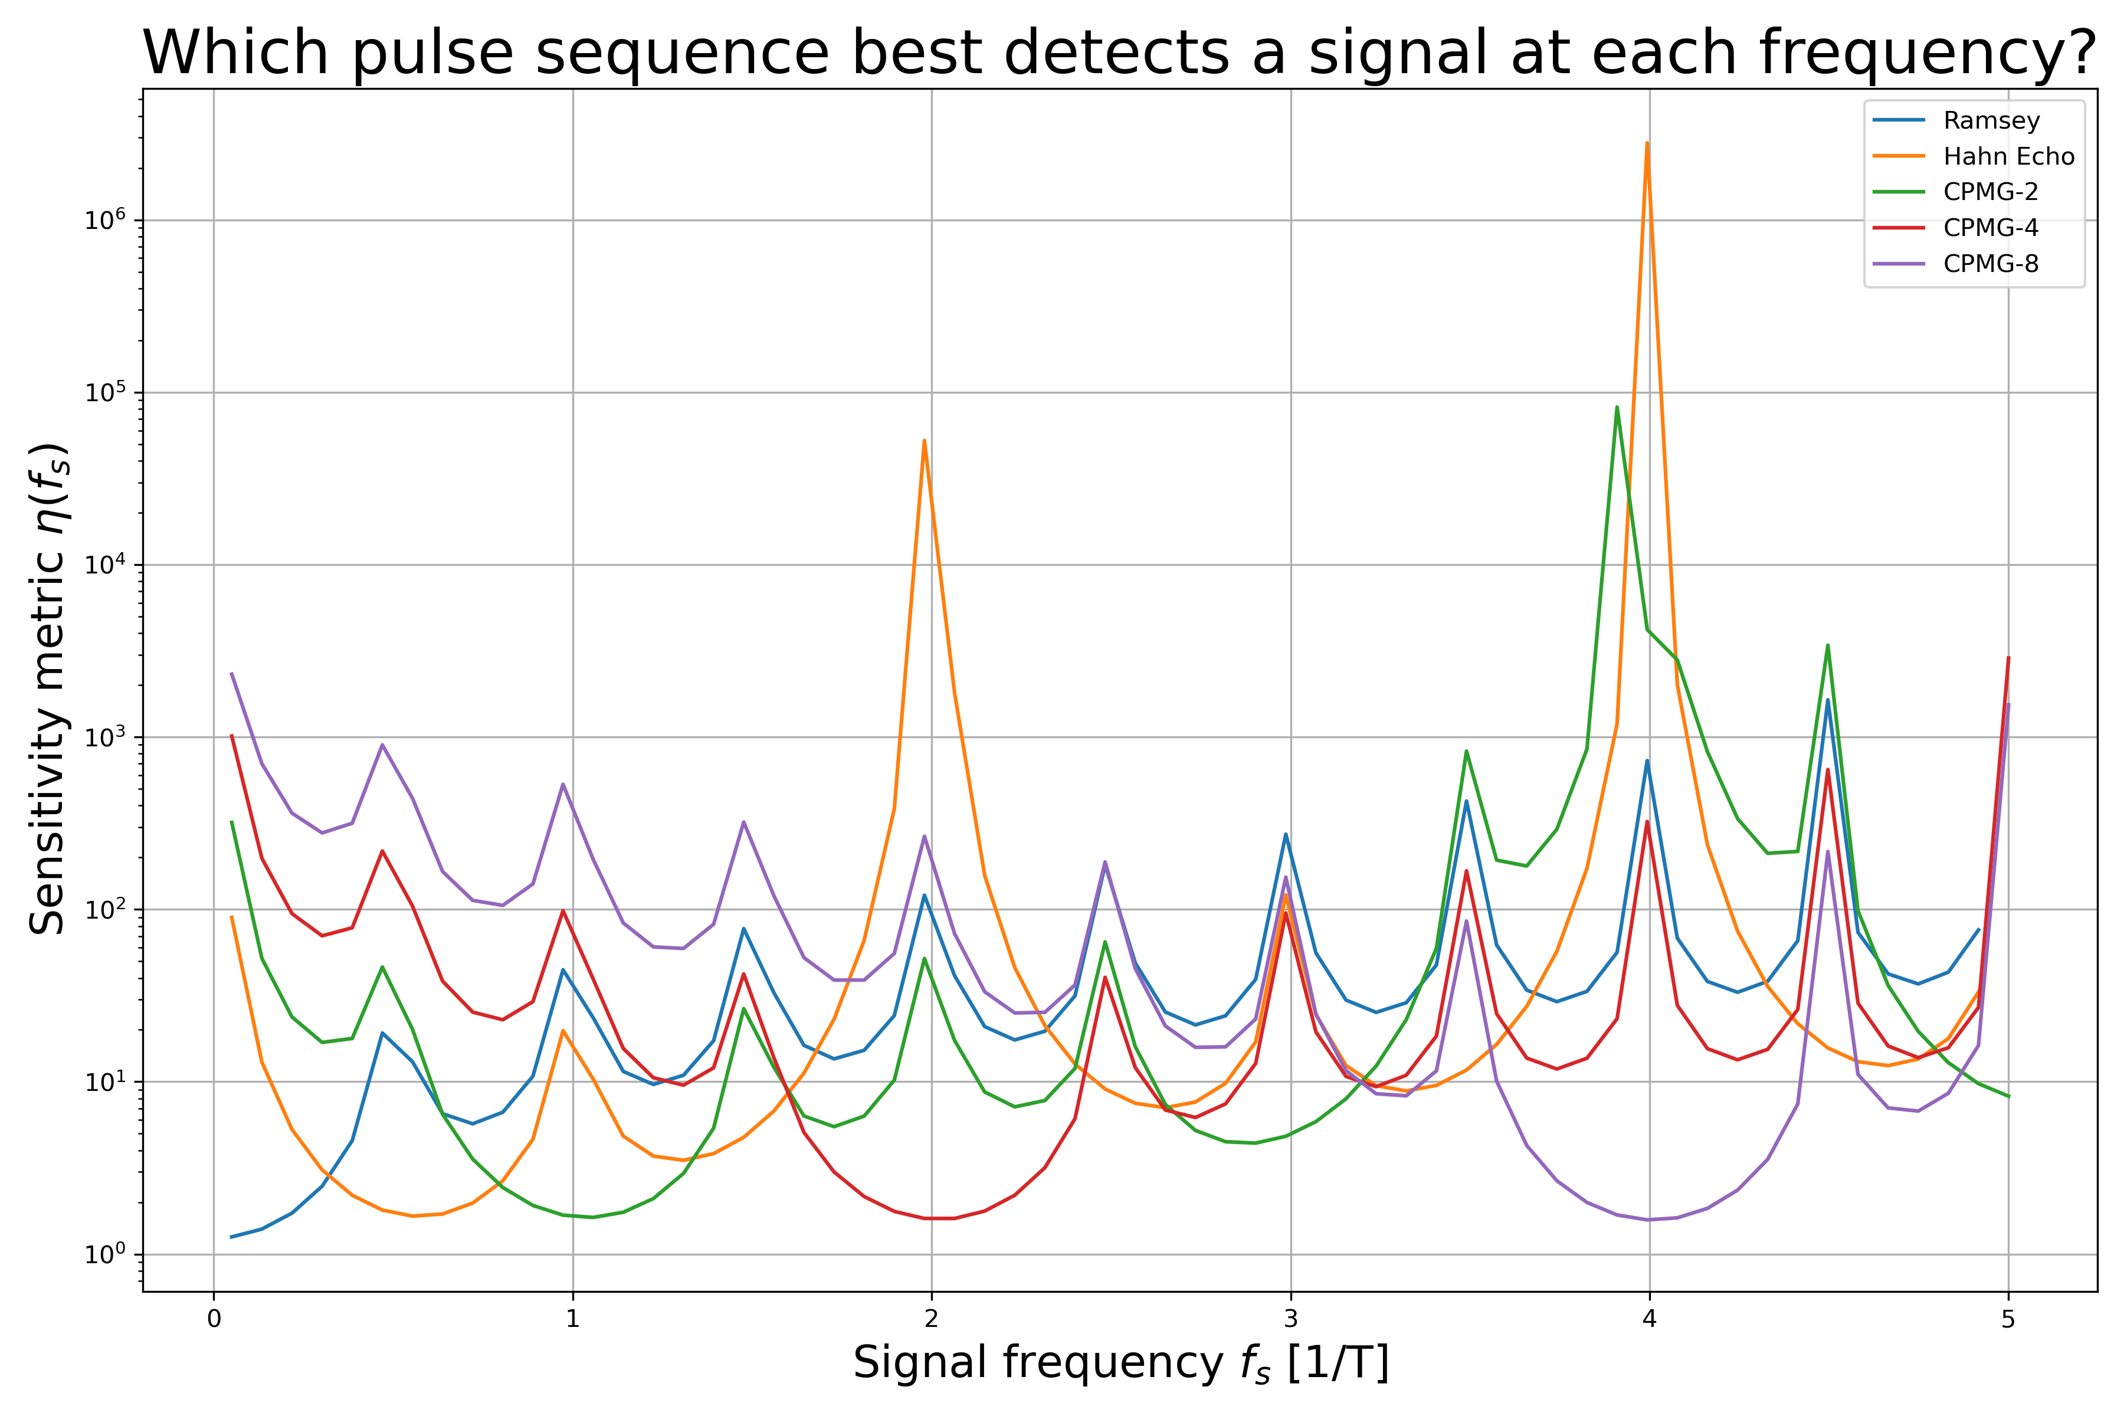
10387 Scientific computing in quantum information science

Slide 6
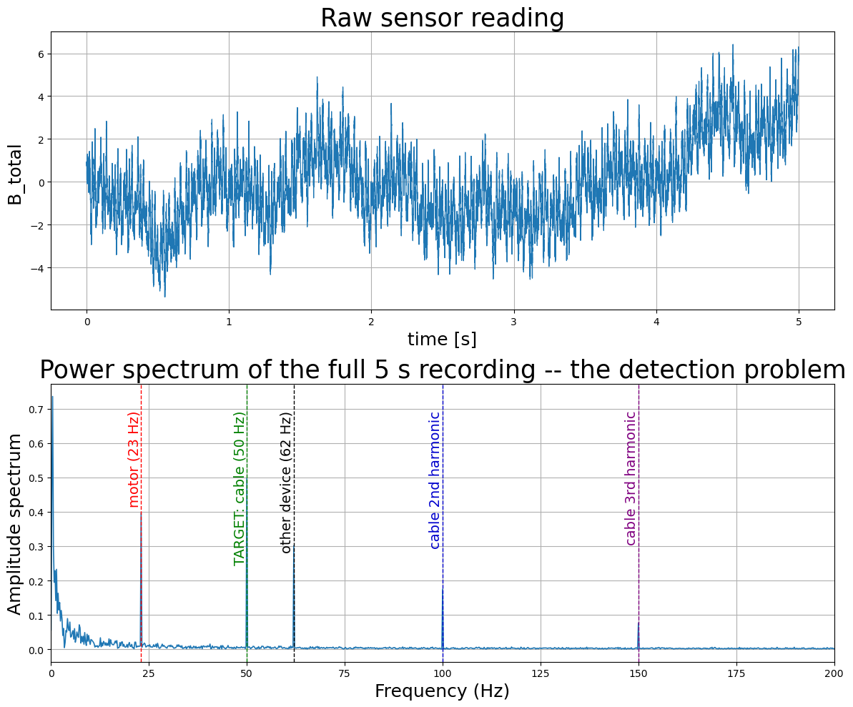
10387 Scientific computing in quantum information science

Slide 7
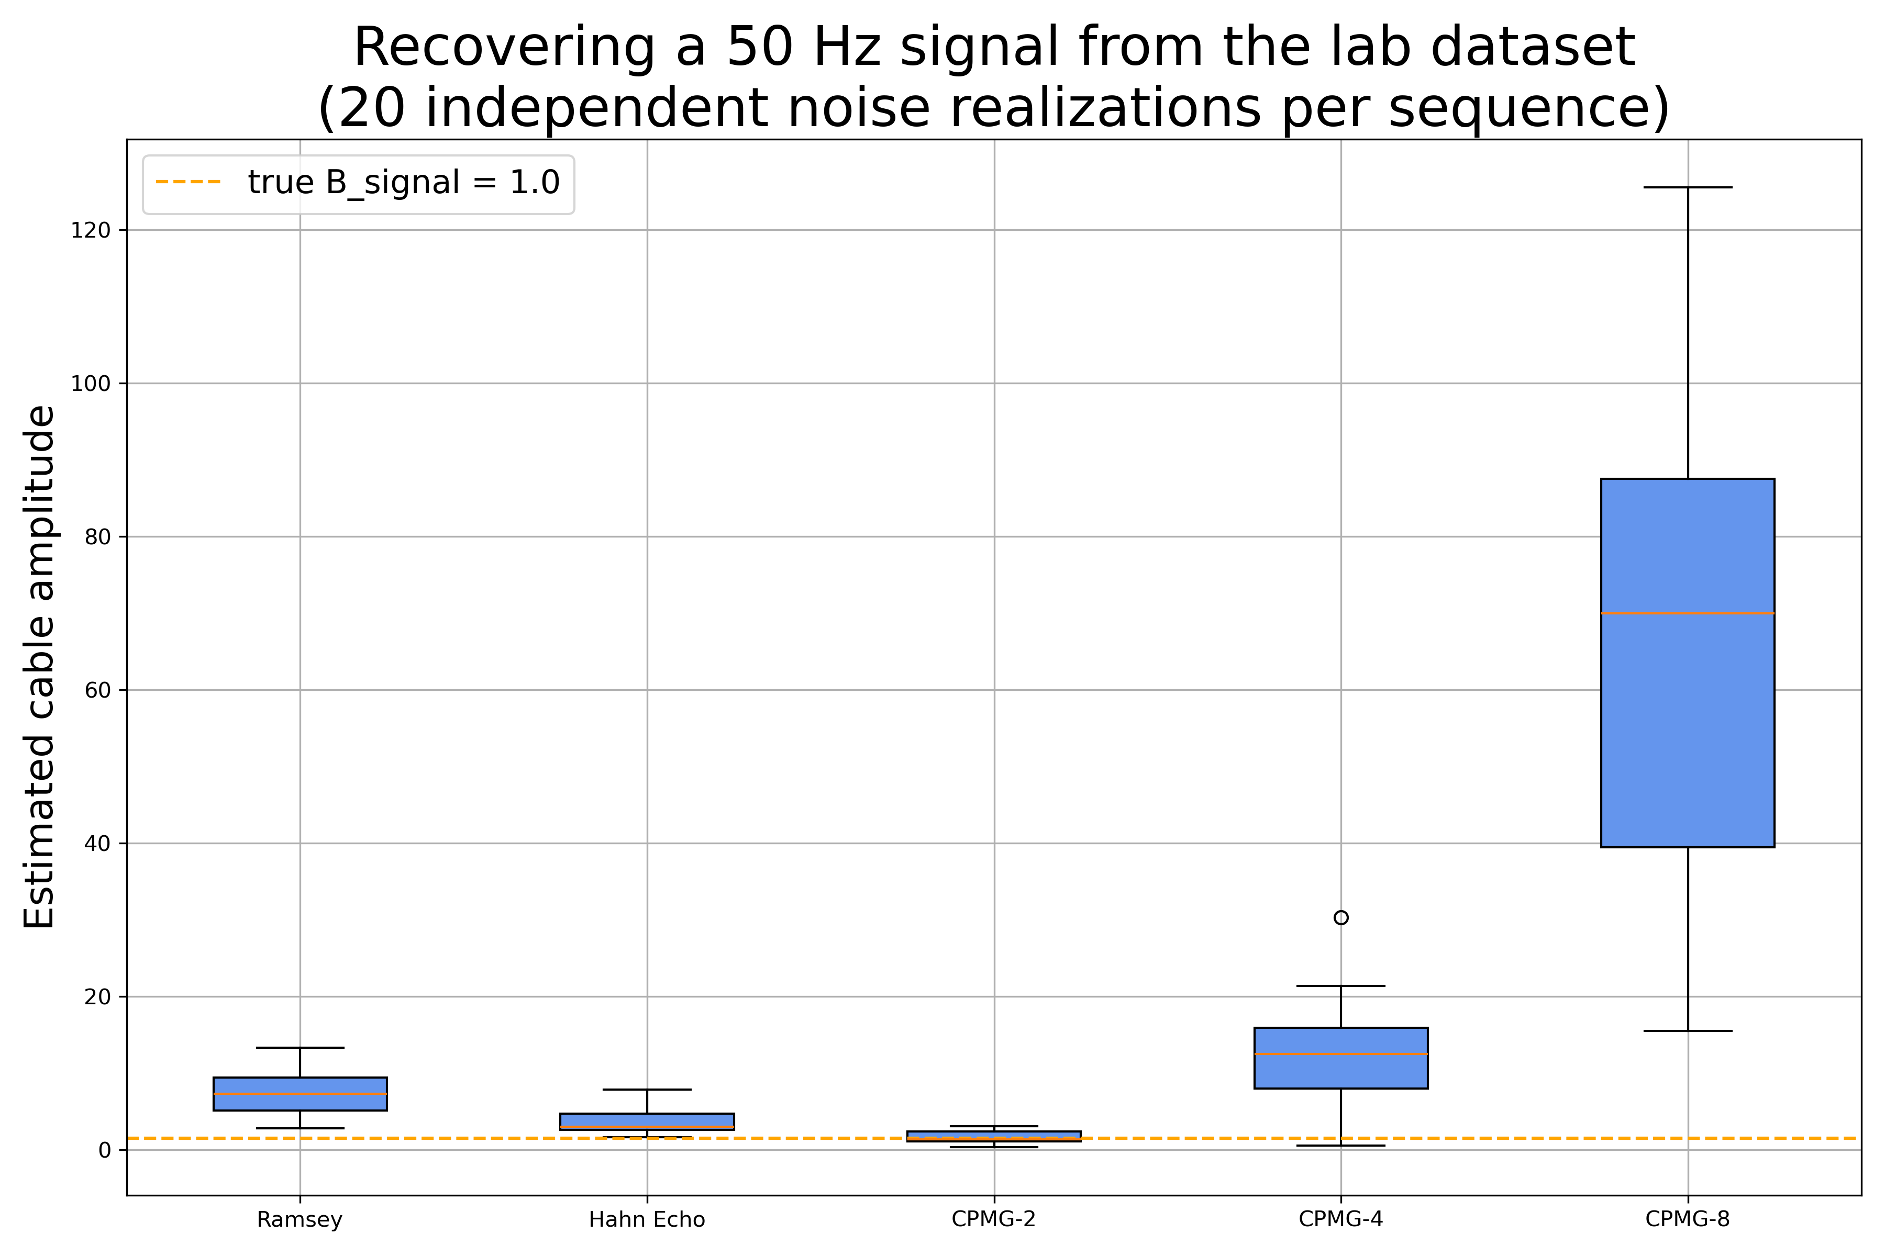
10387 Scientific computing in quantum information science

Slide 8



10387 Scientific computing in quantum information science

