Slide 1
The World in One Hand
How Limitation Became Sudek's Style
Josef Sudek — the Poet of Prague
Notes:
Good morning, everyone — thank you all for being here. Before I start, let me ask you something: have you ever felt that having less actually made you more creative? Hold that thought. Today I want to introduce a photographer who saw the whole world through a single window — and who made every one of his images with only one hand. His name is Josef Sudek, often called 'the Poet of Prague.' My talk is The World in One Hand, and honestly, the whole thing comes down to one question I kept asking myself: how did a physical limitation become an artistic style? Let's find out together. (0:30)

Slide 2
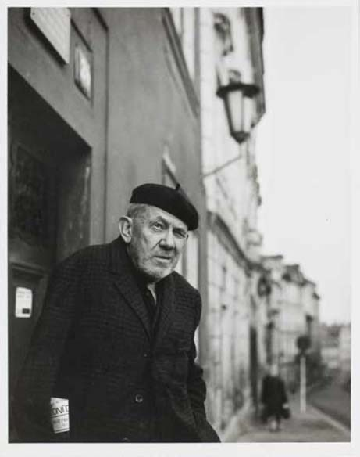
Josef Sudek
1896–1976 · the Poet of Prague
Czech photographer who spent his life in Prague.
Lost his right arm in the First World War.
Worked one-handed with a large-format view camera.
Turned that limitation into a slow, quiet, poetic style.
Notes:
So this is the man himself — take a good look at that face. Josef Sudek, born in 1896, who lived and worked almost his entire life in Prague. Now here is the detail that always stops people: he made every single one of his photographs with just one hand, hauling around a heavy large-format camera. Try to imagine doing that on a tripod, by yourself, for fifty years. Keep his face in mind, because we're about to see how he turned a wartime injury into one of the most poetic styles in all of photography.

Slide 3
Who Was Josef Sudek?
Born in Bohemia, 1896.
Lost his right arm in the First World War.
Chose the large-format view camera — slow, deliberate work on a tripod.
Spent his life in Prague: 'the Poet of Prague.'
Notes:
Josef Sudek was born in Bohemia in 1896. Then the First World War came, and he lost his right arm. Just think about that for a second — for most people that's the end of a photographic career; a camera is hard enough to handle with two hands. But here's what fascinates me about Sudek: instead of fighting the limitation, he leaned right into it. He gave up fast, handheld photography and committed to the large-format view camera, the kind of slow, deliberate instrument that forces you to slow down. And he spent almost his whole life right here in Prague — which is exactly why they call him the Poet of Prague. (1:30)

Slide 4
The Main Idea
Sudek's limitation pushed him toward one way of working: slow, close, patient.
That became his signature style.
Four qualities organize this talk:
SLOW · CLOSE · REPEATED · SOLITARY
Every photograph is evidence for one of them.
Notes:
Okay, so here's the whole argument of my talk in a nutshell. Sudek's limitation quietly pushed him toward one particular way of working — slow, close, and patient — and over time that became his signature style. So instead of organizing his photographs by subject, the usual way, I've grouped them by four qualities that all grow out of that single limitation: Slow, Close, Repeated, and Solitary. Keep these four words in the back of your mind — every photograph you're about to see is really evidence for one of them. (1:00)

Slide 5
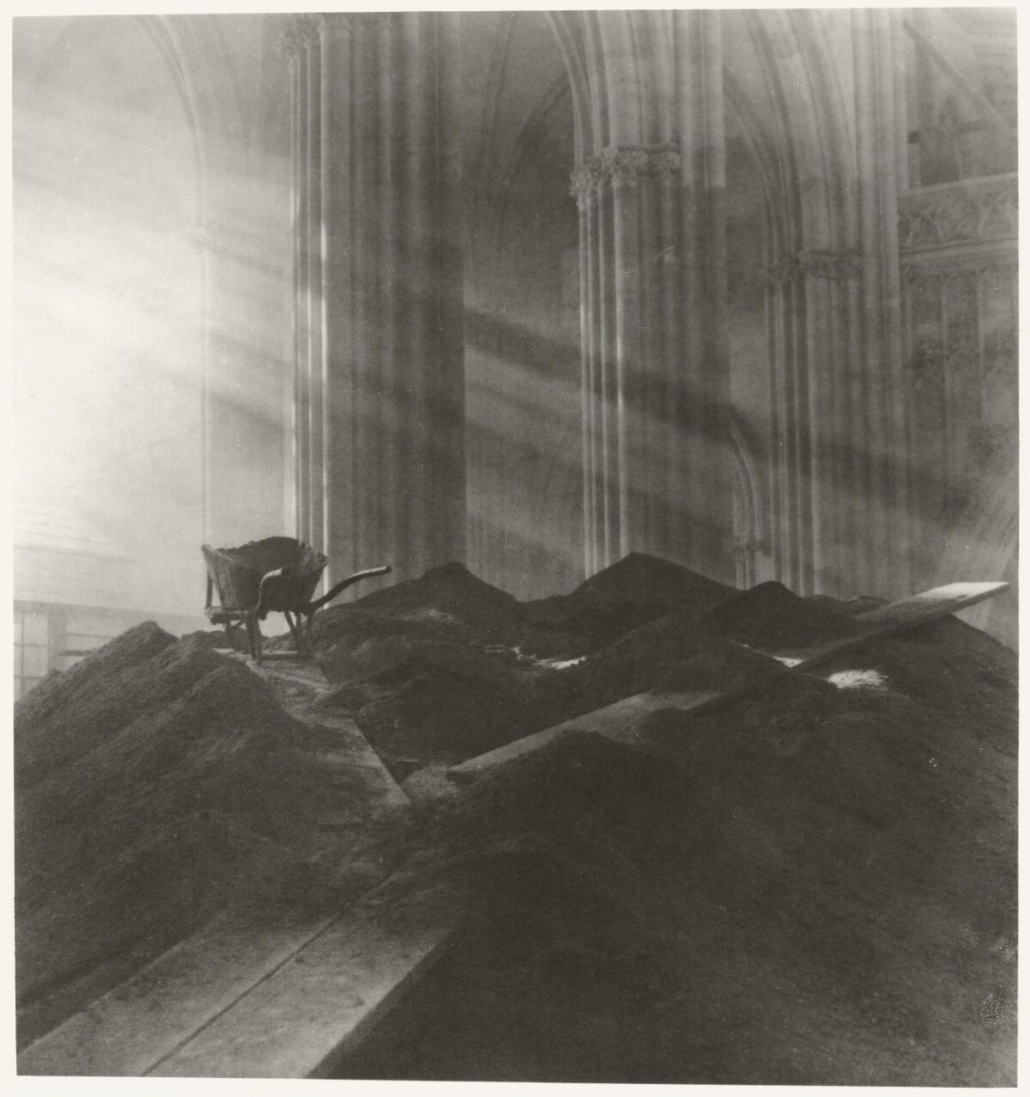
SLOW
Photo 1 of 15
Saint Vitus Cathedral, interior
c. 1924–1928
Notes:
Legend — dark = must say · brown italic = optional (say only if you need to fill time)
First, SLOW. The view camera demanded long exposures, so Sudek learned to wait. A long exposure gathers soft, diffused light the eye barely notices — light becomes almost solid. This patience is the foundation of everything that follows. (optional) Look how there are almost no hard shadows — the light seems to settle into the stone. Exposures like this could run for many minutes.

Slide 6
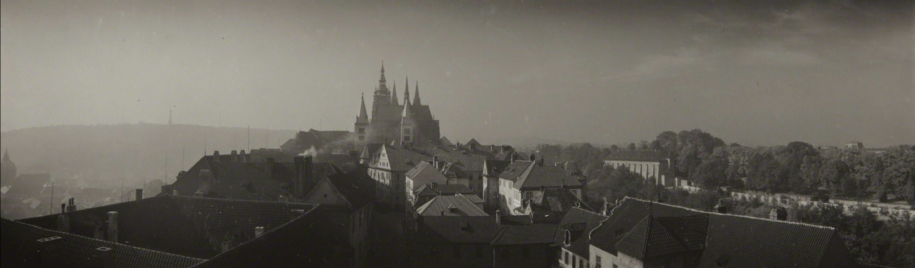
SLOW
Photo 2 of 15
Prague Panorama, misty city
c. 1950s–1960s
Notes:
Legend — dark = must say · brown italic = optional (say only if you need to fill time)
Here, slowness turns fog and damp air into something dreamlike. This is from his panoramic work — a wide, demanding format. The mist isn't a problem to fix; it is the subject. (optional) That long horizontal frame was unusual for its time, and it makes the city feel like it goes on forever. The damp Prague air was almost a collaborator for him.

Slide 7
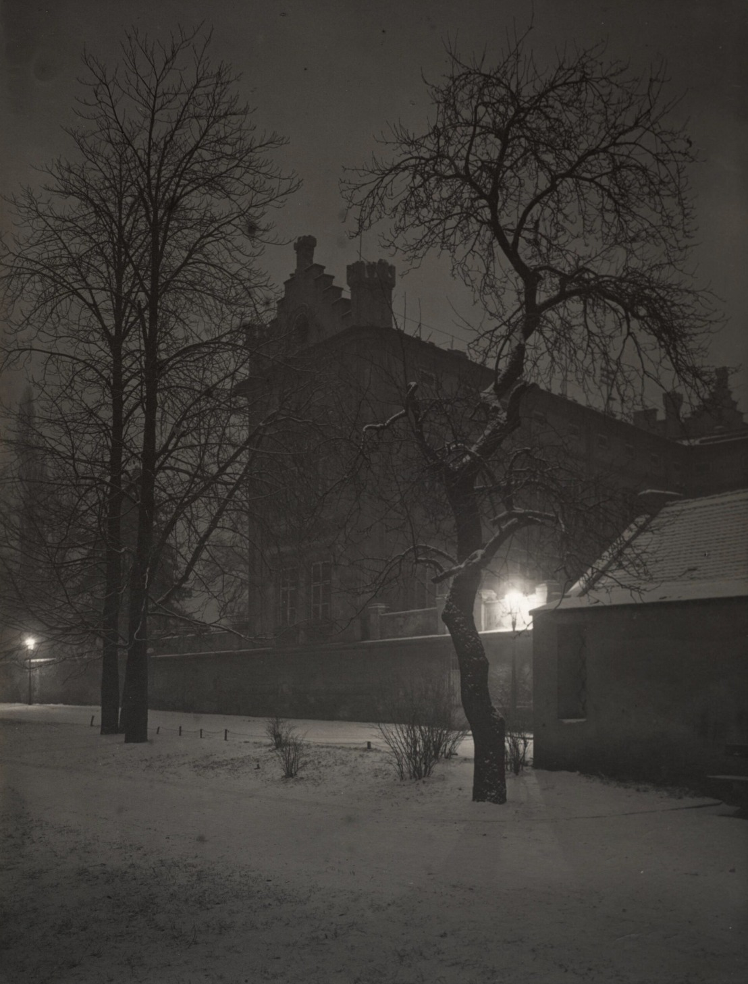
SLOW
Photo 3 of 15
Prague at Night
c. 1950s
Notes:
Legend — dark = must say · brown italic = optional (say only if you need to fill time)
This near-darkness was only possible with a long exposure on a tripod. The empty, glowing street shows how Sudek used time itself as a tool — letting faint light slowly build into a quiet scene. (optional) If you tried to shoot this by hand, you'd get nothing but a black frame. The few points of light almost feel like they're breathing.

Slide 8
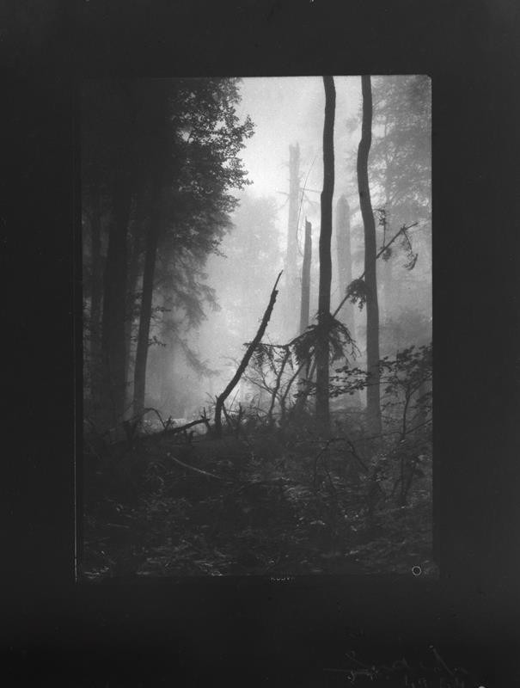
SLOW
Photo 4 of 15
Mionší Forest, mist in the woods
c. 1950s
Notes:
Legend — dark = must say · brown italic = optional (say only if you need to fill time)
In a misty forest, the stillness becomes visible. The soft grey light and motionless trees are the trace of a long, patient exposure. Slowness was never a weakness — it was how he found poetry in ordinary light. (optional) There's no wind, no movement, nothing dramatic — and that's exactly the point. He's photographing the quiet itself.

Slide 9
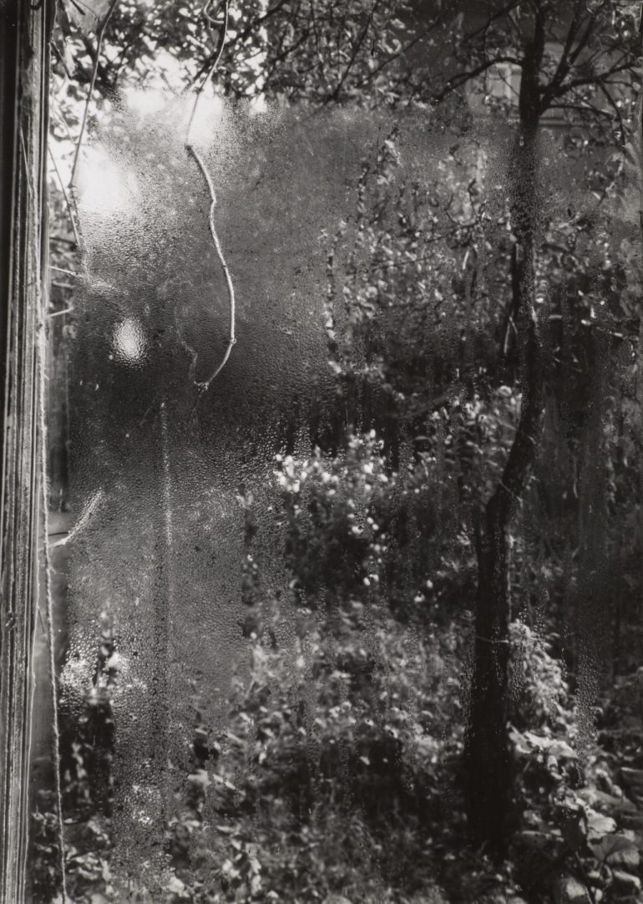
CLOSE
Photo 5 of 15
The Window of My Studio
c. 1940–1948
Notes:
Legend — dark = must say · brown italic = optional (say only if you need to fill time)
Second, CLOSE. Because movement was difficult, Sudek worked within arm's reach. His most famous motif: the window of his studio, covered in mist and droplets. A single pane of glass became an entire universe. (optional) He made dozens of versions of this window over the years, often just looking out at his garden. He didn't need to travel to find a world — it was right in front of him.

Slide 10
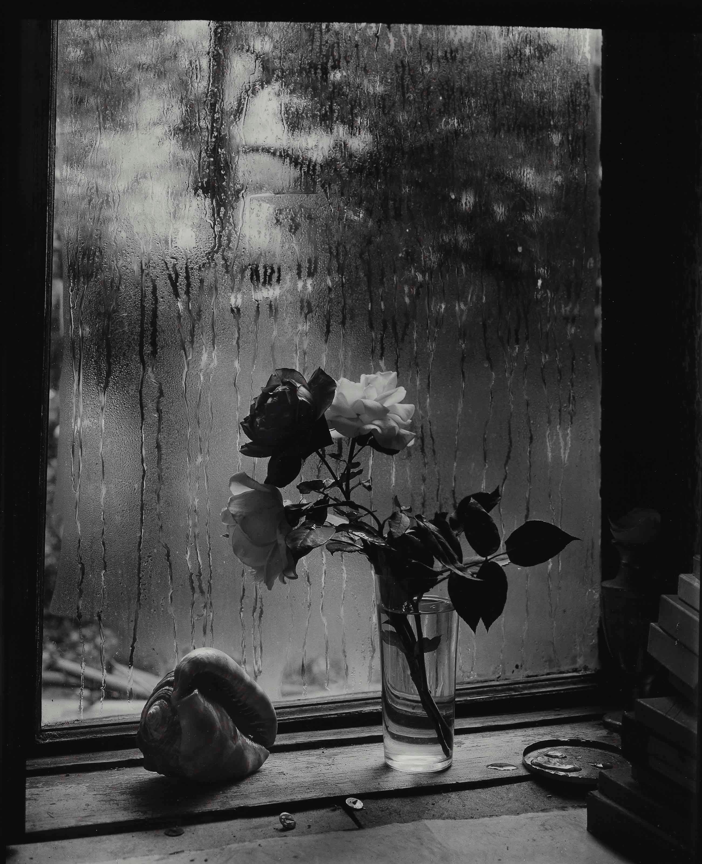
CLOSE
Photo 6 of 15
The Last Rose
c. 1956
Notes:
Legend — dark = must say · brown italic = optional (say only if you need to fill time)
On his table, a single fading rose. Seen this closely, an ordinary flower becomes a meditation on beauty and time — one of his most poetic still lifes. (optional) It's not a fresh, perfect bloom — it's wilting, and that's the whole point. He found beauty in the moment things begin to fade.

Slide 11
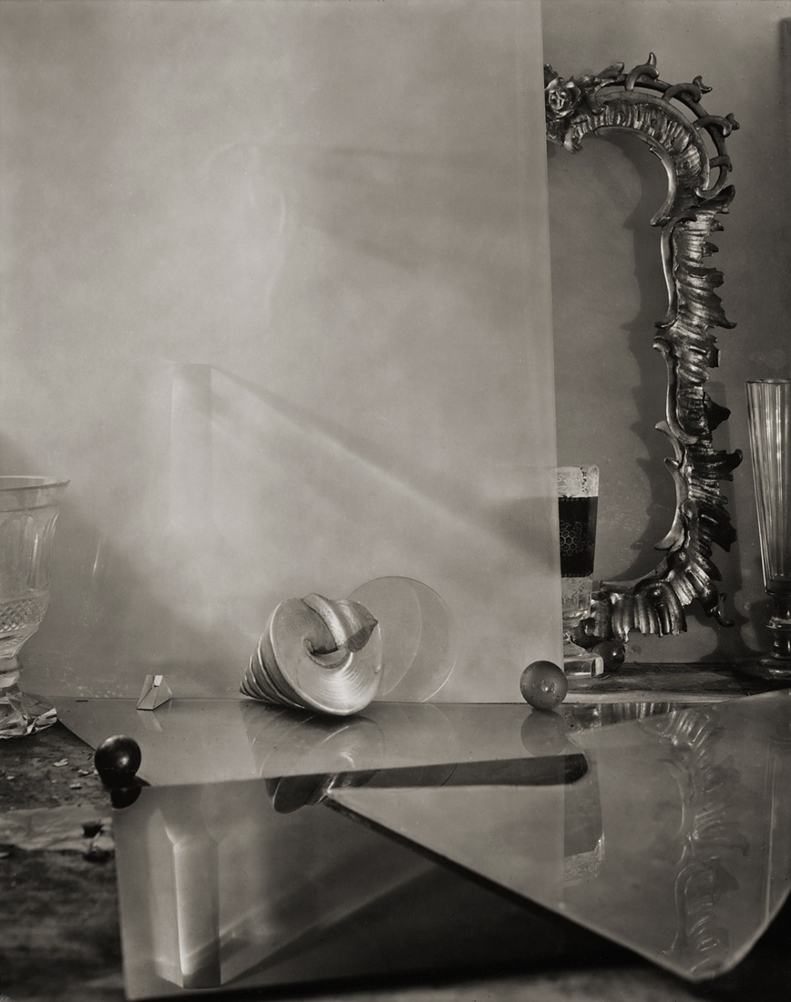
CLOSE
Photo 7 of 15
Glass and Egg (Labyrinths)
c. 1950s
Notes:
Legend — dark = must say · brown italic = optional (say only if you need to fill time)
In his still lifes, simple objects hold tiny, glowing worlds of light. A glass, an egg — close up, their surfaces become mysterious. Closeness was his limitation, but also his way of seeing the extraordinary in the plain. (optional) He called some of these his 'Labyrinths.' Spend a moment on the reflections — there's a whole little landscape inside that glass.

Slide 12
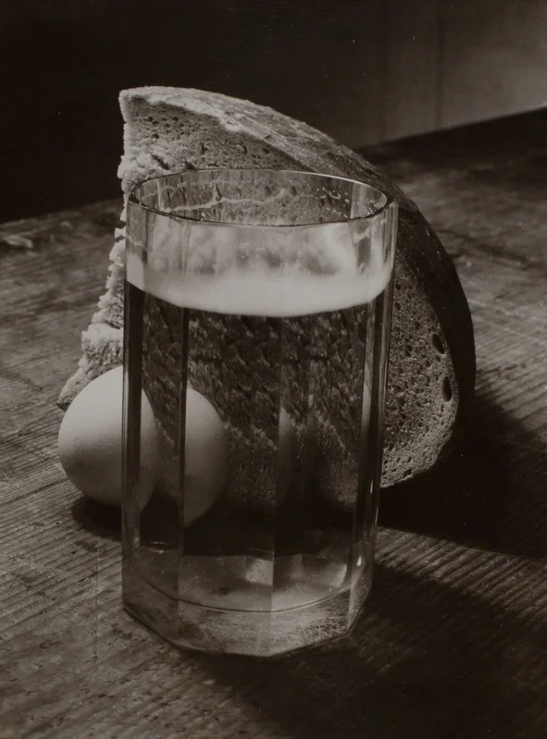
CLOSE
Photo 8 of 15
Still life with Bread and Glass
c. 1950s
Notes:
Legend — dark = must say · brown italic = optional (say only if you need to fill time)
Bread and a glass on a dark table. Humble, everyday things — yet lit so gently they feel almost sacred. Intimacy as a method: the closer he looked, the more meaning he found. (optional) This is the kind of food you'd find in any modest Prague kitchen. Sudek treats it with the same care a painter might give a portrait.

Slide 13
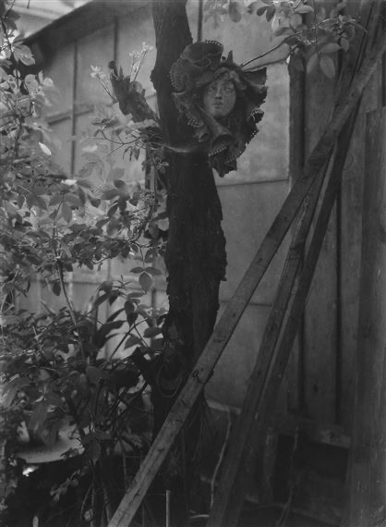
REPEATED
Photo 9 of 15
Window — view to the garden, summer
c. 1940s
Notes:
Legend — dark = must say · brown italic = optional (say only if you need to fill time)
Third, REPEATED. Sudek returned to the same subjects for years. Here is the view from his studio window onto the garden in one season, full and green. (optional) Keep this exact frame in your memory for a second — because the next image is the very same window. He photographed it over and over across the seasons.

Slide 14
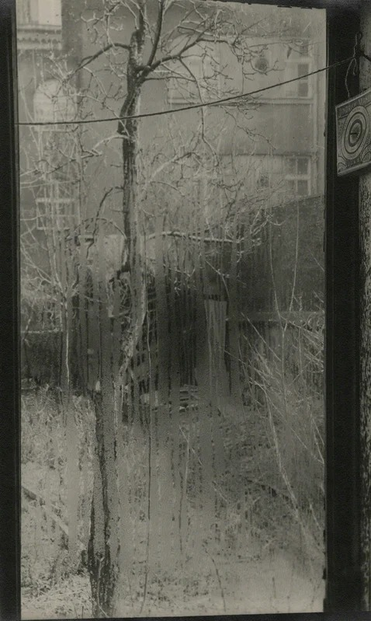
REPEATED
Photo 10 of 15
Window — frost, winter
c. 1940s–1950s
Notes:
Legend — dark = must say · brown italic = optional (say only if you need to fill time)
The same window in winter, the glass laced with frost. Same frame, completely different mood. Repetition let him discover endless variation inside a single point of view. (optional) Same window, same spot — only the season has changed, and suddenly it's a different world. This is what patience with one subject can reveal.

Slide 15
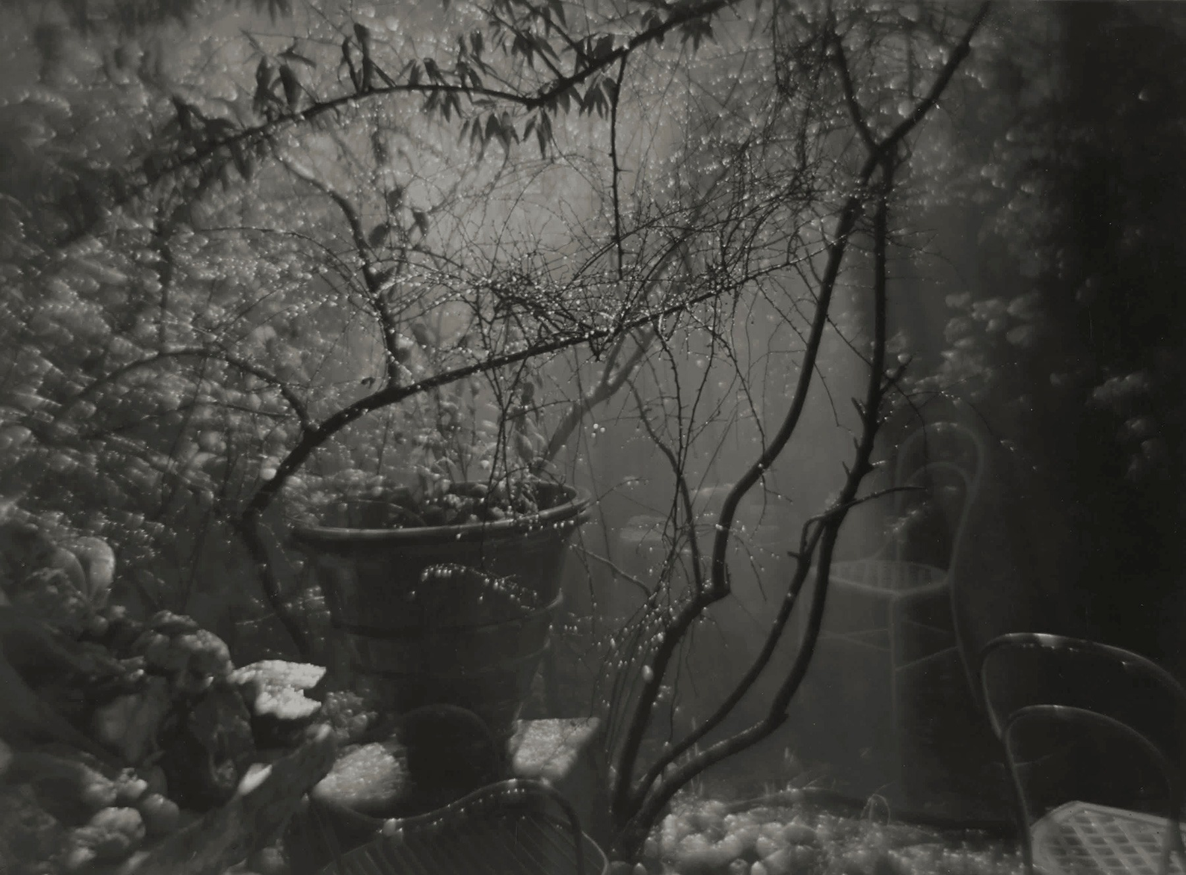
REPEATED
Photo 11 of 15
A Walk in the Magic Garden I
c. 1954
Notes:
Legend — dark = must say · brown italic = optional (say only if you need to fill time)
He gave the same devotion to his small, wild garden — his 'magic garden.' He photographed it again and again, finding life in its overgrown corners. (optional) It was just a modest, tangled little garden in Prague, nothing grand. But to him it was endless.

Slide 16
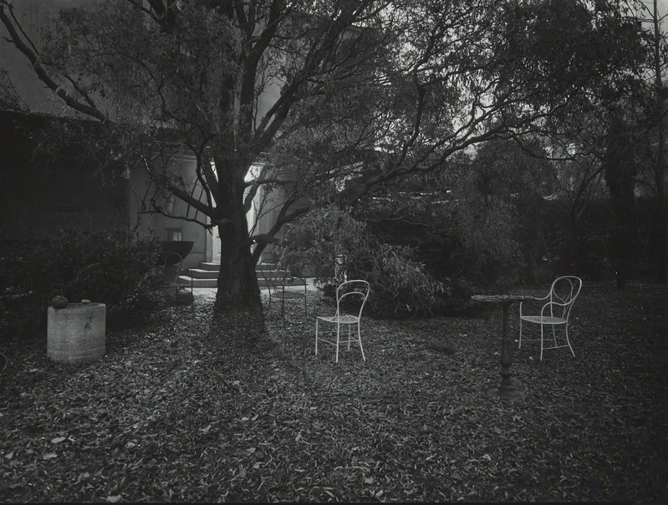
REPEATED
Photo 12 of 15
A Walk in the Magic Garden II
c. 1960s
Notes:
Legend — dark = must say · brown italic = optional (say only if you need to fill time)
The garden again, at a different hour and light. Repetition was not a lack of ideas — it was depth. By doing less, again and again, he saw more than photographers who do everything once. (optional) Same garden, different day, different light — and a completely different feeling. For Sudek, returning was a form of looking deeper.

Slide 17
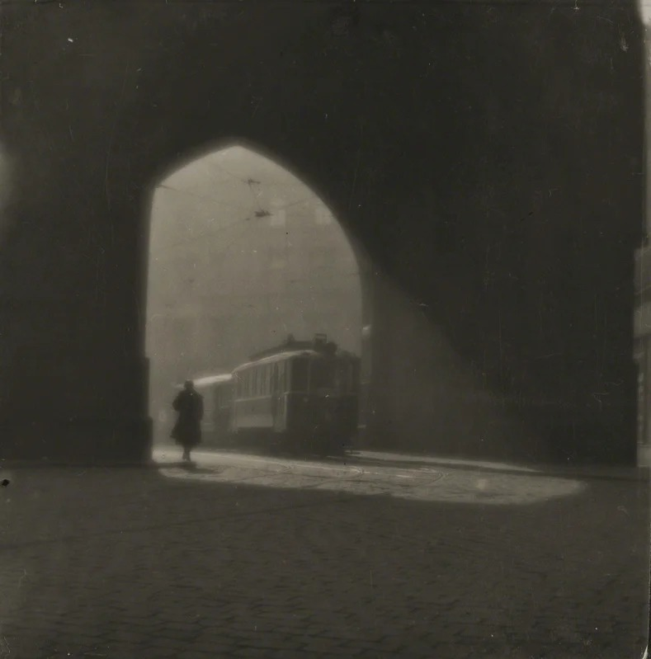
SOLITARY
Photo 13 of 15
Prague Panorama — empty street/square
c. 1950s–1960s
Notes:
Legend — dark = must say · brown italic = optional (say only if you need to fill time)
Fourth, SOLITARY. Sudek's images are almost always empty of people. This empty square feels quiet, inward, a little melancholy — a whole city holding its breath. (optional) Notice there's not a single person in the frame. That emptiness isn't lonely exactly — it leaves room for you, the viewer.

Slide 18
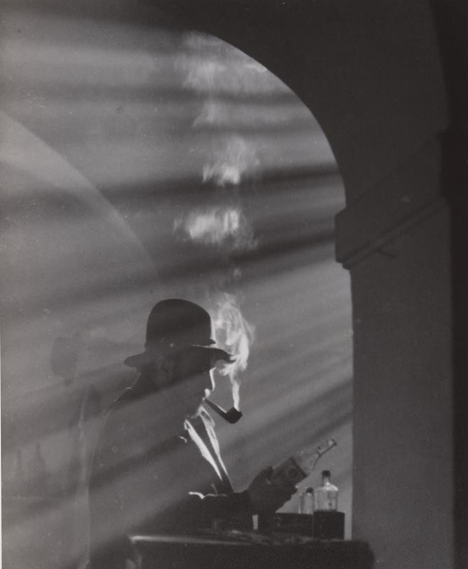
SOLITARY
Photo 14 of 15
Veteran from the Invalidovna
c. 1922–1927
Notes:
Legend — dark = must say · brown italic = optional (say only if you need to fill time)
This earlier, documentary work shows a war veteran at the Invalidovna in Prague. It connects directly to Sudek's own war experience and his lost arm. Here, solitude is personal — where his whole sensibility begins. (optional) Remember, Sudek lost his own arm in that same war. When he photographs this man, he's also, in a way, photographing himself.

Slide 19
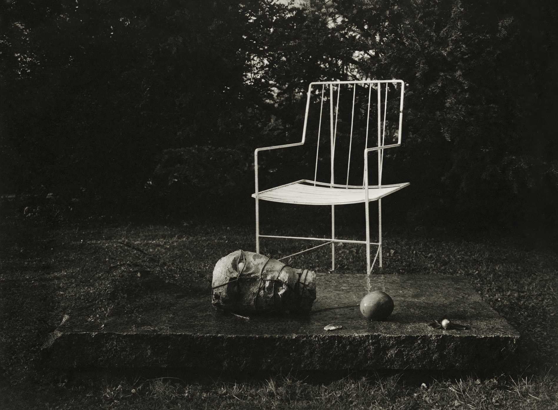
SOLITARY
Photo 15 of 15
A Chair in the Magic Garden / Remembrance
c. 1950s
Notes:
Legend — dark = must say · brown italic = optional (say only if you need to fill time)
I'll end with this: a single empty chair in the garden. No people, just pure silence and memory. For me, this is the emotional heart of his entire body of work. (optional) An empty chair always suggests someone who was there and is now gone. Let it sit in silence for a second before we move on.

Slide 20
Bringing It Together
He lost his arm, so he worked slowly.
He worked slowly, so he stayed close.
He stayed close, so he repeated intimate subjects for years.
The result: stillness and solitude.
The constraint didn't shrink his world — it concentrated it.
Notes:
So let's circle back to the question I asked at the very beginning. How did a limitation become a style? Follow the chain with me: he lost his arm, so he worked slowly. He worked slowly, so he stayed close. He stayed close, so he ended up repeating the same intimate subjects for years. And out of all of that came a body of work defined by stillness and solitude. This is the part I find genuinely moving — the constraint didn't shrink his world, it concentrated it. He found the infinite inside one small studio, one window, one garden. (1:30)

Slide 21
Conclusion & Q&A
Creativity isn't always about having more.
Sometimes it's about going deeper into less.
One hand, one window — some of the most poetic photographs of the 20th century.
Thank you. Questions?
Notes:
So if you take just one thing away today, let it be this. Josef Sudek shows us that creativity isn't really about having more — more mobility, more subjects, more expensive equipment. Sometimes it's about going deeper into less. With his single hand and his single window he gave us some of the most poetic photographs of the entire twentieth century. And maybe that's worth remembering the next time we feel limited by something ourselves. Thank you so much for listening — now I'd love to hear your questions. (1:00)

Slide 22
Image Credits
All photographs © Estate of Josef Sudek. Reproduced here for educational, non-commercial use only.
1. Saint Vitus Cathedral, interior (c. 1924–1928) — National Gallery of Canada / Nasjonalmuseet
2. Prague Panorama, misty city (c. 1950s–1960s) — Sudek panorama series — various public collections
3. Prague at Night (c. 1950s) — Sudek panorama series — various public collections
4. Mionší Forest, mist in the woods (c. 1950s) — Sudek Project archive (sudekproject.cz)
5. The Window of My Studio (c. 1940–1948) — Museum of Modern Art (MoMA) / National Gallery of Canada
6. The Last Rose (c. 1956) — National Gallery of Canada
7. Glass and Egg (Labyrinths) (c. 1950s) — Sudek Project archive (sudekproject.cz)
8. Still life with Bread and Glass (c. 1950s) — Sudek Project archive (sudekproject.cz)
9. Window — view to the garden, summer (c. 1940s) — Museum of Modern Art (MoMA)
10. Window — frost, winter (c. 1940s–1950s) — Museum of Modern Art (MoMA)
11. A Walk in the Magic Garden I (c. 1954) — Museum of Modern Art (MoMA)
12. A Walk in the Magic Garden II (c. 1960s) — National Gallery of Canada
13. Prague Panorama — empty street/square (c. 1950s–1960s) — Sudek panorama series — various public collections
14. Veteran from the Invalidovna (c. 1922–1927) — Sudek Project archive (sudekproject.cz)
15. A Chair in the Magic Garden / Remembrance (c. 1950s) — Cleveland Museum of Art / National Gallery of Canada
Notes:
All images are reproductions of works by Josef Sudek, whose estate still holds copyright (he died in 1976), shown here for educational, non-commercial use. The listed institutions are the suggested reference sources; verify the exact provenance and the title and year of each file you used against the holding institution before presenting. Full search links are in images/sources.md.

