Slide 1

TEMPERATURE AND MALTREATMENT OF YOUNG CHILDREN
Mary F. Evans
Ludovica Gazze
Jessamyn Schaller
Lucas Simatovic
Ahmed-Zakaria Hedroug
NATIONAL BUREAU OF ECONOMIC RESEARCH
1050 Massachusetts Avenue Cambridge, MA 02138
August 2023, Revised October 2024

Slide 2
INTRODUCTION
Book written in 2023, revised in 2024 and pusblished in 2025
Main question: Does temperature affect the maltretment of children ? Both heat or cold
Big result of a 2011 survey: 40% of adults were maltretaed when they were children
Consequences: lower education, higher unemployment, criminal behavior and substance abuse
Combinaison of child welfare and weather variations data
Heat provides more neglect and abuse in households on children due to parental stress and alter daily routines

Slide 3
BACKGROUND
Maltreatment: physical abuse, sexual abuse, emotional maltretment and neglect
Stats: 40% of children under 5 are the victims and ¾ of cases involve neglect in US
What is neglect? Simply omission of care and leaving a child unsupervised
CPS: Child Protection Services only captures reported and investigate cases
Interpreting seasonal patterns is difficult because children, somestimes, dépend of the context

Slide 4
DATA
NCANDS: National Child Abuse and Neglect Data System
  Sample 2006-2016, 433 counties (14%) but represents 2/3 of children under five, 42 states
Two outcomes (per 1000 aged 0-4): allegation rate (number of children involved in at least one report), victimization rate (officialy confirmed as victims after investigation) → stronger
After they link this results to PRISM: climate organization who provides high resolution temperature and precipitation data
  For each county and semimonthly period
    Conversion from Fareinheit to Celsuis
    Ranging Celsius from below 0°C to above 35°C by 5°C
    Other variables: precipitation, local poverty rate, median income, racial composition

Slide 5
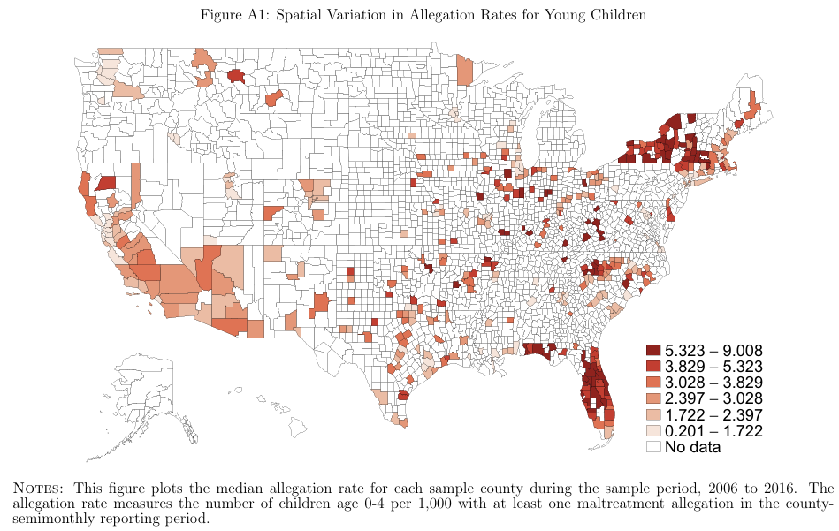
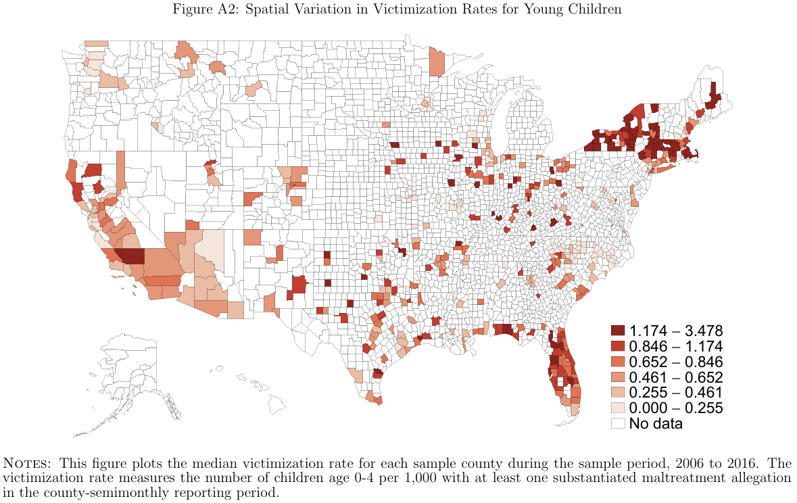
ALLEGATION RATES
VICTIMIZATION RATES

Slide 6
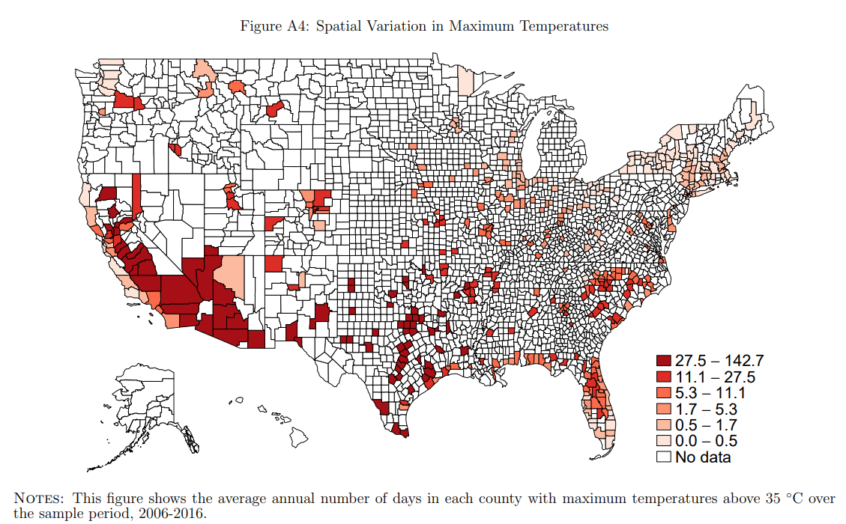
Maximum temperatures

Slide 7
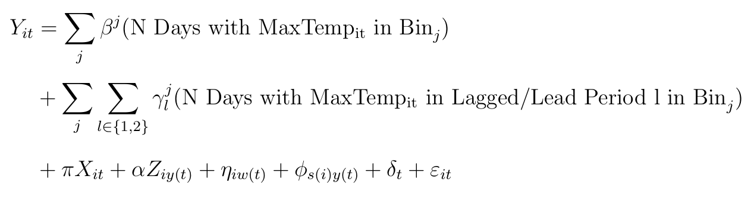
METHODOLOGY AND MAIN RESULTS
: child maltreatment outcome in i at t
First line: counts the number of days in county i during period t in which the daily maximum temperature lies within 5-degree Celsius bin j
Second line: two period lags and leads of the temperature variables, to allow for delayed effects and to check for spurious correlations, respectively
Third line: = average daily precipitation with two period of leads and lags of precipitation
= set of county by year controls
= county by period fixed effects (specific seasonality by state)
= state by year fixed effects (state specific policies over time)
= control idiosyncratic national shocks
= residuals

Slide 8
Use of fixed effects regression model to estimate the causal impact of temperatures who compares periods within the same county over time to isolate effect of short term weather.
Principales results:
  above 20°C confirm an increase in maltreatment
  Each additional day above 35°C rises by 0.5% relative to a moderate temperature day (15-20°C)
  Sample indicates a 0.8 victims per 1000 children represents 2 more victims for each additional day of extreme heat in a two week period. Szme for allegations
  In an other way, cold temperature are linked with lower reported maltreatment

Slide 9
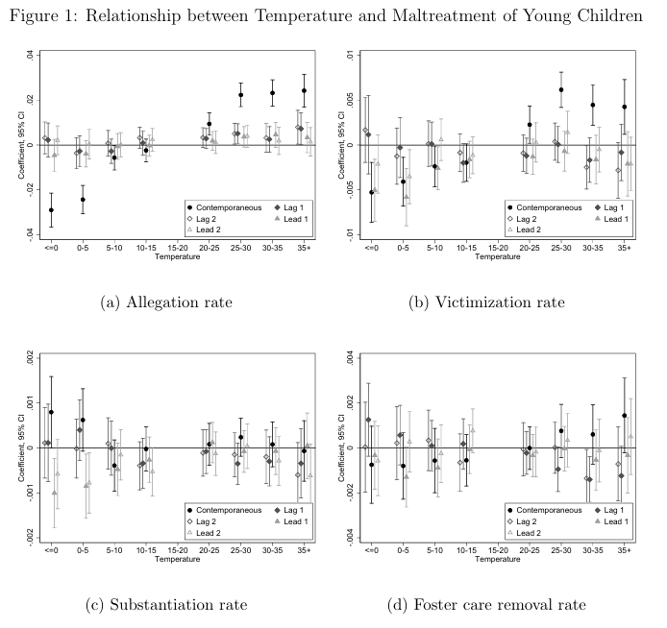
MECHANISMS AND HETEROGENEITY

Slide 10
IMPORTANT POINT: the authors test if the increase come from more reporting or more actual maltreatmen: if true, a drop in the share of allegations confirmed as real cases
This rate stays flat during hot periods ; that means the rise likely reflects real increases in harm -> when we separate rates of maltreatment, neglect is absolutely the more important
Children leave their home for a foster care rises during hot days, additional are not trivial
Basically, heat effects is stronger in low income and less urban counties with low rate air conditioning.
Finally adaptation capacity in wealthier or highly urbanized counties decrease the causal effect (protective factor)

Slide 11
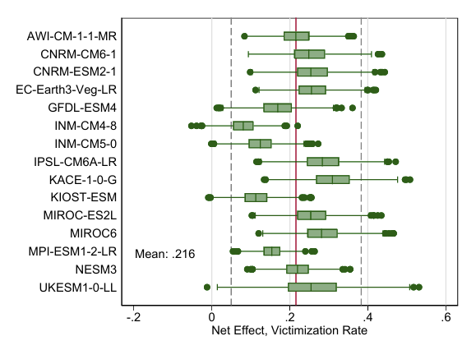
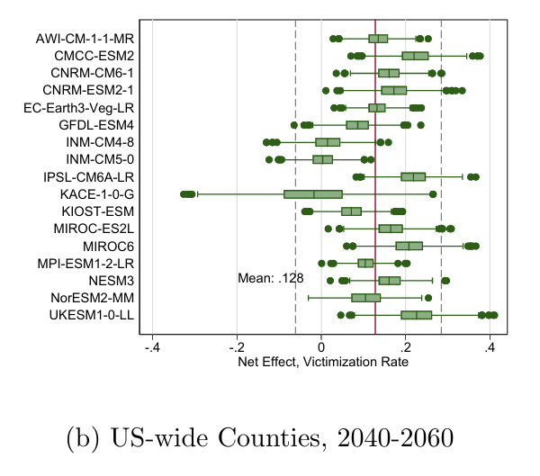
CLIMATE CHANGE PROJECTIONS
Projection using 15 globzl climate models to estimate how future warming affect maltretment
2081-2100 climate change will cause on average a increase of 0.21 victims per 1000 0 to 4 aged children each year about 1.5% compared to 2016
Authors say that hidden social costs will be impose not only on econmics or health impacts but also effects on child welfare

Slide 12
CONCLUSION AND PERSONAL REFLEXION
High temperatures increase maltreatment on children (more neglect than violence)
The mainly space affected by heat is simply the home.
With simple adaptations could make difference in terms of expanding access to air conditionning in poor and rural environments, supporting parents and caregivers during heat waves and ensuring safe environments for children when outdoors temperatures rise.
But don’t neglect that CPS exclude fatal cases and miss the most severe neglect
Future research will explore the driving mecahnisms are cognitive fatigue, stress or reduced supervision

Slide 13
OPENING QUESTION
To what extend can adaptation policies actually break the link between extremes heat waves and child neglect?

Slide 14
THANKS!

