Slide 1

FYP Connect
Developed by:
Ahmad Ryan – 22i-0781
Zubair Adnan – 22i-0789
Shayan Memon – 22i-0773

Slide 2
Agenda
Scope and Introduction
Objectives
Functional Requirements
Non-Functional Requirements
Use cases
Class Diagram
Component Diagram
Deployment Diagram
User Interface
Conclusion
FYP Connect

Slide 3
Scope:
Academic institutions, particularly universities.
Purpose:
Streamline management of final-year projects (FYPs) for students, supervisors, and admins.
Scope and Introduction
FYP Connect

Slide 4
Create a collaborative environment for students, supervisors, and admins.
Streamline group formation, mentorship, and deliverable submissions.
Objectives
FYP Connect

Slide 5
Student Features:
Create and Join Groups
View available project opportunities.
Submit deliverables, view feedback, and track grades.
Supervisor Features:
Share Resources and Projects
Manage and set deliverable deadlines.
Review and grade student submissions.
Admin Features:
Manage users (students, supervisors, admins).
Functional Requirements
FYP Connect

Slide 6
Performance:
Platform must handle multiple concurrent users without significant delays.
Usability:
User-friendly interface for all stakeholders.
Security:
Secure authentication, role-based access to the platform.
Safety:
Data integrity and input validations.
Non-Functional Requirements
FYP Connect

Slide 7
Create Groups
Join Groups
Resource sharing
Create and Manage Deliverables
Submit Deliverables
Feedback sharing
Upload Projects
Project Mentorship
Set Timelines
Manage Users
Use Cases
FYP Connect

Slide 8
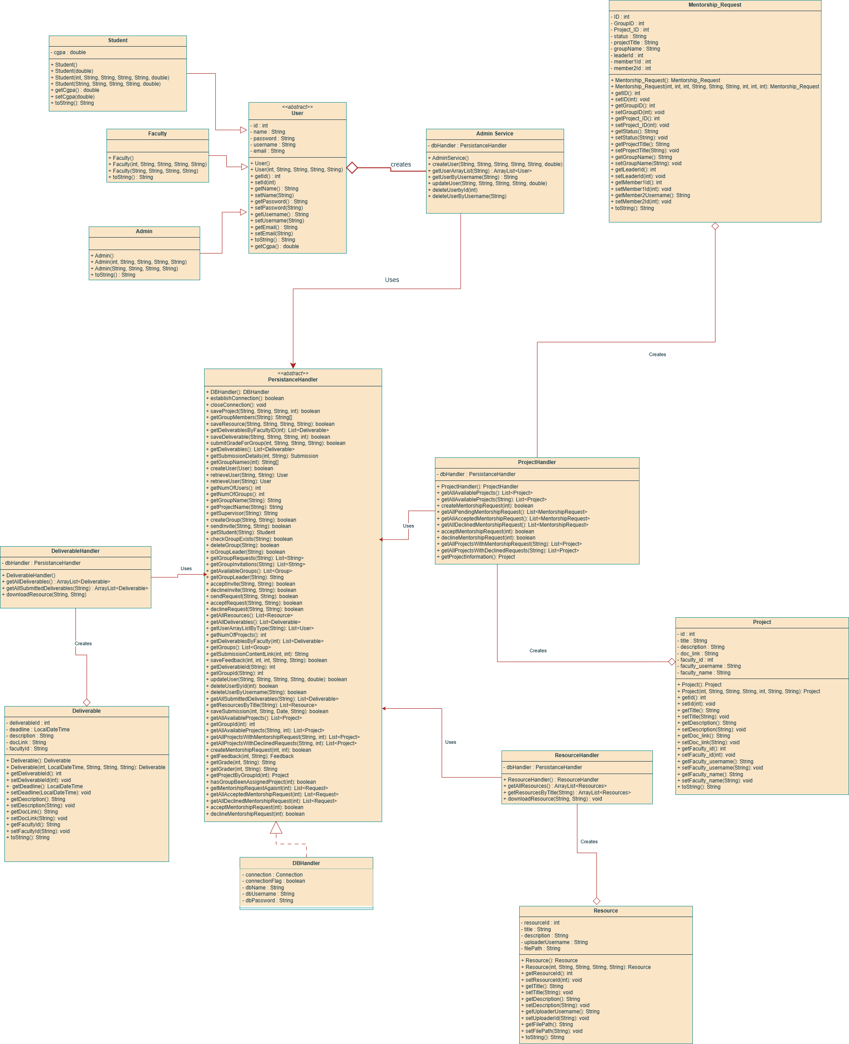
Class Diagram
FYP Connect

Slide 9
FYP Connect

Slide 10
FYP Connect

Slide 11
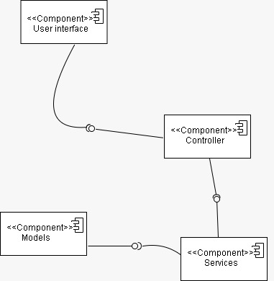
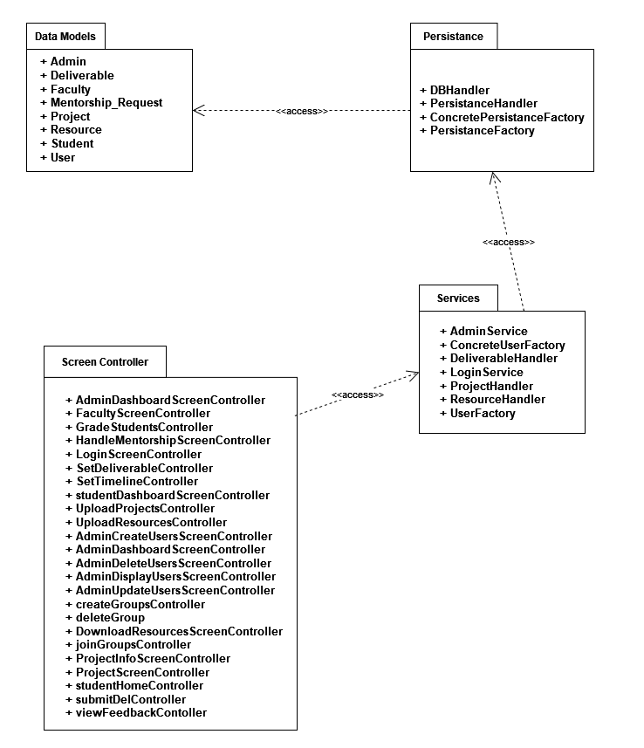
Package Diagram
FYP Connect

Slide 12
Package Diagram
FYP Connect

Slide 13
Component Diagram
FYP Connect

Slide 14
Component Diagram
FYP Connect

Slide 15
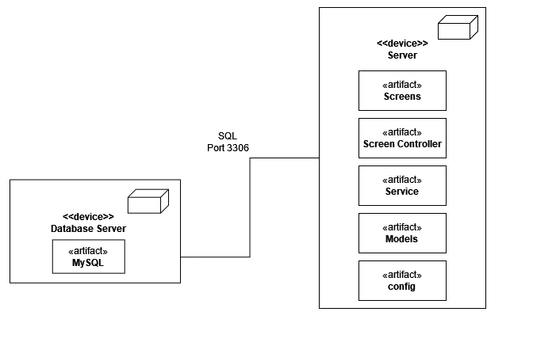
Deployment Diagram
FYP Connect

Slide 16
Deployment Diagram
FYP Connect

Slide 17
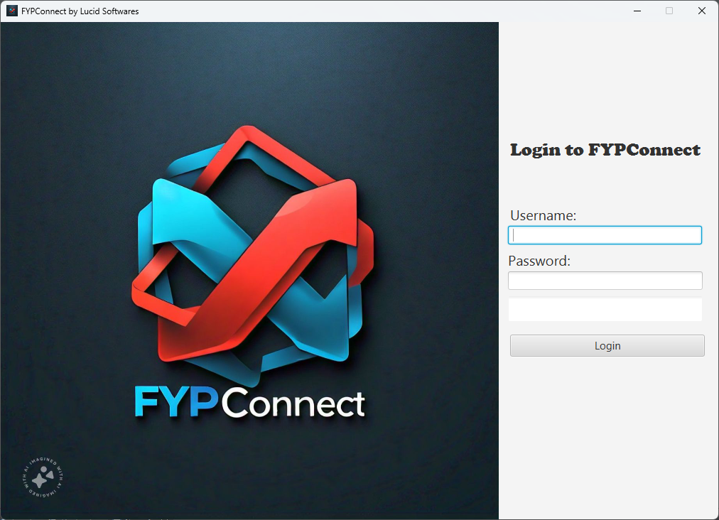
Login Page
Let’s See the User Interface
FYP Connect

Slide 18
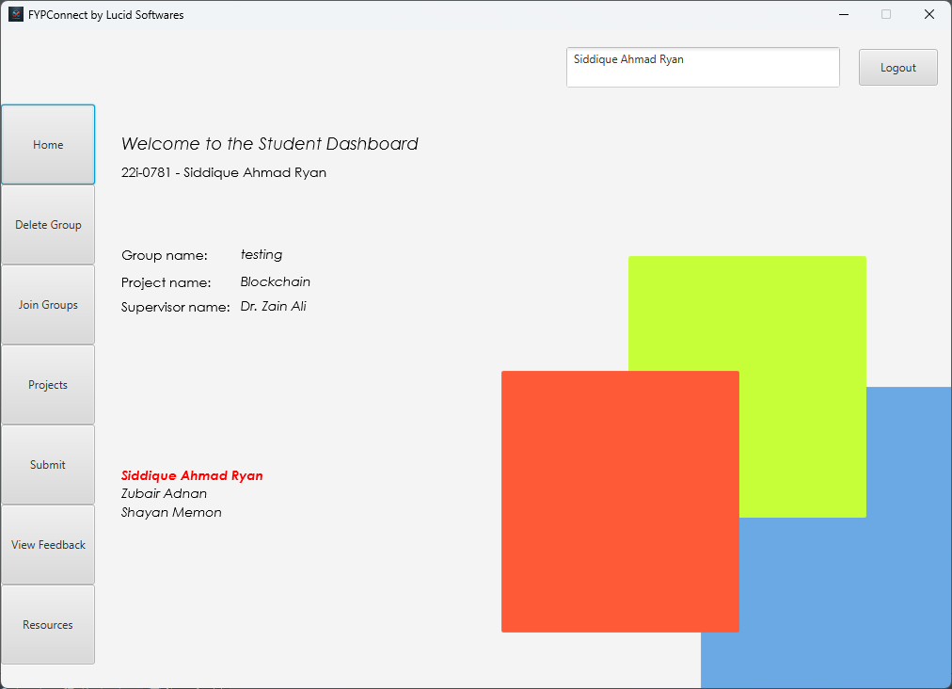
Let’s See the User Interface
Student Dashboard
Login Page
FYP Connect

Slide 19
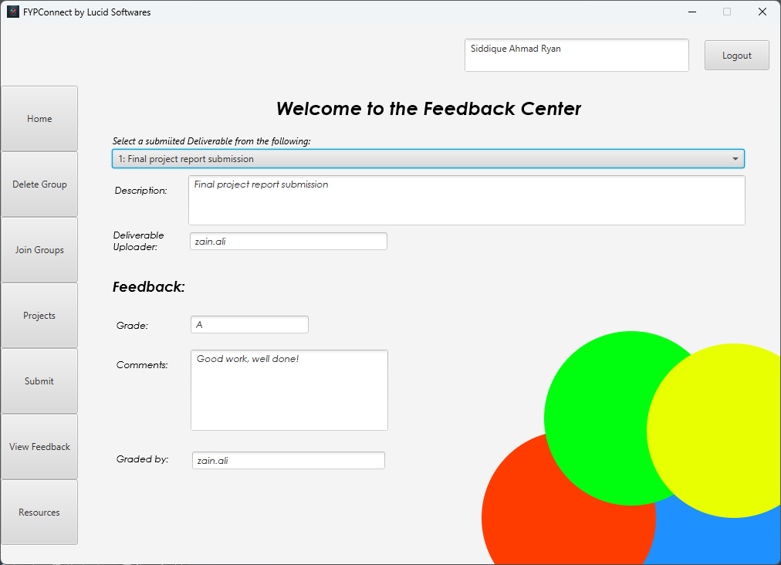
Login Page
Student Dashboard
FYP Connect

Slide 20
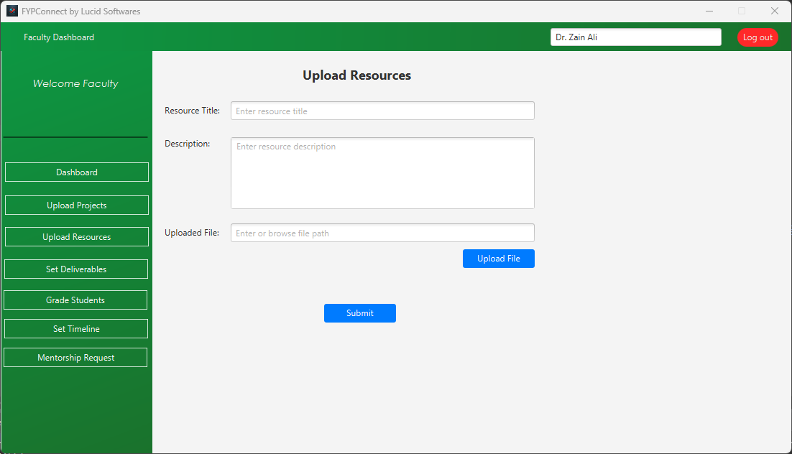
Login Page
Faculty Dashboard
Student Dashboard
FYP Connect

Slide 21
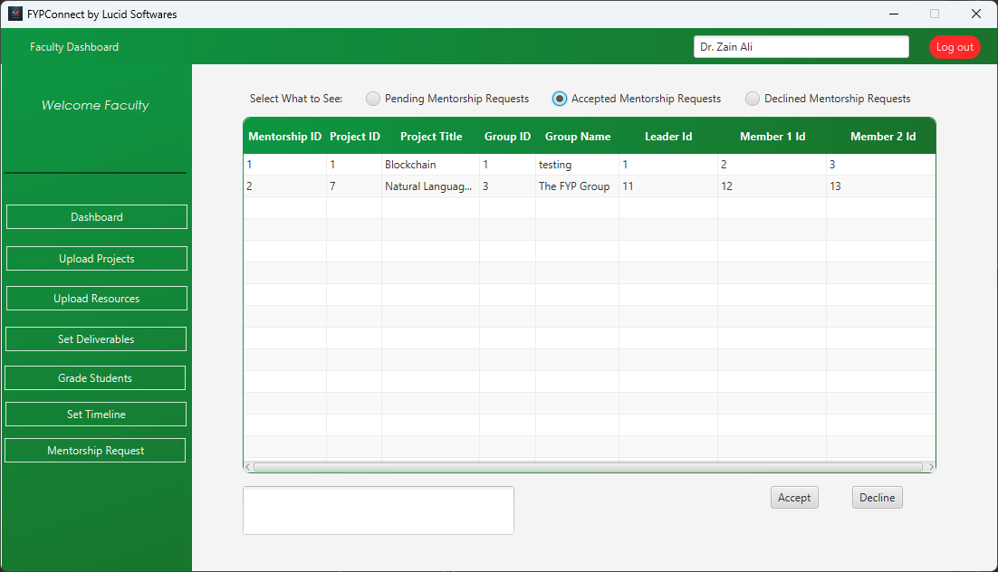
Login Page
Student Dashboard
Faculty Dashboard
FYP Connect

Slide 22
Login Page
Student Dashboard
Conclusion
Faculty Dashboard
FYP Connect provides a structured and efficient way to manage projects.
Aims to reduce administrative overhead while improving collaboration.
FYP Connect

Slide 23
FYP Connect provides a structured and efficient way to manage projects.
Aims to reduce administrative overhead while improving collaboration.
Faculty Dashboard
Conclusion
FYP Connect

Slide 24
FYP Connect
Thank You

