Slide 1
Version Control with Git
Linux Users Group
UT Arlington
Rohit Rawat
rohitrawat@gmail.com

Slide 2
Need for Version Control
Better than manually storing backups of older versions
Easier to keep everyone updated on a large project
  Allows concurrent development by multiple developers and safely merges those chages
  Accountability for all changes
  Fine tuned access control

Slide 3
Version Control Systems
Examples: CVS, SVN, Git, Mercurial, and other propreitary tools
Git
  Created by Linus Trovalds
  Distributed VCS
    CVS and SVN use centralized model
  http://git-svn.com
  Free and open source
  Cross platform

Slide 4
Distributed VCS
Each user has a copy of the whole repository, i.e. all the code and all the revisions.
Advantages:
  Safer due to redundancy
  Fast access, can also work offline
  No central server required
  Less hesitation in branching and making commits
Disadvantages:
  Commits are local/delayed
  First time download is slow as you also download the complete project history

Slide 5
Distributed VCS
Each user has a copy of the whole repository, i.e. all the code and all the revisions.
Advantages:
  Safer due to redundancy
  Fast access, can also work offline
  No central server required
  Less hesitation in branching and making commits
Disadvantages:
  Commits are local/delayed
  First time download is slow as you also download all project history

Slide 6
Is Git hard to set up?
Git easily installs on Windows/Linux/Mac
  You can create a local repository and start working with it immediately
You can synchronize your repository to an online service to collaborate with others, or just to have a remote backup
Free online hosting is available
  GitHub, Bitbucket, SourceForge, Assembla
  You can also set up your own hosting server

Slide 7
VCS Terminology
Repository – a location where all your code revisions and history is stored
Commit – 1. v. The act of recording changes into the repository. 2. n. A snapshot of your code created during a commit
Branch – A sequence of commits leading to a particular code state.
  Different branches lead to different versions of code
  Convention is to have a ”master” branch for your stable code, separate branches for development work

Slide 8

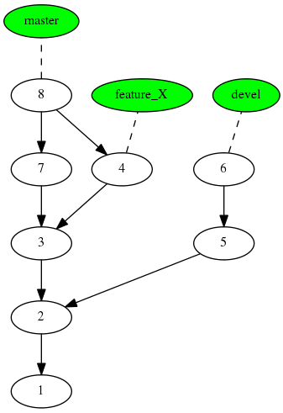
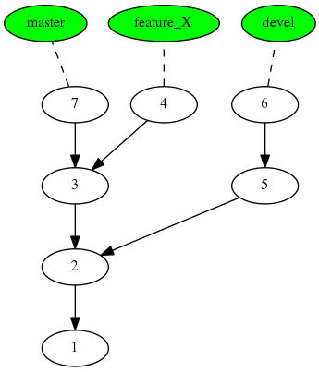
Repositories and branches
Image source: [1] http://sitaramc.github.com/gcs/

Slide 9
More terminology
Working copy – the code present on your machine, with changes that may or may not have been committed
Staging area – Git collects all files submitted with the 'git add' command in a staging area till you finally decide to commit them
Unversioned files – Files which are not put under version control, like temporary files, binaries.

Slide 10
Using Git
Linux – install git package
Windows – install msysgit
Graphical tools are also available – GitGUI, TortoiseGit
Configure git for first time use:
  git config --global user.name "Rohit"
  git config --global user.email "rohit.rawat@mavs.uta.edu"
  * Your username and email are logged with each commit.

Slide 11
Two workfows
Create a new local repository and start adding files to it
  You link it to an online host like GitHub now or later
Clone an existing repository from a git server
  This creates a copy of the repository on your machine and links it to that source

Slide 12
Initialize Git repository
Git repositories reside with the code
  Project_folder/
  code1.cpp, code2.cpp, subfolders, '.git' folder
Initialize git repository, creates '.git' folder:
  git init
Check status of the repository:
  git status

Slide 13
Add files to version control
You need to select which files are to be kept under git
  git add *.cpp
  git status
Files are added to a staging area. They have not been comitted yet and no permanent changes have been made to the repository.
Make the first commit
  git commit -m ”First import of code into Git!”
  git status

Slide 14
Making changes
Modify a file, then check git status. It should tell you the file has been modified, but not staged.
If you change multiple files, git does not assume you want to record all those changes in the next commit.
You have to manually add the changed files to the staging area with git add.
Or you can commit with the -a option:
  git commit -a -m ”Second commit!”

Slide 15
Comparing versions
Git lets you compare commits with other commits or your working copy (w.c.).
Compares the last commmit with w.c.:
  git diff
HEAD is a label pointing to the the commit responsible for the w.c. To compare w.c. with the version 1 commit behind HEAD:
  git diff HEAD~1
To diff with two specific commits, use their SHA code
  git diff sha1 sha2
If you manually staged files for commit with git add, they don't show up in the diff without the --cached switch.

Slide 16
Creating a branch
Do you need a branch if you are the sole developer?
  If you are working on more than one feature at the same time, you should do that on separate branches.
  If you are experimenting with stuff that you are not sure you want to keep, do it on a branch – the master branch will stay clean.
  Since there are no conflicts with other developers, merging witll be fast and easy.

Slide 17
Creating a branch
Create a branch:
  git branch branch_name
List the active branch:
  git branch
  The active branch will have an *.
Switch to the new branch:
  git checkout branch_name
Shortcut: git checkout -b branch_name
All further commits go on the active branch. Make changes and commit them to the branch

Slide 18
Creating a branch
Create a branch:
  git branch branch_name
List the active branch:
  git branch
  The active branch will have an *.
Switch to the new branch:
  git checkout branch_name
Shortcut: git checkout -b branch_name
All further commits go on the active branch.

Slide 19
Merge a branch back into master
Switch to the master branch
  git checkout master
Merge the branch branch_name
  git merge branch_name
If there are any conflicts during the merge, git highlights them in the file using markers ”>>>”. You can manually open the files and fix the conflicts.
You can delete the branch to keep things clean
  git branch -d branch_name

Slide 20
Remote repositories
Create a free account on Github
Follow instructions to create a new repository
Follow instructions to push an existing repository from the command line:
  git remote add origin https://github.com/rohitrawat/Demo22.git
  git push -u origin master

Slide 21
Remote repositories
A remote is like an alias for a remote copy of the repository.
Multiple remotes may be added.
In this case, we added a remote at Github, which was empty.
When we pushed out changes, the remote repo got updated with our code.
When you clone a repo, that source is automatically added as a remote called 'origin'

Slide 22
Add a second developer
The new developer also creates a Github account, and configures his git installation with the correct email address.
The original developer logs into Github and adds him under Admin->Collaborators
The new developer clones the repository:
  git clone https://url/of/the/repository
  Clone automatically initializes a new local repo, adds the url as the 'origin', and pulls the code.
  You may save your public key to your github account to avoid autheticating every time.

Slide 23
Back and forth
Users may now commit changes to their local repositories.
  vi code.cpp
  git commit -a
To sync, they would first 'push' their commits to the remote.
  git push origin master
The other user would then 'pull' from the remote.
  git pull origin master

Slide 24
Git fetch and pull
Git fetch downloads the latest copy of the remote repository to your machine, but does not affect any code sitting on it.
Remote branches are different from local branches even if they have the same name!
You may now diff it with your working copy to see how they differ, and then merge them if you like.
Git pull does the fetch and merge together.

Slide 25
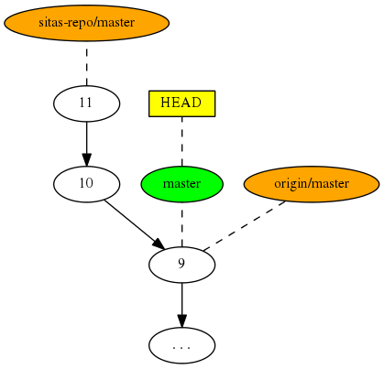
Different remotes and branches
Here there are two remotes:
origin and sitas-repo
The local repo and origin are in sync, i.e. their master branch is the same. sitas-repo/master is at a different commit.
You would want to pull sitas-repo.
Image source: [1] http://sitaramc.github.com/gcs/

Slide 26
Your own remote repository
”remote” can refer to any storage location where a repository can be created. It could be a folder on a backup drive.
You can create an empty shared repo on a shared folder on a Linux server:
  git init --bare --shared
  This is what Github gives when creating a new repo
You can give certain users read/write permissions to the folder.
They may set up a remote or clone that location using the format user@server:/path/to/shared/repo

Slide 27
With tools
You may set up a git server with very fine tuned access controls using a tool like Gitolite or Gitosis

Slide 28
References
[1] http://sitaramc.github.com/gcs/

Slide 29
The End

