Slide 1
Basic Shell Commands
SSH
Omega & Gamma servers
www.luguta.org
Rohit Rawat

Slide 2
Using Linux Occasionally
Install it on a virtual machine on your laptop
  Virtual machines are safe – your actions cannot harm the data on your computer (unless you are sharing folders with the host)
  Quickly switch between Windows/MacOS and Linux
  No need to reboot unlike with dual-booting
  Installation help: http://www.uta.edu/studentorgs/lug/files/LUG_Intro_Linux.pdf
Use Cygwin - It directly interacts with your files, potentially risky
Dual boot – risky meddling with partitions and bootloaders, reboot waiting times
Use the Unix accounts provided by UTA
  Uses SSH (Secure Shell) software
  Omega and Gamma servers
  More info: http://www.uta.edu/oit/cs/unix/UNIX--Linux.php
  You cannot install new programs on these servers

Slide 3
Accessing the terminal
Why the shell?
  Server computers do not have graphical interfaces; most don't even have monitors/keyboards plugged in and use remote shells
  Shell commands can achieve the same or higher functionality than the graphical desktop
  The shell can be harder to use, but is necessary sometimes
On Ubuntu, open the program called “Terminal”
On MacOS, run “Terminal” under /Applications/Utilities
On Windows, if you don't have an Ubuntu VM, run the “SSH Client” program or “Putty”

Slide 4
Filesystem Commands
pwd – tells you which directory are you currently in
ls – list files in current directory
cp – copy files
  cp hello.txt world.txt - copies hello.txt to/over world.txt
mv – move files
  mv hello.txt world.txt - renames hello.txt to world.txt
rm – delete files
  rm hello.txt - permanently deletes hello.txt – remember, there is no undo or recycle bin!
cd – change directory
  cd Documents - goes to the Documents folder
  cd .. - goes one folder level up
mkdir – create a new directory
  mkdir projects - creates a new directory named projects under the current directory
All commands and filenames are case sensitive
Filenames with spaces and funny characters must be “quoted”, e.g., “Hello World.cpp”

Slide 5
File Creation and Processing
cat – display the contents of a file
  cat hello.txt - displays hello.txt in the current directory
  cat /home/rohit/Documents/hello.txt - using absolute path for hello.txt
  cat ../Pictures/hello.txt - uses a relative path
nano – edit a text file
grep – search text files or the output of other commands
  grep Linux hello.txt - searches for Linux in hello.txt

Slide 6

Administration
sudo – run a command as the super user
  Do not use sudo for every command you run!
apt-get – package management & update
  To update your Linux system:
  sudo apt-get update && sudo apt-get upgrade
  To install packages: C/C++ compilers:
  sudo apt-get install build-essential
  To install the Java compiler
  sudo apt-get install openjdk-7-jdk
  To install the OpenCV library
  sudo apt-get install libopencv-dev
https://xkcd.com/149/

Slide 7
Omega/Gamma accounts
Omega is typically used for computer programming and database applications.
Gamma has many engineering software installed.
Both account are disabled by default (maybe)
  To enable, login at: https://ithelp.uta.edu/
    Use your net-ID and password
    Complete the form as shown on the next page
  CSE students' accounts might already be enabled
  Your instructor may have already requested this for you

Slide 8
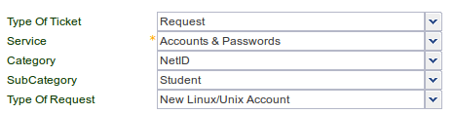
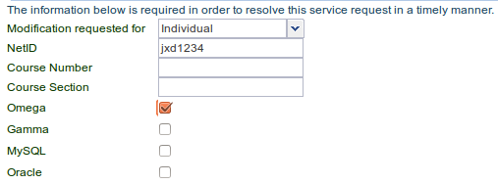
Requesting Unix accounts

Slide 9
Connecting to the server
SSH is a protocol for secure communication between a client and a server
The server in this case is omega.uta.edu
You install an SSH client on your machine
  Get the windows client from here
  Linux/MacOS come with an SSH client pre-installed

Slide 10
Software on Omega
C, C++, Python, Java compilers
Oracle and MySQL databases
SAS
Mathematica
...
See: http://omega.uta.edu/

Slide 11
Software on Gamma
MATLAB
Electronics
  ADS
  Cadence
  EM Pro
  IC Cap
ANSYS
...

Slide 12
High Performance Computing (HPC) Cluster
Only for researchers and faculty
Lengthy or parallel computing tasks
Available software:
  ANSYS, Materials Studio, MATLAB, Mathematica
  Compilers for C, C++, Java, FORTRAN, MPI
Knowledge of job scheduling tools required
More information here:
https://www.uta.edu/oit/eos/hpc/

Slide 13
Installing SSH client
If you are running Linux no extra software is needed. The SSH client and X11 packages are pre-installed.
On Windows, you need to install:
  SSH client (UTA provided) or Putty
  and
  XMing (this allows you to run graphical software over SSH)
On MacOS, the SSH client is included.
  You can install XQuartz to run graphical software

Slide 14
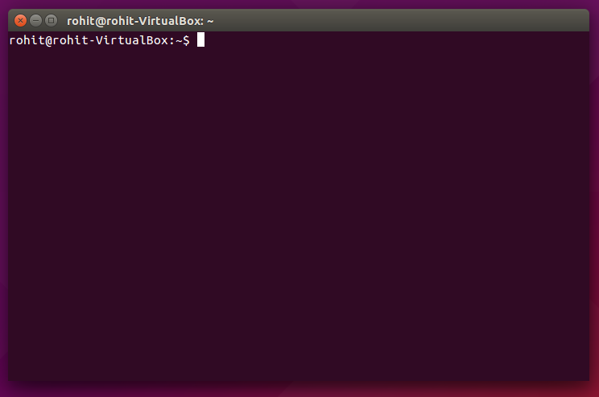
Connecting
On Linux/Mac/Cygwin, open a Terminal and run
  ssh -X jxd1234@omega.uta.edu
  Jump to the next slide.
On Windows, install the Secure Shell Client
  Create a new profile with
    Hostname: omega.uta.edu
    Port: 22
    Username: jxd1234 (use your NetID)
    Tunnelling → X11 → Enable X11 forwarding
    Save each page by clicking OK, verify your settings
  Create one more profile and replace omega.uta.edu with gamma.uta.edu for the Gamma server
  Video on installing and using the Windows SSH client

Slide 15
Your remote shell
[rxr1234@gamma ~]$ pwd
/home/r/rx/rxr1234
[rxr1234@gamma ~]$ logout
ads EMPro2011 matlabr2009b nemo_3.2.4 sonnet.v13
ADS2009 firescope matlabr2010a ns-allinone-2.30 splunkforwarder
ADS2011 hobbit matlabr2010b oit synopsys
afni iccap matlabr2011b simpana synopsys.orig
ansys_inc ICCAP_2009 matlabr2012a simplesim
cadence ICCAP_2011 microsoft sonnet
dell lost+found nemo sonnet.v12
rohit@MyPC:~$ ssh -X rxr1234@omega.uta.edu
The authenticity of host 'omega.uta.edu (129.107.56.23)' can't be established.
RSA key fingerprint is 25:0c:8a:b2:3c:d5:dd:dd:0c:3d:6b:0c:24:45:9e:77.
Are you sure you want to continue connecting (yes/no)? yes
Warning: Permanently added 'omega.uta.edu,129.107.56.23' (RSA) to the list of known hosts.
This UT Arlington information resource, including all related equipment,
networks and network devices, is provided for authorized use only. All
unauthorized use of this information resource is prohibited. Misuse is
subject to criminal prosecution and/or administrative or other
disciplinary action.
...
Usage of this information resource constitutes consent to all policies
and procedures set forth by UT Arlington and there is no expectation of
privacy except as otherwise provided by applicable privacy laws.
rxr1234@omega.uta.edu's password: <invisible password>
Last login: Tue Oct 6 07:03:52 2015 from asa-resnet.uta.edu
[rxr1234@omega ~]$
You won't see your password as you type it – which is normal.

Slide 16
Basic commands
[rxr1234@omega ~]$ pwd
/home/r/rx/rxr1234
[rxr1234@omega ~]$ ls
abc.cpp hello_world.m hpeesof launcher.120.log
[rxr1234@omega ~]$ logout
Connection to omega.uta.edu closed.
rohit@MyPC:~$

Slide 17
Example: MATLAB on Gamma
[rxr1234@gamma ~]$ matlab
You should see the MATLAB GUI load on your machine.
If you receive a message:
“Warning: No display specified. You will not be able to display graphics on the screen.”
It means that you forgot to enable X11 tunneling or the -X flag in the SSH client.
Go back to profile settings to make sure your settings are correct.
To verify:
[rxr1234@gamma bin]$ echo $DISPLAY
localhost:10.0

Slide 18
Example: Compiling C++ code
[rxr1234@omega ~]$ pwd
/home/r/rx/rxr1234
[rxr1234@omega ~]$ gedit hello_world.cpp
[rxr1234@omega ~]$ g++ hello_world.cpp -o hello_world.run
[rxr1234@omega ~]$ ./hello_world.run
Hello World
[rxr1234@omega ~]$
Without X11 forwarding, “gedit” will not work. You can use a text-only editor like nano
nano hello_world.cpp
Press Ctrl-x, then press y to save and exit the file.

Slide 19
Example: Background execution
[rxr1234@omega ~]$ nohup ./hello_world.run &
[1] 8204
[rxr1234@gamma ~]$ nohup: appending output to `nohup.out'
[rxr1234@gamma ~]$ cat nohup.out
10
9
[rxr1234@gamma ~]$ cat nohup.out
10
9
8
7
6
5
4
3
2
1
[1]+ Done nohup ./hello_world.run
[rxr1234@gamma ~]$

Slide 20
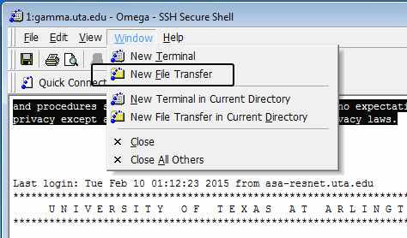
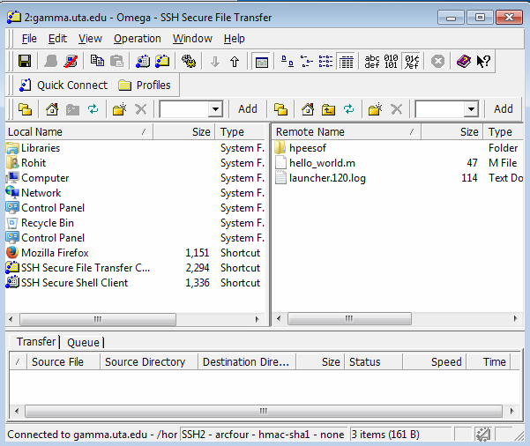
Transferring files
You can use the SFTP client
You can drag and drop files
from the server.

Slide 21
Transferring files
Or you can use SCP. Copy file.zip on your machine to your home directory on Gamma.
[rohit@MyPC ~]$ scp file.zip rxr1234@gamma.uta.edu:/home/r/rx/rxr1234/
This UT Arlington information resource, including all related equipment,
...
rxr1234@gamma.uta.edu's password: <invisible password>
file.zip 100% 1492 1.5KB/s 00:00
[rohit@MyPC ~]$ ssh -X rxr1234@omega.uta.edu
[rxr1234@gamma ~]$ ls
file.zip
[rxr1234@gamma ~]$ unzip file.zip
scp file.zip rxr1234@gamma.uta.edu:/home/r/rx/rxr5243/
and
scp file.zip rxr1234@gamma.uta.edu:
are equivalent. For any other destination folder, you must provide the full path after the “:”

Slide 22
Transferring files
Copy file.zip on the Omega server to the current local folder (./).
[rohit@MyPC ~]$ scp rxr1234@gamma.uta.edu:/home/r/rx/rxr1234/file.zip ./
This UT Arlington information resource, including all related equipment,
...
rxr1234@gamma.uta.edu's password: <invisible password>
file.zip 100% 1492 1.5KB/s 00:00
[rohit@MyPC ~]$ ls
file.zip
[rohit@MyPC ~]$ unzip file.zip
scp file.zip rxr1234@gamma.uta.edu:/home/r/rx/rxr5243/
and
scp file.zip rxr1234@gamma.uta.edu:
are equivalent. For any other destination folder, you must provide the full path after the “:”

Slide 23
QnA
What is Xming / Xquartz?
  Linux uses a client (application sends drawing commands) – server (draws them on the screen) approach to graphics. Read about X11. With X forwarding, the program runs on the remote machine but sends drawing commands to you over the SSH link and your local X server draws them here on your machine.
  Xming is an X server written for Windows.
  Xquartz is an X server written for Windows.

Slide 24
QnA
Can we access Omega/Gamma from home?
  You must be on the UTA network or on ResNet to access these servers.
  From home, you can establish a VPN connection to get on the UTA network. See:
  http://www.uta.edu/oit/cs/software/vpn/

Slide 25
QnA
Tar and Zip usage?
  Create a ZIP archive from two files:
    zip output.zip input_file1 input_file2
  Create a ZIP archive from all files in a directory
    cd .. (go to the parent directory)
    zip -r output.zip directory_name
  Unzip:
    unzip output.zip
  Create a compressed tarball from two files:
    tar -cvzf output.tar.gz input_file1 input_file2
  Create a ZIP archive from all files in a directory
    cd .. (go to the parent directory)
    tar -cvzf output.tar.gz directory_name
  Untar:
    tar -xvzf output.tar.gz

