Slide 1
Wine - Easing the switch from Window$
Rohit Rawat
Linux User Group at UTA

Slide 2
What is Wine?
Wine (originally an acronym for "Wine Is Not an Emulator") is a compatibility layer capable of running Windows applications on several POSIX-compliant operating systems, such as Linux, Mac OSX, & BSD.
Notes:
Emulation is a computer behaving like a different computer. Virtual machines are based on emulation.
POSIX is an IEEE standard.

Slide 3
API Calls
An Application Programming Interface provides facilities for
  Accessing the file system
  Drawing windows and dialog boxes
  Accessing graphics and other devices
  Networking, and many other services
Windows programs are written using the Windows API (Win32/Win64)
Linux, Unix, and BSD applications are written using the POSIX standard (a public IEEE standard)
Other examples would be the Android and iOS APIs
Notes:
Windows API:
Windows Software Development Kit (SDK)
Focused on C and C++

Slide 4
API Calls
Wine translates Windows API calls into POSIX calls on-the-fly.
Virtual machines/Emulators are slow, having to emulate each processor instruction at a low level.
Wine and Unix can sometimes be faster than Windows itself.
Notes:
Emulators have to fake a new processor with its own fake memory and hardware which is slower.

Slide 5
Window$ Copyrights?
You do not need to buy a copy of Windows to run Wine.
Wine developers have written their own implementation of the Windows API from scratch using publicly available information and experimentation.

Slide 6
Popular Wine Uses
Microsoft Office (till Office 2010)
Adobe Photoshop CS6
Google's Picasa and Sketchup
Valve's Steam and many other games
Teamviewer remote access for Linux
Spotify music client

Slide 7
Wine structure
Wine (1.6 or 1.7) - gives the core functionality
  Winecfg is an included graphical configuration utility
Winetricks – helper script for
  Installing DLLs and libraries necessary to run certain programs
  Installing some popular programs automatically

Slide 8
Wine Bottles
Wine bottles are like different installed instances of Windows
Apps installed in one bottle do not see or affect apps in other bottles
Advantages:
  Prevents a new app from damaging others
  Lets you run apps on different versions of Windows and load different DLLs to ensure compatibility

Slide 9
Wine Bottles
Wine bottles can be created and managed from the command line
The default bottle is called “.wine” in your home folder
The WINEPREFIX and WINEARCH environment variables are used for selecting bottles.
But this can become a hassle

Slide 10
Wine Front-ends
Wine front-ends make installation and use of Windows software easy
  PlayOnLinux (also PlayOnMac)
    Automatically installs required DLLs and frameworks
    Uses the correct version of Wine
    Applies any necessary patches

Slide 11
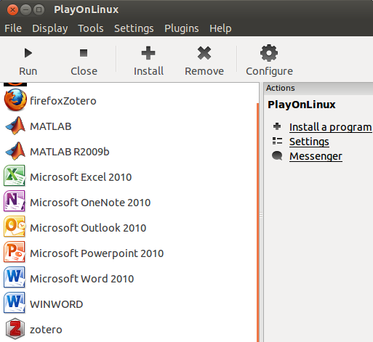
PlayOnLinux

Slide 12
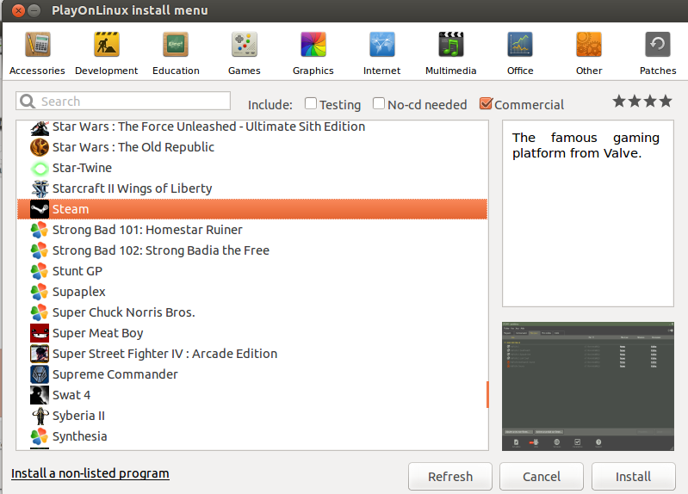
Many Supported Games and Applications

Slide 13
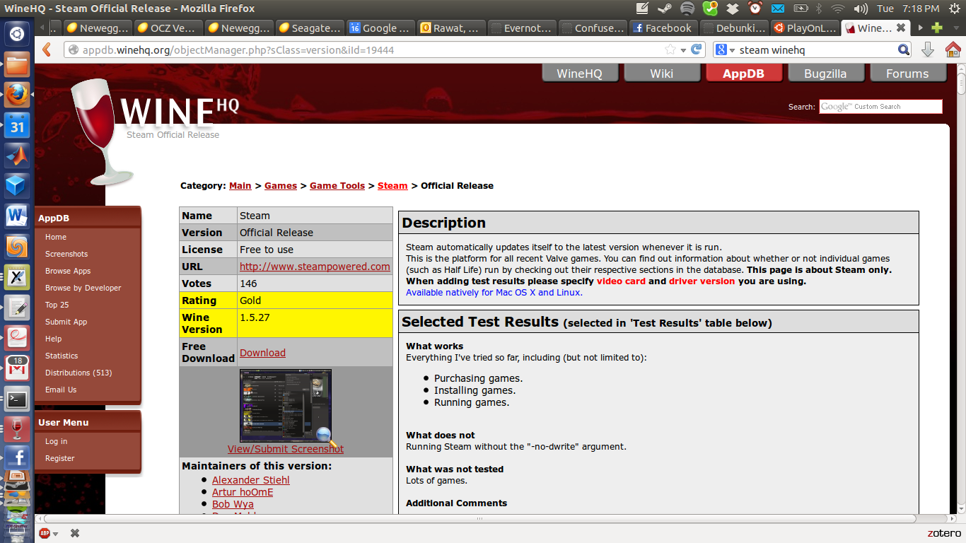
Checking Support
Applications are rated Platinum/Gold/Silver/ Bronze/Garbage based on user success.
Installation instructions are usually included at the bottom of the page.

Slide 14
My most often used Apps
Windows App | Linux Alternative | What I Use
MS Office | LibreOffice | LibreOffice and MS-Office under Wine and Virtualbox
MATLAB | MATLAB for Linux, Octave, FreeMat, SciLab | Both Octave and MATLAB under Wine
Steam Games | Steam for Linux | Both Steam for Linux and Wine
Visual Studio | Eclipse, Netbeans, etc. | Build Win32 apps in a Virtual Machine Build all other cross platform apps in Netbeans

Slide 15
Incompatible Applications
Some applications just won't run under Wine
  In case the Linux alternative does not fit your needs, use a virtual machine running Windows

